Slide 1




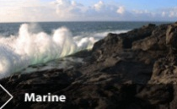

Chemical amendments for the treatment of various types of agricultural effluent
M.G. Healy*, O. Fenton, G. Lanigan, J. Grant, R.B. Brennan, C.J. O’ Flynn, A. Serrenho
ICEPR, Toronto, Ontario, Canada, July 15-17, 2013

Slide 2
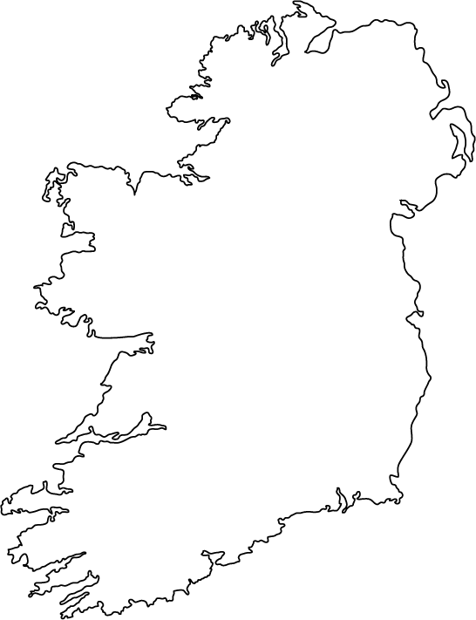

Background
The land area of Ireland is 6.9 m ha, of which 4.6 m ha is used for agriculture.*
Almost 80% of agricultural area is devoted to pasture, hay and grass silage, 11% to rough grazing, and 10% to crop production.*
* Fact sheet on agriculture – April 2012 http://www.agriculture.gov.ie/media/migration/publications/2012/FactsheetonIrishAgricultureApr12.pdf

Slide 3
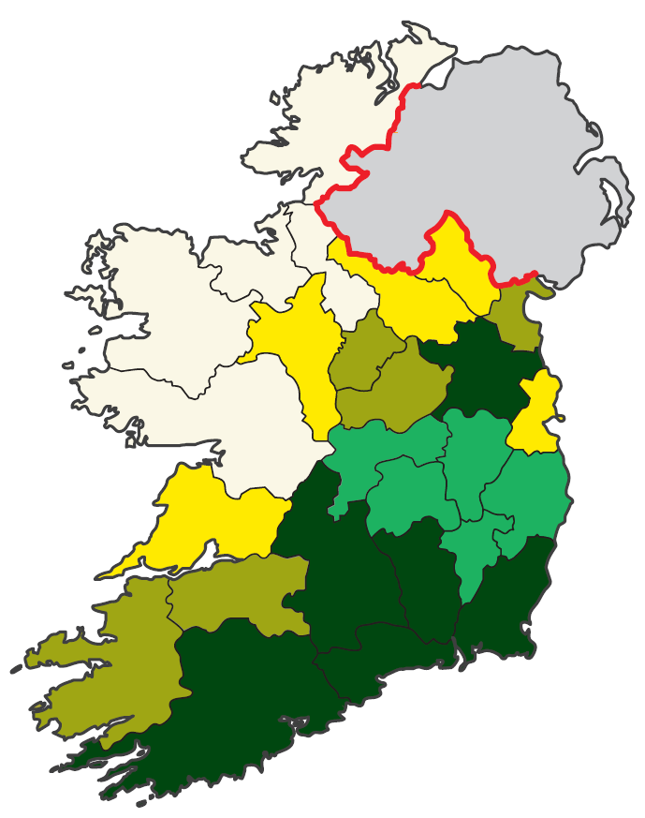
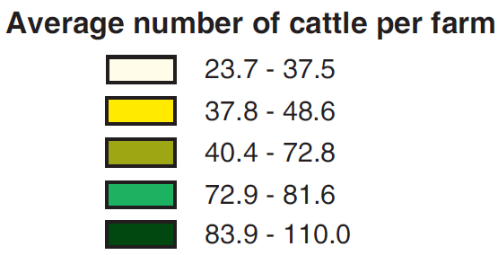
Background
In 2010, there were 110,998 farms with cattle
* Census of Agriculture 2010 – Preliminary Results http://www.cso.ie/en/media/csoie/releasespublications/documents/agriculture/2010/coapre2010.pdf

Slide 4
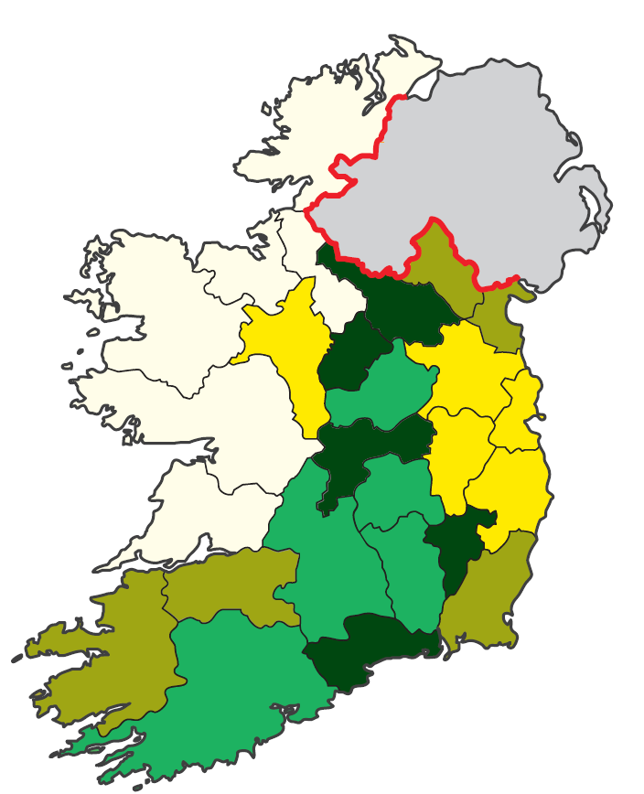
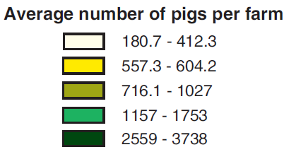
Background
In 2010, there were 1,214 farms with pigs
* Census of Agriculture 2010 – Preliminary Results http://www.cso.ie/en/media/csoie/releasespublications/documents/agriculture/2010/coapre2010.pdf

Slide 5
Background
Water from concreted areas, hard stand areas and holding areas for livestock
Characterisation of wastewater
Parameter | units | Pig slurry¹ | Dairy cattle slurry² | Dairy soiled water (DSW)³
Total Phosphorus | mg L⁻¹ | 613±40 | 1140±76 | 14.2±0.5
Total Nitrogen | mg L⁻¹ | 2800±212 | 4430±271 | 730±212
Ammonium-N | mg L⁻¹ | 2290 ±39 | 1760 ±123 | 110±35
pH |  | 7.85 ± 0.03 | 7.47 ± 0.05 | 7.9±0.0
Dry matter | % | 3.41± 0.08 | 10.5± 0.04 | 0.2±0.1
¹ O’ Flynn C.J., Fenton O., Wilson P., Healy M.G. (2012) J Environ Manage 113, 78 – 84.
² Brennan R.B., Fenton O., Grant J., Healy M.G. (2011) Sci Tot Environ 409, 5111-5118.
³ Serrenho A., Fenton O., Murphy P.N.C., Grant J., Healy M.G. (2012) Sci Tot Environ 430, 1-7.

Slide 6
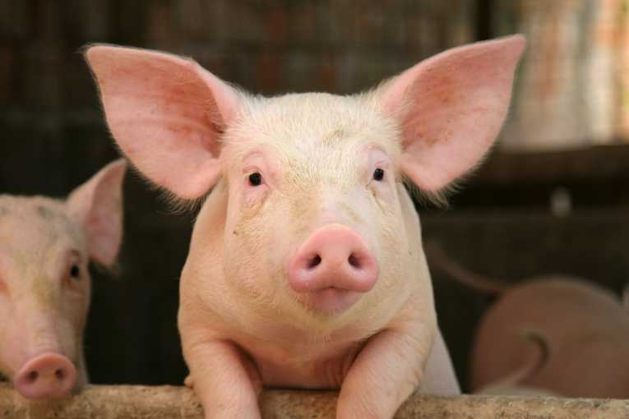
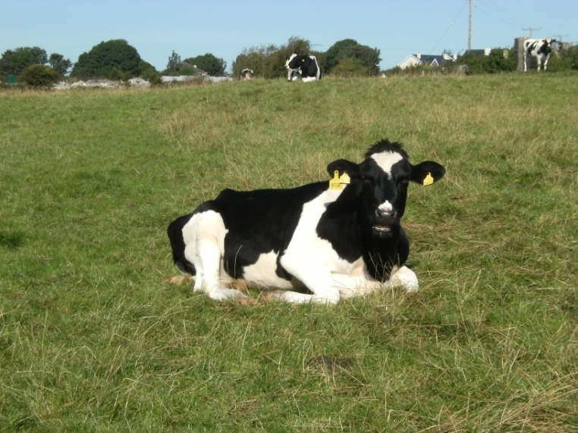
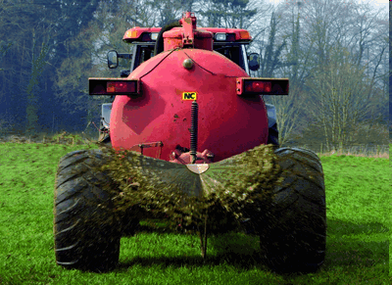

Background
Currently, land application is the most common method for the disposal of slurries and DSW
Land application of dairy and pig slurry, and DSW can result increased loss of phosphorus (P) to runoff
Slurry application can result in a build-up in soil test phosphorus (STP) increasing chronic P loss

Slide 7

Background
  Incidental P losses
    Occur when a rainfall event occurs shortly after slurry application and before fertiliser infiltrates the soil
P
Slurry P
Soil P
P
P
P
P
P
P
P
P
P
P
P
P
P
P
P

Slide 8

Background
  Chronic P losses
    Long-term loss of P from soil as a result of a build-up in STP caused by application of inorganic fertilisers and manure
P
Slurry P
Soil P
P
P
P
P
P
P
P
P
P
P
P

Slide 9

Background
Critical Source Area (CSA) for P loss
High P source
High transport
potential

Slide 10
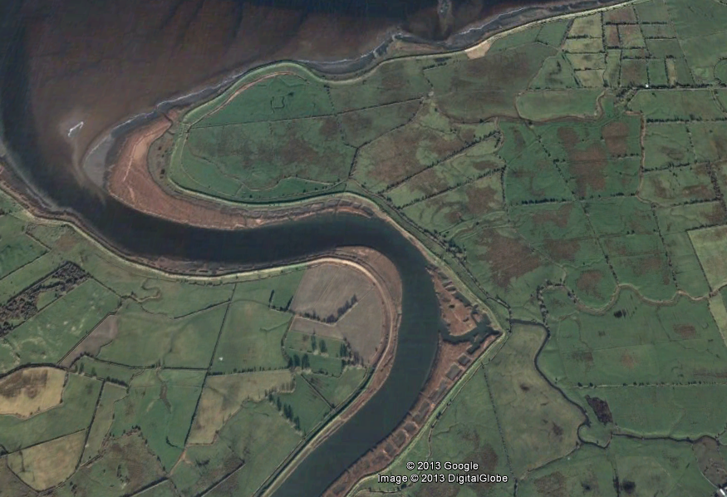
Background
Critical Source Area

Slide 11

Background
Food Harvest 2020* aims to (by 2020):
  ‘increase the value of primary output in the agriculture and fisheries sector by €1.5 billion.
  Increase value-added output by €3 billion
  Achieve an export target of €12 billion’.
http://www.agriculture.gov.ie/media/migration/agri-foodindustry/foodharvest2020/2020FoodHarvestEng240810.pdf

Slide 12
Background
Cattle farms Pig farms
This will lead to increased intensification of farming and, in turn, increased loading of nutrients, which may be a threat to water quality.
The land surrounding intensive farmed areas will become P rich
Farmers may have no choice but to use it for landspreading
This could be potentially problematic if the land is located in a CSA

Slide 13
Objectives
If farmers have no choice but to spread wastewater in high soil test phosphorus areas, which may be located in a CSA, they may be able to add chemical amendments to wastewater to reduce surface runoff.
The aim of this study was to identify suitable chemical amendments for addition to three types of wastewater
dairy cattle slurry
pig slurry and
DSW
to reduce surface runoff of nutrients and suspended sediment (SS) in surface runoff.

Slide 14
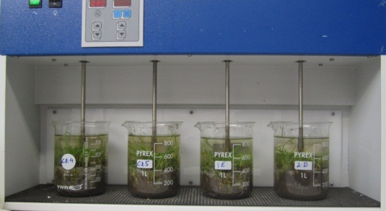
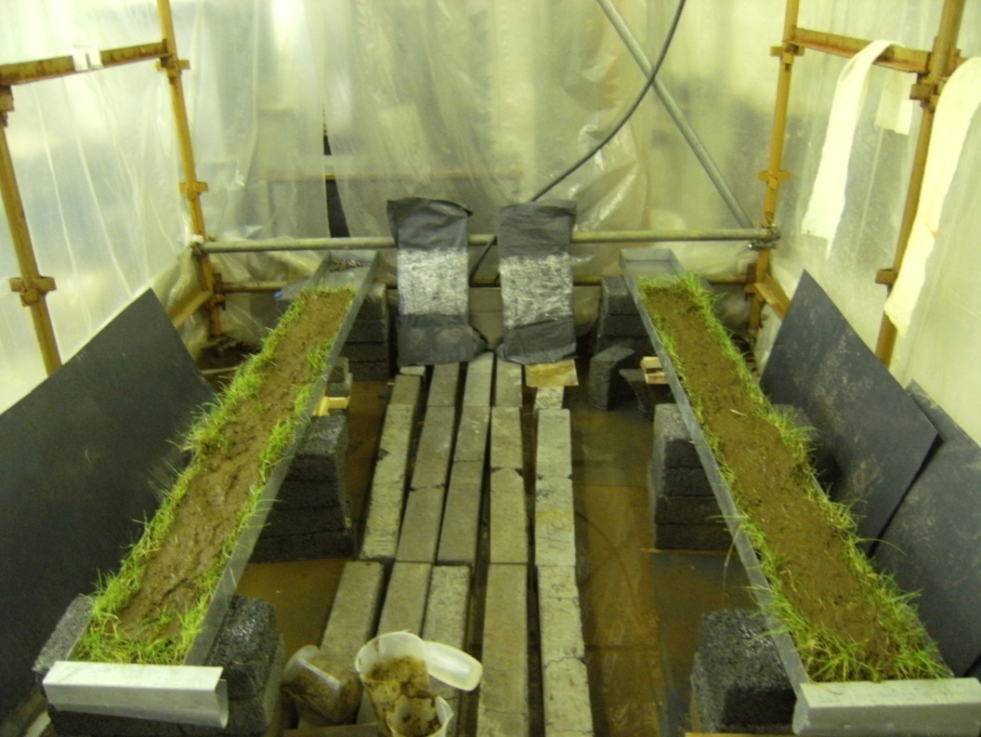
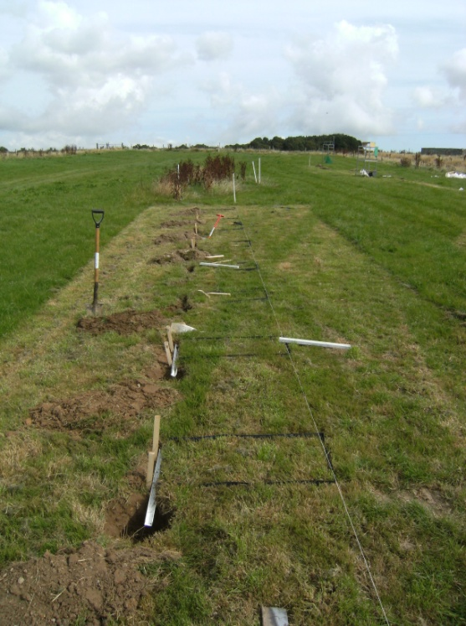
Methodology
Batch-scale tests
Identification of amendments
Determine how much amendments to use per unit volume of wastewater
Laboratory-scale tests
Efficacy of amendments at laboratory-scale
Efficacy of amendments at field plot-scale
Plot and field-scale tests
Efficacy of amendments at field-scale

Slide 15
Methodology
Batch-scale tests
Identification of amendments
Determine how much amendments to use per unit volume of wastewater
Laboratory-scale tests
Other issues to consider in determination of best amendment:
Efficacy of amendments at laboratory-scale
Potential greenhouse gas emissions
Subsurface leaching of nutrients
Impact on chronic (long-term) losses of nutrients
Efficacy of amendments at field plot-scale
Plot and field-scale tests
Efficacy of amendments at field-scale

Slide 16
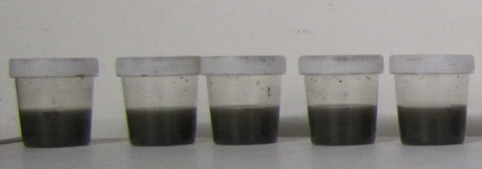
Methodology
Batch-scale tests
Aims:
Identify the most effective amendments to reduce the solubility of P in the wastewater
Identify optimum application rates
Select amendments most suitable for further examination (some may work well, but may cost too much)
‘Stoichometric Tests’
Amount expressed as ratio of weight of amendment to weight of TP
Wastewater

Slide 18
Methodology
Batch-scale tests
Aims:
Identify the most effective amendments to reduce the solubility of P in the wastewater
Identify optimum application rates
Select amendments most suitable for further examination (some may work well, but may cost too much)

Slide 19
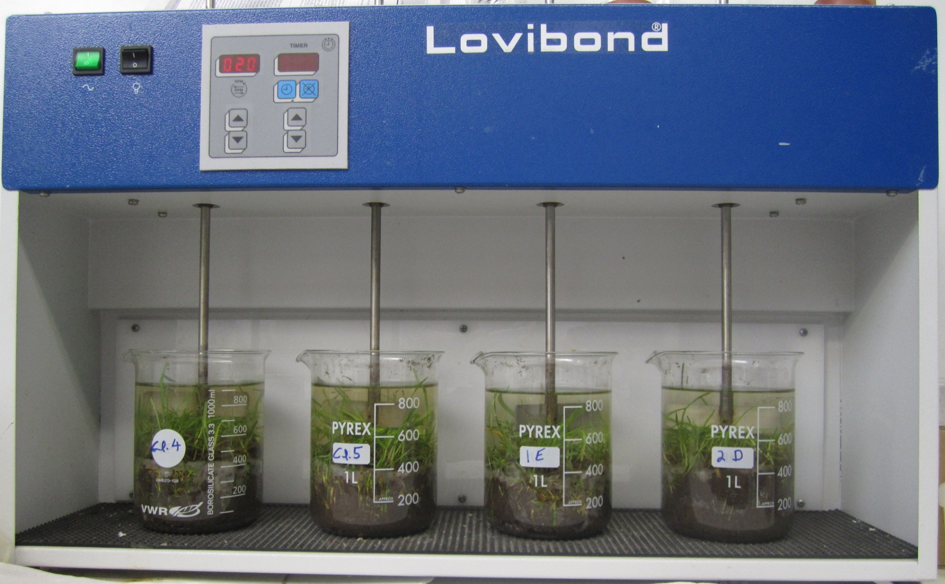

Slide 20
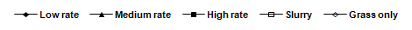

Slide 25
Methodology
Batch-scale tests
Aims:
Identify the most effective amendments to reduce the solubility of P in the wastewater
Identify optimum application rates
Select amendments most suitable for further examination (some may work well, but may cost too much)

Slide 28
Results
Batch-scale tests
Most effective amendments identified by the batch-scale tests
Pig slurry¹ | Dairy cattle slurry² | Dairy soiled water³
Alum
Poly-aluminium chloride
Ferric chloride (FeCl₃)
Lime
¹ O’ Flynn, C.J., Fenton, O., Healy, M.G. (2012) CLEAN – Soil, Air, Water 40: 164-170.
² Brennan, R.B., Fenton, O., Rodgers, M., Healy, M.G. (2011) Soil Use Manage 27: 238-246.
³ Fenton, O., Serrenho, A., Healy, M.G. (2011) Water, Air Soil Poll 222: 185-194.

Slide 29
Results
Batch-scale tests
Most effective amendments identified by the batch-scale tests
Pig slurry¹ | Dairy cattle slurry² | Dairy soiled water³
Alum | Alum
Poly-aluminium chloride | Poly-aluminium chloride
Ferric chloride (FeCl₃) | Ferric chloride (FeCl₃)
Lime | Lime
 | Aluminium-based sludge
 | Flue-gas desulfurization by-product (FGD)
¹ O’ Flynn, C.J., Fenton, O., Healy, M.G. (2012) CLEAN – Soil, Air, Water 40: 164-170.
² Brennan, R.B., Fenton, O., Rodgers, M., Healy, M.G. (2011) Soil Use Manage 27: 238-246.
³ Fenton, O., Serrenho, A., Healy, M.G. (2011) Water, Air Soil Poll 222: 185-194.

Slide 30
Results
Batch-scale tests
Most effective amendments identified by the batch-scale tests
Pig slurry¹ | Dairy cattle slurry² | Dairy soiled water³
Alum | Alum | Alum
Poly-aluminium chloride | Poly-aluminium chloride
Ferric chloride (FeCl₃) | Ferric chloride (FeCl₃) | Ferric chloride (FeCl₃)
Lime | Lime | Lime
 | Aluminium-based sludge | Bottom ash
 | Flue-gas desulfurization by-product (FGD)
¹ O’ Flynn, C.J., Fenton, O., Healy, M.G. (2012) CLEAN – Soil, Air, Water 40: 164-170.
² Brennan, R.B., Fenton, O., Rodgers, M., Healy, M.G. (2011) Soil Use Manage 27: 238-246.
³ Fenton, O., Serrenho, A., Healy, M.G. (2011) Water, Air Soil Poll 222: 185-194.

Slide 31
Methodology
Batch-scale tests
Identification of amendments
Determine how much amendments to use per unit volume of wastewater
Laboratory-scale tests
Efficacy of amendments at laboratory-scale
Efficacy of amendments at field plot-scale
Plot and field-scale tests
Efficacy of amendments at field-scale

Slide 32
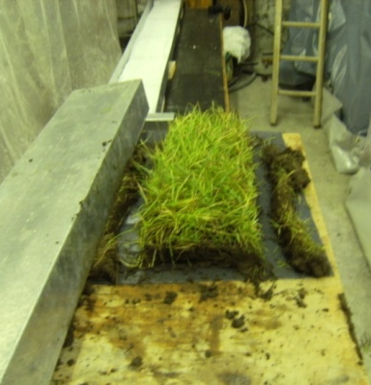
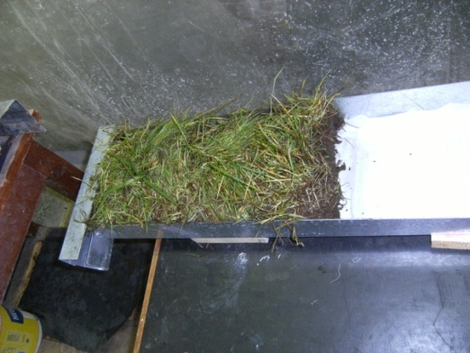
Laboratory-scale runoff study
Runoff-box experiment designed to examine effectiveness of chemical amendments, identified at bench-scale, under more ‘realistic’ conditions
Examined incidental losses of DRP, suspended sediment (SS), particulate phosphorus (PP) and total phosphorus (TP)
Examined incidental loss of metals (Al, Ca and Fe) to runoff

Slide 33
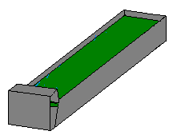
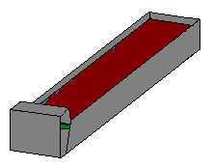
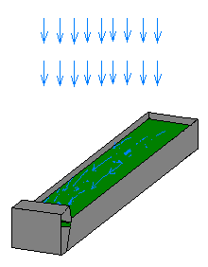
Laboratory-scale study
t= -24 hr Pack runoff boxes, then saturate and allow to drain and reach approx. field capacity
t=0 hr Apply slurry
Rainfall simulation:
Intensity 11.5 ± 1mm hr⁻¹
Three 30-min rainfall simulations conducted on each runoff box
t=48 hr RS 1
t=72 hr RS 2
t=96 hr RS 3
24 hr interval
24 hr interval

Slide 34

SLOPED RUNOFF BOXES
GRASS SOD
AMENDED
SLURRY
1 m
0.225 m
Notes:
34
SOIL FLUME SLURRY AMENDMENT RAINFALL SLOPE RUNOFF

Slide 35
O’ Flynn et al. 2012. J Env Man 113: 78-84.

Slide 36
Results
Laboratory-scale tests
Most effective amendments identified by the batch-scale tests
Pig slurry¹ | Dairy cattle slurry² | Dairy soiled water³
Alum | Alum | Alum
Poly-aluminium chloride | Poly-aluminium chloride
Ferric chloride (FeCl₃) | Ferric chloride (FeCl₃) | Ferric chloride (FeCl₃)
Lime | Lime | Lime
 | Aluminium-based sludge | Bottom ash
 | Flue-gas desulfurization by-product (FGD)
¹ O’ Flynn, C.J., Fenton, O., Wilson, P., Healy, M.G. (2012) J. Environ Manage 113: 78-84
² Brennan, R.B., Fenton, O., Grant, J., Healy, M.G. (2011) Sci Tot Environ 409: 5111-5118
³ Serrenho, A., Fenton, O., Murphy, P., Grant, J. Healy, M.G. (2012) Sci Tot Env 430: 1-7.

Slide 37
Results
Laboratory-scale tests
Pig slurry¹ | Dairy cattle slurry² | Dairy soiled water³
Alum | Alum | Alum
Poly-aluminium chloride | Poly-aluminium chloride
Ferric chloride (FeCl₃) |  | Ferric chloride (FeCl₃)
¹ O’ Flynn, C.J., Fenton, O., Wilson, P., Healy, M.G. (2012) J. Environ Manage 113: 78-84
² Brennan, R.B., Fenton, O., Grant, J., Healy, M.G. (2011) Sci Tot Environ 409: 5111-5118
³ Serrenho, A., Fenton, O., Murphy, P., Grant, J. Healy, M.G. (2012) Sci Tot Env 430: 1-7.

Slide 38
Methodology
Batch-scale tests
Identification of amendments
Determine how much amendments to use per unit volume of wastewater
Laboratory-scale tests
Efficacy of amendments at laboratory-scale
Efficacy of amendments at field plot-scale
Plot and field-scale tests
Efficacy of amendments at field-scale

Slide 39

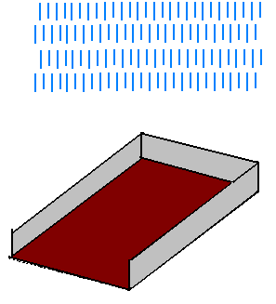

Plot-scale study
Plot isolated using PVC sheeting (50 mm below soil surface)
Rainfall simulators used to apply rain 2, 10 and 28 days after slurry application date
Intensity 10.5 mm hr⁻¹
Slurry applied at 33 m³ ha⁻¹

Slide 40
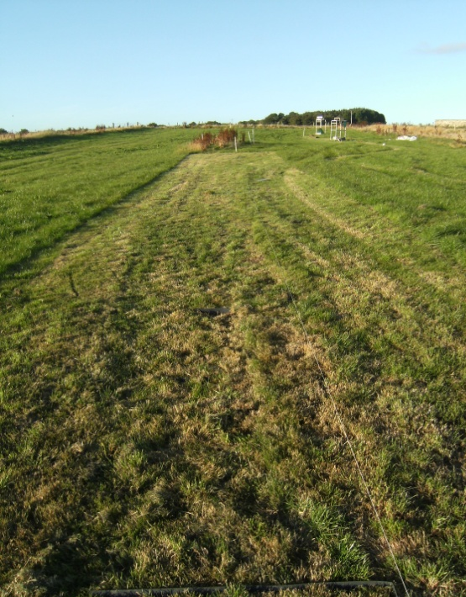
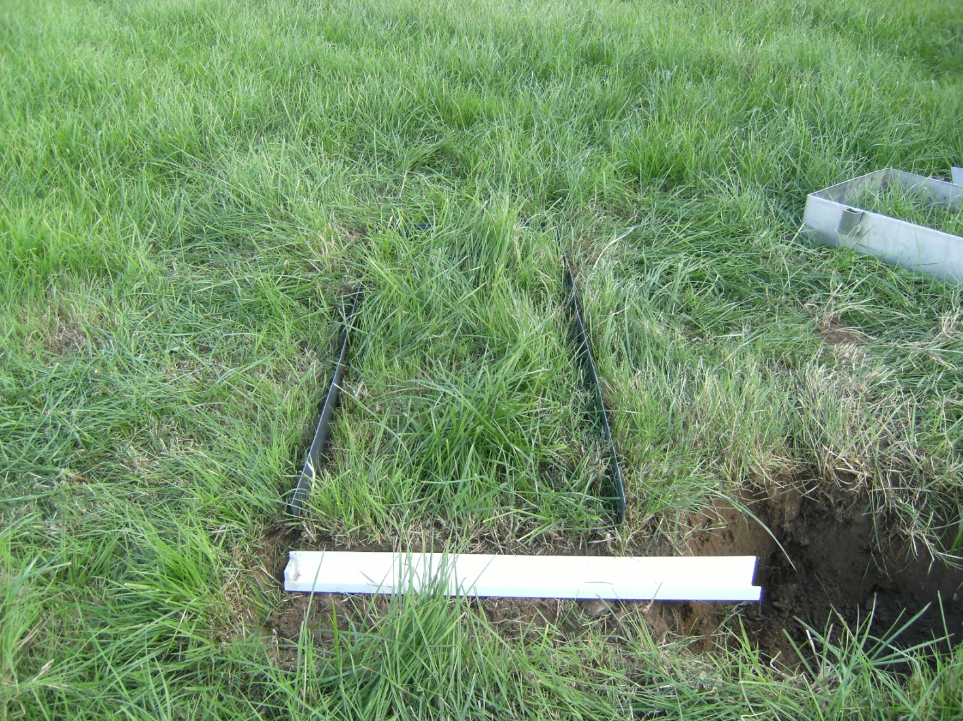
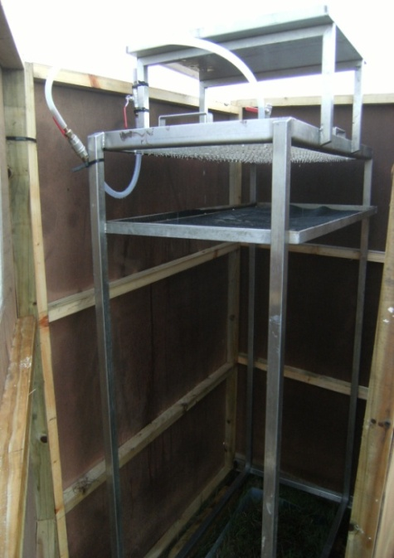

Slide 41
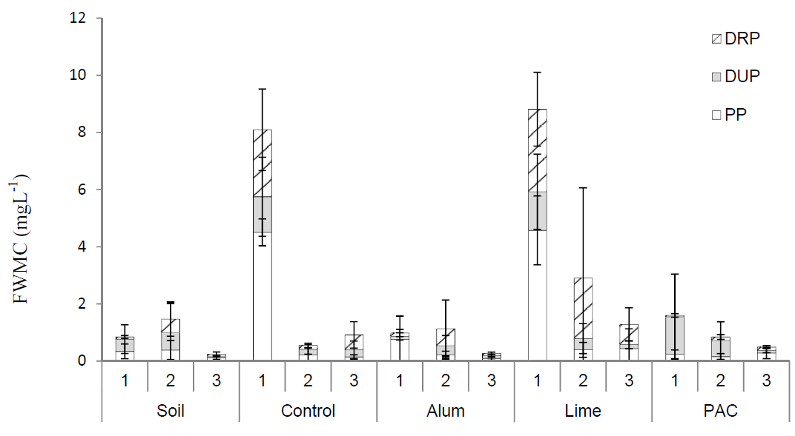
Phosphorus in runoff from dairy cattle slurry
Brennan et al. 2012. Sci Tot Env 441: 132-140.

Slide 42
Results
Field plot-scale tests
Pig slurry | Dairy cattle slurry¹ | Dairy soiled water
Alum | Alum | Alum
Poly-aluminium chloride | Poly-aluminium chloride
Ferric chloride (FeCl₃) |  | Ferric chloride (FeCl₂)
Lime |  | Lime
 |  | Bottom ash
¹ Brennan, R., Healy, M.G., Grant, J., Ibrahim, T.G., Fenton, O. (2012) Sci Tot Env 441: 132-140

Slide 43
Results
Field plot-scale tests
Pig slurry | Dairy cattle slurry¹ | Dairy soiled water
Alum |  | Alum
Poly-aluminium chloride | Poly-aluminium chloride
Ferric chloride (FeCl₃) |  | Ferric chloride (FeCl₂)
Lime |  | Lime
 |  | Bottom ash
¹ Brennan, R., Healy, M.G., Grant, J., Ibrahim, T.G., Fenton, O. (2012) Sci Tot Env 441: 132-140

Slide 44
Results
Field plot-scale tests
Taking into account GHG emissions, subsurface leaching, long-term impact
Pig slurry | Dairy cattle slurry¹ | Dairy soiled water
 |  | Alum
Poly-aluminium chloride | Poly-aluminium chloride

Slide 45
Conclusions
Due to the high cost of amendments, their incorporation into existing management practices can only be justified on a targeted basis where inherent soil characteristics deem their usage suitable to receive amended slurry.
It is prudent for farmers to adhere, whenever possible, to the 48-h rule (SI 610 of 2010) to reduce the risk of surface runoff of nutrients and sediment.

Slide 46




Acknowledgements

