Slide 1





Achieving equilibrium in the Soil Water Characteristic Curve: An ‘effective’ approach
S.E. Vero^{1,2}, R. E. Creamer¹, M.G. Healy², T. Henry³, P. Forristal¹, K.G. Richards¹ & O. Fenton¹
¹Teagasc, Johnstown Castle, Environment Research Centre, Co. Wexford, Ireland.
² Civil Engineering, National University of Ireland, Galway, Ireland.
³Earth & Ocean Sciences, National University of Ireland, Galway, Ireland.
.

Slide 2
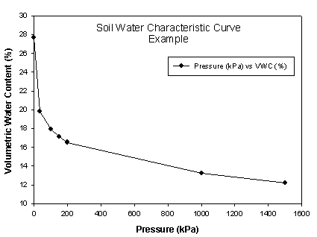
Soil Water Characteristic Curve
Relationship between pressure (Ψ) and water content (θ)

Slide 3

Soil Water Characteristic Curve
Soil Hydraulic Parameters
θ_{r} θ_{s} α n m
Uses:
  Pore size distribution
  Plant available water
  Numerical modelling

Slide 4
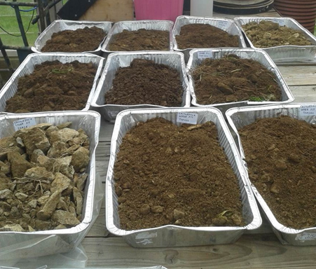
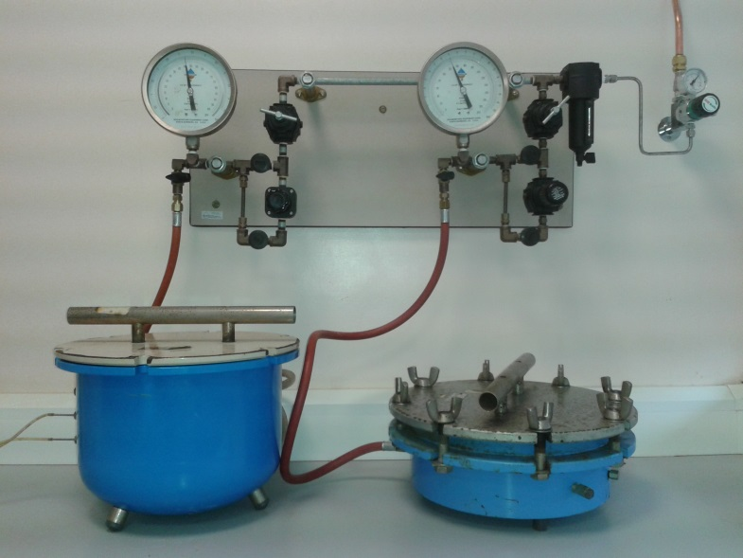
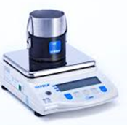
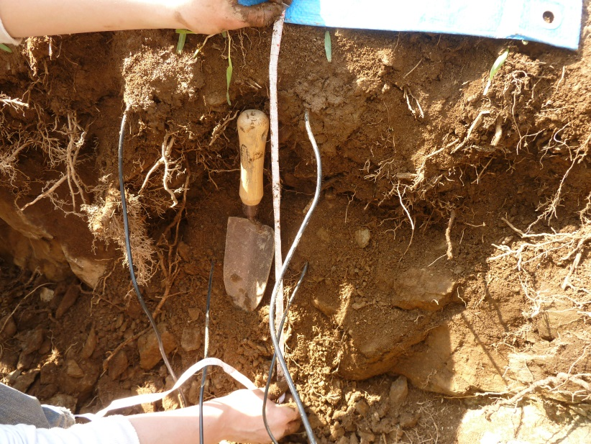
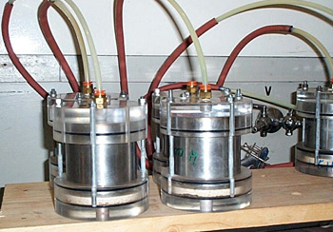
Measurement

Slide 5
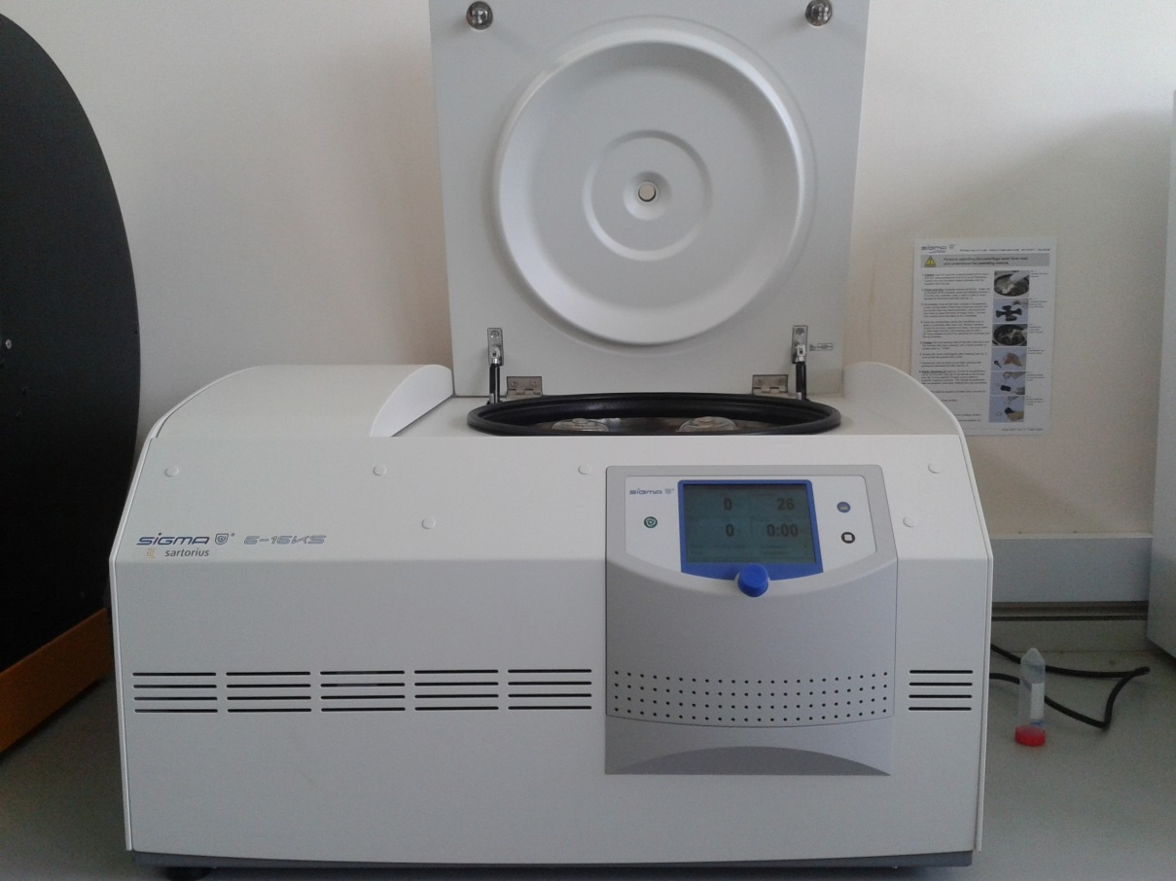
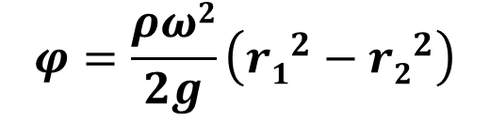
Centrifuge Method
Gardner Equation (Gardner, 1937)
$$φ=\frac{ρω2}{2g}\left({r1}^{2}−{r2}^{2}\right)$$
ω = angular velocity (rad)
ϕ = matric suction (kPa)
ρ = density of pore fluid (g cm³)
g = acceleration due to gravity
r₁ = radial distance to midpoint of specimen (cm)
r₂ = radial distance to free water surface (cm)
Notes:
First proposed by Briggs and McClane 1907, and further developed by Russell and Richards 1938
Limited availability of commercial benchtop centrifuges prior to Beckman Coulter’s purchase of SpinCo in 1954 and subsequent improvements in both the availability and capacity of such instruments, surely contributed to the establishment of slower methods such as pressure plates as de rigeour.

Slide 6
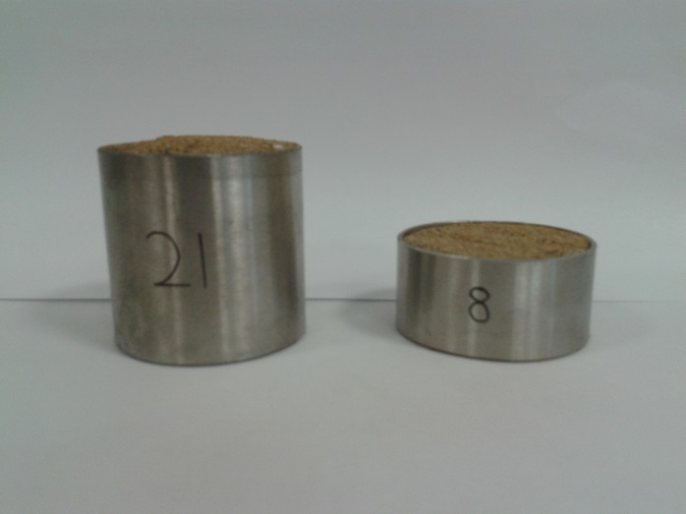
Equilibrium
‘All of the water in the soil has the same value of free energy’
  No hydraulic gradient
  No flow
Small samples
Disturbed
In-flight instruments
Intact soil cores vs. disturbed samples
Notes:
Dexter et al 2012 - Geoderma

Slide 7
Rules of Thumb
Disturbed Samples
2 Hours – Khanzode et al., 2002 (12 mm)
2 Hours – Russell and Richards (5 mm)
4-8 Hours – Smagin 2012 (10-15 g)

Slide 8
Rules of Thumb
Intact Samples
Until dewatering ceases? – Reis et al., 2011
3-8 Hours – Nimmo et al., 1987 (38 mm) – steady state flow
3-72 Hours – Nimmo 1990(38 mm) – in-flight instruments
>80 Minutes – da Silva and de Azevedo 2002 (50 mm)

Slide 9
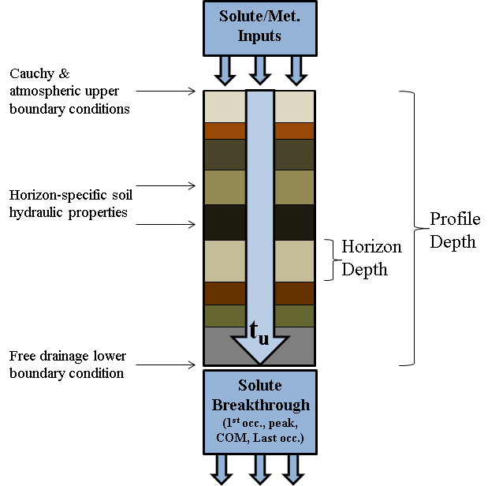
Objectives
Using the SWCC as input data (RETC and Hydrus 1D) to determine time lag in two vulnerable watersheds
How long should I centrifuge my samples?

Slide 10
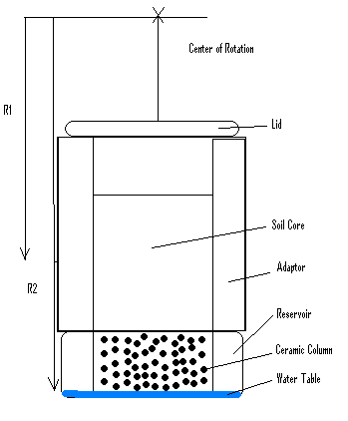
Initial Testing
Four intact soil cores
  Sand 40%
  Silt 36%
  Clay 24%
  Bulk density 1.35 – 1.47 g cm³
No predetermined experimental duration
Samples weighed every hour

Slide 11
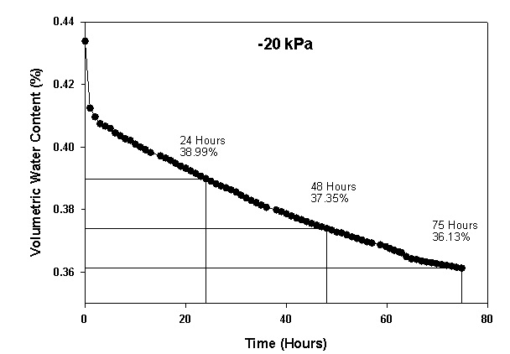
Dewatering

Slide 12
Effective Equilibrium
Almost impossible in practice to identify true equilibrium
What does this mean for numerical modelling?
Is there an Effective Equilibrium?
Grassland and arable soil
3x4 soil cores
1 m² area
0, -50, -100, -150, -200, -1000 and -1500 Kpa
24 hours, 48 hours and 72 hours

Slide 13
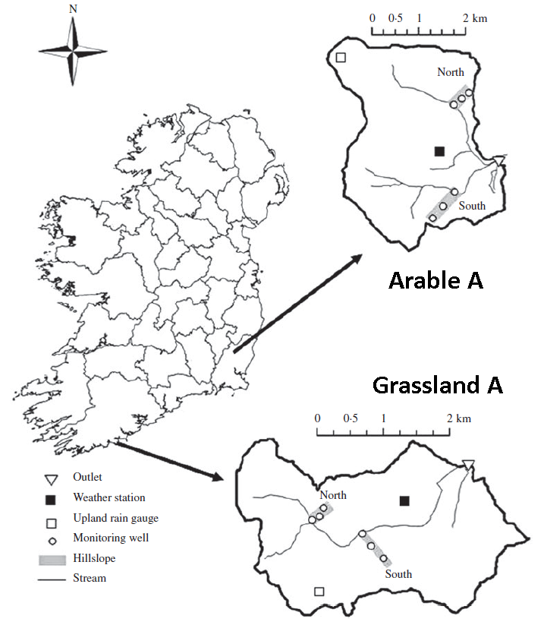
Arable
Sand (%) | 43
Silt (%) | 24
Clay (%) | 33
Bulk Density (g cm³) | 0.93
Grassland
Sand (%) | 33
Silt (%) | 31
Clay (%) | 36
Bulk Density (g cm³) | 0.86

Slide 14
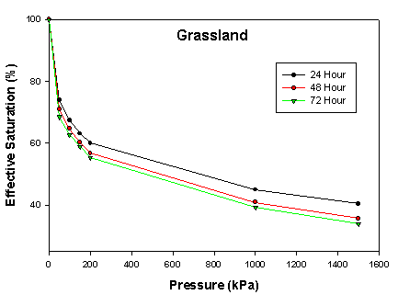
Soil Water Characteristic Curves

Slide 15
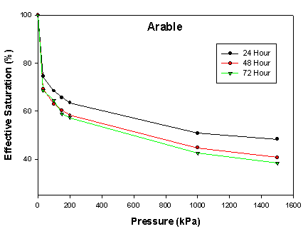
Soil Water Characteristic Curves

Slide 16
VGM Parameters
Grassland |  | Arable
Treatment effect | Significance Level | Treatment effect | Significance Level
Pressure | *** | Pressure | ***
Treatment | *** | Treatment | ***
Pressure x Treatment | n.s | Pressure x Treatment | n.s
Treatment | Estimate | Treatment | Estimate
24-h | 64a† | 24-h | 67a
48-h | 61b | 48-h | 62b
72-h | 59c | 72-h | 61b
† Letters in common for each site indicate no significant difference between treatments (P<0.05) *** significant at P<0.0001, n.s non-significant

Slide 17
Conclusions
24 hour treatment underestimates water content in undisturbed cores
Close similarities between 48 and 72 hour treatments
Effective Equilibrium

Slide 18
Thank you
Any questions?

