Slide 1


The use of Bauxite Residue for Phosphorus (P) recovery in wastewater
Patricia B. Cusack ^{1,2,3*}, Mark G. Healy², Eva Ujaczki^{3,4}, Lisa M. T. O’ Donoghue⁴, Teresa Curtin⁵, Ronan Courtney^{1,3}
¹Department of Biological Sciences, University of Limerick, Castletroy, Co. Limerick, Ireland.
²Civil Engineering, National University of Ireland, Galway, Ireland.
³The Bernal Institute, University of Limerick, Castletroy, Co. Limerick, Ireland.
⁴Department of Design and Manufacturing Technology, University of Limerick, Castletroy, Co. Limerick, Ireland.
⁵Chemical Sciences Department, University of Limerick, Castletroy, Co. Limerick, Ireland.
Corresponding Author Email Address: Patricia.Cusack@ul.ie

Slide 2




Objectives of presentation
Some background on Critical Raw Materials (CRM) and phosphorus
Bauxite residue, what is it?
Bauxite residue as an adsorbent for phosphorus (P)
My study and results

Slide 3
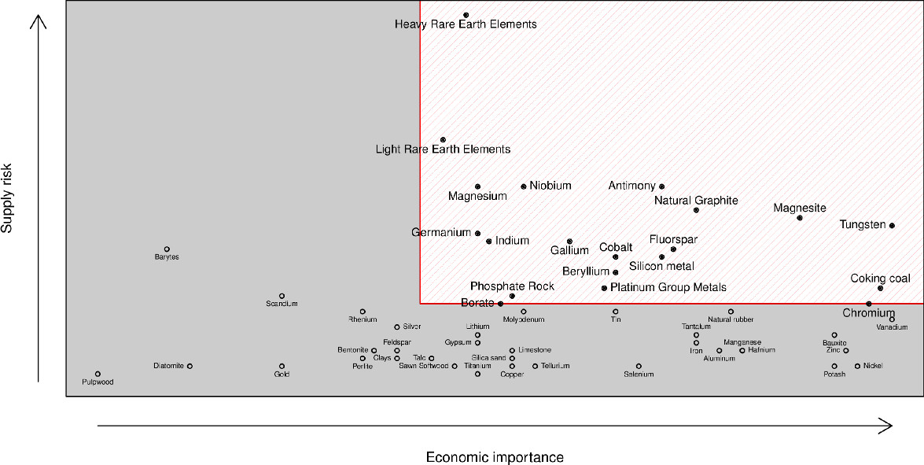

Critical raw materials
(European Commission (EC) (2010))
Notes:
Economic importance - the proportion of each material associated with industrial megasectors such as construction, combined with its gross value added to EU GDP. This total is scaled according to total EU GDP to define the overall economic importance of a material.
Supply risk - the World Governance Indicator (WGI) is used to measure the supply risks of raw materials. This indicator takes into account accountability, political stability and absence of violence, government effectiveness, regulatory quality, and rule of law.

Slide 4
Critical raw materials
(European Commission (EC) (2010))

Slide 5
Phosphorus
Phosphorus is a non-metal and a key component in the composition of animals and plants; essential for successful crop yields.
Phosphorus is added to land through the use of fertilisers.
  Organic fertiliser – phosphorus sourced from the manure.
  Mineral fertiliser – phosphorus sourced from phosphate rock.
    Demand projected to increase with increasing population; production costs increasing.
    Therefore decline in phosphate rock supplies.
Eutrophication
  Phosphorus one of the major nutrients contributing to eutrophication of lakes/natural waters.
Table 1 Estimation of remaining phosphate rock reserves.
Estimated lifetime of reserves | Estimated year of depletion | Reference
80 years | 2080 | Smil 2000
93 years | 2102 | Fixen 2009
90 years | 2099 | Vaccari 2009
Notes:
Phosphorus is a non-metal.
Key component of the composition of animals and essential nutrient required in crop growth. Would not survive without phosphorus.

Slide 6
Methods of P removal from wastewater
Chemical Precipitation
Biological Phosphate Removal (BPR)
Adsorbents
Notes:
Chemical precipitation costly and utilises high amounts of chemicals.
BPR; sludge formation and disposal necessary.
Adsorbents such as activated carbon (which is expensive).
Studies looking at utilising by-products such as fly ash, slag and bauxite residue as low-cost adsorbents.

Slide 7
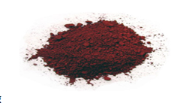
Bauxite residue – what is it?
More commonly known as red mud
Storage practices and management
A by-product produced in the aluminium industry
Globally: Roughly 150Mt is being produced annually (Evans 2016)
Approximately 0.8t of bauxite residue produced per 1t of alumina
Notes:
Approximately only 2% of bauxite residue is being utilised.
Bauxite residue is predominantly going into storage → requires land and can be expensive to manage.

Slide 8
Bauxite residue – storage considerations
Highly alkaline
High electrical conductivity (EC)
Fine particle size
(Gräfe et al. 2009)
Notes:
pH can range from 10-13.

Slide 9
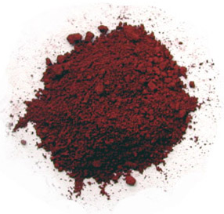
Bauxite residue as an adsorbent for P
High composition of iron (Fe) and aluminium(Al) oxides
Adsorption of phosphates at the edge of Al/Fe-O
Notes:
Bauxite residue as a resource for phosphorus.

Slide 10
Previous studies
Table 2 Previous P adsorption studies that have been carried out using bauxite residues, untreated and treated residues, and their recovery efficiencies.
 | Recovery Technique | Factors investigated | Type of water | Initial P concentration of the water | P Recovery Efficiency | Reference
Untreated bauxite residue | Batch adsorption experiment | Kinetics, pH and temperature | Synthetic water | 5-100mg P L⁻¹ | 0.204mg P g⁻¹ | Grace et al. 2015
Gypsum Treated | Batch adsorption experiment | Contact time (3, 6, 24, 48hr) | Synthetic water | 20-400mg P L⁻¹ | 7.027mg P g⁻¹ | Lopez et al. 1998
Brine treated bauxite residue | Batch adsorption experiment | pH, ionic strength, time | Synthetic water | 0.5-2mg P L⁻¹ | 6.5-14.9 mg P g⁻¹ | Akhurst et al. 2006
Acid and brine treated bauxite residue | Batch adsorption experiment | Kinetics and isotherms | Synthetic water | 200mg P L⁻¹ | 55.72mg P g⁻¹ | Ye et al. 2014

Slide 11
Objectives of this segment of the study
To characterise and treat bauxite residue from two different refineries, with seawater and gypsum.
To investigate the effect of the treated bauxite residue on P adsorption.

Slide 12
Step 1: Treatment of bauxite residue
Refinery 1
Refinery 2
Fine Fraction
Coarse Fraction
Unseparated Bauxite Residue
Gypsum
Seawater
Gypsum
Seawater
Gypsum
Seawater
(9 media for the batch adsorption study)

Slide 13
Step 2: Characterisation of bauxite residue samples
Physicochemical properties
Mineralogiclal composition
Elemental composition

Slide 14
Physicochemical properties of the bauxite residue
Parameter | Fine fraction | Fine fraction +gypsum | Fine fraction+ seawater | Coarse fraction | Coarse fraction + gypsum | Coarse fraction +seawater | Unseparated | Unseparated+ gypsum | Unseparated +seawater
pH | 10.8±0.10 | 8.7±0.04 | 9.02±0.07 | 11.4±0.31 | 7.95±0.16 | 6.79±0.08 | 11.9±0.06 | 9.17±0.02 | 9.49±0.01
EC (µS cm⁻¹) | 704±29.9 | 1338±3.5 | 3080±17.3 | 856±1.53 | 909±2 | 916±1.53 | 1184±17.3 | 1219±7.21 | 5323±172
% Water | 23.5±0.65 | 28.9±0.6 | 32.1±1.72 | 0.39±0.2 | 0.82±0.18 | 3.13±0.72 | 28±0.54 | 35.3±1.32 | 36.5±0.16
d₁₀ (µm) d₅₀ (µm) d₉₀ (µm) | 0.6±0.09 2.43±0.29 6.02±0.86 | 1.37±0.22 3.56±0.59 7.12±1.98 | 1.26±0.05 3.52±0.11 7.69±1.97 | 1.27±0.48 5.13±0.63 12.0±1.27 | 1.11±0.24 3.68±0.4 9.51±0.25 | 1.66±0.84 3.69±0.5 7.0±0.13 | 1.3±0.04 3.69±0.13 10.1±2.4 | 1.49±0.05 4.11±0.39 9.81±2.68 | 1.08±0.74 3.47±0.98 7.17±3.25
Total porosity (%) | 50.0±2.25 | 54±6.72 | 50.3±2.16 | 8.4±0.83 | 15.8±1.19 | 11.8±1.96 | 61.8±1.17 | 55.03±0.62 | 55.1±0.88
Bulk density (g cm⁻³) | 1.5±0.02 | 1.41±0.04 | 1.46±0.02 | 2.47±0.007 | 2.44±0.01 | 2.45±0.02 | 1.3±0.03 | 1.28±0.05 | 1.25±0.16
Particle size density (g cm⁻³) | 2.99±0.1 | 3.11±0.5 | 2.94±0.12 | 2.81±0.21 | 2.65±0.4 | 2.7±0.14 | 3.41±0.06 | 2.85±0.08 | 2.85±0.07
PZCpH | 7±1.21 | 3.43±0.73 | 6.28±0.99 | 2.85±0.75 | 5.45±0.33 | 5.43±0.22 | 6.16±0.21 | 6.32±0.51 | 4.43±0.09
CEC (K)(cmol kg⁻¹) | 63.3±2.56 | 64.1±3.41 | 60.1±2.96 | n.a.* | n.a.* | n.a.* | 57.5±2.13 | 56.4±3.49 | 48.9±13.7
*n.a. = not available

Slide 15

Physicochemical properties of the bauxite residue
Parameter | Fine fraction | Fine fraction +gypsum | Fine fraction+ seawater | Coarse fraction | Coarse fraction + gypsum | Coarse fraction +seawater | Unseparated | Unseparated+ gypsum | Unseparated +seawater
pH | 10.8±0.10 | 8.7±0.04 | 9.02±0.07 | 11.4±0.31 | 7.95±0.16 | 6.79±0.08 | 11.9±0.06 | 9.17±0.02 | 9.49±0.01
EC (µS cm⁻¹) | 704±29.9 | 1338±3.5 | 3080±17.3 | 856±1.53 | 909±2 | 916±1.53 | 1184±17.3 | 1219±7.21 | 5323±172
% Water | 23.5±0.65 | 28.9±0.6 | 32.1±1.72 | 0.39±0.2 | 0.82±0.18 | 3.13±0.72 | 28±0.54 | 35.3±1.32 | 36.5±0.16
d₁₀ (µm) d₅₀ (µm) d₉₀ (µm) | 0.6±0.09 2.43±0.29 6.02±0.86 | 1.37±0.22 3.56±0.59 7.12±1.98 | 1.26±0.05 3.52±0.11 7.69±1.97 | 1.27±0.48 5.13±0.63 12.0±1.27 | 1.11±0.24 3.68±0.4 9.51±0.25 | 1.66±0.84 3.69±0.5 7.0±0.13 | 1.3±0.04 3.69±0.13 10.1±2.4 | 1.49±0.05 4.11±0.39 9.81±2.68 | 1.08±0.74 3.47±0.98 7.17±3.25
Total Porosity (%)^{d} | 50.0±2.25 | 54±6.72 | 50.3±2.16 | 8.4±0.83 | 15.8±1.19 | 11.8±1.96 | 61.8±1.17 | 55.03±0.62 | 55.1±0.88
Bulk Density (g cm⁻³) | 1.5±0.02 | 1.41±0.04 | 1.46±0.02 | 2.47±0.007 | 2.44±0.01 | 2.45±0.02 | 1.3±0.03 | 1.28±0.05 | 1.25±0.16
Particle Size Density (g cm⁻³) | 2.99±0.1 | 3.11±0.5 | 2.94±0.12 | 2.81±0.21 | 2.65±0.4 | 2.7±0.14 | 3.41±0.06 | 2.85±0.08 | 2.85±0.07
PZCpH | 7±1.21 | 3.43±0.73 | 6.28±0.99 | 2.85±0.75 | 5.45±0.33 | 5.43±0.22 | 6.16±0.21 | 6.32±0.51 | 4.43±0.09
CEC (K)(cmol kg⁻¹) | 63.3±2.56 | 64.1±3.41 | 60.1±2.96 | n.a.* | n.a.* | n.a.* | 57.5±2.13 | 56.4±3.49 | 48.9±13.7
*n.a. = not available

Slide 16
Mineralogical composition of the bauxite residue
Parameter | Fine fraction | Fine fraction +gypsum | Fine fraction+ seawater | Coarse fraction | Coarse fraction + gypsum | Coarse fraction +seawater | Unseparated | Unseparated+ gypsum | Unseparated +seawater
Fe2O3 (%) | 43.9±1.1 | 3.5±0.8 | 41.8±1.2 | 64.0±5.1 | 61.4±3.0 | 69.9±3.8 | 43.9±0.6 | 47.9± 0.5 | 53.3± 5.8
Al2O3 (%) | 12.7±0.6 | 11.3±1.0 | 11.1±2.5 | 19.4±1.8 | 11.1±0.6 | 7.4±0.7 | 14± 1 | 11.2± 0.3 | 11.4± 2.2
CaO (%) | 5.9±0.2 | 8.2±0.5 | 4.4±0.3 | 1.1±0.2 | 7.6±0.4 | 1.2±0.1 | 5.6± 0.1 | 7.7± 0.3 | 3.2± 0.5
SiO2 (%) | 8.6±0.7 | 8.5±0.9 | 8.6±1.7 | 2.6±0.3 | 1.3±0.2 | 1.4±0.2 | 9.4± 0.5 | 5.1± 0.4 | 4.3± 0.3
TiO2 (%) | 2.4±0.3 | 2.1±0.1 | 2.7±0.1 | 0.9±0.1 | 1.0±0.1 | 2.1±0.6 | 2.5± 0 | 2.3± 0.1 | 2.3± 0.5
MgO (%) | 3.6±1.3 | 40.6±0.6 | 3.1±1.0 | 4.7±1.8 | 3.6±0.8 | 2.6±0.6 | 4.1±0.6 | 3.8± 0.9 | 3.2± 1.6
Other (%) | 22.9 | 25.8 | 28.3 | 10.3 | 15 | 15.4 | 20.5 | 22 | 22.3

Slide 17
Main elemental composition of the bauxite residue
Parameter | Fine fraction | Fine fraction +gypsum | Fine fraction+ seawater | Coarse fraction | Coarse fraction + gypsum | Coarse fraction +seawater | Unseparated | Unseparated+ gypsum | Unseparated +seawater
Al (mg kg⁻¹) | 72538±1390 | 81095±1219 | 80608±3090 | 45855±2769 | 48851±2336 | 45855±2769 | 67296±3343 | 65389±1326 | 64189±595
Fe (mg kg⁻¹) | 338571±3057 | 289459±1859 | 298282±4937 | 434739±9980 | 460078±23043 | 434740±9981 | 353392±10003 | 328114±4498 | 332251±3435
Mg (mg kg⁻¹) | 122.28±4.96 | 163±37 | 1047±25.6 | 18.32±4.78 | <LOD* | 18.3±4.8 | 109±3.9 | 150±9 | 2203.8±134
K (mg kg⁻¹) | 399±1.47 | 454±29 | 1108±41 | 255±38 | 195±23 | 255.2±38 | 399±13 | 359±11 | 1048±63.2
Si (mg kg⁻¹) | 232±62 | 256±92 | 245.7±35 | 213±6.6 | 234±34 | 212.9±6.6 | 276±20 | 285±34 | 258.5±11.7
Na (mg kg⁻¹) | 28647±261 | 38180±352 | 41864±2012 | 8804±666 | 5935±114 | 8804.8±666 | 25514±317 | 23703±499 | 31974±1087
Ti (mg kg⁻¹) | 1395±196 | 1309±100 | 1265±22 | <LOD* | <LOD* | <LOD* | 1382±38 | 1288±120 | 1233±46
Ca(mg kg⁻¹) | 46855±1073 | 51641±485 | 17159±413 | 4152±490 | 12771±823 | 4152.4±490 | 15084±358 | 42703±2383 | 14820±926
P(mg kg⁻¹) | 955±0.57 | 962±99 | 1018±15 | 1040±23 | 1011±59 | 1039.6±23 | 1298±26 | 1220±10 | 1320±53.8
*<LOD = Below the limit of detection

Slide 18
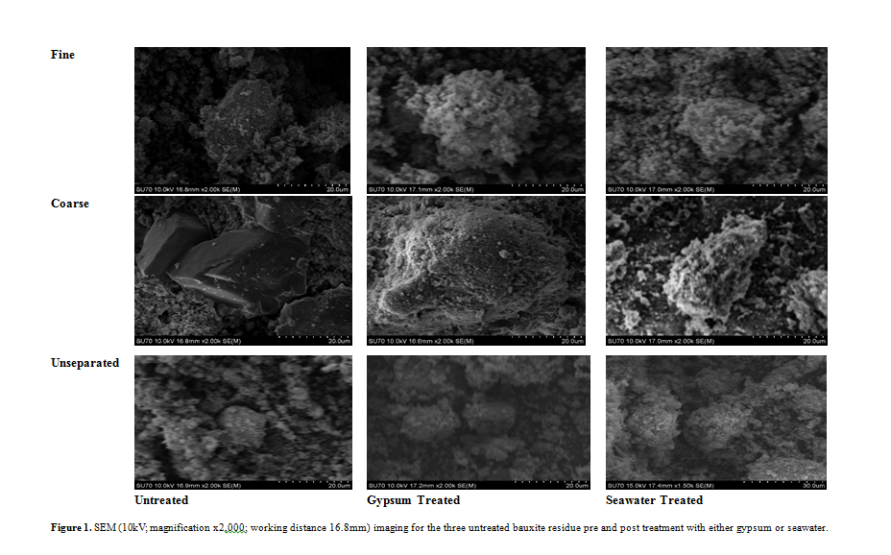
Surface morphology

Slide 19
Step 3: Batch adsorption study
9 different media used:
  Untreated fine fraction, seawater treated, gypsum treated
  Untreated coarse fraction, seawater treated, gypsum treated
  Untreated unseparated bauxite residue, seawater treated, gypsum treated
Concentration range: 0 to 150mg P L⁻¹
Shaken for 24 hours

Slide 20
Maximum adsorption capacity
Table 6 Removal rate of P using each of the nine media.
Media |  | Isotherm | R² | Q_{max} (mg P g⁻¹ media)
Untreated bauxite | Unseparated | Langmuir | 0.992 | 1
 | Fine Fraction | Langmuir | 0.996 | 0.375
 | Coarse Fraction | Langmuir | 0.982 | 0.346
Gypsum treatment bauxite | Unseparated | Langmuir | 0.993 | 2.73
 | Fine Fraction | Langmuir | 0.971 | 2.46
 | Coarse Fraction | Langmuir | 0.999 | 1.39
Seawater treated bauxite | Unseparated | Langmuir | 0.995 | 1.92
 | Fine Fraction | Langmuir | 0.995 | 0.475
 | Coarse Fraction | Langmuir | 0.999 | 0.66

Slide 21
Present and future work
.
Permeability testing to achieve a suitable media mix to set up column trials.
Column trials with wastewater.
  Look at media volume, kinetics of adsorption, effect of retention time and flow rate.

Slide 22
References
Akhurst, D.J., Jones, G.B., Clark, M. and McConchie, D., 2006. Phosphate removal from aqueous solutions using neutralised bauxite refinery residues (Bauxsol™). Environmental chemistry, 3(1), pp.65-74.
European Commission (EC) (2010) Critical Raw Materials [image], available: https://ec.europa.eu/growth/sectors/raw-materials/specific-interest/critical_en [accessed 30 March 2017].
Fixen, P.E. and Johnston, A.M., 2012. World fertilizer nutrient reserves: a view to the future. Journal of the Science of Food and Agriculture, 92(5), pp.1001-1005.
Grace, M.A., Healy, M.G. and Clifford, E., 2015. Use of industrial by-products and natural media to adsorb nutrients, metals and organic carbon from drinking water. Science of The Total Environment, 518, pp.491-497.
Gräfe, M., Power, G. and Klauber, C., 2009. Review of bauxite residue alkalinity and associated chemistry. Clay Miner. Karawara, WA, Australia.
Evans, K., 2016. The history, challenges, and new developments in the management and use of bauxite residue. Journal of Sustainable Metallurgy, 2(4), pp.316-331.
Lopez, E., Soto, B., Arias, M., Nunez, A., Rubinos, D. and Barral, M.T., 1998. Adsorbent properties of red mud and its use for wastewater treatment. Water Research, 32(4), pp.1314-1322.
Smil, V., 2000. Phosphorus in the environment: natural flows and human interferences. Annual review of energy and the environment, 25(1), pp.53-88.
Vaccari, D.A., 2009. Phosphorus: a looming crisis. Scientific American, 300(6), pp.54-59.
Ye, J., Zhang, P., Hoffmann, E., Zeng, G., Tang, Y., Dresely, J. and Liu, Y., 2014. Comparison of response surface methodology and artificial neural network in optimization and prediction of acid activation of Bauxsol for phosphorus adsorption. Water, Air, & Soil Pollution, 225(12), p.2225.

Slide 23
Acknowledgements
Acknowledgements and thanks to the EPA for funding this project.
Special thanks to my supervisors Dr. Ronan Courtney (UL) and Dr. Mark G. Healy (NUIG).

