Slide 1






Investigation into potential risks associated with the use of treated municipal sludge on agricultural land
Healy, M.G., Fenton, O., Cummins, E., Clarke, R., Peyton, D.P., Fleming, G.T.A., Wall, D., Morrison, L., and Cormican, M.

Slide 2
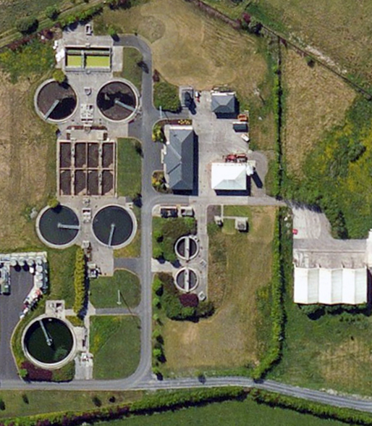
Background
Wastewater in
Clean water out
Sludge generated

Slide 3
Background
Sewage sludge destination routes in Ireland in 2014*
 | Agriculture | Composting | Landfill | Other | Total
Quantity (tonnes dry solids) | 42,483 (79.3%) | 9,266 (17.3%) | 361 (0.7%) | 1,433 (2.7%) | 53,543
*EPA. 2015. Urban Waste Water Treatment in 2014.
http://www.epa.ie/pubs/reports/water/wastewater/2014%20waste%20water%20report_web.pdf

Slide 4
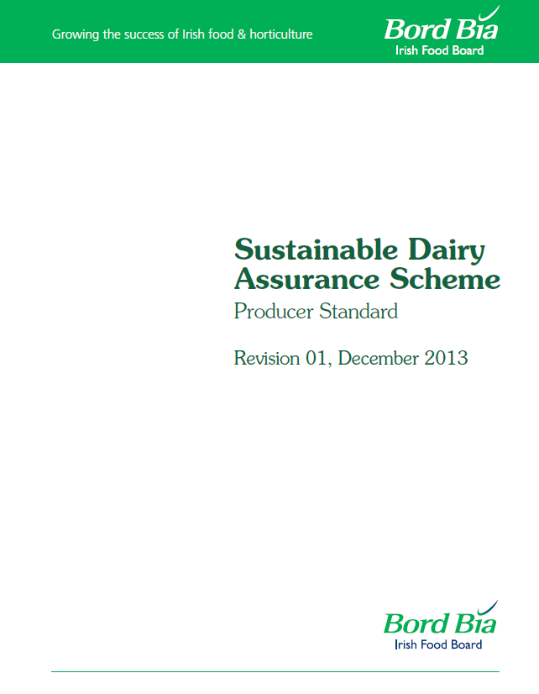
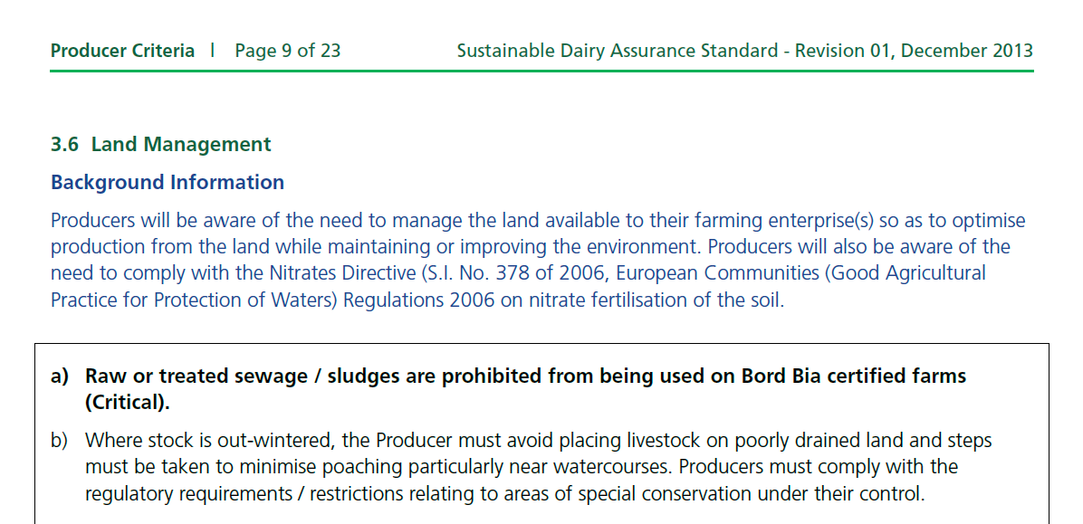
Background
http://www.bordbia.ie/industry/farmers/quality/SDQASDocuments/SustainableDairyAssuranceScheme-ProducerStandard.pdf

Slide 5
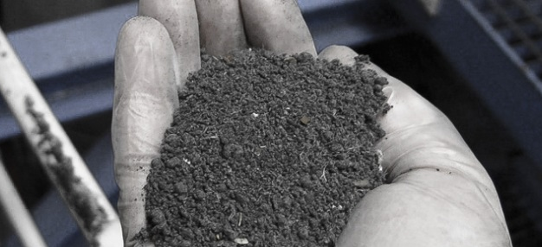
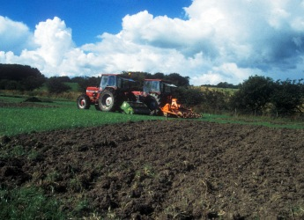
Background
Benefits of recycling treated sludge (‘biosolids’) to grassland:
  May be used as a soil conditioner, improving physical, chemical and biological properties
  May reduce the possibility of soil erosion
  A cheap alternative to commercial fertiliser
© Scanship Bio-sludge Treatment
© The James Hutton Institute

Slide 6
Background
Drawbacks of recycling biosolids to grassland:
  Nutrient, metal and suspended sediment losses may occur
  Presence of ‘emerging contaminants’, such as pharmaceuticals, microplastics, etc.
  Presence of human enteric pathogens, as complete sterilisation is difficult to achieve
  Metals may accumulate in soils and crops after repeated applications
© Scanship Bio-sludge Treatment
© The James Hutton Institute

Slide 7
Research aims
To characterize the metal and pharmaceutical concentrations in treated municipal sludge in Ireland.
The measure the surface runoff of nutrients, solids, microbial matter, pharmaceuticals and metals following land application.
To measure the update of metals by vegetation (ryegrass).

Slide 8
Research aims
To characterize the metal and pharmaceutical concentrations in treated municipal sludge in Ireland.

Slide 9

Methodology – Metal characterisation
Treated sludge was collected from 16 wastewater treatment plants (WWTPs) with population equivalents (PE) ranging up to approximately 2.3 million.
Metals analysed using a handheld X-ray fluorescence (XRF) analyser
Metals examined: Cadmium (Cd), chromium (Cr), copper (Cu), iron (Fe), mercury (Hg), molybdenum (Mo), nickel (Ni), lead (Pb), antimony (Sb), selenium (Se), tin (Sn), and zinc (Zn)

Slide 10
Methodology – Pharmaceutical characterisation
Treated sludge was collected from 16 wastewater treatment plants (WWTPs) with population equivalents (PE) ranging up to approximately 2.3 million.
Pharmacuetical analysed using mass spectrometry
Pharmaceuticals examined: Triclosan and Triclocarban

Slide 11
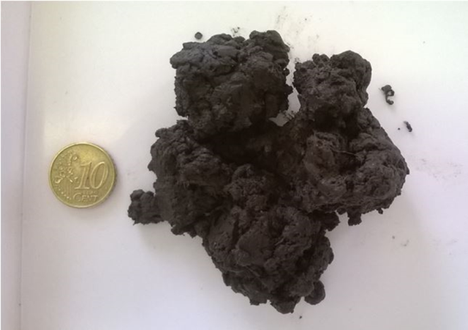
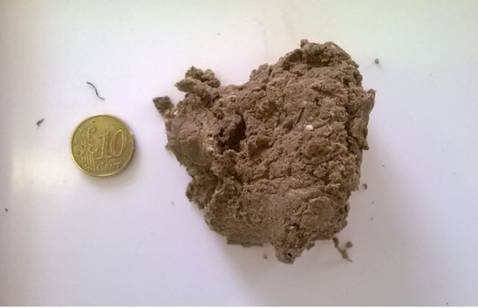
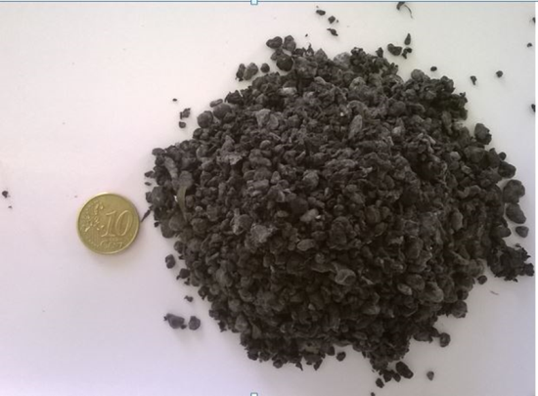
Methodology
Three types of biosolids, were examined:
  anaerobically digested (AD)
  lime stabilized (LS)
  thermally dried (TD)

Slide 12
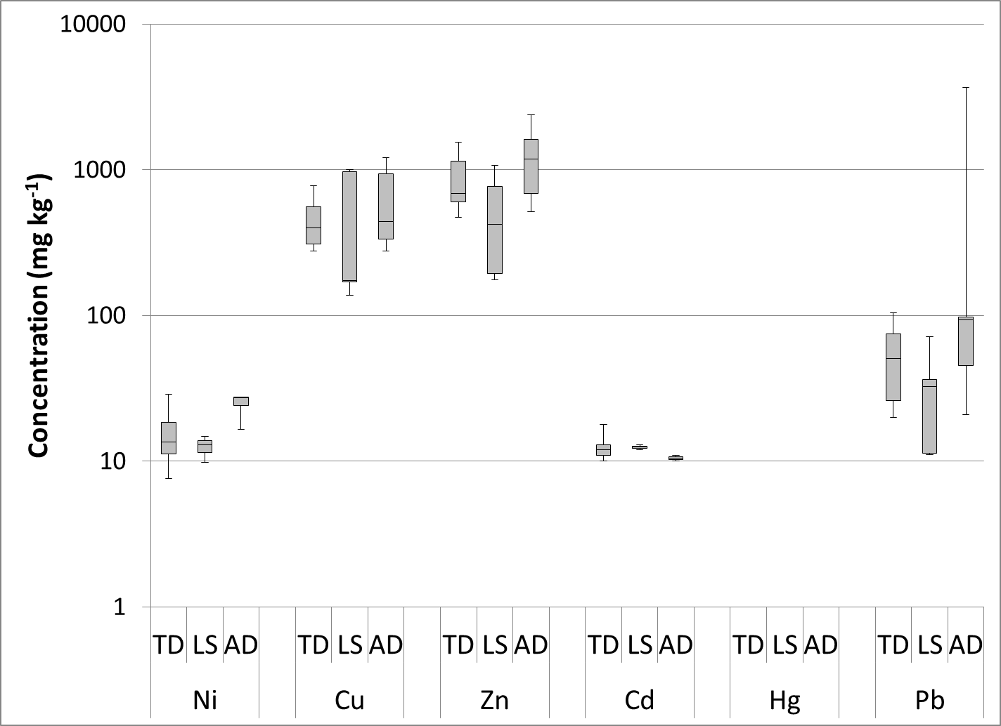
Healy et al. 2016. Waste Manage. 48: 404-8
Results
Characterization of biosolids from 16 WWTPs
Limit values for metal concentrations in sludge for use in agriculture

Slide 13
Healy et al. 2016. Waste Manage. 48: 404-8
Results
Characterization of biosolids from 16 WWTPs
Concentrations (mg kg⁻¹) of unlegislated metals (in the EU) in the treated sludge
Metal | Anaerobic digestion |  | Lime stabilisation |  | Thermal drying
 | Mean | SD | Mean | SD | Mean | SD
As | <LOD |  | <LOD |  | <LOD
Se | 3 | 2 | 3 | 1 | 2 | 1
Sr | 162 | 61 | 183 | 75 | 114 | 36
Mo | 5 | 2 | 4 | 1 | 5 | 1
Ag | 11 | 2 | 11 | 3 | 8 | 3
Sn | 55 | 57 | 23 | 4 | 23 | 5
Sb | 20 | 5 | 17 | 3 | 17 | 4
Cr | 51 | 43 | 25 | 15 | 16 | 12
Antimony (Sb) is substantially higher than in non-polluted soils (0.53 mg kg⁻¹)

Slide 14
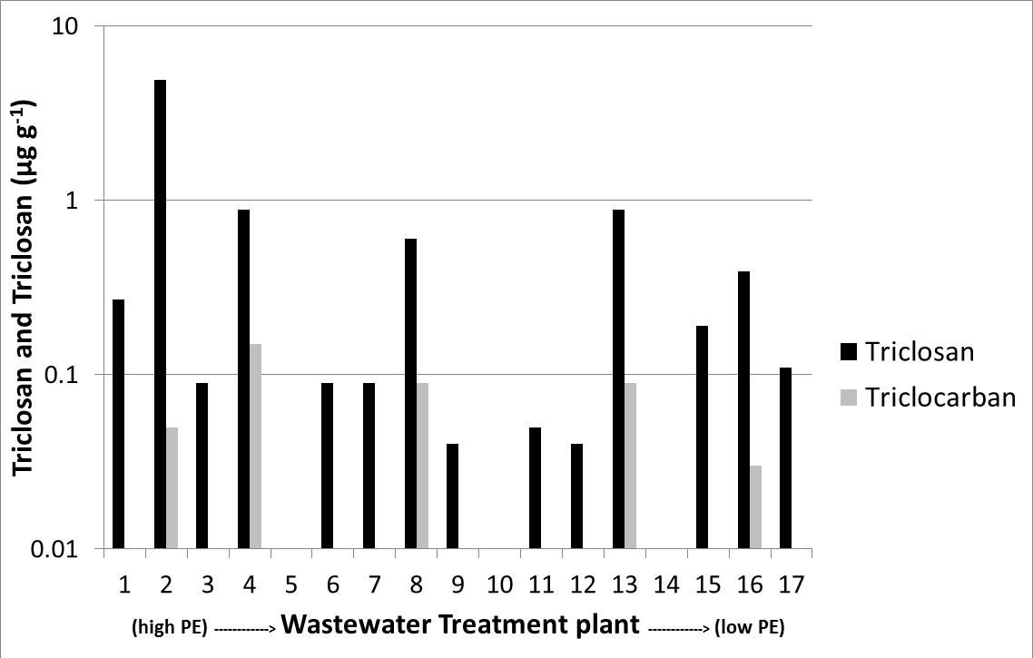
Healy et al. 2016. Waste Manage. 48: 404-8
Results
Presence of pharmaceuticals in 16 WWTPs

Slide 15
Addendum to study
Small particles of plastic, called ‘microplastics’, have also been found on sludge particles.
These may carry contaminants that may attach to their surface.
McMahon et al. 2016. In press.

Slide 16
Research aims
To characterize the metal concentrations in treated municipal sludge in Ireland.
The measure the surface runoff of nutrients, solids, microbial matter, pharmaceuticals and metals following land application.
To measure the update of metals by vegetation (ryegrass).

Slide 17
Research aims
The measure the surface runoff of nutrients, solids, microbial matter, pharmaceuticals and metals following land application.

Slide 18
Aims
To quantify losses of:
  nutrients
  metals
  microbes (total and faecal coliforms)
  anti-microbial agents, triclosan and triclocarbon
in runoff from micro-plots (n=5) at time intervals of 24, 48 and 360 hr following application of three types of biosolids
  Thermally dried
  Anaerobically digested
  Lime stabilised
applied at the legal application rate.
© Scanship Bio-sludge Treatment
© The James Hutton Institute
Runoff was also compared to runoff from dairy cattle slurry, applied at the same rate.

Slide 19
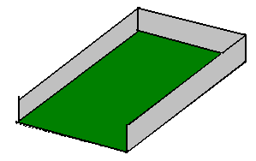
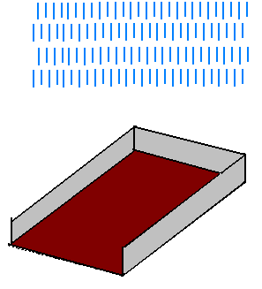
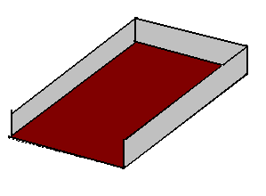
Methodology
Plot isolated using PVC sheeting (50 mm below soil surface)
Rainfall simulators used to apply rain 24, 48, 360 hr after application date
Target Intensity 10.5 mm hr⁻¹

Slide 20
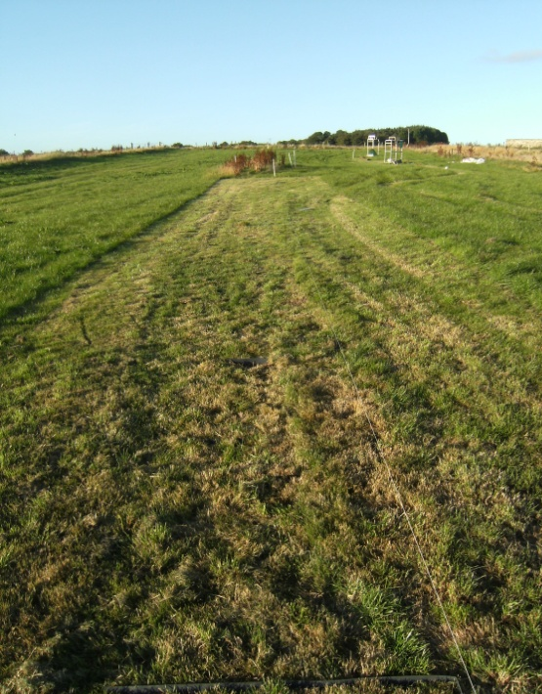
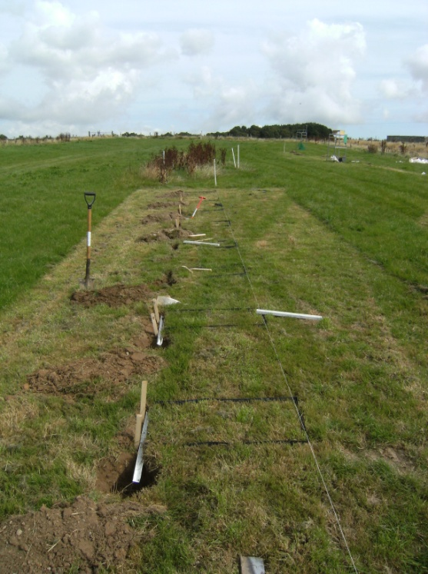
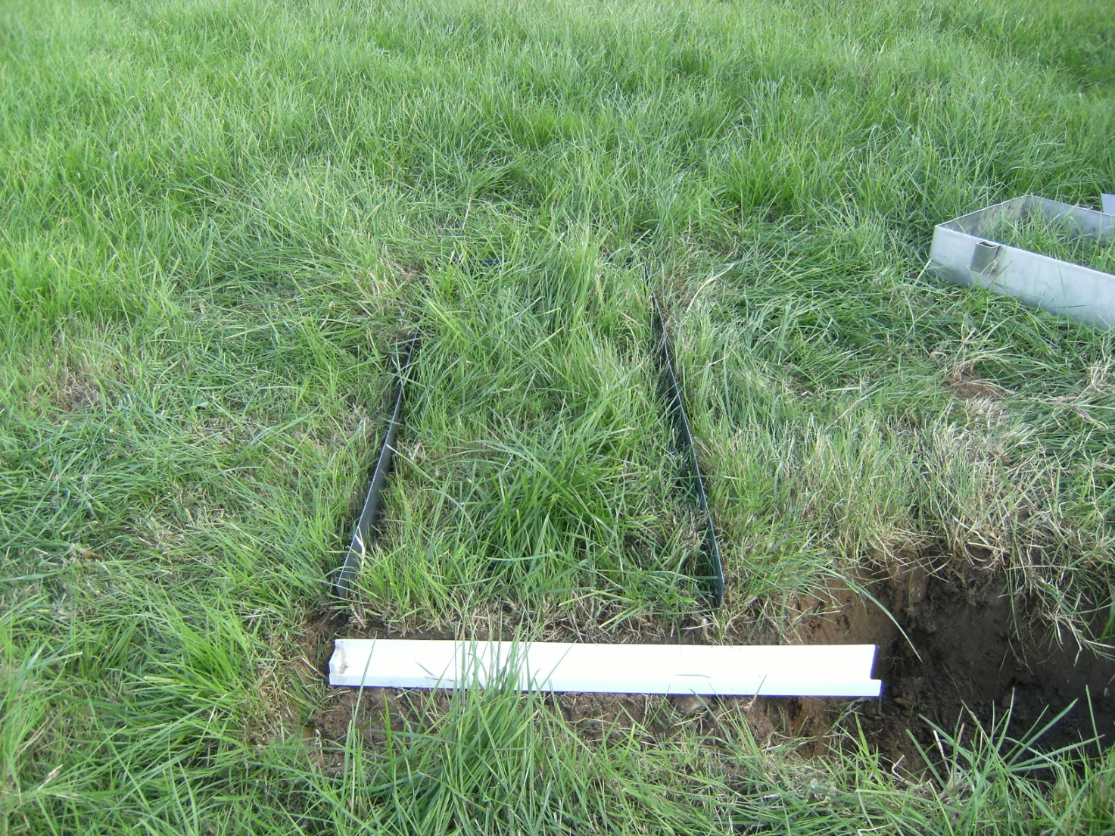
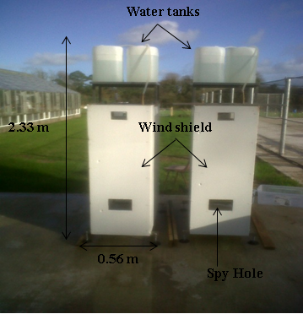
0.4 m
0.9 m

Slide 21
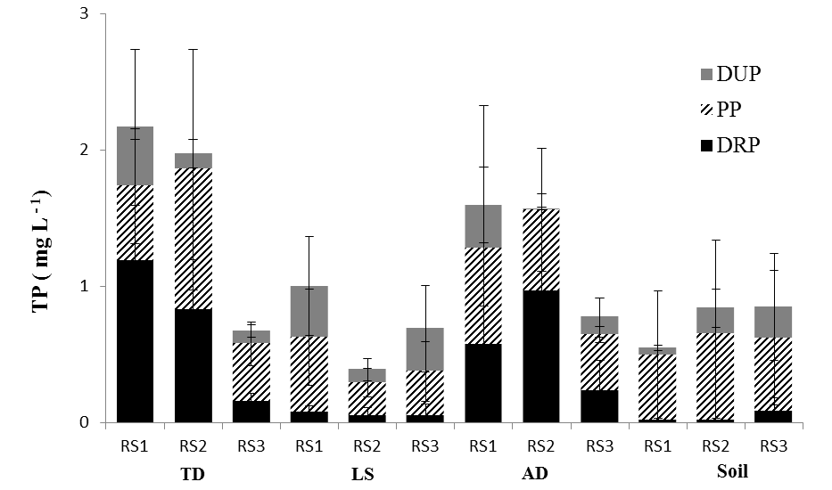
Results
Phosphorus loss in runoff
RS1 = 24 hr after application
RS2 = 48 hr after application
RS3 = 360 hr after application
Peyton et al. 2016. Sci. Tot. Env. 548: 218-29

Slide 22
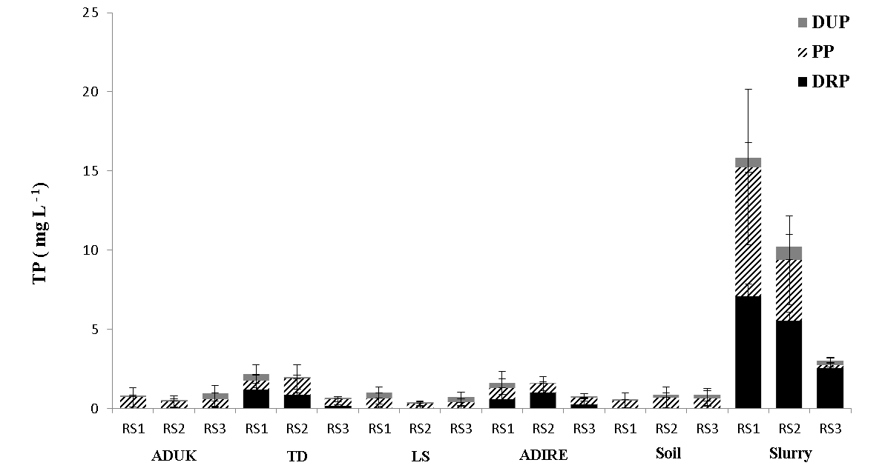

Results
Phosphorus loss in runoff
RS1 = 24 hr after application
RS2 = 48 hr after application
RS3 = 360 hr after application
Peyton et al. 2016. Sci. Tot. Env. 548: 218-29

Slide 23
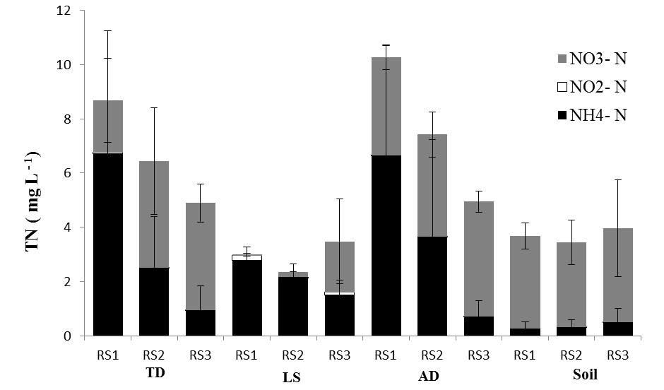
Results
Nitrogen loss in runoff
RS1 = 24 hr after application
RS2 = 48 hr after application
RS3 = 360 hr after application
Peyton et al. 2016. Sci. Tot. Env. 548: 218-29

Slide 24
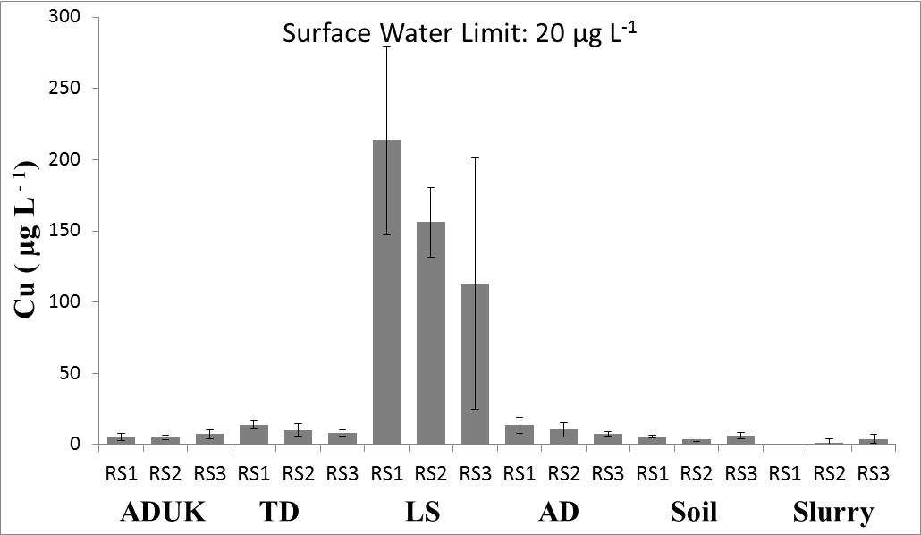
Results
Metal loss in runoff
Regulated parameter | Surface water limit (µg L⁻¹)* | Runoff in excess of surface water limit
Nickel (Ni) | None | n/a
Copper (Cu) | 20 | Yes
Zinc (Zn) | 500 | No
Cadmium (Cd) | 1 | No
Lead (Pb) | 50 | No
Chromium (Cr) | 50 | No
* S.L. 549.21
Peyton et al. 2016. Sci. Tot. Env. 548: 218-29

Slide 25
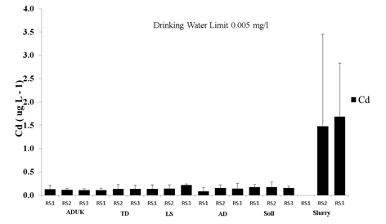
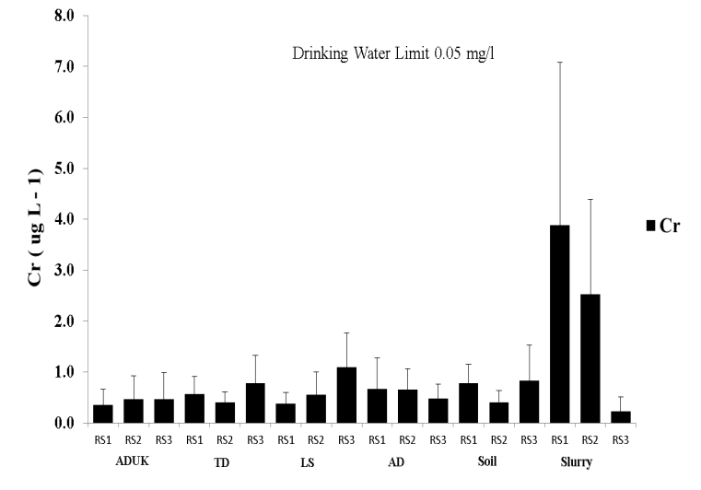
Results
Metal loss in runoff
Cadmium Chromium
Peyton et al. 2016. Sci. Tot. Env. 548: 218-29

Slide 26
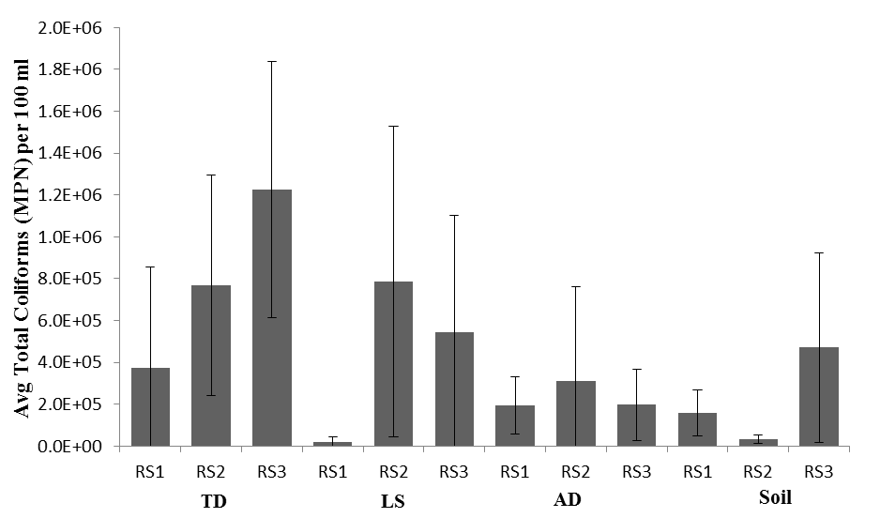
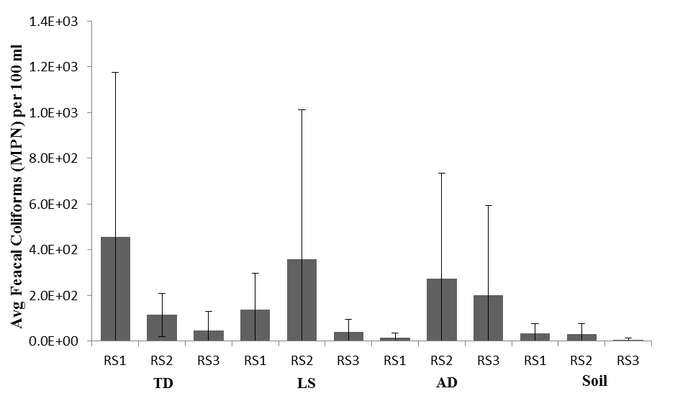
Results
Total and faecal coliform loss in runoff
Peyton et al. 2016. Sci. Tot. Env. 548: 218-29

Slide 27
Results
Pharmaceutical loss in runoff
 | Triclosan |  |  |  |  | Triclocarban
 | Influent | 1 d | 2 d | 15 d |  | Influent | 1 d | 2 d | 15 d
 | µg g⁻¹ | µg L⁻¹ |  |  |  | µg g⁻¹ | µg L⁻¹
TD | 4.9 | <LOD | <LOD | <LOD |  | 0.05 | <LOD | <LOD | 0.01
LS |  | <LOD | <LOD | <LOD |  |  | 0.02 | <LOD | <LOD
AD | 0.27 | <LOD | <LOD | <LOD |  | <LOD | <LOD | <LOD | <LOD

Slide 28
Research aims
To characterize the metal concentrations in treated municipal sludge in Ireland.
The measure the surface runoff of nutrients, solids, microbial matter, pharmaceuticals and metals following land application.
To measure the update of metals by vegetation (ryegrass).

Slide 29
Research aims
To measure the update of metals by vegetation (ryegrass).

Slide 30

Best landspreading practices
Guidelines state that ‘no animal fodder, including kale, food beet or silage, may be harvested until at least three weeks after application of biosolids, and livestock should not be turned out to pasture which has been fertilised with biosolids until three to six weeks after the date of application’.
Fehily Timoney and Company (1999) Codes of good practice for the use of biosolids in agriculture - guidelines for farmers. http://www.environ.ie/en/Publications/Environment/Water/FileDownLoad,17228,en.pdf

Slide 31
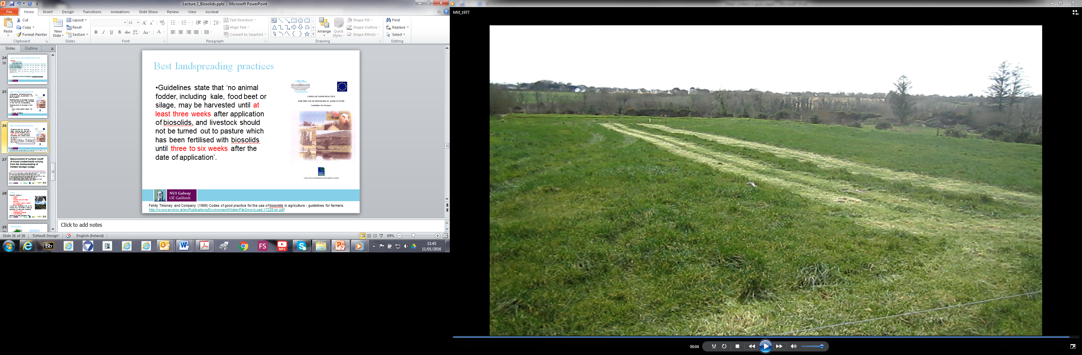
Best landspreading practices
To investigate this regulation, we applied three types of biosolids to grassland (ryegrass) plots and measured the metal uptake over a period of up to 18 weeks.
The treatments were:
Anaerobically digested biosolids
Lime stabilised biosolids
Thermally dried biosolids
A study control (grass without biosolids)

Slide 32
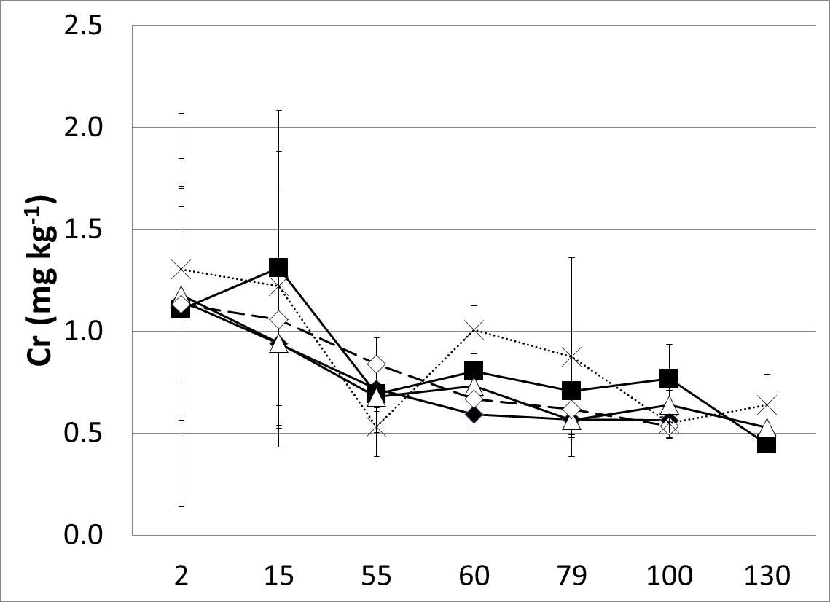
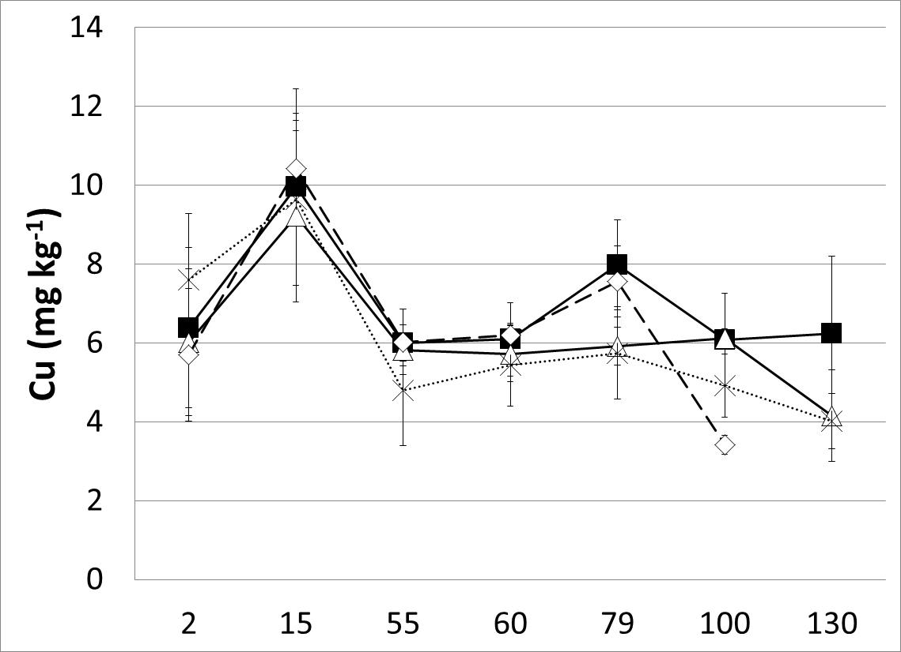
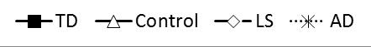
Best landspreading practices
All legislated metals (Cr, Cu, Pb, Ni, Zn, Cd) had similar concentrations to study control and reduced in concentration over time.

Slide 33
Conclusions of metal uptake by plant study.
There was no statistically significant difference between shoot metal concentration of ryegrass in biosolids-amended plots and unamended (control plots).
On the basis of the parameters measured, it would appear the guidelines are overly strict.

Slide 34
Overall conclusions
On the basis of these micro-plot experiments:
Biosolids application to agricultural land are no more dangerous than applications of agricultural slurry.
Regulations governing the time between biosolids application and animal foraging on the same plot would seem to be overly strict.
An important caveat…
Pharmaceuticals and other emerging contaminants, which may be present in sewage sludge, may be inadvertently applied to land and build up in the soil after continued application.

Slide 35
Acknowledgement
The authors wish to acknowledge funding from the Irish EPA (Project reference number 2012-EH-MS-13) and the Department of Communications, Energy and Natural Resources under the National Geoscience Programme 2007 – 2013 (Griffiths Award).
Email: mark.healy@nuigalway.ie
Web: nuigalway.ie/gene/

