Slide 1




The Power of Plants in
Constructed Wetlands
C.J.Mulkeen, C.D.Williams, M.J.Gormally, M.G.Healy
Applied Ecology Unit, NUI Galway, Ireland
Civil Engineering, NUI Galway, Ireland
IPC 2017, Montréal

Slide 2
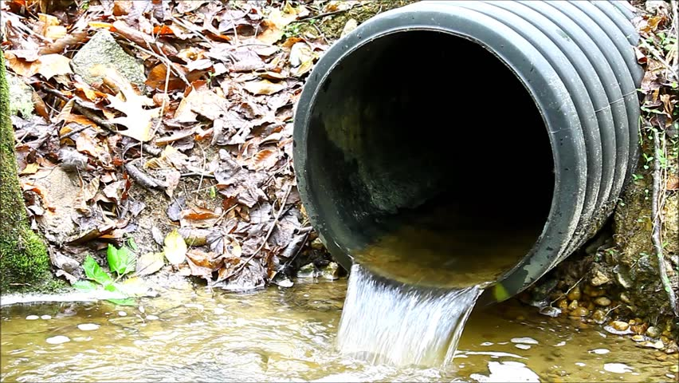

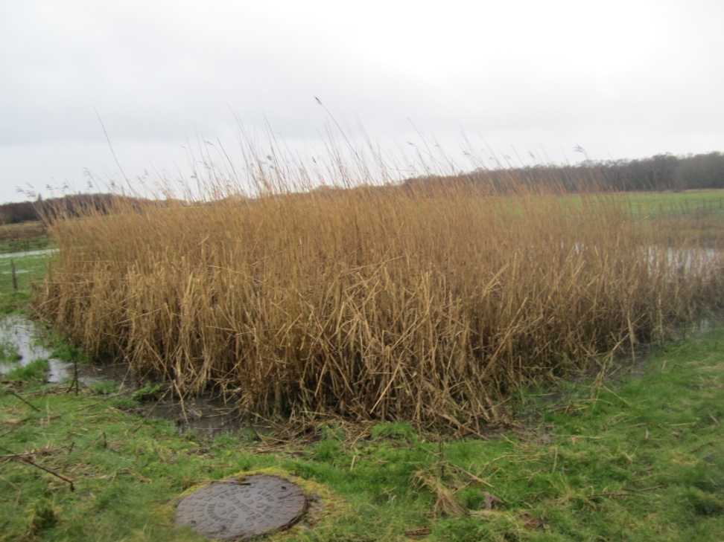
Constructed wetlands (CWs)

Slide 3
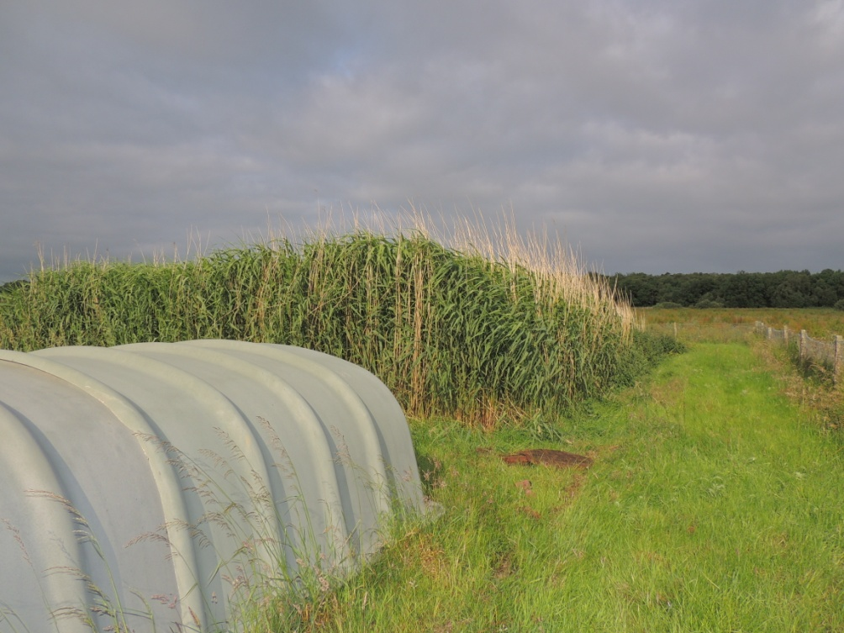

Slide 4
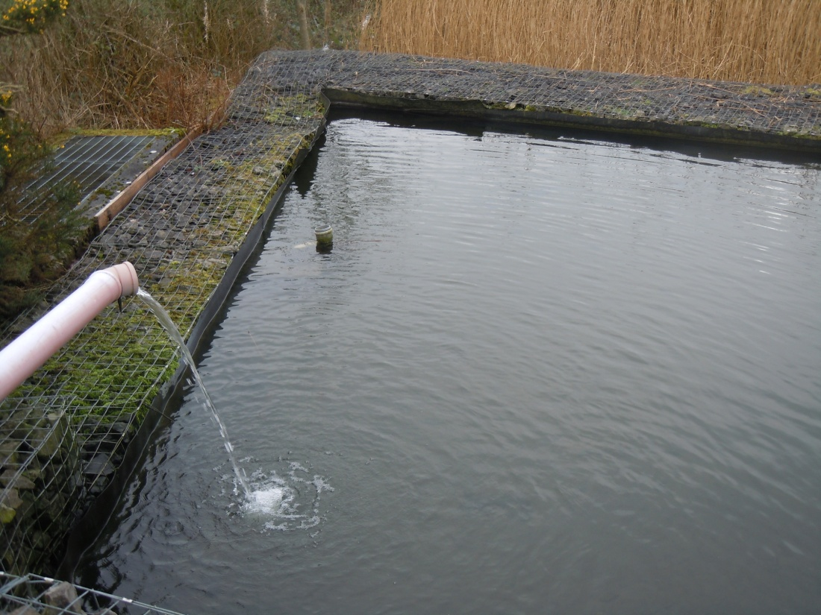

Slide 5
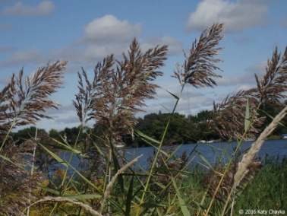
Biodiversity
Particulate trapping
Nutrient & metal uptake
Vegetation
Flow resistance
Surface area for microbes
Insulation

Slide 6
Research Question 1
What are the seasonal patterns of nutrients and metals in
Phragmites australis?

Slide 7
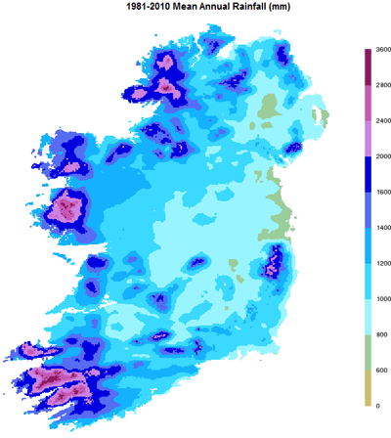

Slide 8
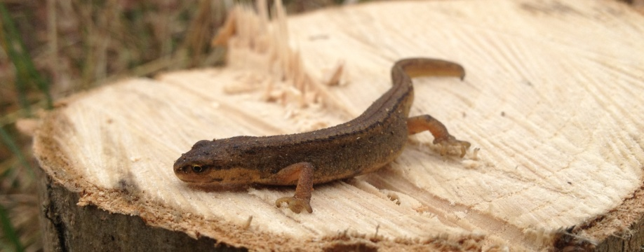
Research Question 2
What is the biodiversity value of constructed wetlands?

Slide 9
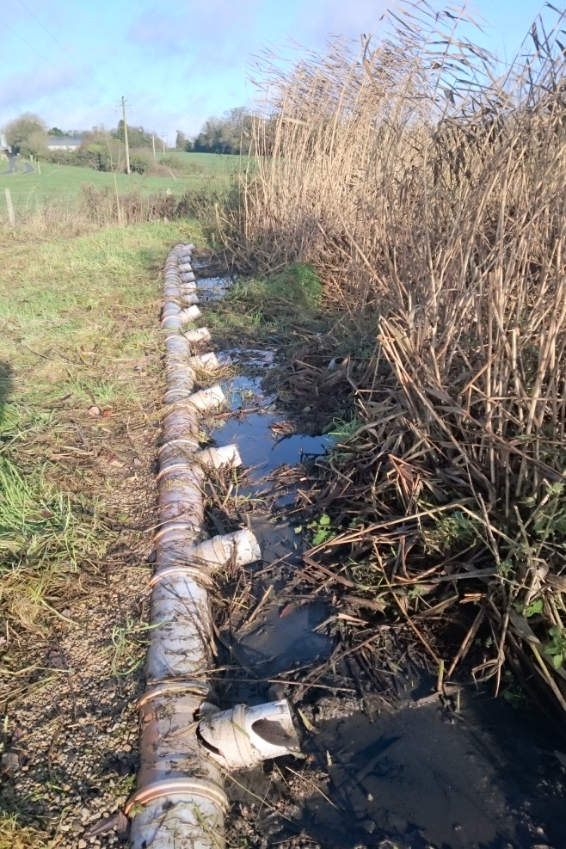
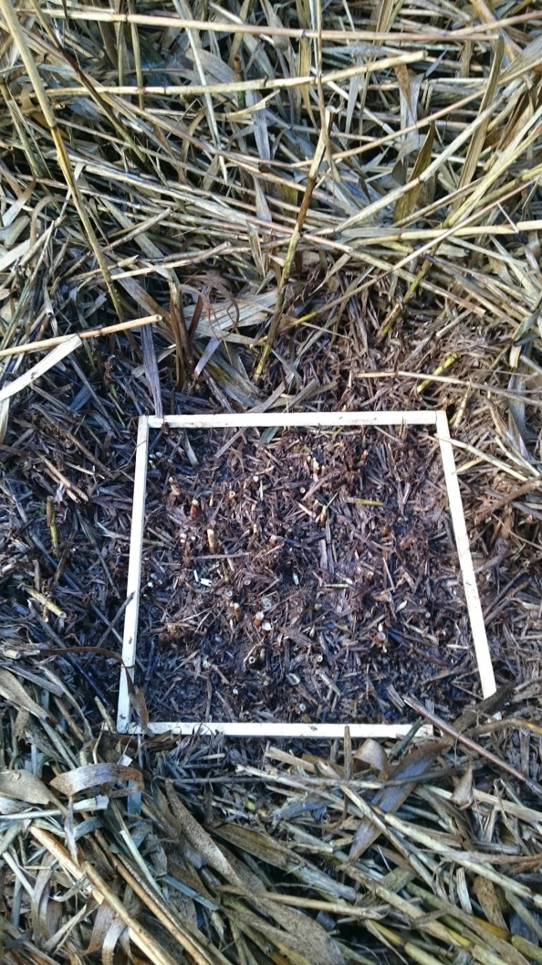
What are the seasonal patterns of nutrients and metals in
Phragmites australis?

Slide 10
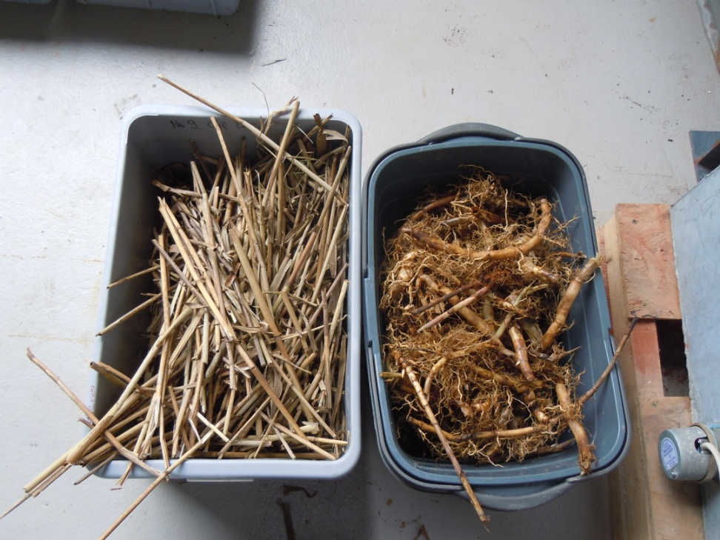
In the laboratory

Slide 11
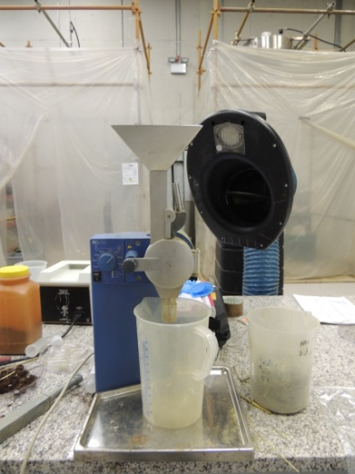
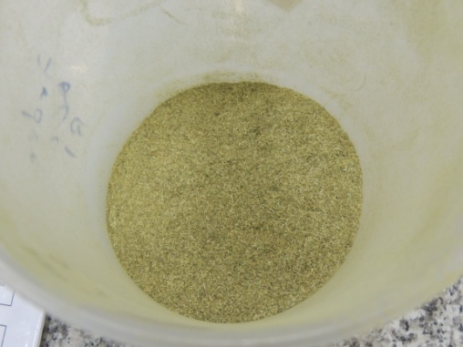
In the laboratory
Nutrients – N, P
Metals - Zn, Cu, Ni, Cr, Cd, Pb

Slide 12
Biomass (g m⁻²)
Aboveground average standing stock (mg m⁻²)
Concentration (mg kg ⁻¹ )

Slide 13
Biomass (g m⁻²)
Aboveground average standing stock (mg m⁻²)
Concentration (mg kg ⁻¹ )

Slide 14
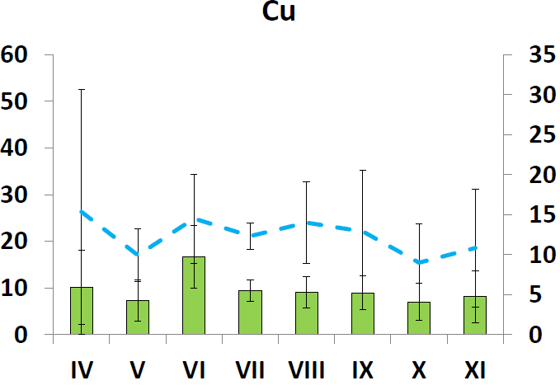
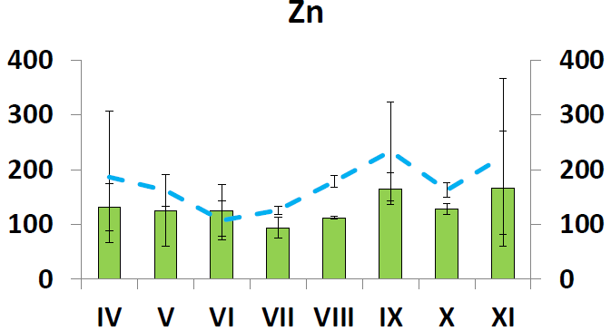
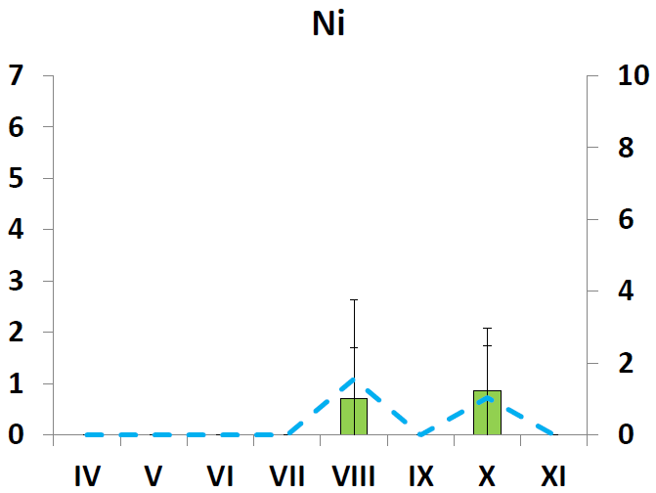
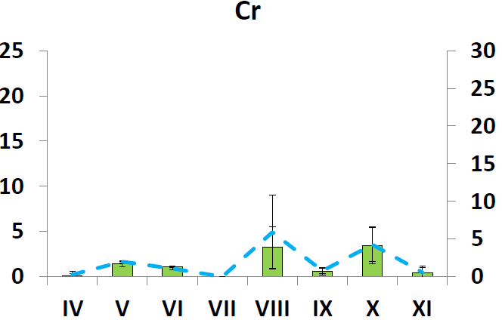
Metals
Concentration (mg kg ⁻¹ )
Concentration (mg kg ⁻¹ )
Aboveground average standing stock (mg m⁻²)
Aboveground average standing stock (mg m⁻²)

Slide 15
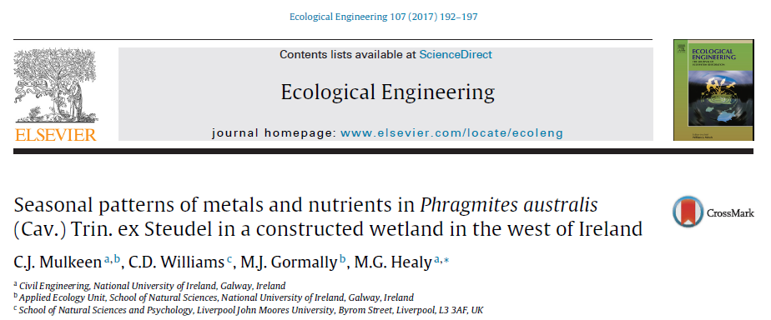
Research Question 1
Harvest in Autumn
Implications for industrial settings
Further studies required

Slide 16
Research Question 2
What is the biodiversity value of constructed wetlands?

Slide 17
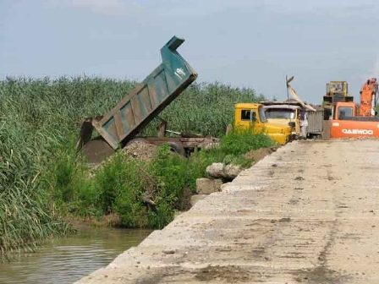
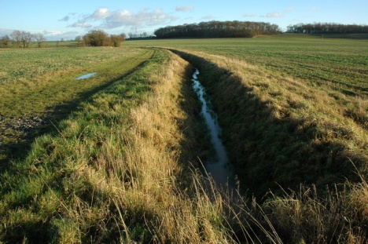
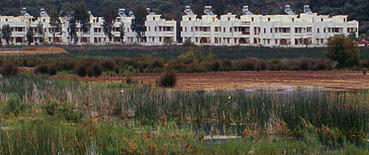
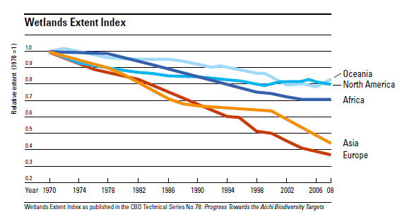
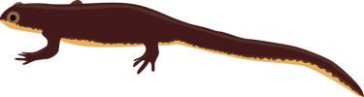
Agriculture
Development
Infilling
Relative extent (1970 = 1)

Slide 18
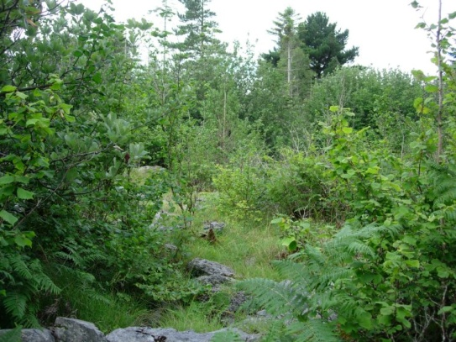
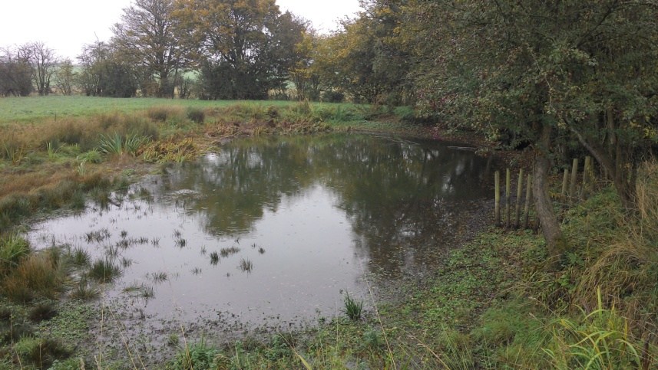
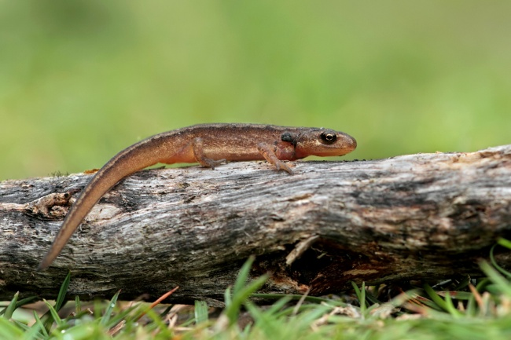
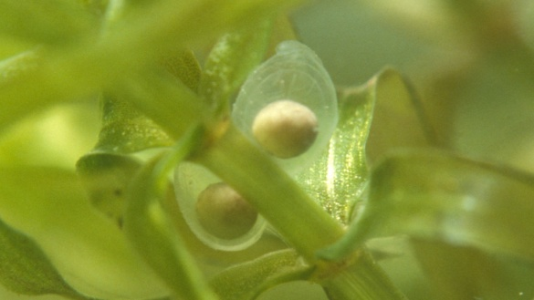
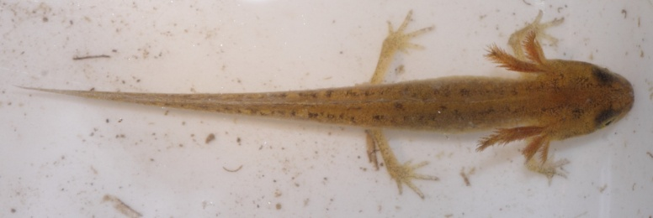
Life cycle
Breeding water bodies
Adult
Egg
Newt larvae

Slide 19
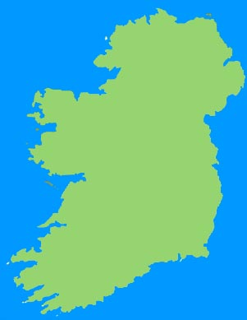
Study sites

Slide 20
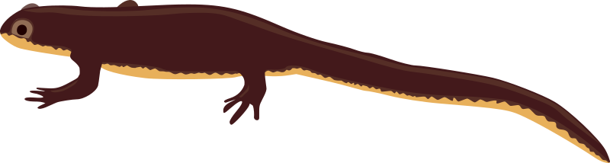
Habitat mapping
Mapped using Fossitt (2000)
Applied a Habitat Suitability Index (Oldham et al., 2000)

Slide 21
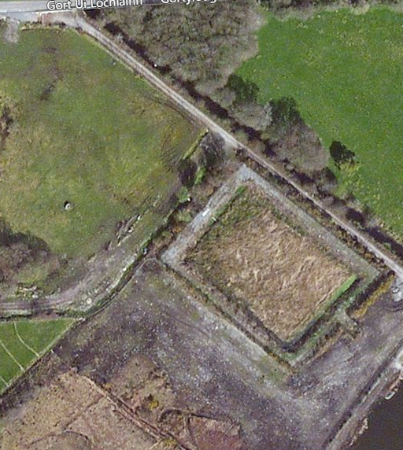
Constructed wetland
Bare ground

Slide 22
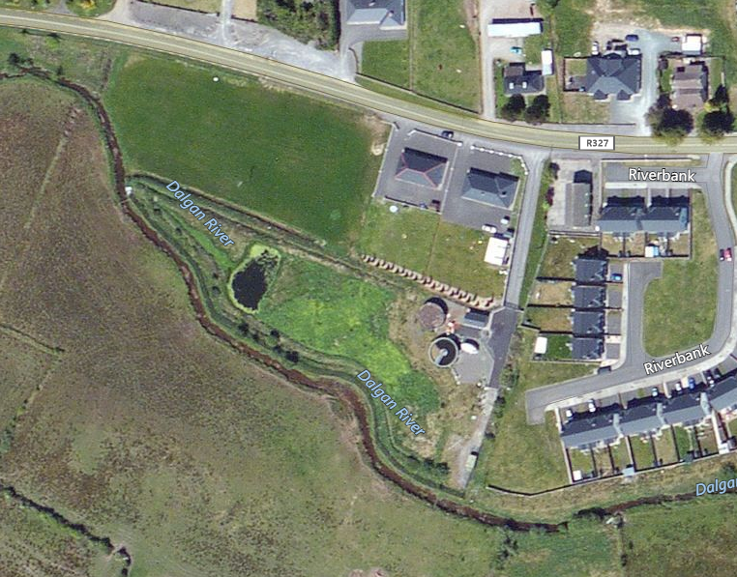
Constructed wetland

Slide 23
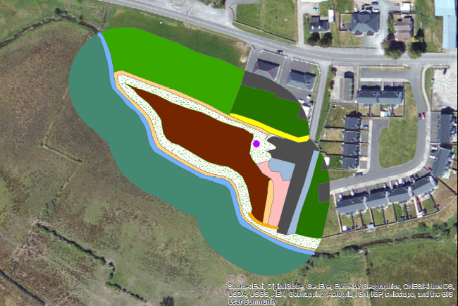
Improved agricultural grassland
Amenity grassland
Scrub
Constructed wetland
Grassy verge
Buildings/artificial surfaces

Slide 24
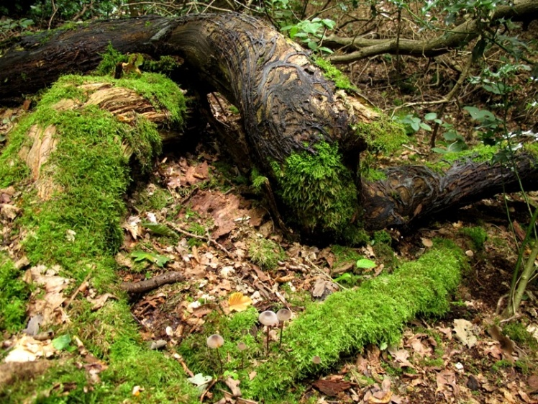
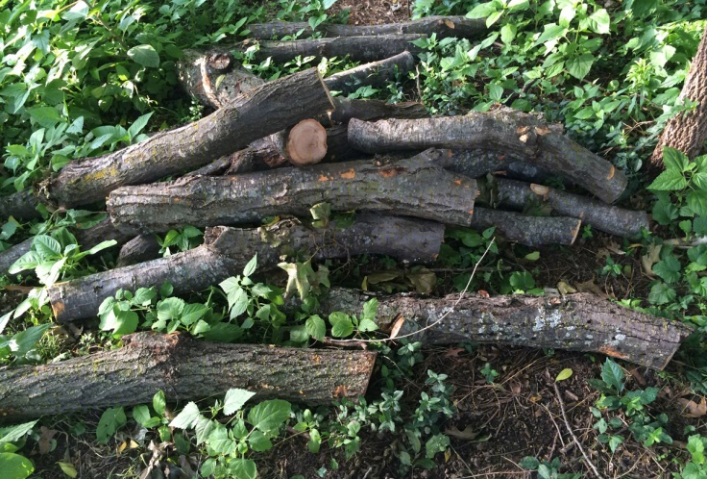
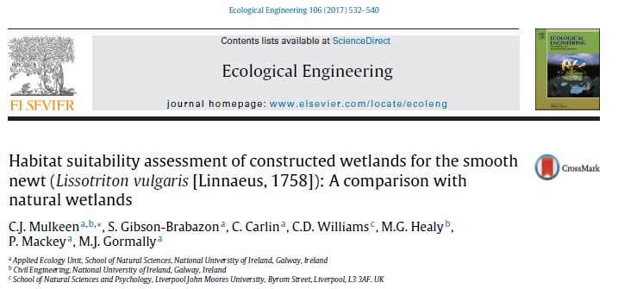
Features

Slide 25
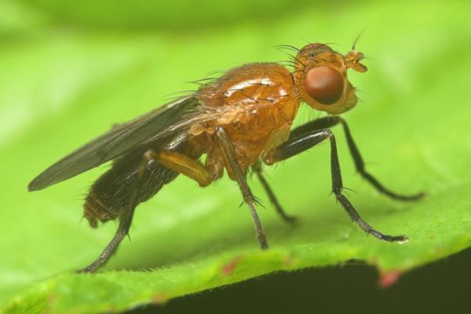
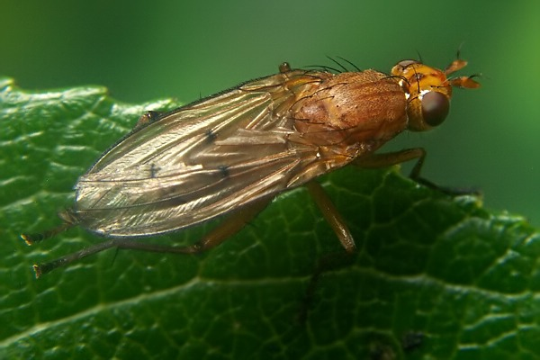
Invertebrates
Diptera: Sciomyzidae
36%
Irish fauna
Sciomyza dryomyzina
Tetanocera freyi

Slide 26
Conclusions
Autumn harvest is best for nutrient and metal removal!
CWs can act as a haven for the smooth newt!
Early research indicates the importance of CWs for aerial invertebrates

Slide 27




Acknowledgements
Environmental Protection Agency
NUI, Galway
Galway, Mayo, Roscommon & Leitrim local authorities

Slide 28
Habitat Suitability Index
Category | HSI | Criteria
Good | 1 | Extensive area of habitat that offers good opportunities for foraging and shelter completely surrounds pond (e.g. rough grassland, scrub or woodland).
Moderate | 0.67 | Habitat that offers opportunities for foraging and shelter, but may not be extensive in area and does not completely surround pond.
Poor | 0.33 | Habitat with poor structure that offers limited opportunities for foraging and shelter (e.g. amenity grassland).
None | 0 | Clearly no suitable habitat around pond (e.g. centre of large expanse of bare habitat).

