Slide 1








Measurement of surface runoff of mixed contaminants arising from the landspreading of treated sewage sludge
Mark G. Healy¹, Dara Peyton^{1,2}, Gerard Fleming³, Martin Danaher⁴, Liam Morrison⁵, David Wall², Jim Grant⁴, Martin Cormican⁶ and Owen Fenton²
¹Civil Engineering, National University of Ireland, Co. Galway, Rep. of Ireland.
²Teagasc, Johnstown Castle, Environment Research Centre, Co. Wexford, Rep. of Ireland.
³Microbiology, National University of Ireland, Galway, Rep. of Ireland
⁴Teagasc Research Centre, Kinsealy, Co. Dublin, Rep. of Ireland.
⁵Earth and Ocean Sciences, National University of Ireland, Galway, Rep. of Ireland
⁶University College Hospital, Galway, Co. Galway, Rep. of Ireland

Slide 2
Background
Production of untreated municipal sludge in the EU has increased from 5.5 million tonnes of dry matter (DM) in 1992 to ~ 10 million tonnes DM in 2010.
EU legislation has forced those involved in sludge management to find alternative uses for sludge.
Recycling to land is currently the most economical and beneficial way for sewage sludge management.
Credit: J. Lucid, MEngSc thesis

Slide 3
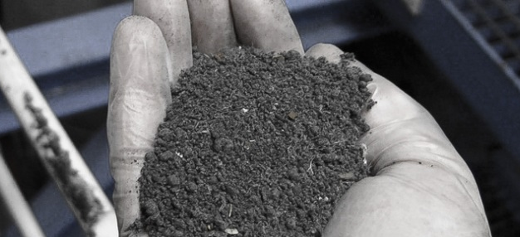
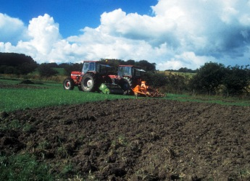
Background
Municipal sewage sludge must be treated before land application.
Treatment methods include:
  Aerobic and anaerobic digestion
  Thermal drying
  Lime stabilisation
  Composting
© Scanship Bio-sludge Treatment
© The James Hutton Institute

Slide 4
Background
Benefits of recycling biosolids to grassland:
  May be used as a soil conditioner, improving physical, chemical and biological properties
  May reduce the possibility of soil erosion
  A cheap alternative to commercial fertiliser
© Scanship Bio-sludge Treatment
© The James Hutton Institute

Slide 5
Background
Drawbacks of recycling biosolids to grassland:
  Nutrient, metal and suspended sediment losses may occur
  Presence of ‘emerging contaminants’, such as pharmaceuticals
  Presence of human enteric pathogens, as complete sterilisation is difficult to achieve
  Metals may accumulate in soils and crops after repeated applications
© Scanship Bio-sludge Treatment
© The James Hutton Institute

Slide 6
Aims
To quantify losses of:
  nutrients
  metals
  microbes (total and faecal coliforms)
  anti-microbial agents, triclosan and triclocarbon
in runoff from micro-plots (n=5) at time intervals of 24, 48 and 360 hr following application of three types of biosolids
  Thermally dried
  Anaerobically digested
  Lime stabilised
applied at the legal application rate
© Scanship Bio-sludge Treatment
© The James Hutton Institute

Slide 7
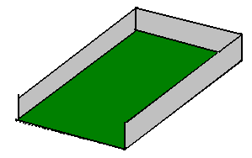
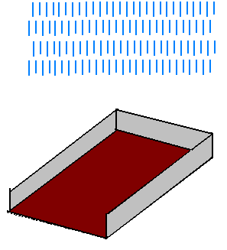
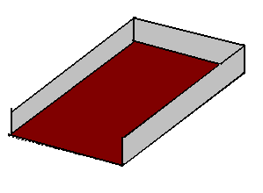
Methodology
Plot isolated using PVC sheeting (50 mm below soil surface)
Rainfall simulators used to apply rain 24, 48, 360 hr after application date
Target Intensity 10.5 mm hr⁻¹

Slide 8
Methodology
Biosolids Application Regime (after Lucid et al., 2013. Wat, Air, Soil Poll 224: 1464)
Determine Soil Test P of land
Determine dry solids (DS), nutrient and metal content of biosolids
Determine maximum spreading rate based on metal content
Determine maximum spreading rate based on nutrient content
Spreading rate is based on minimum of metal and nutrient spreading rate

Slide 9
Methodology
Biosolids Application Regime (after Lucid et al., 2013. Wat, Air, Soil Poll 224: 1464)
Determine Soil Test P of land
Determine dry solids (DS), nutrient and metal content of biosolids
Determine maximum spreading rate based on nutrient content
Spreading rate:
40 kg P ha⁻¹

Slide 10
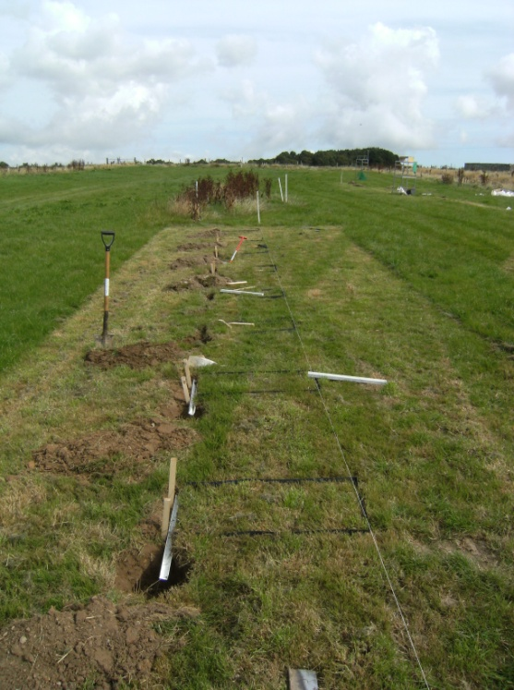
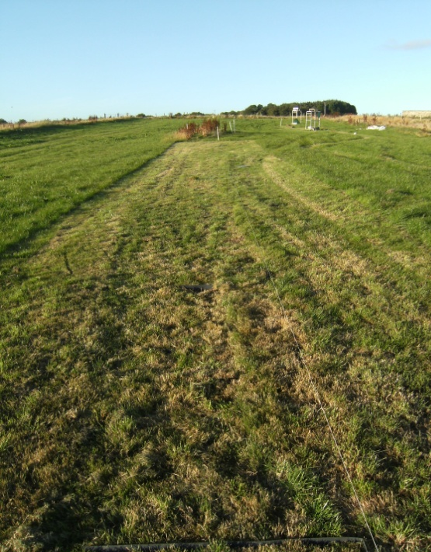
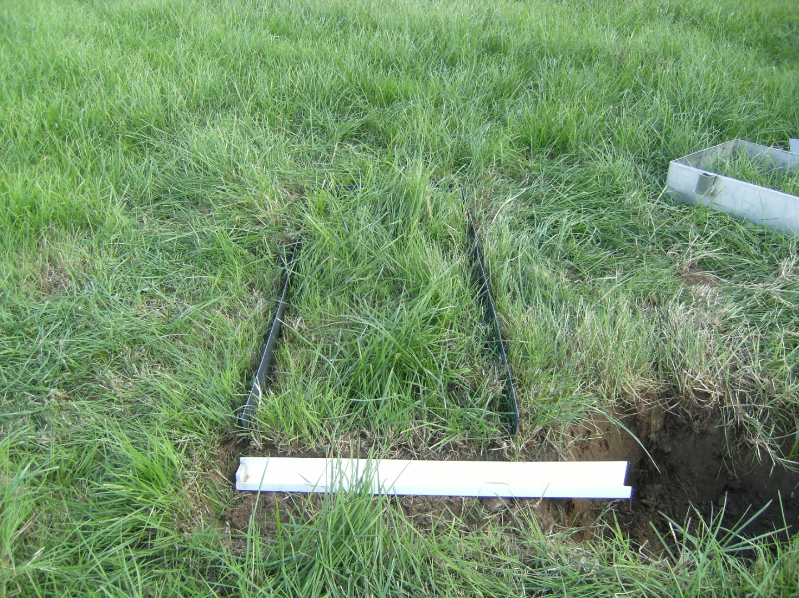
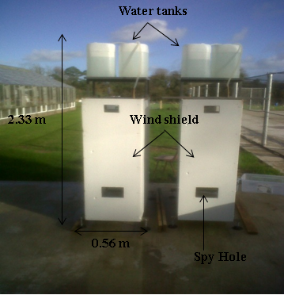
0.4 m
0.9 m

Slide 11
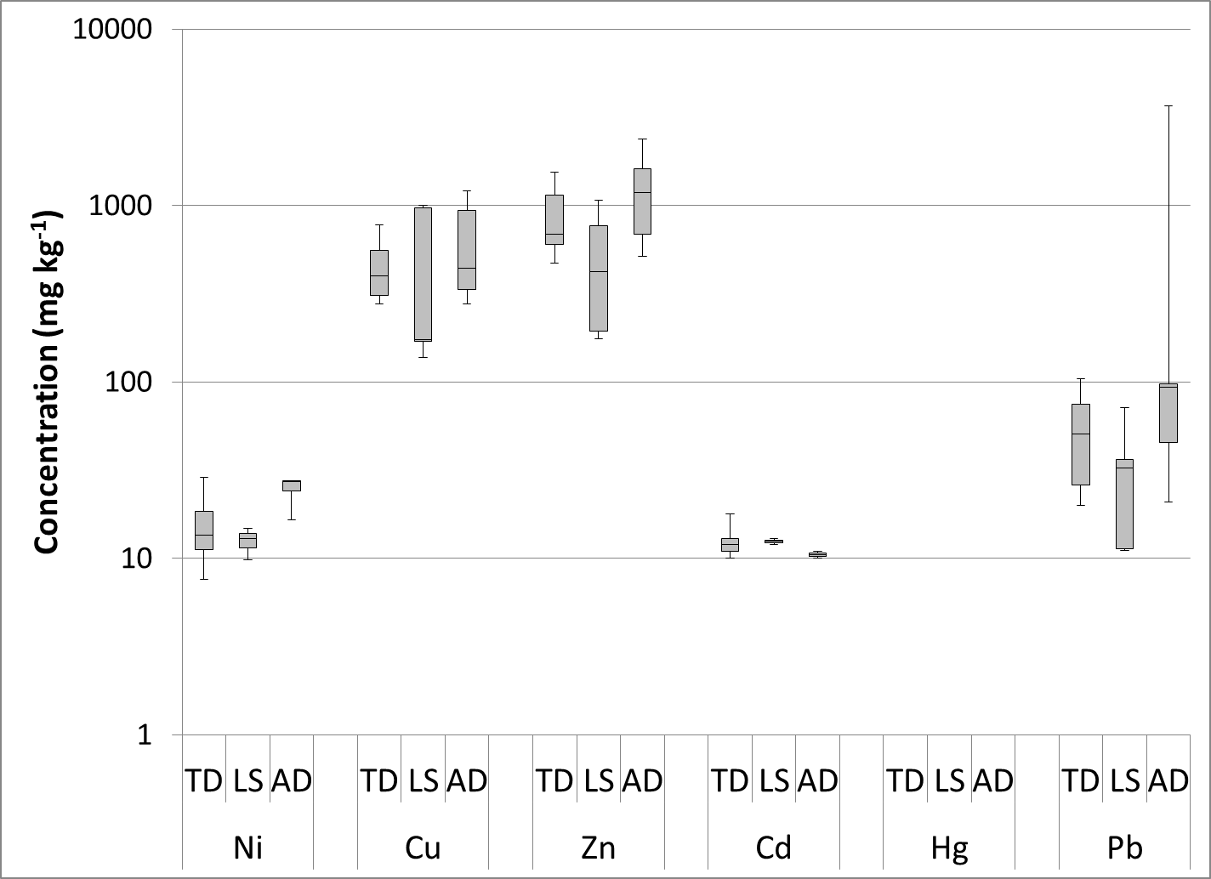
Results
Characterization of biosolids
Results from 16 wastewater treatment plants in Ireland (Healy et al., submitted)
TD biosolids
LS biosolids
AD biosolids

Slide 12
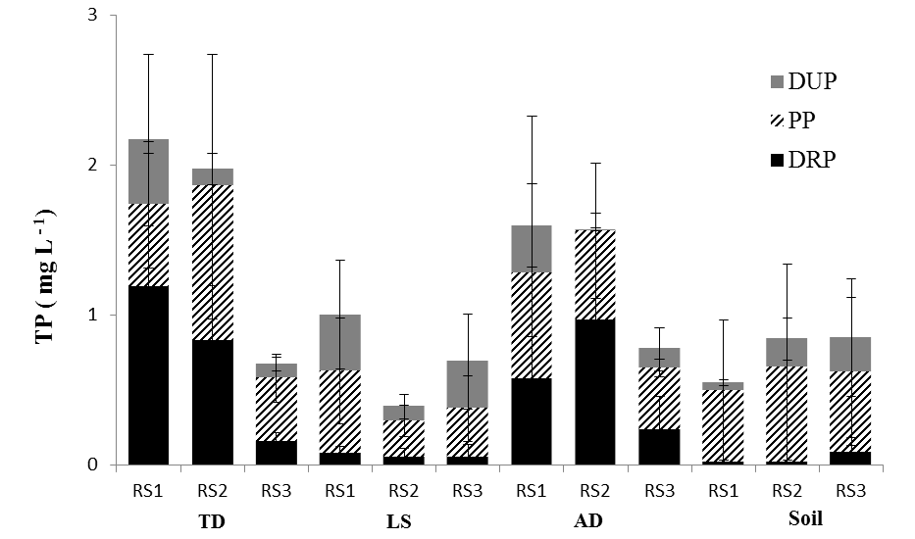
Results
Phosphorus loss in runoff
RS1 = 24 hr after application
RS2 = 48 hr after application
RS3 = 360 hr after application

Slide 13
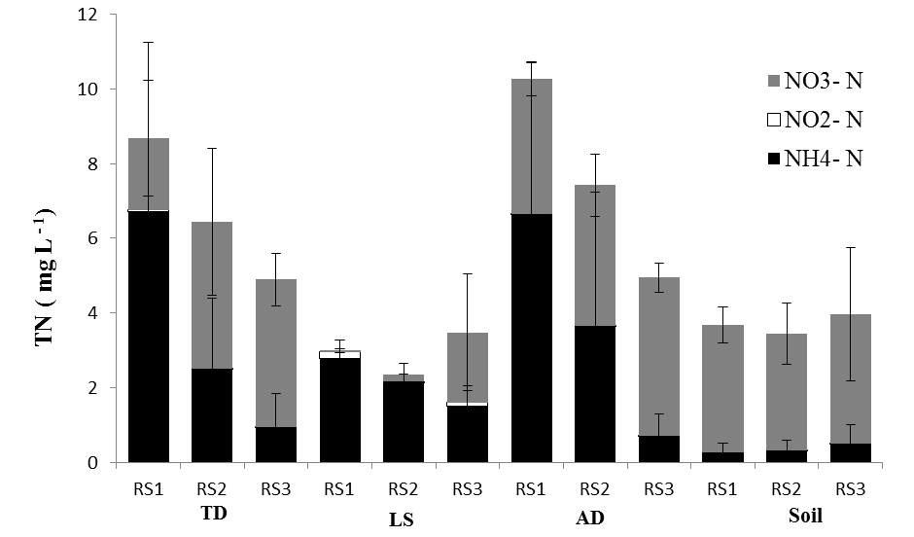
Results
Nitrogen loss in runoff
RS1 = 24 hr after application
RS2 = 48 hr after application
RS3 = 360 hr after application

Slide 14
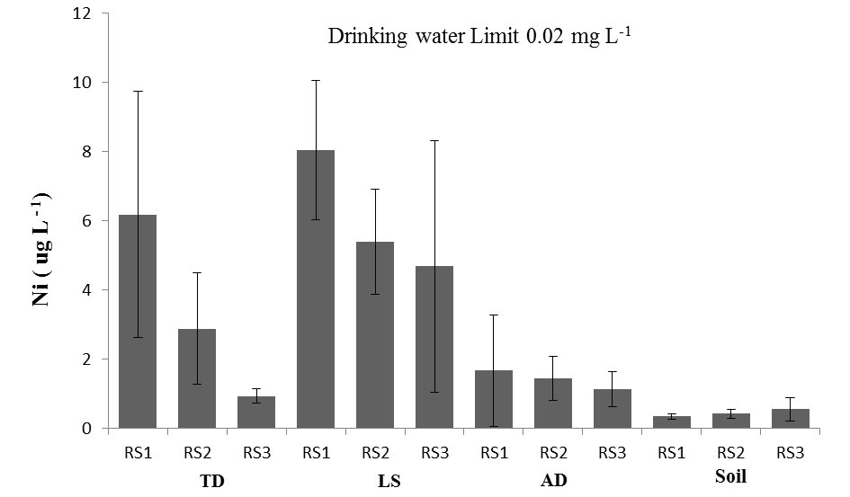
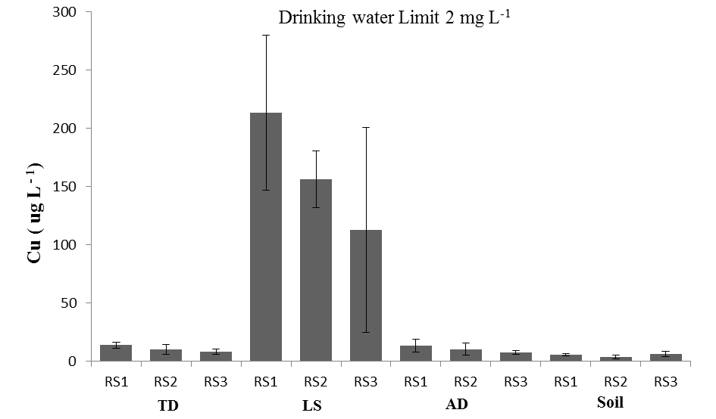
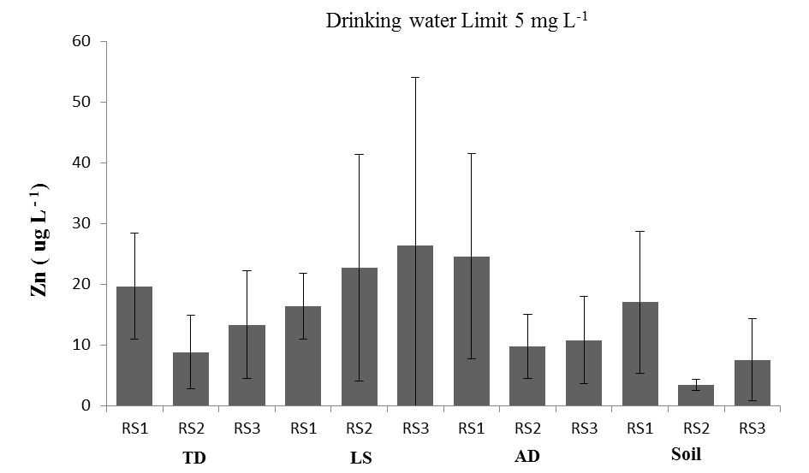
Results
Metal loss in runoff
Regulated parameter | Drinking water limit (mg L⁻¹) | Runoff in excess of drinking water limit
Nickel (Ni) | 0.005 | Yes
Copper (Cu) | 2 | Yes
Zinc (Zn) | 5 | Yes
Cadmium (Cd) | 0.005 | Yes
Lead (Pb) | 0.015 | Yes

Slide 15
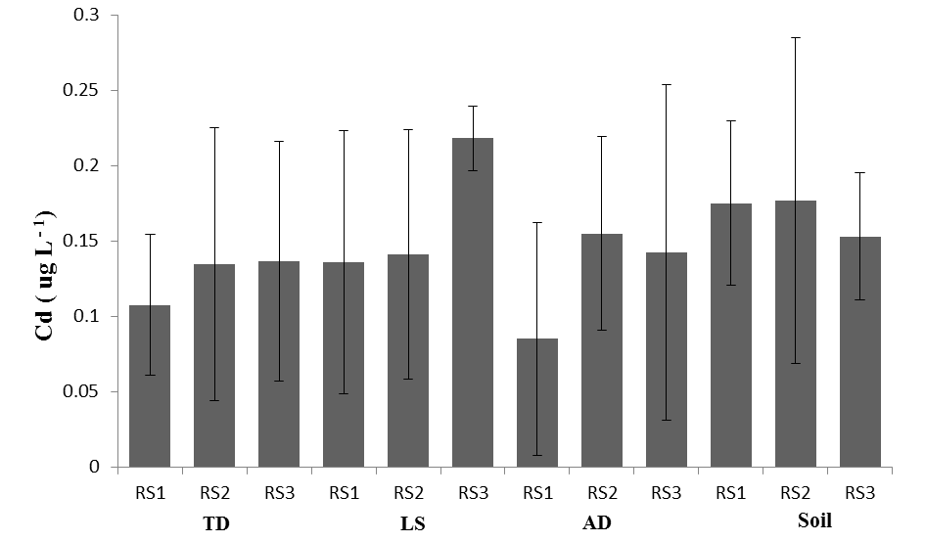
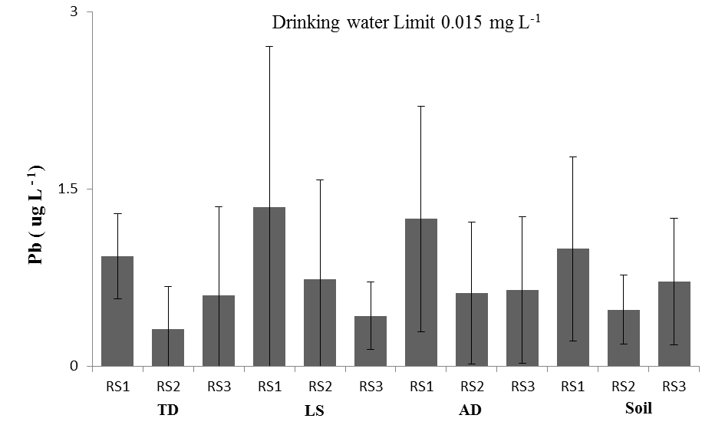
Results
Metal loss in runoff
Drinking water Limit: 0.005 mg L⁻¹
Regulated parameter | Drinking water limit (mg L⁻¹) | Runoff in excess of drinking water limit
Nickel (Ni) | 0.005 | Yes
Copper (Cu) | 2 | Yes
Zinc (Zn) | 5 | Yes
Cadmium (Cd) | 0.005 | Yes
Lead (Pb) | 0.015 | Yes

Slide 16
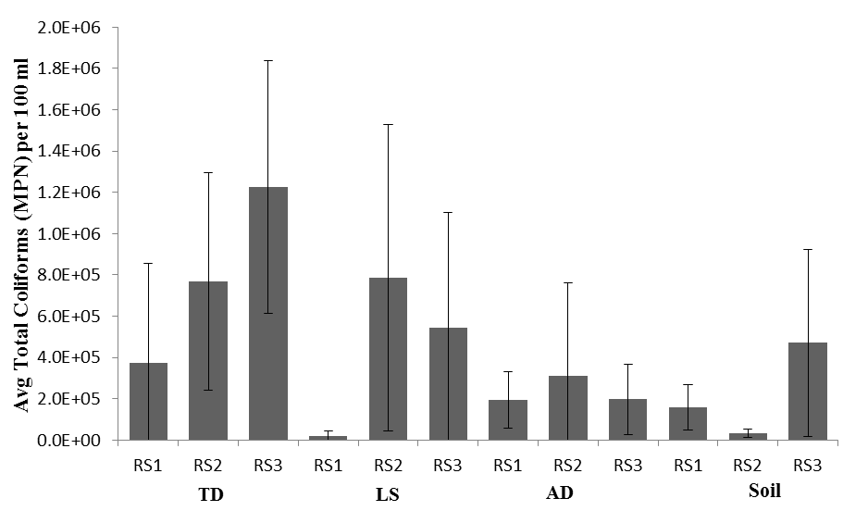
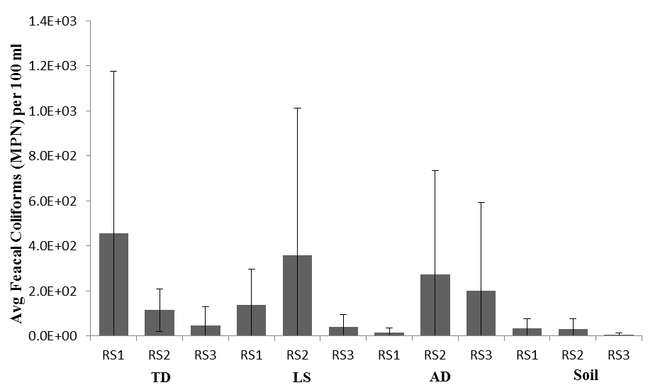
Results
Total and faecal coliform loss in runoff

Slide 17
Conclusions
On the basis of these micro-plot experiments:
High amounts of phosphorus, nitrogen, metals and coliforms (total and faecal) are present in surface runoff up to 10 d after application
However…
Loss in runoff is a ‘worst case’ scenario (no buffer zones)
Losses are low in comparison to organic fertiliser applications
A final important caveat…
Pharmaceutical testing of biocides, present in most biosolids, is ongoing, and may be decisive

