Slide 1




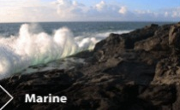

Treatment of agricultural waste using chemical amendments – a summary of 8 years of research
M.G. Healy, O. Fenton
17th International Ramiran Conference, 4 – 6 September, 2017.

Slide 2




Acknowledgements
The PhD and MSc researchers:
Dr Ray Brennan | Dr Con O’ Flynn | Ana Serrenho | Dr John Murnane
Our co-authors:
Prof Gary Lanigan | Dr Jim Grant | Dr David Wall | Dr Paul Wilson
Dr Shane Troy | Cathal Somers | Prof Andrew Sharpley | Dr Paul Murphy
N. Noekstra | Dr Tristan Ibrahim
Our funders:

Slide 3
Publications arising from this work
1. Murnane, J.G., Brennan, R.B., Fenton, O., Healy, M.G. 2016. Zeolite combined with alum and aluminium chloride mixed with agricultural slurries reduces carbon losses in runoff from grassed soil boxes. J. Environ Qual. 44: 1674 – 1683.
2. Murnane, J.G., Brennan, R.B., Healy, M.G., Fenton, O. 2016. Assessment of intermittently loaded woodchip and sand filters to treat dairy soiled water. Water Research 103: 408 – 415.
3. Murnane, J.G., Brennan, R.B., Healy, M.G., Fenton, O. 2015. Use of zeolite with alum and PAC amendments to mitigate runoff losses of P, N and suspended solids from agricultural wastes applied to land. Journal of Environmental Quality 44: 1674 – 1683.
4. Brennan RB, Healy MG, Fenton O, Lanigan GJ. 2015. The effect of chemical amendments used for phosphorus abatement on greenhouse gas and ammonia emissions from dairy cattle slurry: synergies and pollution swapping. PLoS ONE 10(6)
5. Brennan, R.B., Wall, D., Fenton, O., Grant, J., Sharpley, A.N., Healy, M.G. 2014. The impact of chemical amendment of dairy cattle slurry before land application on soil phosphorus dynamics. Commun. Soil Sci. Plant Analy. 45(16): 2215 – 2233.
6.O’ Flynn, C.J., Healy, M.G., Lanigan, G.J., Troy, S.M., Somers, C., Fenton, O. 2013. Impact of chemically amended pig slurry on greenhouse gas emissions, soil properties and leachate. Journal of Environmental Management 128: 690-698.
7. O’ Flynn, C.J., Healy, M.G., Wilson, P., Noekstra, N.J., Troy, S.M., Fenton, O. 2013. Chemical amendment of pig slurry: control of runoff related risks due to episodic rainfall events up to 48 hours after application. Environ. Sci. Poll. Res. 20: 6019 – 6027.
8. Brennan, R.B., Healy, M.G., Grant, J., Ibrahim, T., Fenton, O. 2012. Incidental phosphorus and nitrogen loss from grassland plots receiving chemically amended dairy cattle slurry. Science of the Total Environment 441: 132 – 140.
9. O’ Flynn, C.J., Fenton, O., Wilson, P., Healy, M.G. 2012. Impact of pig slurry amendments on phosphorus, suspended sediment and metal losses in laboratory runoff boxes under simulated rainfall. J. Environ. Manage. 113: 78 – 84.
10. Serrenho, A., Fenton, O., Murphy, P.N.C., Grant, J., Healy, M.G. 2012. Effect of chemical amendments to dairy soiled water and time between application and rainfall on phosphorus and sediment losses in runoff. Sci. Tot. Environ. 430: 1-7.
11. O’ Flynn, C.J., Fenton, O., Healy, M.G. 2012. Evaluation of amendments to control phosphorus losses in runoff from pig slurry applications to land. CLEAN – Soil, Air, Water 40(2): 164-170.
12. Brennan, R.B., Fenton, O., Grant, J., Healy, M.G. 2011. Impact of chemical amendment of dairy cattle slurry on phosphorus, suspended sediment and metal loss to runoff from a grassland soil. Science of the Total Environment 409: 5111-5118.
13. Brennan, R.B., Fenton, O., Rodgers, M., Healy, M.G. 2011. Evaluation of chemical amendments to control phosphorus losses from dairy slurry. Soil Use and Management 27(2): 238-246.

Slide 4
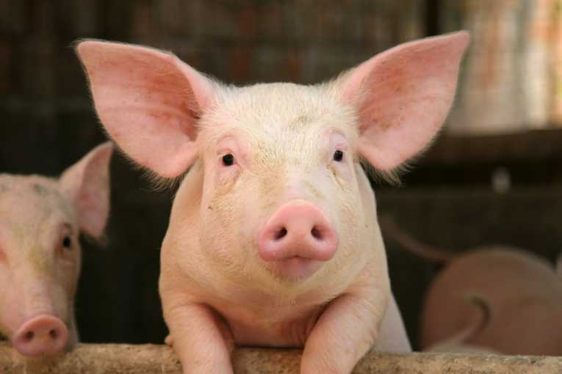
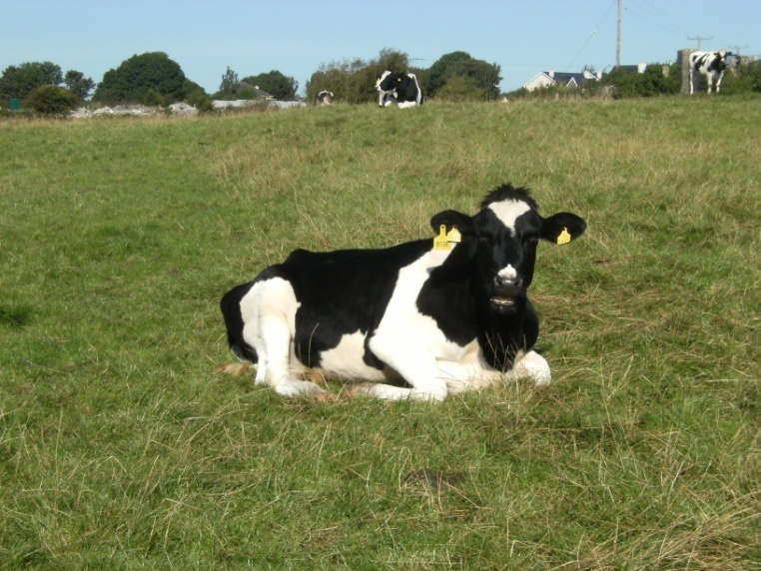
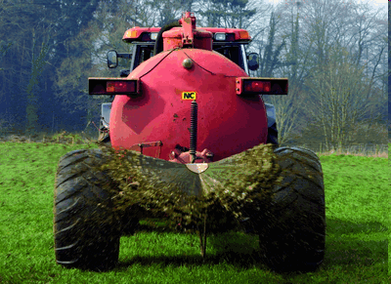

Background
Currently, land application is the most common method for the disposal of slurries and dairy soiled water (DSW)
Land application of dairy and pig slurry, and DSW can result increased loss of phosphorus (P) to runoff
Slurry application can result in a build-up in soil test phosphorus (STP) increasing chronic P loss

Slide 5

Background
  Incidental P losses
    Occur when a rainfall event occurs shortly after slurry application and before fertiliser infiltrates the soil
P
Slurry P
Soil P
P
P
P
P
P
P
P
P
P
P
P
P
P
P
P

Slide 6

Background
Critical Source Area (CSA) for P loss
High P source
High transport
potential

Slide 7
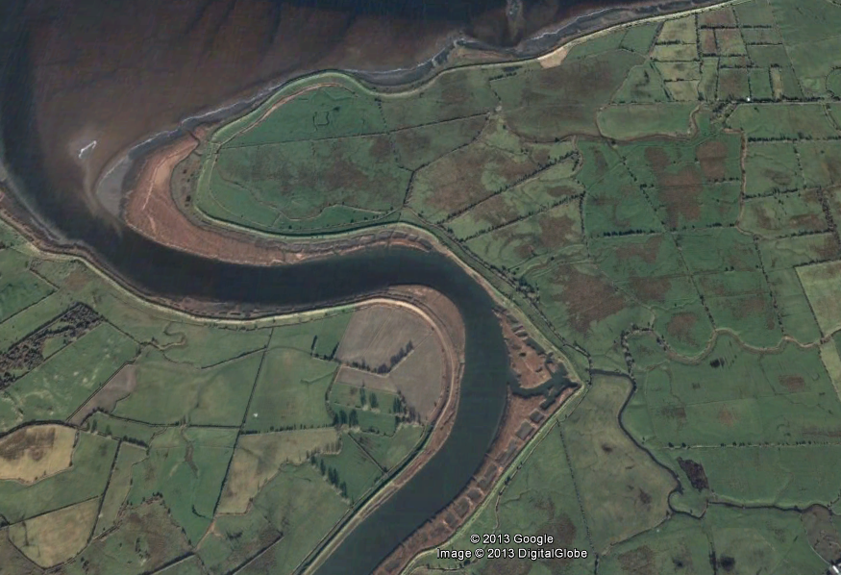
Background
Critical Source Area

Slide 8
Objectives
If farmers have no choice but to spread wastewater in high soil test phosphorus areas, which may be located in a CSA, they may be able to add chemical amendments to wastewater to reduce surface runoff.
The aim of this study was to identify suitable chemical amendments for addition to three types of wastewater
dairy cattle slurry
pig slurry and
dairy soiled water (DSW)
to reduce surface runoff of nutrients in surface runoff.
Phosphorus was initially the main focus

Slide 9
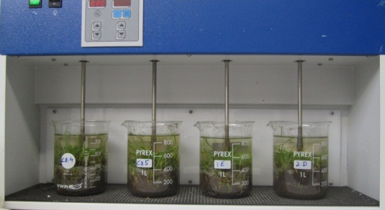
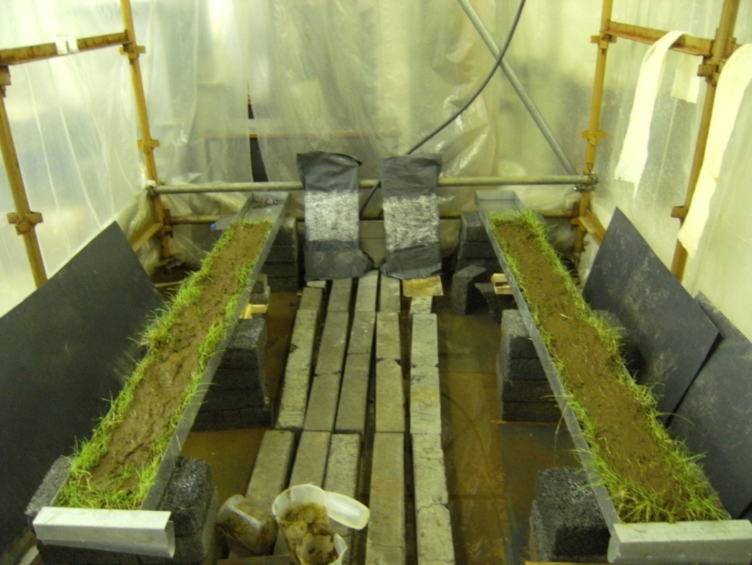
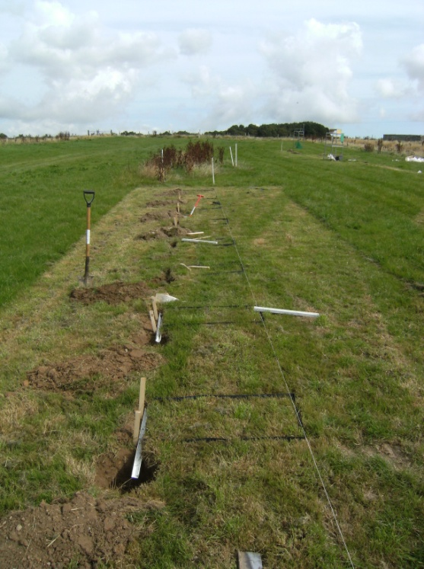

Methodology
Batch-scale tests
Identification of amendments
Determine how much amendments to use per unit volume of wastewater
Laboratory-scale tests
Efficacy of amendments at laboratory-scale
Efficacy of amendments at field plot-scale
Plot and field-scale tests
Efficacy of amendments at field-scale

Slide 10
Methodology
Batch-scale tests
Identification of amendments
Determine how much amendments to use per unit volume of wastewater
Laboratory-scale tests
Other issues to consider in determination of best amendment:
Efficacy of amendments at laboratory-scale
Potential greenhouse gas emissions
Subsurface leaching of nutrients
Impact on chronic (long-term) losses of nutrients
Efficacy of amendments at field plot-scale
Plot and field-scale tests
Efficacy of amendments at field-scale

Slide 11
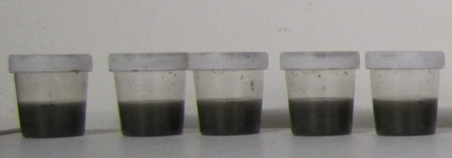
Methodology
Batch-scale tests
Aims:
Identify the most effective amendments to reduce the solubility of P in the wastewater
Identify optimum application rates
Select amendments most suitable for further examination (some may work well, but may cost too much)
‘Stoichometric Tests’
Amount expressed as ratio of weight of amendment to weight of TP
Wastewater

Slide 12
Methodology
Batch-scale tests
Aims:
Identify the most effective amendments to reduce the solubility of P in the wastewater
Identify optimum application rates
Select amendments most suitable for further examination (some may work well, but may cost too much)

Slide 13
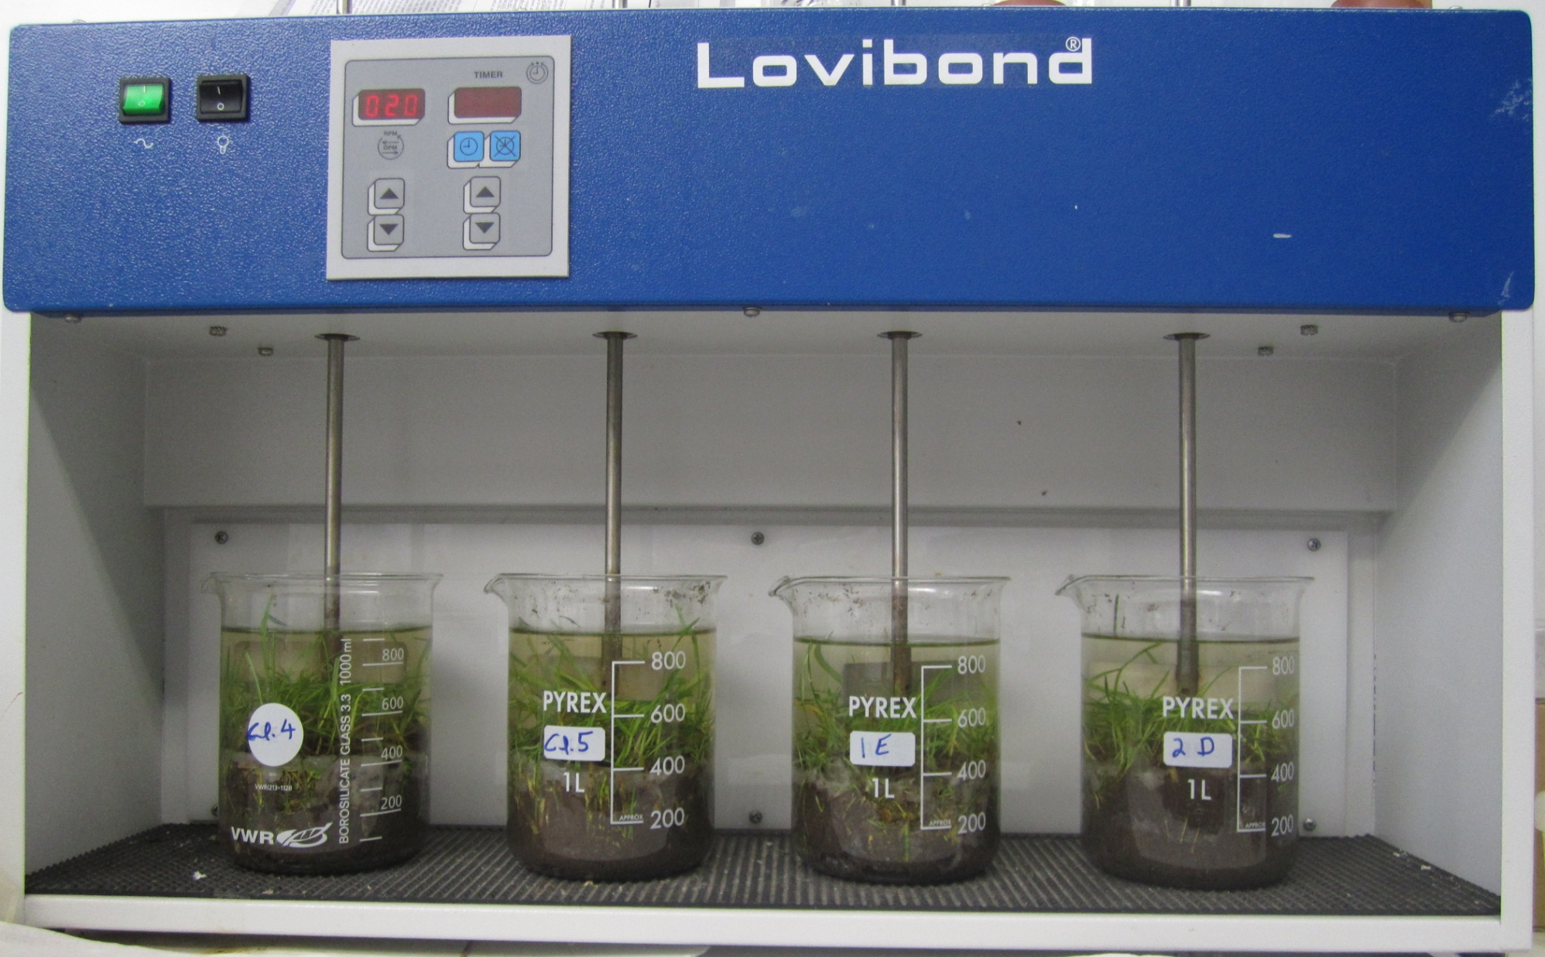

Slide 14
Methodology
Batch-scale tests
Aims:
Identify the most effective amendments to reduce the solubility of P in the wastewater
Identify optimum application rates
Select amendments most suitable for further examination (some may work well, but may cost too much)

Slide 15
Results
Batch-scale tests
Most effective amendments identified by the batch-scale tests
Pig slurry¹ | Dairy cattle slurry² | Dairy soiled water³
Alum
Poly-aluminium chloride
Ferric chloride (FeCl₃)
Lime
¹ O’ Flynn, C.J., Fenton, O., Healy, M.G. (2012) CLEAN – Soil, Air, Water 40: 164-170.
² Brennan, R.B., Fenton, O., Rodgers, M., Healy, M.G. (2011) Soil Use Manage 27: 238-246.
³ Fenton, O., Serrenho, A., Healy, M.G. (2011) Water, Air Soil Poll 222: 185-194.

Slide 16
Results
Batch-scale tests
Most effective amendments identified by the batch-scale tests
Pig slurry¹ | Dairy cattle slurry² | Dairy soiled water³
Alum | Alum
Poly-aluminium chloride | Poly-aluminium chloride
Ferric chloride (FeCl₃) | Ferric chloride (FeCl₃)
Lime | Lime
 | Aluminium-based sludge
 | Flue-gas desulfurization by-product (FGD)
¹ O’ Flynn, C.J., Fenton, O., Healy, M.G. (2012) CLEAN – Soil, Air, Water 40: 164-170.
² Brennan, R.B., Fenton, O., Rodgers, M., Healy, M.G. (2011) Soil Use Manage 27: 238-246.
³ Fenton, O., Serrenho, A., Healy, M.G. (2011) Water, Air Soil Poll 222: 185-194.

Slide 17
Results
Batch-scale tests
Most effective amendments identified by the batch-scale tests
Pig slurry¹ | Dairy cattle slurry² | Dairy soiled water³
Alum | Alum | Alum
Poly-aluminium chloride | Poly-aluminium chloride
Ferric chloride (FeCl₃) | Ferric chloride (FeCl₃) | Ferric chloride (FeCl₃)
Lime | Lime | Lime
 | Aluminium-based sludge | Bottom ash
 | Flue-gas desulfurization by-product (FGD)
¹ O’ Flynn, C.J., Fenton, O., Healy, M.G. (2012) CLEAN – Soil, Air, Water 40: 164-170.
² Brennan, R.B., Fenton, O., Rodgers, M., Healy, M.G. (2011) Soil Use Manage 27: 238-246.
³ Fenton, O., Serrenho, A., Healy, M.G. (2011) Water, Air Soil Poll 222: 185-194.

Slide 18
Methodology
Batch-scale tests
Identification of amendments
Determine how much amendments to use per unit volume of wastewater
Laboratory-scale tests
Efficacy of amendments at laboratory-scale
Efficacy of amendments at field plot-scale
Plot and field-scale tests
Efficacy of amendments at field-scale

Slide 19
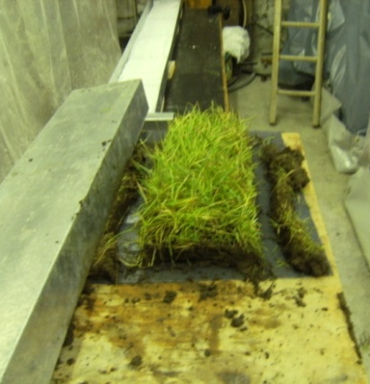
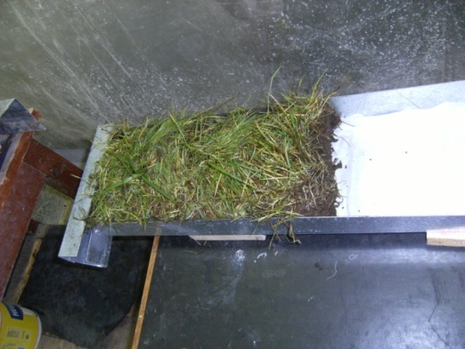
Laboratory-scale study
Runoff-box experiment designed to examine effectiveness of chemical amendments, identified at bench-scale, under more ‘realistic’ conditions
Examined incidental losses of phosphorus

Slide 20
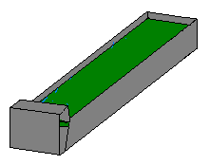
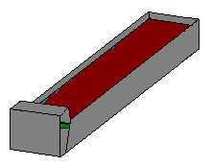
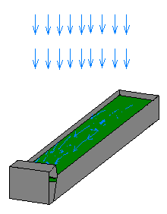
Laboratory-scale study
t= -24 hr Pack runoff boxes, then saturate and allow to drain and reach approx. field capacity
t=0 hr Apply slurry
Rainfall simulation:
Intensity 11.5 ± 1mm hr⁻¹
Three 30-min rainfall simulations conducted on each runoff box
t=48 hr RS 1
t=72 hr RS 2
t=96 hr RS 3
24 hr interval
24 hr interval

Slide 21

SLOPED RUNOFF BOXES
GRASS SOD
AMENDED
SLURRY
1 m
0.225 m
Notes:
21
SOIL FLUME SLURRY AMENDMENT RAINFALL SLOPE RUNOFF

Slide 22
O’ Flynn et al. 2012. J Env Man 113: 78-84.
Dissolved reactive P

Slide 23
Results
Laboratory-scale tests
Most effective amendments identified by the batch-scale tests
Pig slurry¹ | Dairy cattle slurry² | Dairy soiled water³
Alum | Alum | Alum
Poly-aluminium chloride | Poly-aluminium chloride
Ferric chloride (FeCl₃) | Ferric chloride (FeCl₃) | Ferric chloride (FeCl₃)
Lime | Lime | Lime
 | Aluminium-based sludge | Bottom ash
 | Flue-gas desulfurization by-product (FGD)
¹ O’ Flynn, C.J., Fenton, O., Wilson, P., Healy, M.G. (2012) J. Environ Manage 113: 78-84
² Brennan, R.B., Fenton, O., Grant, J., Healy, M.G. (2011) Sci Tot Environ 409: 5111-5118
³ Serrenho, A., Fenton, O., Murphy, P., Grant, J. Healy, M.G. (2012) Sci Tot Env 430: 1-7.

Slide 24
Results
Laboratory-scale tests
Pig slurry¹ | Dairy cattle slurry² | Dairy soiled water³
Alum | Alum | Alum
Poly-aluminium chloride | Poly-aluminium chloride
Ferric chloride (FeCl₃) |  | Ferric chloride (FeCl₃)
¹ O’ Flynn, C.J., Fenton, O., Wilson, P., Healy, M.G. (2012) J. Environ Manage 113: 78-84
² Brennan, R.B., Fenton, O., Grant, J., Healy, M.G. (2011) Sci Tot Environ 409: 5111-5118
³ Serrenho, A., Fenton, O., Murphy, P., Grant, J. Healy, M.G. (2012) Sci Tot Env 430: 1-7.

Slide 25
Methodology
Batch-scale tests
Identification of amendments
Determine how much amendments to use per unit volume of wastewater
Laboratory-scale tests
Efficacy of amendments at laboratory-scale
Efficacy of amendments at field plot-scale
Plot and field-scale tests
Efficacy of amendments at field-scale

Slide 26

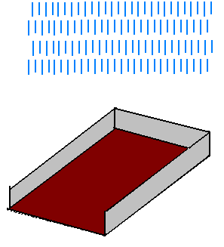

Plot-scale study
Plot isolated using PVC sheeting (50 mm below soil surface)
Rainfall simulators used to apply rain 2, 10 and 28 days after slurry application date
Intensity 10.5 mm hr⁻¹
Slurry applied at 33 m³ ha⁻¹

Slide 27
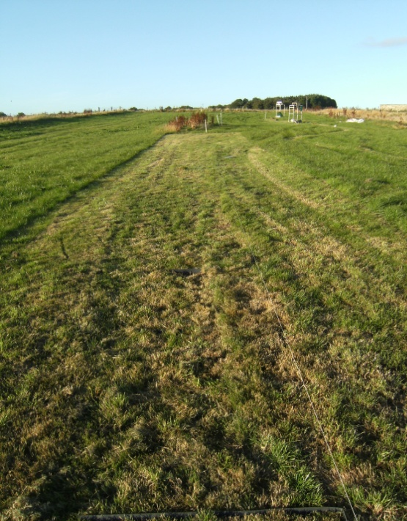
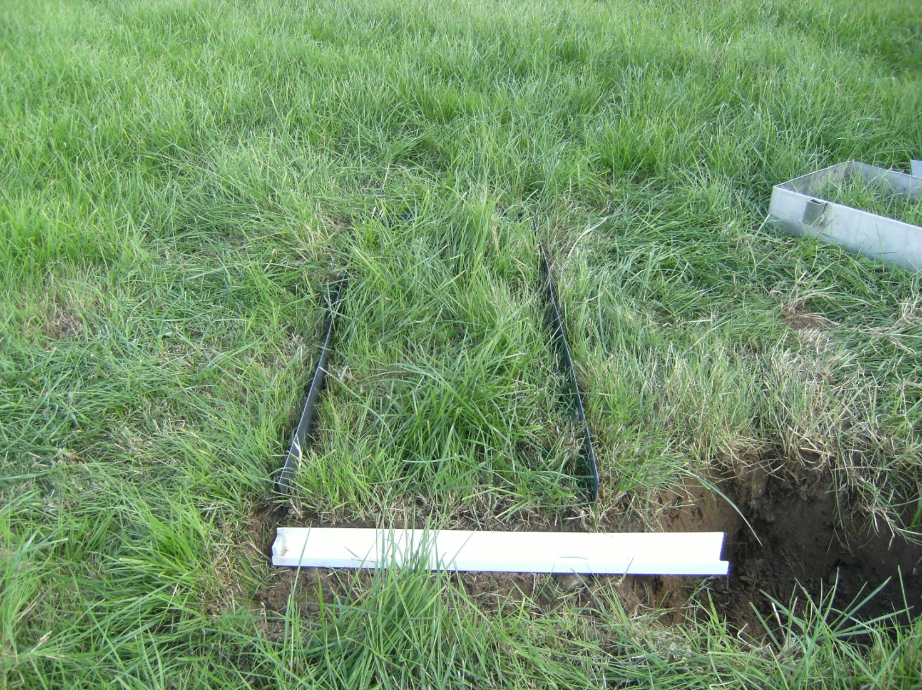
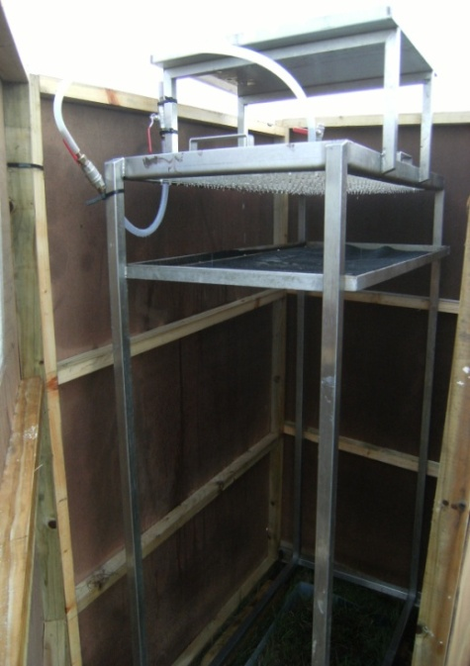

Slide 28
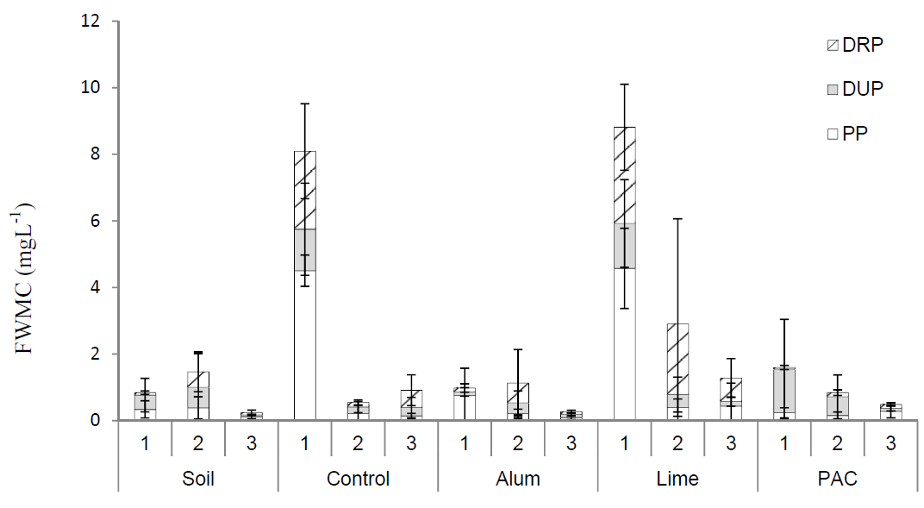
Phosphorus in runoff from dairy cattle slurry
Brennan et al. 2012. Sci Tot Env 441: 132-140.

Slide 29
Results
Field plot-scale tests
Pig slurry | Dairy cattle slurry¹ | Dairy soiled water
Alum | Alum | Alum
Poly-aluminium chloride | Poly-aluminium chloride
Ferric chloride (FeCl₃) |  | Ferric chloride (FeCl₂)
Lime |  | Lime
 |  | Bottom ash
¹ Brennan, R., Healy, M.G., Grant, J., Ibrahim, T.G., Fenton, O. (2012) Sci Tot Env 441: 132-140

Slide 30
Results
Field plot-scale tests
Pig slurry | Dairy cattle slurry¹ | Dairy soiled water
Alum |  | Alum
Poly-aluminium chloride | Poly-aluminium chloride
Ferric chloride (FeCl₃) |  | Ferric chloride (FeCl₂)
Lime |  | Lime
 |  | Bottom ash
¹ Brennan, R., Healy, M.G., Grant, J., Ibrahim, T.G., Fenton, O. (2012) Sci Tot Env 441: 132-140

Slide 31
Results
Field plot-scale tests
Taking into account GHG emissions¹, subsurface leaching², long-term impact²
Pig slurry | Dairy cattle slurry¹ | Dairy soiled water
 |  | Alum
Poly-aluminium chloride | Poly-aluminium chloride
¹ Brennan RB, Healy MG, Fenton O, Lanigan GJ. 2015. PLoS ONE 10(6)
² Brennan, R.B., Wall, D., Fenton, O., Grant, J., Sharpley, A.N., Healy, M.G. 2014. Soil Sci. Plant Analy. 45(16): 2215 – 2233.

Slide 32
Evolution of study focus to include parameters other than phosphorus
Can the amendments, which are capable of reducing phosphorus in runoff, be mixed with some other amendment to also reduce nitrogen in runoff?
2. If so, what are the impacts on carbon in runoff?
Why carbon?
When carbon-rich water is treated in water treatment plants, trihalomethanes (THMs) may be formed.

Slide 33
Results
Pig slurry | Dairy cattle slurry¹ | Dairy soiled water
 |  | Alum
Poly-aluminium chloride | Poly-aluminium chloride
+ zeolite
+ zeolite
+ zeolite

Slide 34
Nitrogen
Murnane et al. 2015. Journal of Environmental Quality 44: 1674 – 1683.
Soil
Dairy slurry
Pig slurry
DSW
TN↓13%
NH₄-N no change
TN↓45%
NH₄-N↓47%
TN↓57%
NH₄-N↓87%
TN↓8%
NH₄-N↓32%
TN↓45%
NH₄-N↓73%

Slide 35
Carbon
Murnane et al. 2016. J. Environ Qual. 44: 1674 – 1683.
Soil
Dairy slurry
Pig slurry
DSW
TOC↓52%
TOC↓16%
TOC↓76%
TOC↓56%
TOC↓65%
TOC↓51%
Histogram of FWMC for TC in runoff

Slide 36
Conclusions
The following amendments were found to be effective in the removal of phosphorus, nitrogen and carbon from wastewater:
Pig slurry | Dairy cattle slurry | Dairy soiled water
Poly-aluminium chloride +zeolite | Poly-aluminium chloride + zeolite | Alum + zeolite
Due to their high cost, their incorporation into existing management practices can only be justified on a targeted basis.
It is prudent for farmers to adhere, whenever possible, to the 48-h rule to reduce the risk of surface runoff of nutrients and sediment.

Slide 37
Further information
See:
www.nuigalway.ie/gene/
Or contact:
Dr Mark Healy
NUI Galway
Email: mark.healy@nuigalway.ie
Prof Owen Fenton
Teagasc
Email: owen.fenton@teagasc.ie

