Slide 1


Full spectrum care,
for a full spectrum life.

Slide 2


A manager’s guide to the
Employee Assistance Programme.

Slide 3

What do you have access to?
Employee Assistance Service (EAS)
Wellbeing Platform
and App.
In-the-moment support 24/7/364, Psychoeducation and coping skills, Up to 6 counselling sessions where clinically appropriate, Signposting to specialised supports with interim support.
A customised, digital platform delivering expert content on mental wellbeing, fitness and nutrition, in addition to a step counter and a calorie tracker.
For example, through the Platform, you will be able to access various Mental Health elearning courses that educates, informs and empowers you in various aspects of mental wellbeing.
Online CBT
Access to clinically led online Cognitive Behavioural Therapy pathways to expand access, drive engagement and increase recovery.

Slide 4

How do I access
the EAS service?
Accessible 24/7, 365 days a year.
A completely free and
confidential service available via:
Freephone:
1800 814 243
WhatsApp:
Text ‘Hi’ to 087 369 0010
SMS
Text ‘Hi’ to 087 145 2056
(standard rates apply)
You can Live Chat or Request a Call Back on the wellbeing portal and phone app
Register Here: URL HERE
Organisation code: CODE HERE

Slide 5

Who will you speak with on the initial telephone call?
Fully qualified and experienced counsellors, who can offer immediate telephone support.
Each case is handled by one of our counsellors who will become your dedicated Case Manager from start to finish.
On the initial call, the Case Manager will collect your details, discuss the issue you are facing and complete a quick assessment, taking approximately 30 minutes. This is also known as the triage process.
The Case Manager will then match the employee with the most appropriate service.

Slide 6

Short-Term Counselling:
How does it work?
Where appropriate, person may be referred to counselling through the EAS following the triage process with the Case Manager.
When a person is referred to workplace they will be provided with up to 6 sessions of counselling, where appropriate.
Our expansive team is spread throughout the Island of Ireland, so a person may be matched with a counsellor within 30km of their home or workplace, where appropriate.
Our counsellors have a wide range of clinical specialties, meaning a person can be matched with someone experienced in dealing with their specific issue.
After being referred, a person’s appointment will be confirmed within 24 hours and scheduled within 5 days of initial contact.
Our team of counsellors speak more than a 33 different languages. Therefore, we can deliver the counselling services in multiple languages.*

Slide 7

How does the EAS support managers?
We offer access to guidance and expertise, where our counsellors can support managers when approaching employee issues where there is an emotional component causing you concern.
Providing guidance in recognising problems at an early stage and support in dealing with difficult employees and complex issues.
Reduces management/HR time spent on employee problems.
Can provide awareness of common issues through statistical feedback and reporting.

Slide 8
Some example of how the EAS can help a manager:
Advice around discipline and grievance issues or employee performance issues.
Referring employees
to the EAS.
Helping employees
with issues at home.
Emotional interviews
with team members.
Managing change
within the team.
Breaking bad news
to employees.
Advice on your own emotional wellbeing.

Slide 9

How do I refer a member of my team to the EAS?
Encourage them to reach out directly to
the EAS.
Or:
Complete the Manager Referral Form.
(please contact HR for a copy of this)
Have the employee sign the form to confirm consent.
Email a copy of the Manager Referral Form to managementreferrals@spectrum.life.
Employee will be called within 48 hours.
This will be confirmed with you.

Slide 10
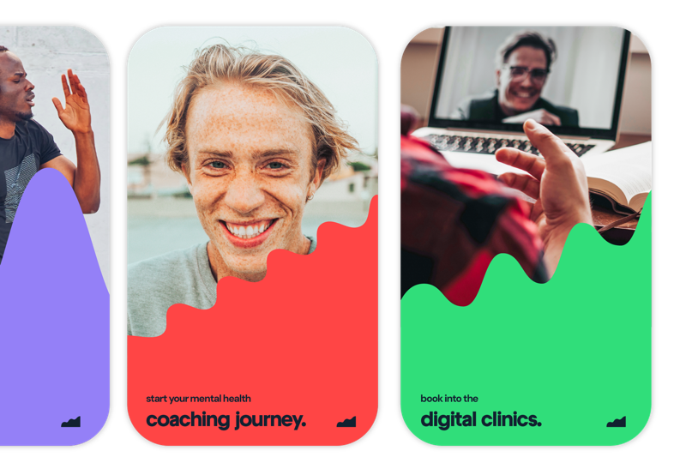
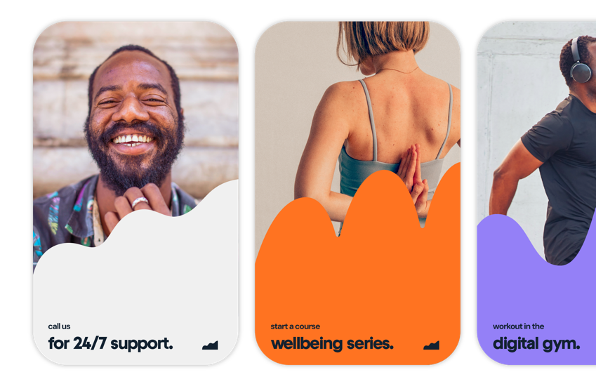
Your Wellbeing Platform and App!
What do you have access to?
Access the EAS directly through the wellbeing portal (desktop) and app (phone/tablet)
Supplying: Freephone number, text and WhatsApp number, Live chat function, request a call back function and email address.
Step and calorie counter.
Mental wellbeing, fitness and nutrition resources.
E-learning modules.
Informative blog articles on all aspects of wellbeing.
On demand webinars.
Book and attend wellbeing events.

Slide 11
Reach out to your EAS today for advice.
Freephone:
1800 814 243
WhatsApp:
Text ‘Hi’ to 087 369 0010
SMS
Text ‘Hi’ to 087 145 2056
(standard rates apply)
You can Live Chat or Request a Call Back on the wellbeing portal and phone app
Register Here: URL HERE
Organisation code: CODE HERE

Slide 12

Full spectrum care,
for a full spectrum life.

