Slide 1




Quit Smoking West
Marie Cuddy Health Promotion and Improvement Officer
North & West Galway City Enhanced Community Care

Slide 2
Overview
Overview
Are Smoking and second hand smoke still a problem in Ireland?
What about e-cigarettes?
What’s the best way to stop smoking?
What can Quit Smoking West offer?

Slide 3

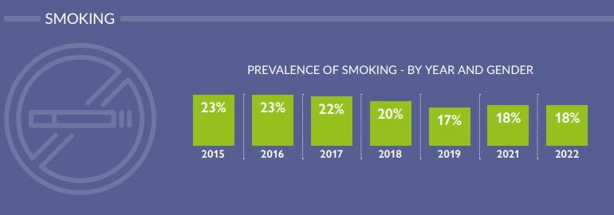

Tobacco Control in Ireland
BOLD AMBITION
Declining population prevalence of smoking
5% prevalence 2025

Slide 4

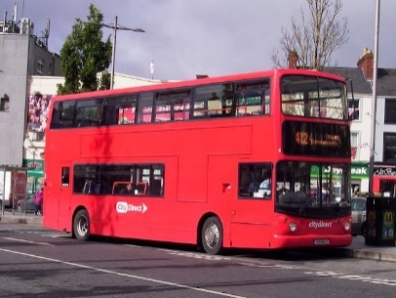


Tobacco Control in Ireland Job Done?
Over 100 deaths/week
Stalling and well of track
X
5% prevalence 2025
1000 hospitalizations/week
A. Sheridan, K.I. Quintyne, P. Kavanagh. Counting the Toll of Smoking-Attributable Hospitalisations. 2020. Ir Med J; Vol 113; No. 1

Slide 5

Annual Impact of Tobacco Use in Ireland
6,000
Deaths a Year
55%
of all Litter is Cigarette Related Litter
21,486
Day Case Admissions
€460 Million
Cost to the Health Service
33,615
Inpatient Hospital Admissions
309,117
Bed Days Used
A. Sheridan, K.I. Quintyne, P. Kavanagh. Counting the Toll of Smoking-Attributable Hospitalisations. 2020. Ir Med J; Vol 113; No. 1

Slide 6

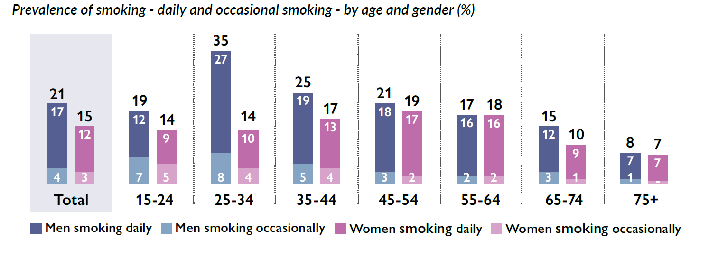
Smoking in the Irish Context
Smoking rates Unemployment 39% Employment 19%
46% of smokers attempted to Quit last year. 23% successfully Quit smoking.
Healthy Ireland Survey 2022

Slide 7
Health Impact of Smoking
Tobacco use is the leading cause of preventable death in Ireland with almost 6,000 smokers dying each year from tobacco related diseases.
Smoking related deaths are mainly due to cancers, chronic obstructive pulmonary diseases (COPD) and heart disease.
If you are a long-term smoker, on average, your life expectancy is about 10 years less than a non-smoker.
www.hse.ie/eng/about/who/tobaccocontro/kf

Slide 8
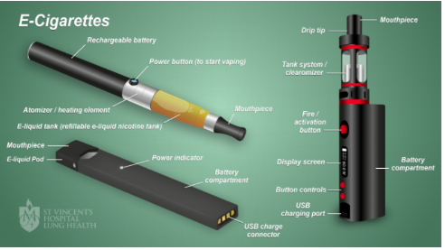
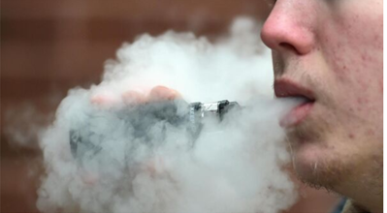
What about e-cigarettes?
Battery operated devices that heat a liquid to produce a vapour that people inhale.
Inhaling this vapour is referred to as ‘vaping’
38% of smokers trying to quit use e-cigs as part of their attempts (Oireachtas Report, 2020)
The HSE promotes the use of Nicotine Replacement Therapy (NRT) products that are recommended and tested. (HSE 2021)

Slide 9

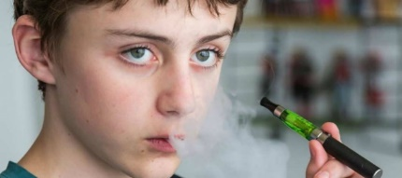
Evidence Base
Risks
Lung disease risk – studies have shown that using e-cigarettes is linked to lung disease, potentially caused by the vapour and flavourings
Cardiovascular risk – studies have shown that e-cigarettes impair blood vessel function and users are more likely to have a heart attack or stroke
E-cigarettes produce toxins and chemicals such as formaldehyde which is known to cause cancer.
The Health Products Regulatory Authority does not authorise e-cigarettes.
Young People who use an e –cigarette are 3-5 times more likely to start smoking (HRB) than those who never used e-cigs
Bill proposing a total ban on e-cigarettes s for under 18.
Claims that e-cigarettes are safer than traditional cigarettes are not proven
St Vincent’s Lung Health 2022, Health Research Board

Slide 10
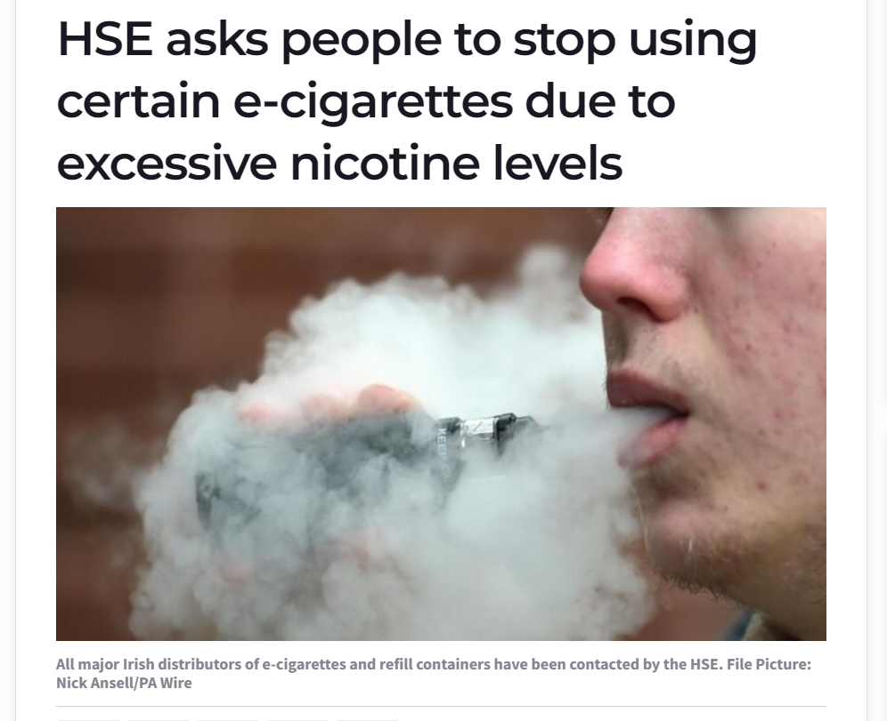
46 samples of a disposable e-cigs were examined and found to have a higher nicotine concentration than is permitted (50.4mg/ml). The declared nicotine concentration on the packaging was 20mg/ml. which is the max nicotine concentration that can be used.
Found to be non- compliant with EU tobacco legislation.
(Irish Examiner, 2022)

Slide 11
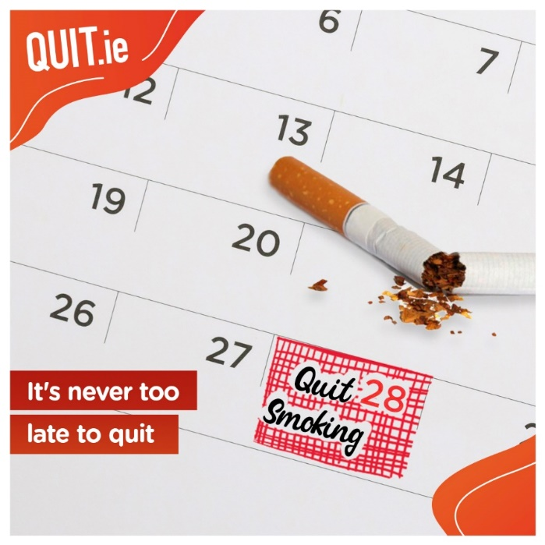
What is the best way to stop Smoking
2 – 3 people who smoke want to stop
46% of smokers have attempted to quit in the past 12 months (23% were successful)
BUT
Too many quit alone without help
Behaviour Support
Nicotine Replacement Therapy (NRT)
3-4 fold increase chance of successful Quit

Slide 12

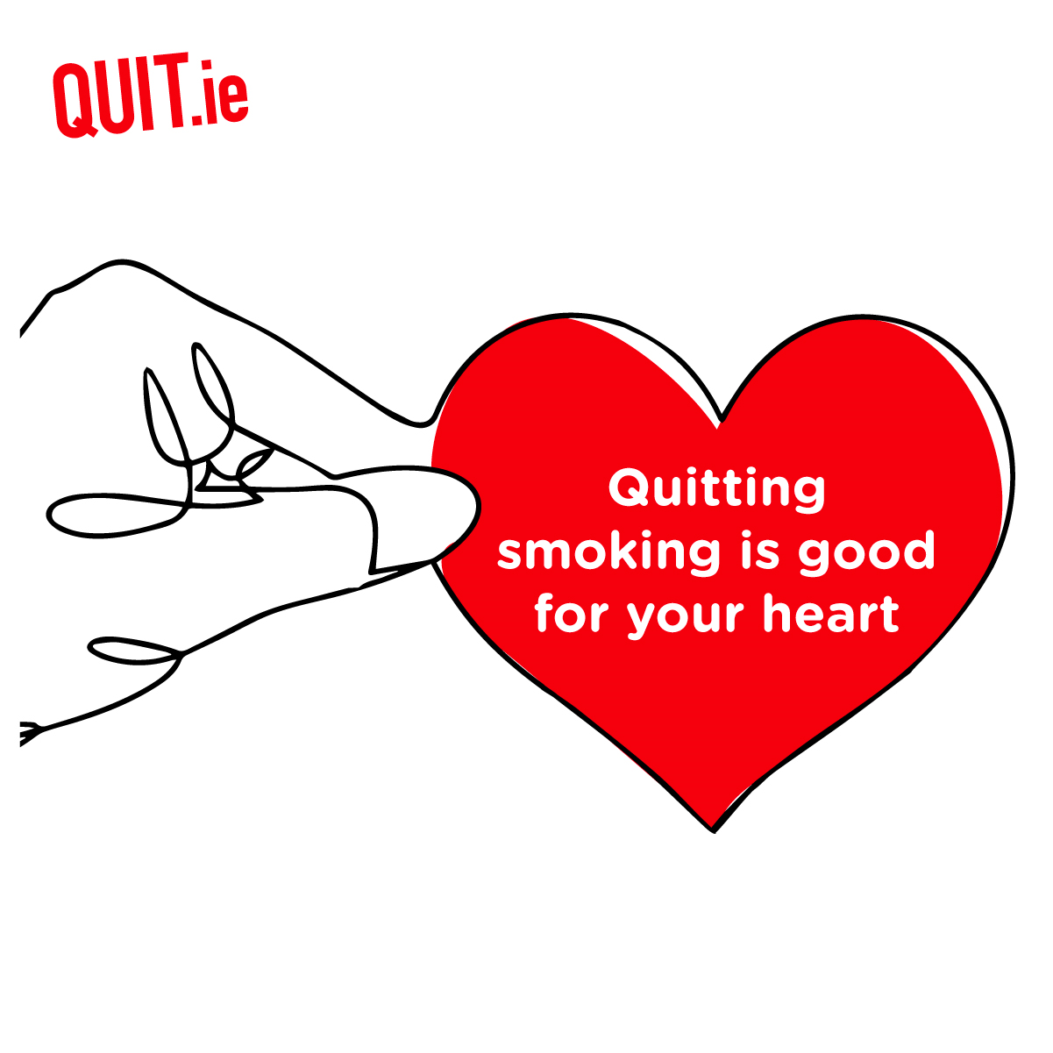
Carbon Monoxide leave body after 24 hours
Improved taste and smell
After 3 days Improved breathing and circulation (risk of heart attack decreases)
After 1 year – risk of heart attack drops by half
After 5 years risk of smoking related cancers greatly reduced
10 years risk of sudden heart attack, stroke and risk of cancer drops significantly

Slide 13
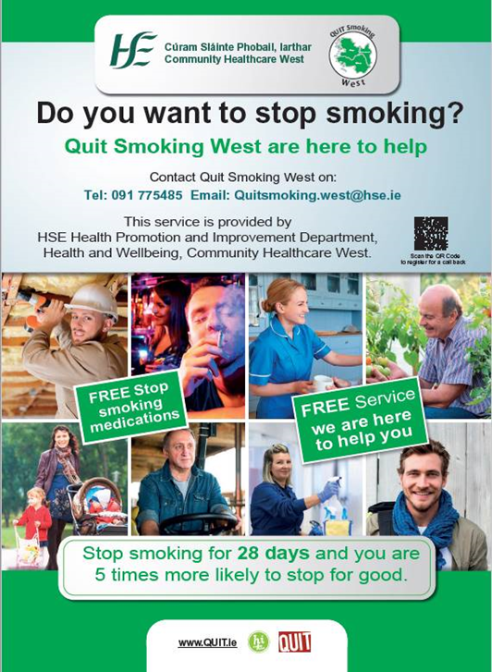
QUIT Smoking West
Free confidential service
Support via phone or our in person clinics
Support includes assess levels of smoking addiction, provide information on NRT, set a quit date
FREE Nicotine Replacement Therapy
Text in Arial Bold
24 point text
Text in Arial Bold
16 point text
500
Text in Arial Bold
16 point text

Slide 14
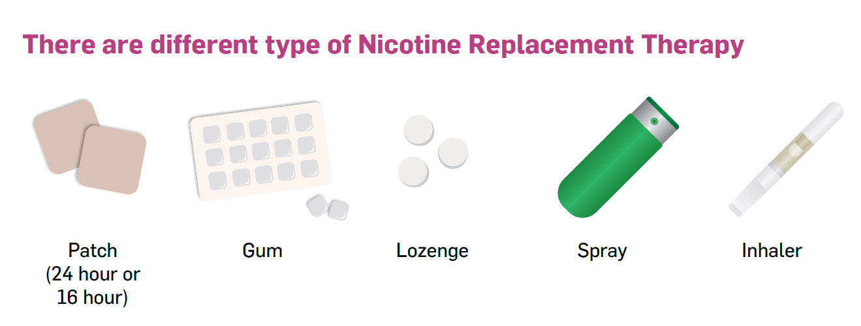
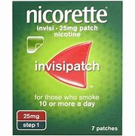
Slow release nicotine- choose one
Quick release nicotine- choose one

Slide 15







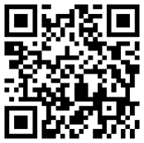

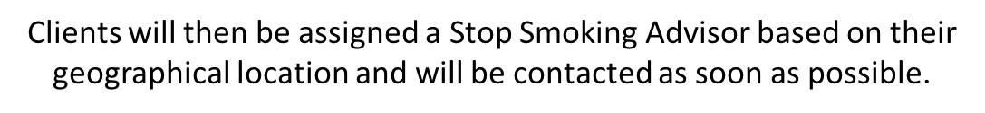
Email Quitsmoking.west@hse.ie
Phone 091 775 485
Complete a short online form

