Slide 1
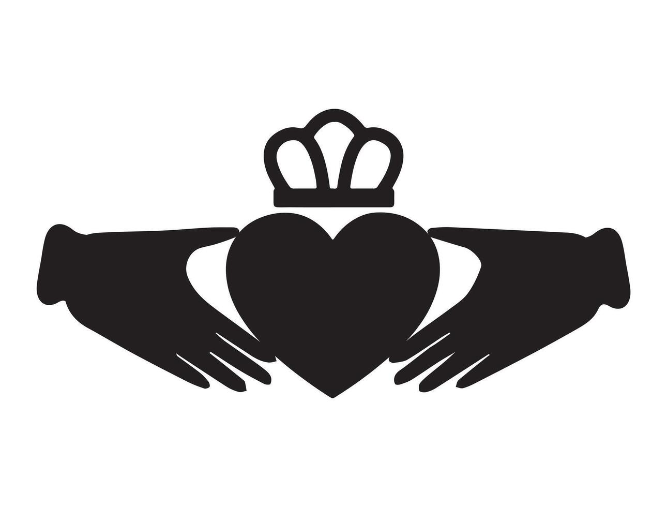
The Claddagh: Symbol of Galway
Notes:
Great — here’s your full 2–3 minute Claddagh presentation script with the hook, story, and closing loop:
Claddagh Orientation Presentation
“You’ve all just received a keyring with a very special symbol on it — the Claddagh. That little design of hands, a heart, and a crown comes from right here in Galway, and it tells a story of friendship, love, and loyalty that has travelled all over the world.
The Claddagh itself is one of Galway’s oldest areas, just across the river from the Spanish Arch. Long before it became part of the city, it was a fishing village with its own way of life. People lived in thatched cottages, and the community even had its own elected leader, known as the King of the Claddagh.
The Claddagh is best known for the Claddagh ring. The design is simple but powerful: the hands represent friendship, the heart is for love, and the crown stands for loyalty. Traditionally, how you wore the ring told your relationship status — on different hands, facing in or out. Over time, this small ring became a worldwide symbol of connection to Galway.
Today, the Claddagh is a modern neighbourhood, but it still keeps that sense of history and community. If you walk down there, you’ll see beautiful views across the Corrib and the Long Walk — a perfect spot for a stroll or photos.
So when you visit the Claddagh, you’ll see where that symbol on your keyring comes from. Hopefully it reminds you not just of Galway’s history, but also of the values of friendship, love, and loyalty to carry with you during your time here — and beyond.”
Would you like me to also create a one-paragraph super-short backup version (about 45 seconds) in case you need to speed things up?

Slide 2
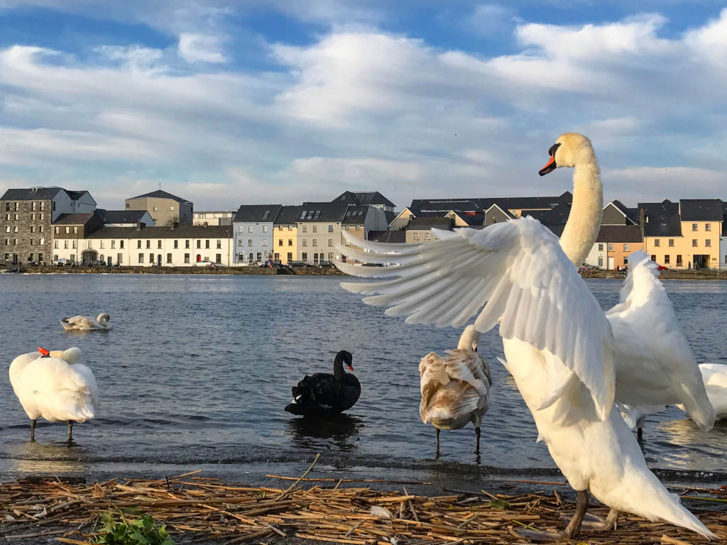
The Claddagh: The Place
The Claddagh was once a fishing village across the River Corrib.
It had its own customs, language, and even elected a 'King of the Claddagh'.
Fishing and traditional hooker boats were central to life here.

Slide 3
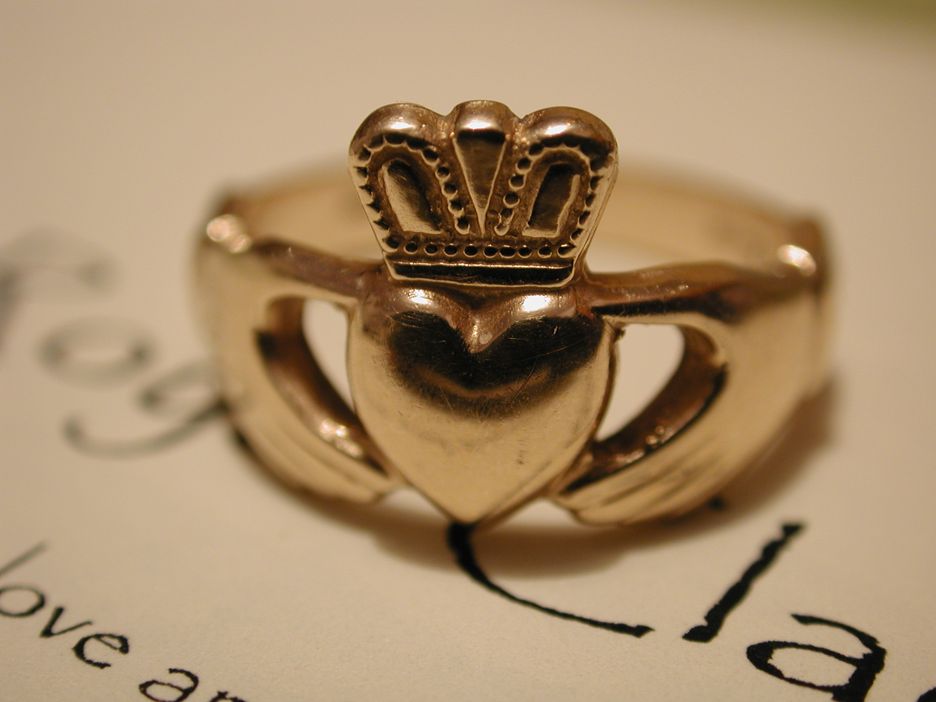
The Claddagh: The Ring
The Claddagh ring dates back over 300 years.
Its design: hands (friendship), heart (love), and crown (loyalty).
Traditionally, how you wear it shows your relationship status.
[Insert Image of Claddagh Ring Here]

Slide 4
