Slide 1

English Language Centre

Slide 2

Who’s Who in ELC
Dr. Maeve Egan – ELC Manager
Paul Williamson – Senior EAP Teacher
Alan O’Connor – EAP Teacher
Anne O’Brien – EAP Teacher
Robert Hanley – EAP Teacher

Slide 3


What does the ELC Offer?
Mix of international students from undergraduate and postgraduate
90 minute classes
FREE!!
Classes available Monday to Friday
Classes start
January 12th

Slide 4
Writing with Impact
Look at different areas of academic writing
There can be big differences between IELTS/Cambridge and essay writing
Examine other areas of formal and informal writing – emails, workplace etc.
Connected to the University Skills Passport

Slide 5
English for Global Communication
Proficiency is not compulsory!
Communication focused classes – be ready to speak!
Strong focus on academic speaking skills and everyday speaking skills (Irish lingo!)
Connected to the University Skills Passport

Slide 6
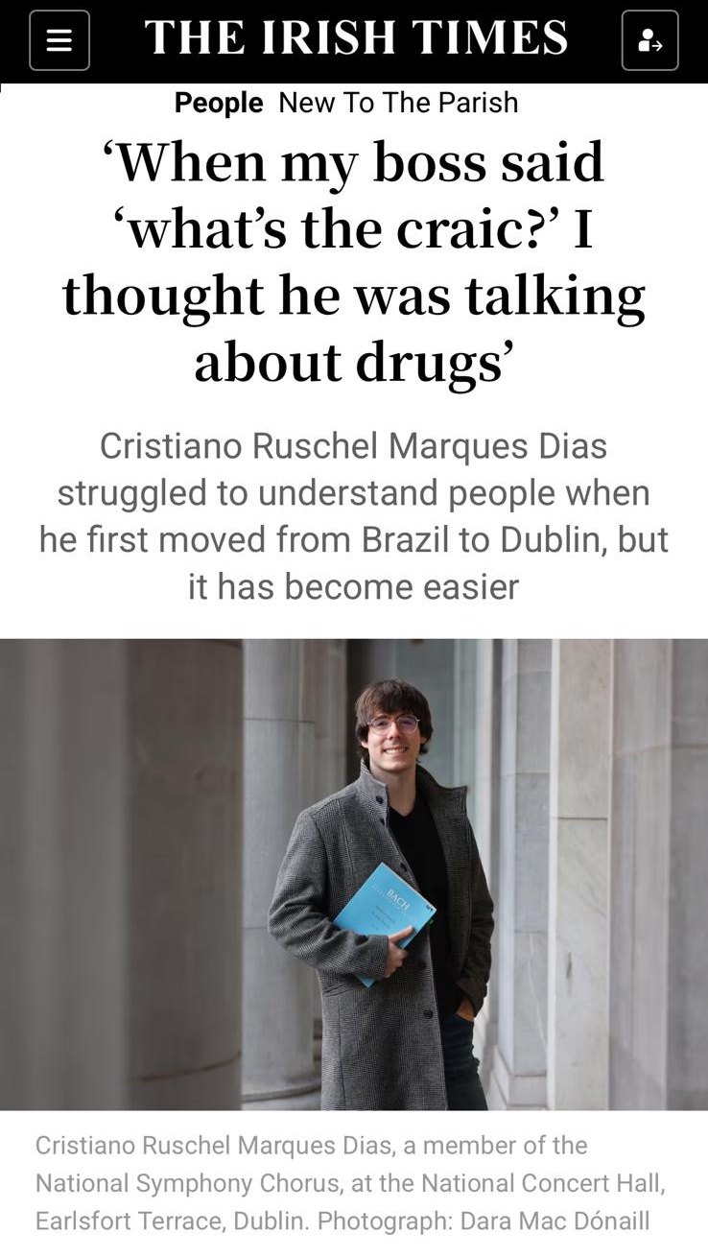
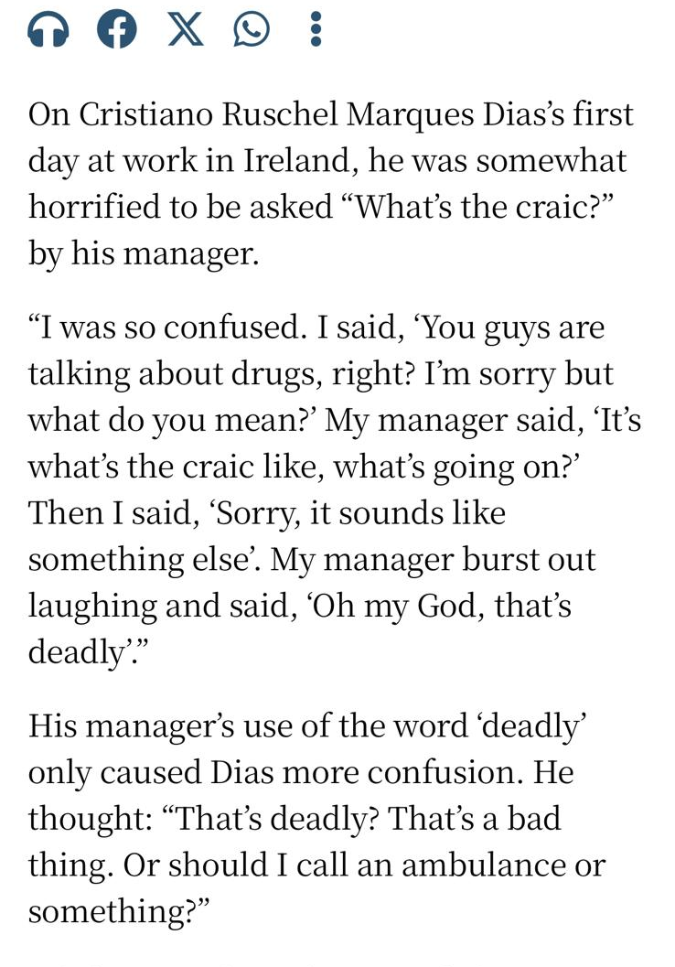
English for Global Communication

Slide 7
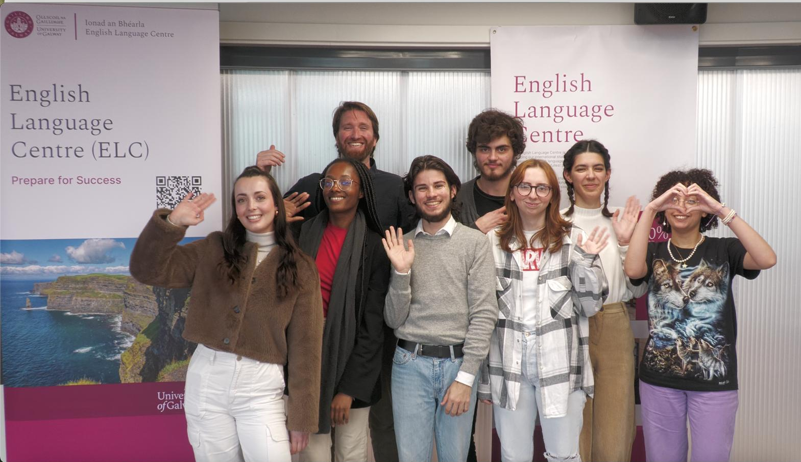
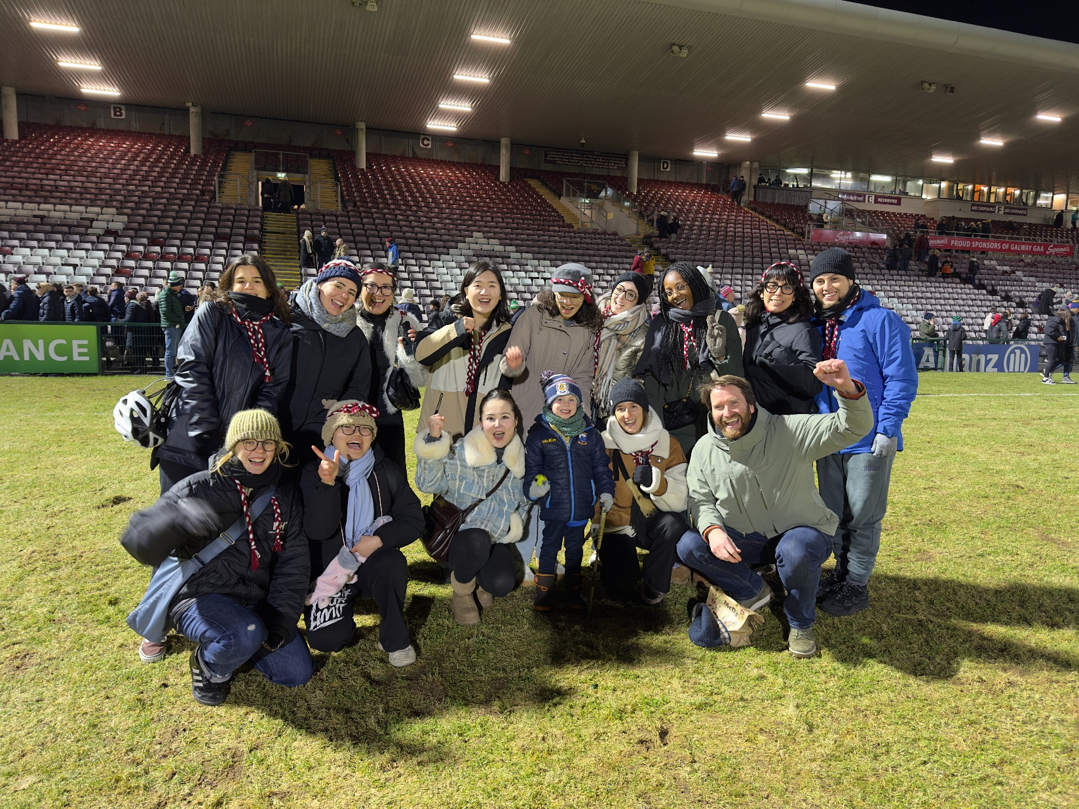
Academic vs non-Academic
Confidence in class participation – feel more comfortable contributing in seminars, group discussions, and tutorials.
Stronger academic writing & presentations – learn how to write essays/reports and give presentations clearly and persuasively.
Everyday communication – from joining clubs and societies to chatting in the student café, you’ll feel more comfortable engaging socially.
Cultural exchange – meet students from other countries, share experiences, and practise English in a relaxed, friendly environment.

Slide 8
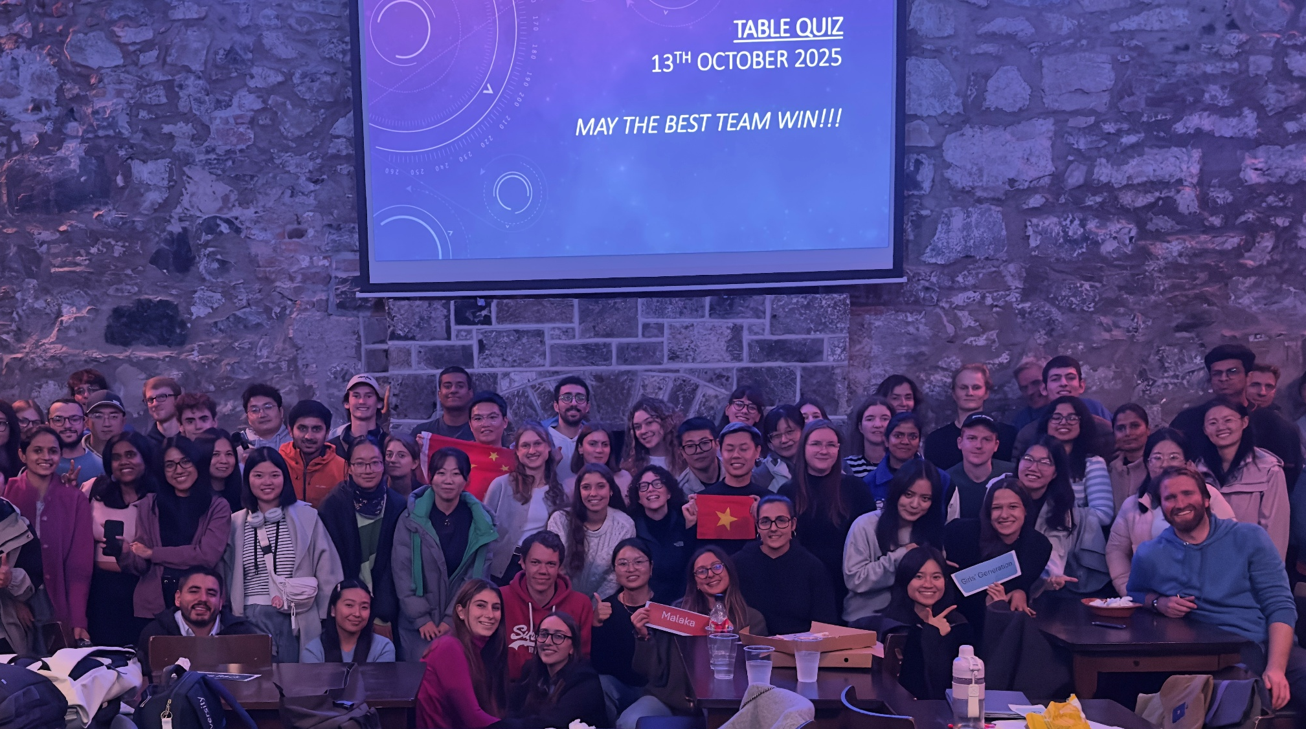
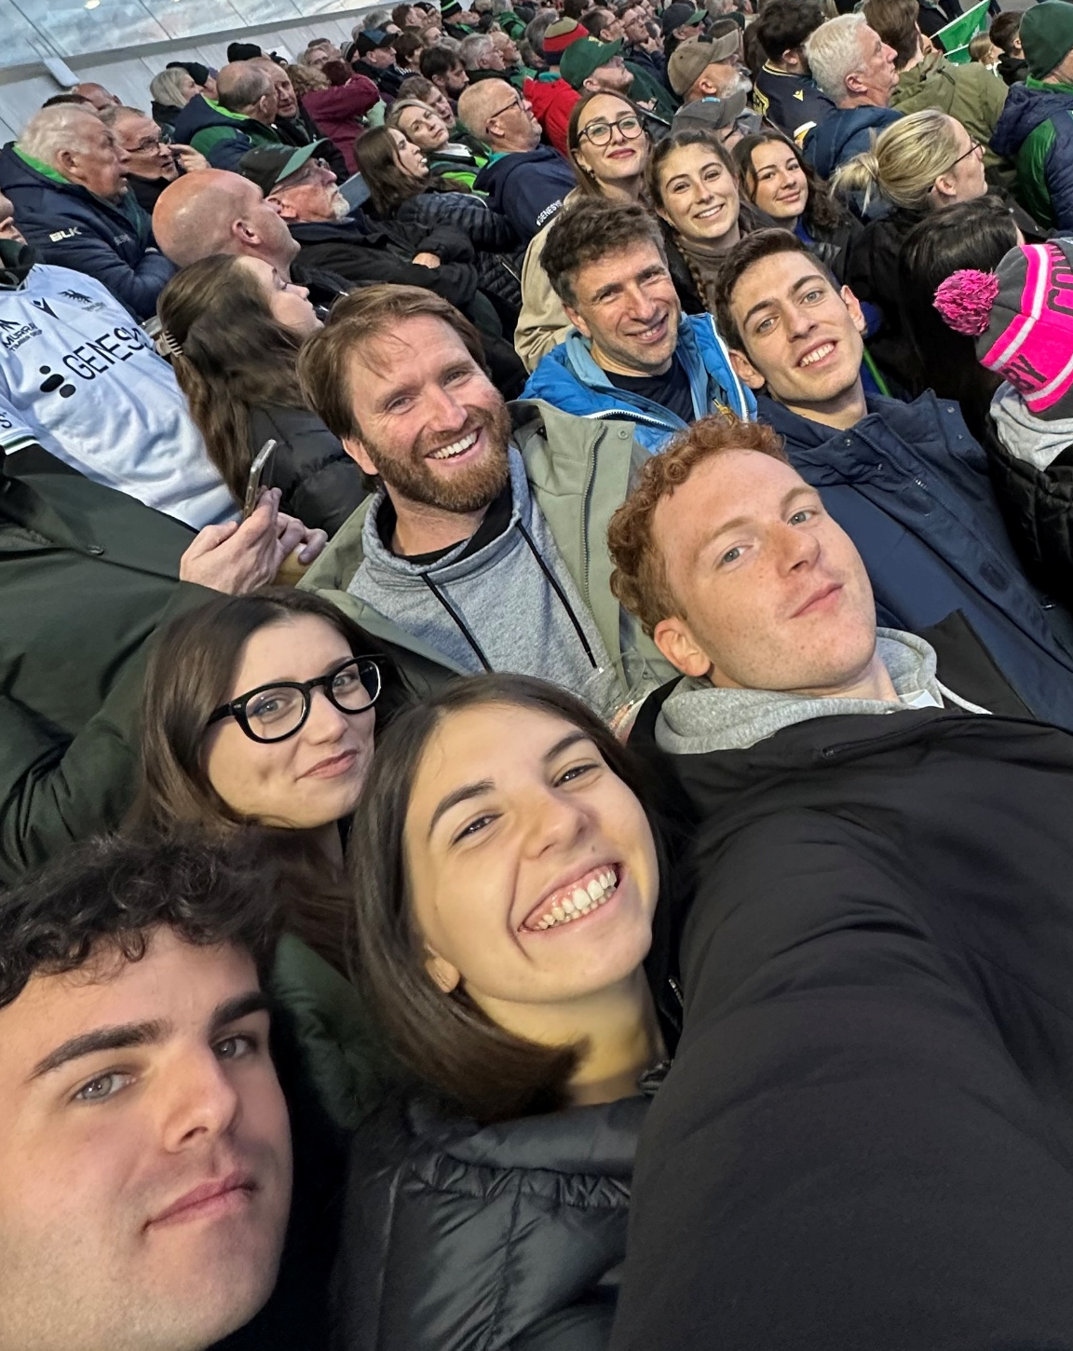
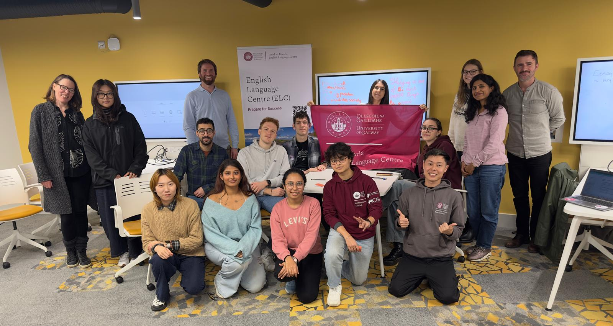
What others say…
It helped me a lot with structuring my essays and getting used to English in an academic setting, but it was also just a really nice environment to meet new people. It made the whole experience of adapting to university life much easier for me.
Matilde Barbe
These English courses were definitely an essential part of my time as a visiting student because they not only optimised the learning at the university but also supported the outlook what happens culturally in Galway.
Martin Baumgartner
During the classes, you learn how to debate, express your opinion, talk about everyday topics, and also work on projects that can help you in other classes, which is really useful to be well prepared.
Colombe Woelfle

Slide 9
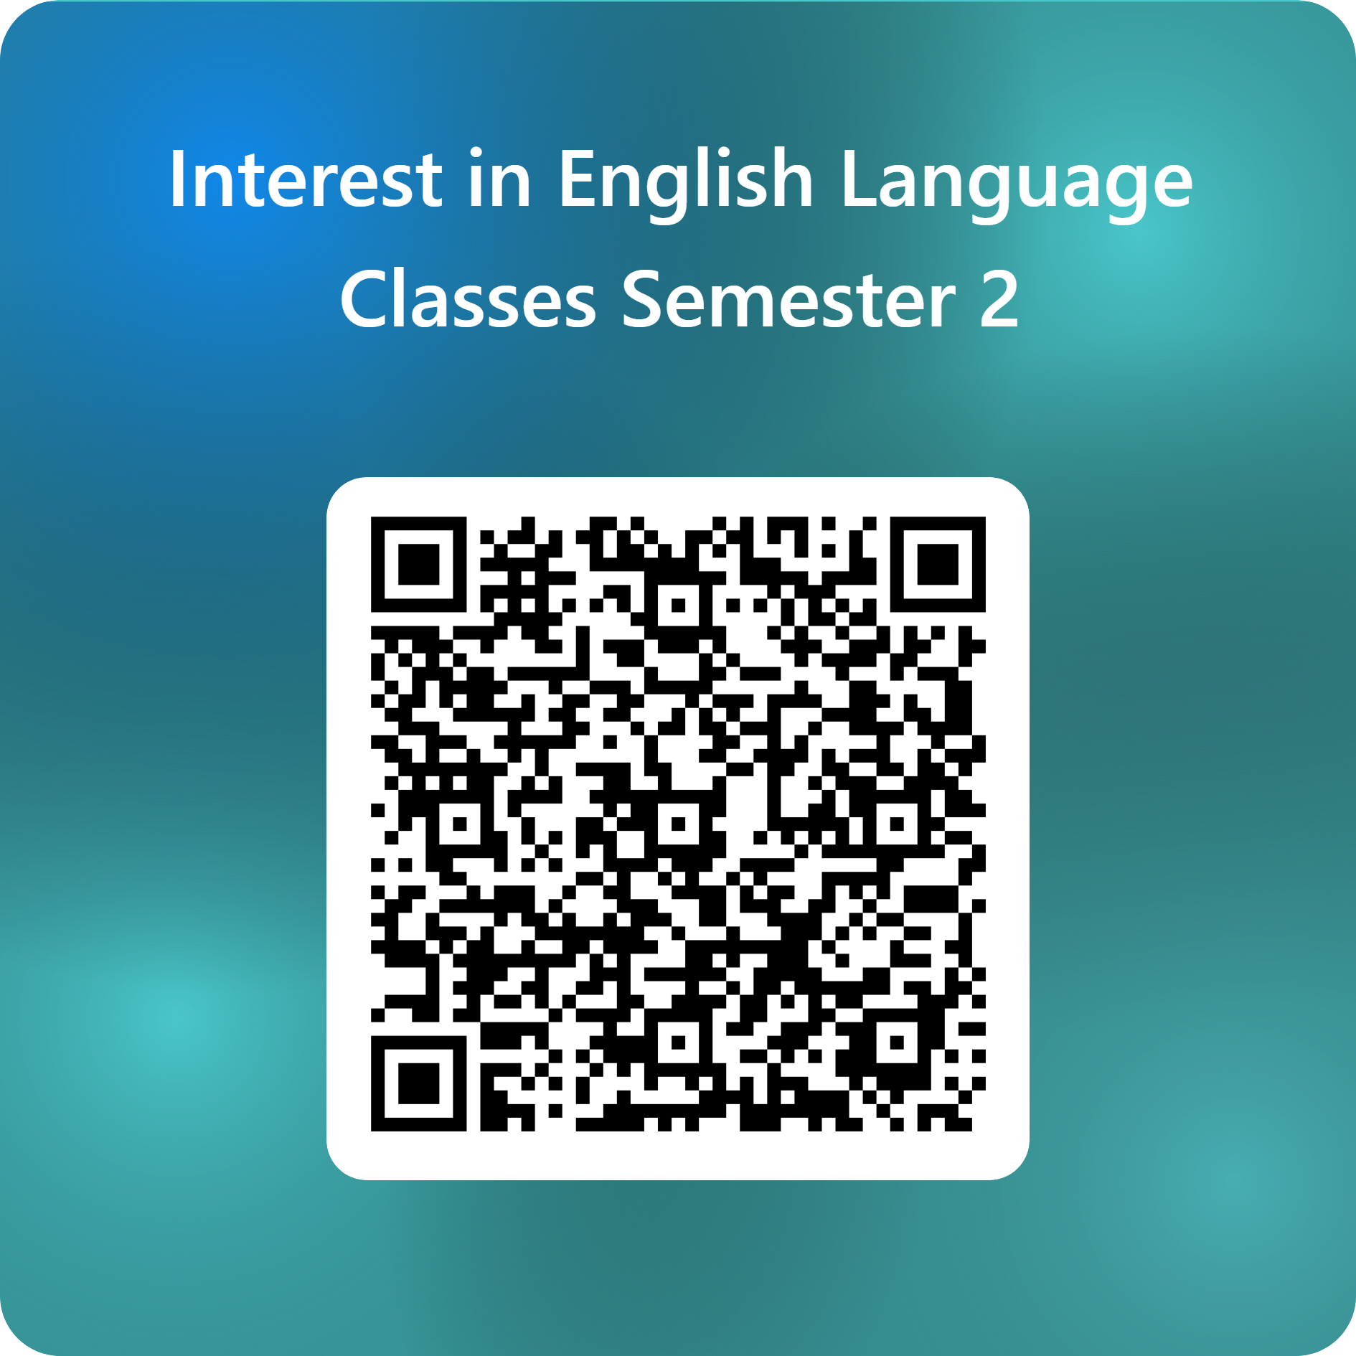
Register your Interest
You can register your interest here first as you don’t know your full timetable yet.
In a few days, we will send you a link to register for your preferred course(s).

Slide 10
Thank you
If you have any questions, you can find us outside in the hall

