Slide 1
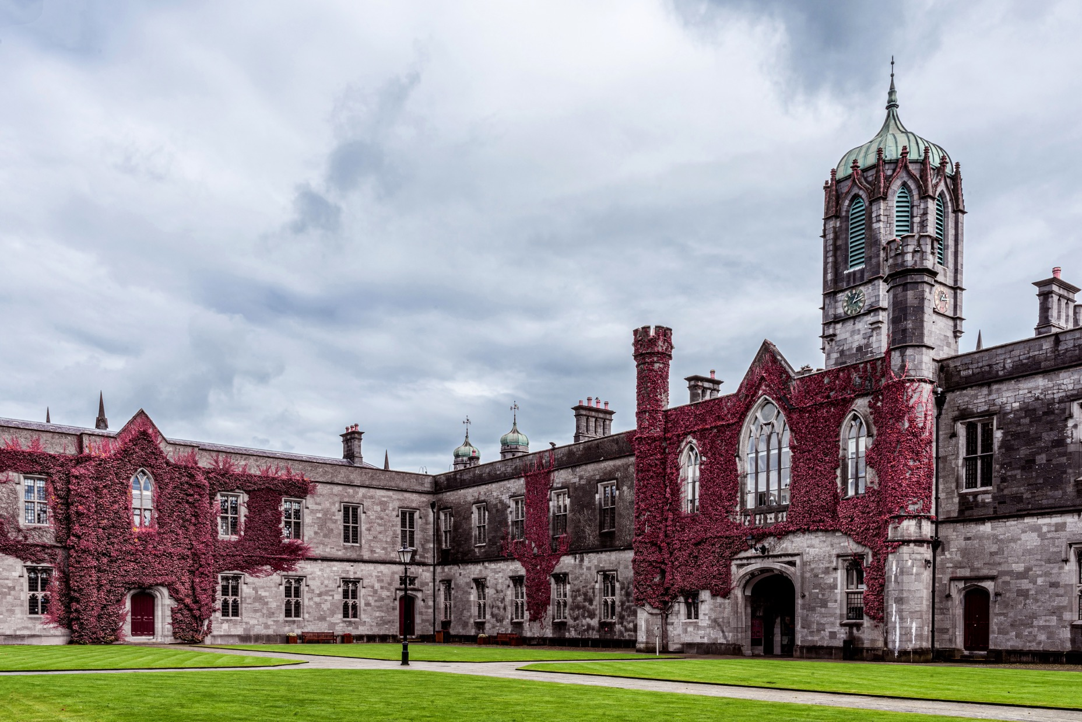
Immigration Essentials
For New International Students

Slide 2
Who needs to register
Non‑EU/EEA/UK/Swiss students staying in Ireland for more than 90 days
EU/EEA/UK/Swiss students do not need to register

Slide 3
Visa Requirements and Entry
Apply online (AVATS) - https://www.visas.inis.gov.ie/avats/OnlineHome.aspx
Print your AVATS summary, then sign and date it
Prepare documents - valid passport, photos, travel plans, proof of funds, invitation (if needed)
Submit and pay - send your form and documents to the relevant Visa Office and pay the fee
Processing times vary — apply early.
Bring all relevant documents when you travel - immigration may ask for them at point of entry

Slide 4

ISD Account & Booking

Slide 5
Where & when
You must register within 90 days of entry to the country
Appointments held at Burgh Quay Registration Office in Dublin
First-time setup is completed online, but the appointment is in Dublin
https://portal.irishimmigration.ie/en/
https://www.irishimmigration.ie/customer-service-portal-a-guide-to-using-the-online-self-service-portal/

Slide 6
Documents Needed
Passport (and photocopy)
University registration letter including Galway address & Eircode
Proof of private health insurance
Evidence of funds: €10,000 (if stay is more than 8 months) or €833/month
Printed originals (no digital documents accepted)
€300 fee (card payment only

Slide 7
At the appointment
Document check, biometrics, and fee payment
IRP card posted within approximately 10 working days
Immigration stamp in passport is temporary until your IRP card arrives

Slide 8
Work & Personal Public Service Number (PPSN)
Stamp 2 entitlement: 20 hrs/week during term-time
40 hrs/week in holidays (June 1st – 30th September & December 15th – January 15th)
Stamp 2A (exchange study abroad): no work allowed
Apply for PPSN for legal employment

Slide 9
Apply for PPSN
Students will need to provide:
A current passport.
Evidence of address in Ireland
Evidence of immigration permission
Proof of why they need a PPSN (University of Galway registration statement)
Apply online or in person:
Students can apply for a PPSN online through MyWelfare.ie or by visiting a Social Welfare office. For first-time applicants, an in-person appointment at a Social Welfare office may be required.

Slide 10
Renewals & Postgraduate Stay (1G)
                IRP renewals, extensions and changes are online, no need for in-person visit
Renewal applications accepted up to 12 weeks before expiry
Stamp 1G (Third-Level Graduate Programme) up to 24 months’ stay

Slide 11
Third Level Graduate Programme (1G)
A valid passport
Current IRP Card with Stamp 2
A document from University of Galway confirming that they have successfully achieved the award for which they had enrolled as a student
Proof of medical insurance
€300 application fee

Slide 12
Key Terms
ISD: Immigration Service Delivery (manages immigration registrations since Jan 2025)
IRP: Irish Residence Permit (plastic card proof of your immigration permission)
Stamp 2 / 2A: Student permission stamps; holders can work part-time (Stamp 2) or not work (Stamp 2A)
https://www.universityofgalway.ie/global-galway/offerholders/immigration/

Slide 13
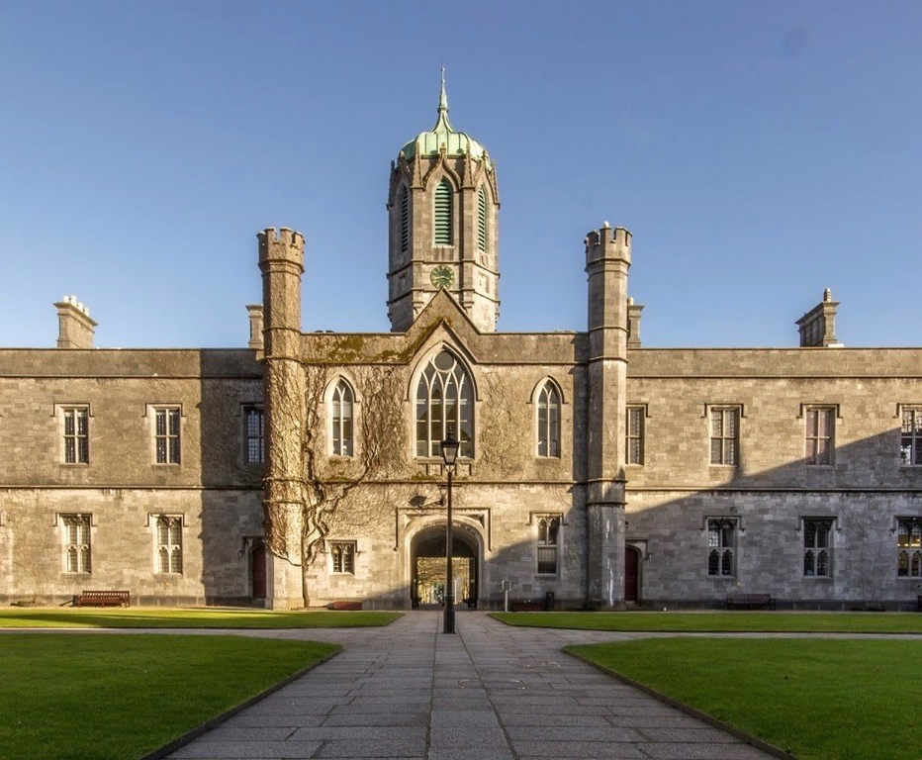
https://www.universityofgalway.ie/global-galway/offerholders/immigration/

Slide 14
Thank you

Slide 15
