Slide 1

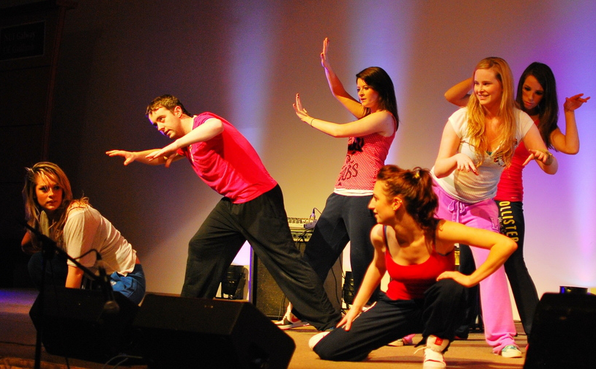
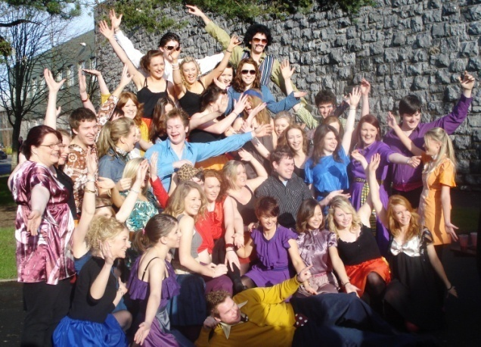
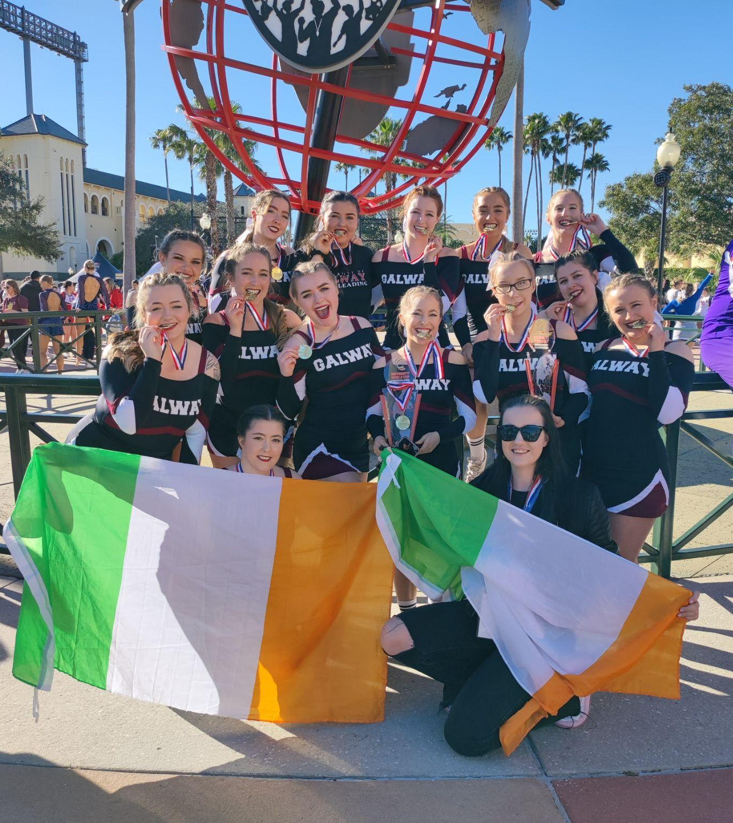
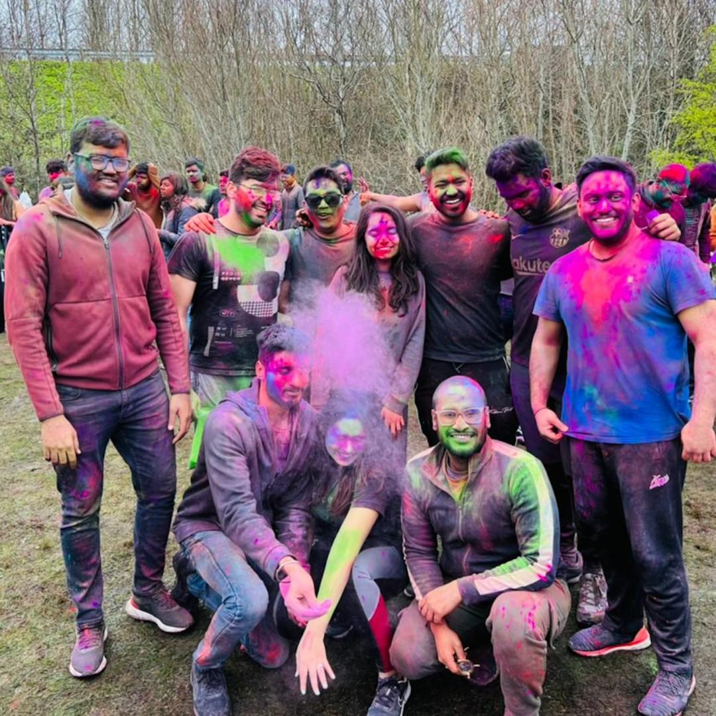
University of Galway
Societies
Notes:
1

Slide 2
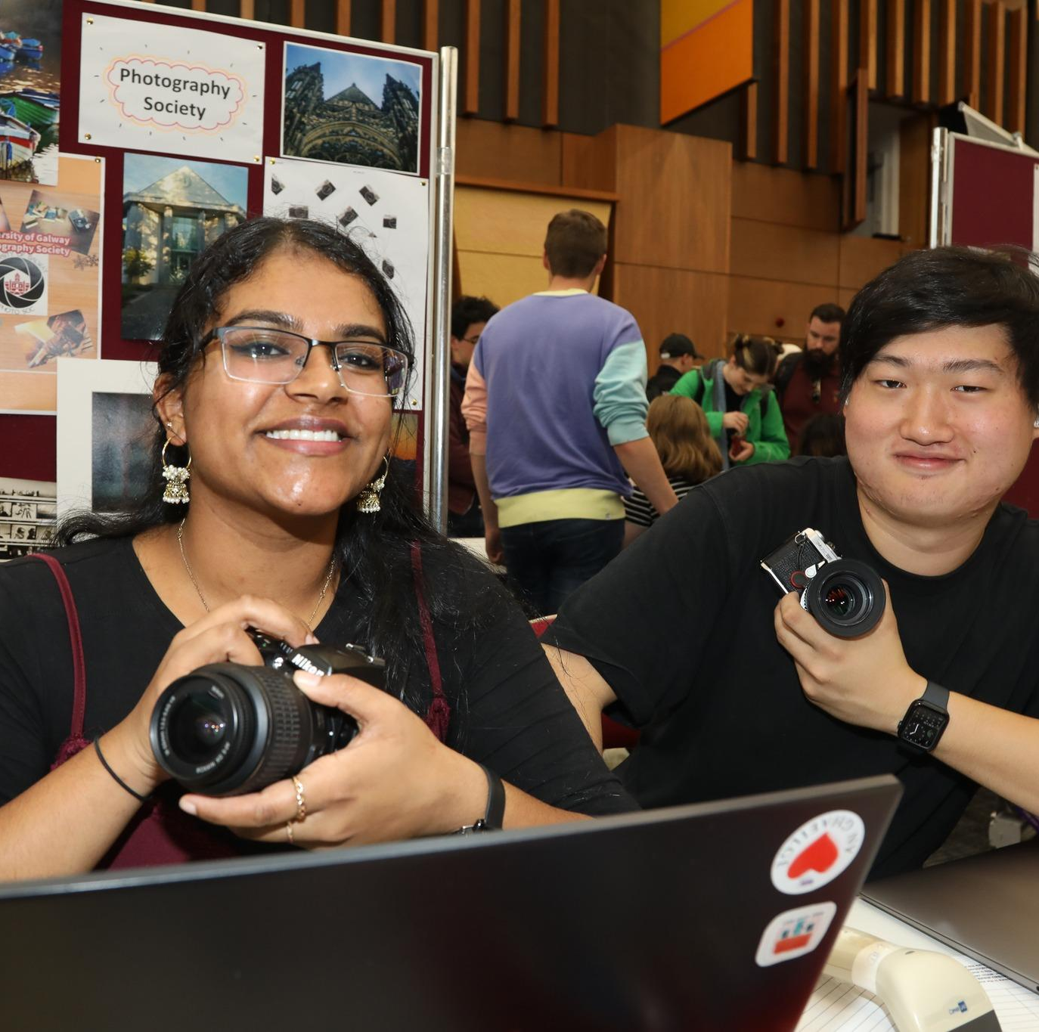
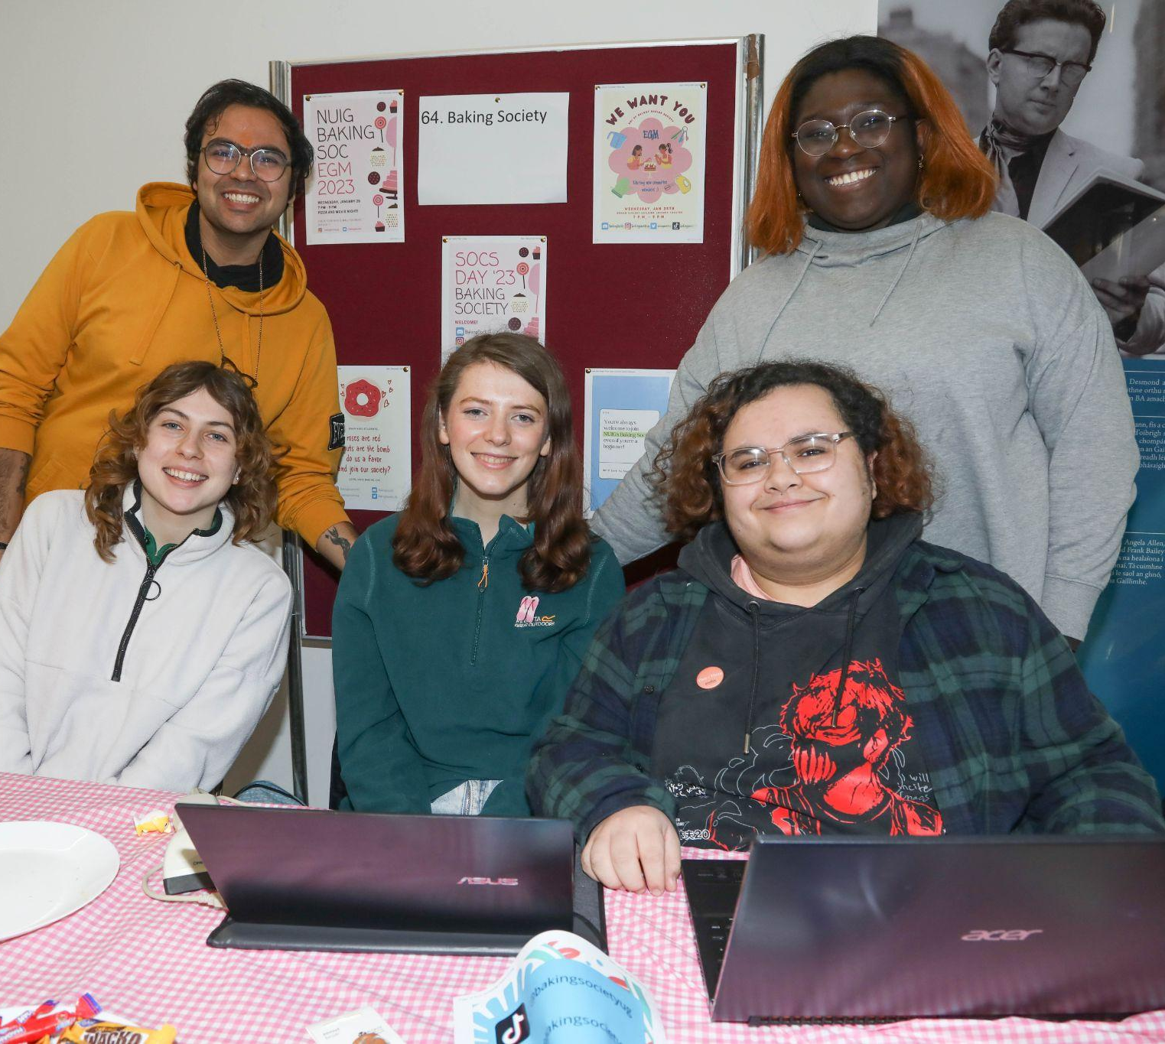
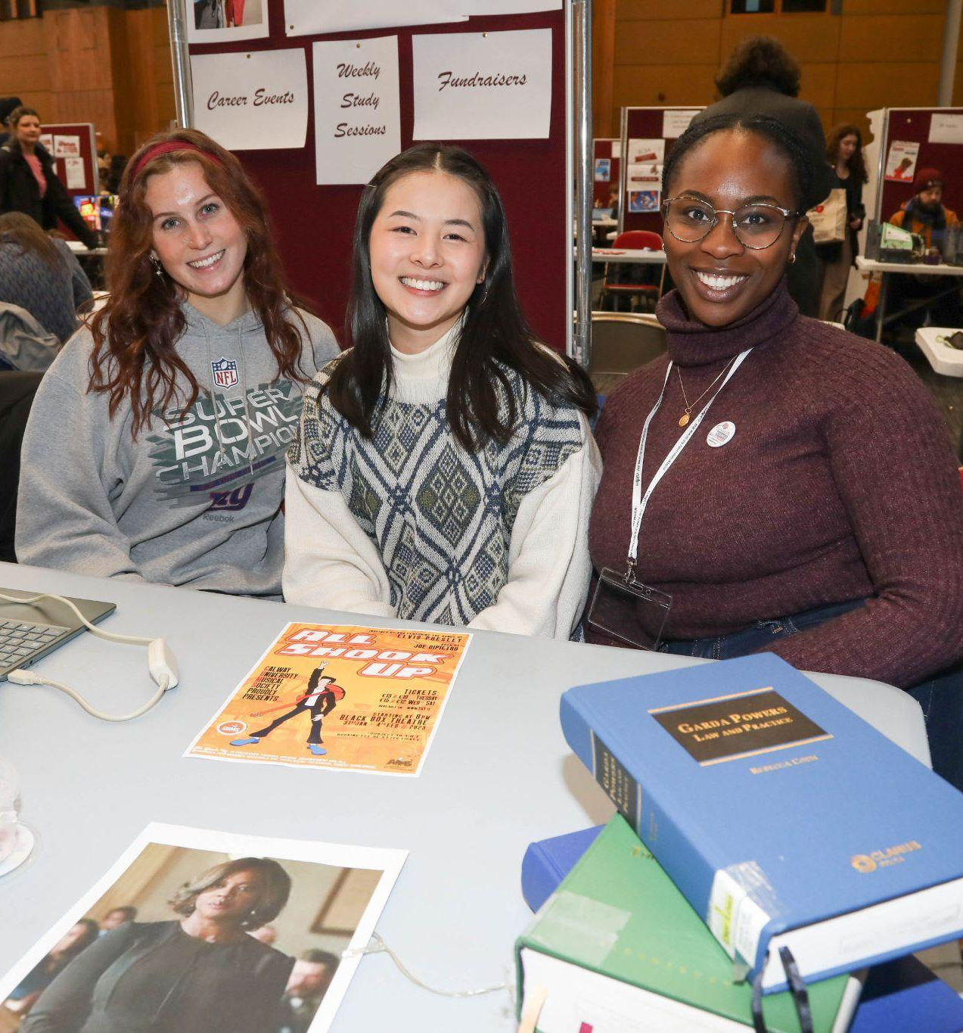
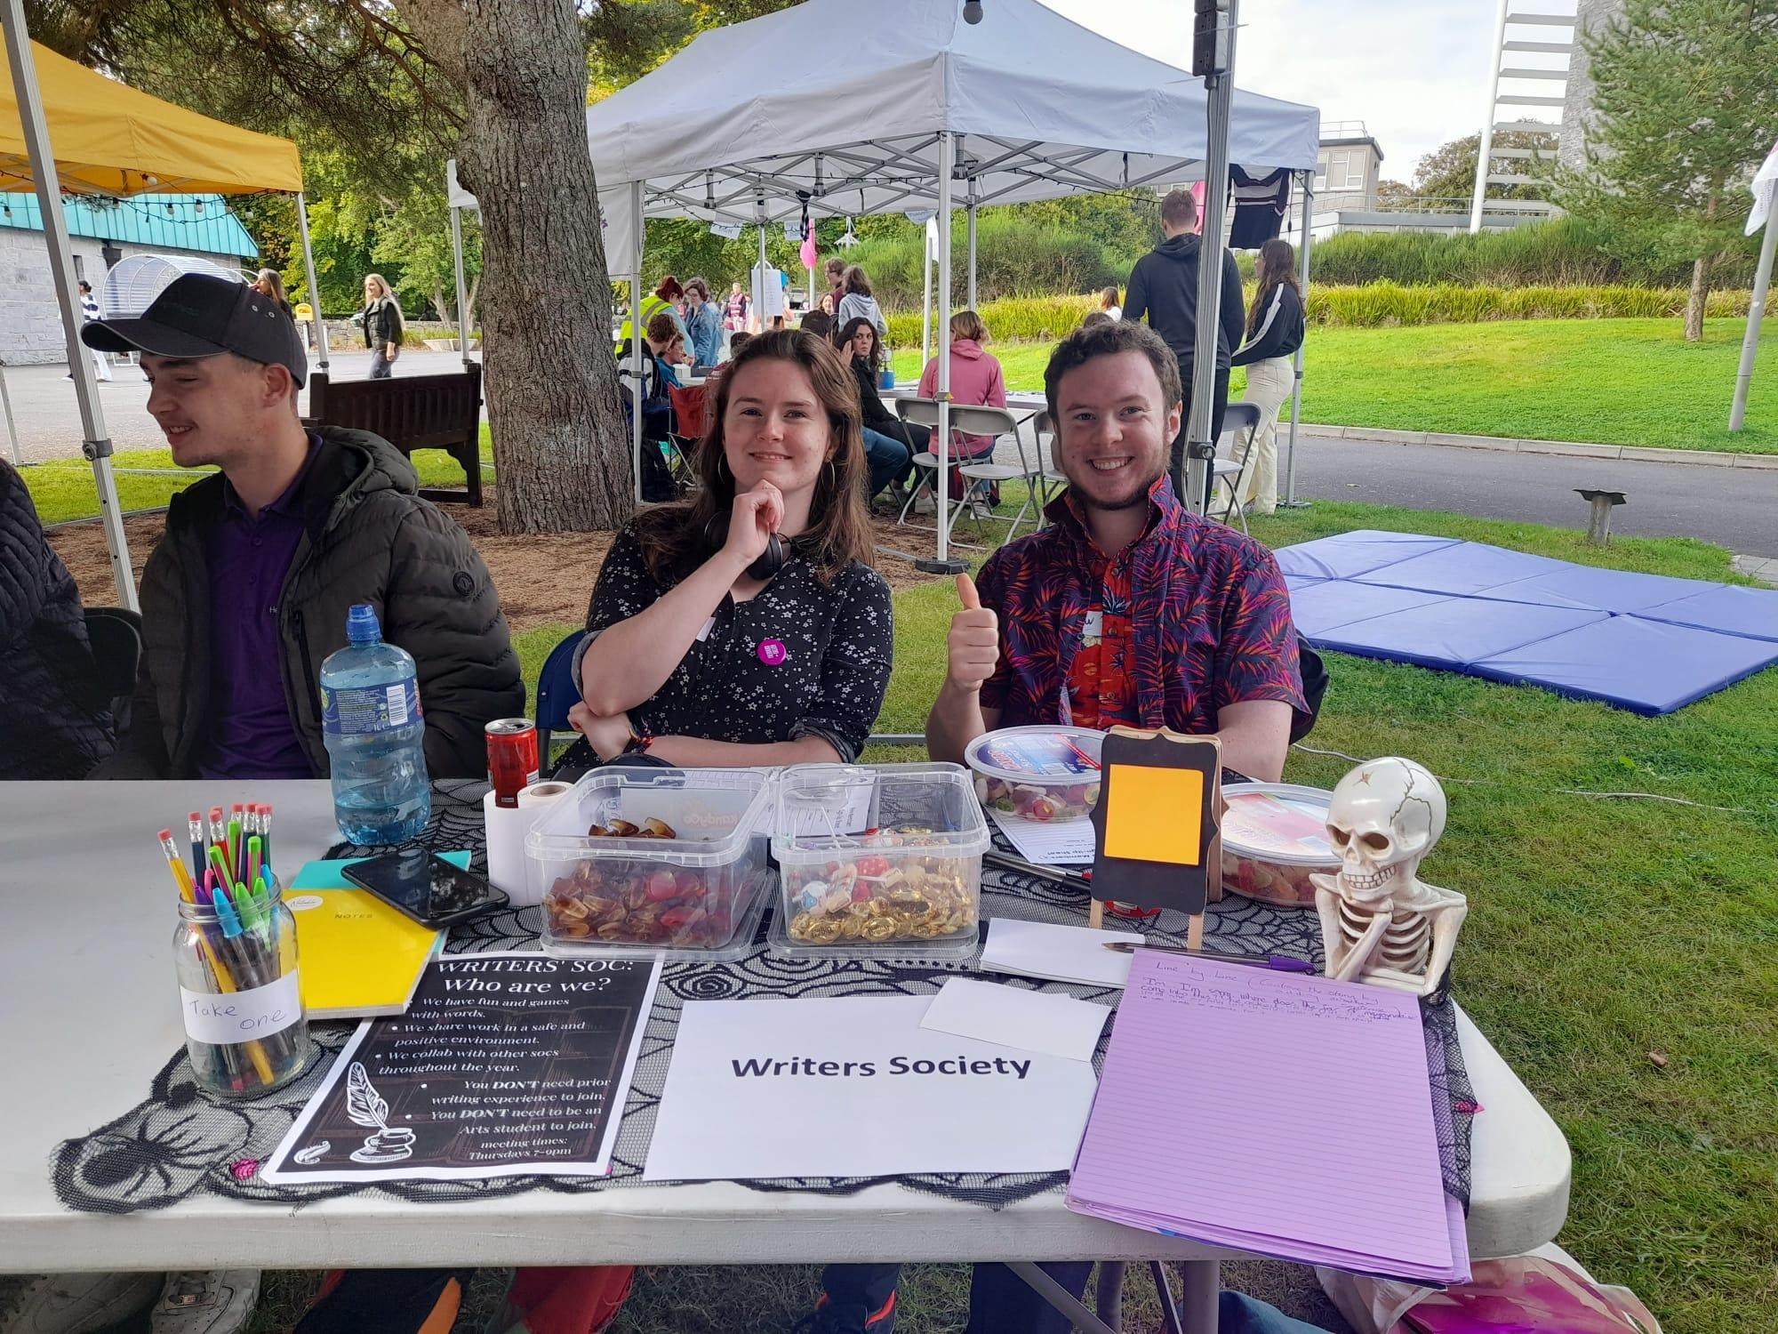
How to Join
In YourSpace & Next Societies’ Day January 14th
151
Active Societies
17,233
Society Members
3,625
Events last year
www.socs.universityofgalway.ie
Notes:
2

Slide 3

What societies can you join?

Slide 4
​​
Societies
Academic
AI, Agricultural. Archaeology, Anesthesiology, Astronomy, Biomedical, Botany, Business Analytics, Business, Chemistry, Classics, Climate Action, Cumann Staire (History), Cyber Security, Dermatology, Economics, ELSA, Emergency Medicine, Engineering, French, General Practitioners, Geography, German, Irish Global Health Network, Hispano, Italian, Law, Marine, Maths, Medicine, Medical Research, Micro, Neuro, OB-GYN, Orthopedics, Paediatrics, Philosophy, Physics, Politics, Postgrad Research, Psychological, Sports Medicine, Surgical, WiSTEM, Women in Law, Women in Medicine, Zoo.
Social and Cultural
African Caribbean, Bangladesh, Bród (LGBTQ+), Chinese, Cumann Gaelach, Disability, Eastern European, Erasmus (ESN), Gulf Cooperation Society, India, International Students, Iranian, Indonesian, Japanese Language, Kuwaiti, Lit & Deb, Mexican,Neurodivergent, Pakistani, Rover.
Artistic and Performing
Art, An Cumann Dramaiochta, An Cumann Rince Seite, Cheerleading, Choral, Dansoc, DJ, Dramsoc, Film Soc, Musical (GUMS), Music, Orchestra, Photography, Rock, Trad, Writers.
Political & Religious
Anaphora Orthodox Christian Fellowship, Believers Connect, Catholic, Cumann de Barra (Fine Fail), Dóchas Christian, Hindu, Islamic, Sinn Féin, Young Greens, Young Fine Gael.
Special Interest
Anime & Manga, Avant Garde, Baking, Book Club, Chess, Computer, eSports, Fansci, Fashion, Folding, Formula 1, Granny, Horror, IEEE Student Branch, Innovator, K-Pop,Muppet, Poker, Republic of Ireland Supporters, Rescue Paws, Sitcom, Sports Analytics, Swiftie (Taylor Swift), Time Lord (Dr. Who), Video Game, Witches. Yoga.
Social Action & Volunteering
Amnesty, Best Buddies, Cancer, CATU, Consultants & Entrepreneurs, Environmental, Eradication of Poverty, Feminist, FLAC, Palestine Solidarity, Sláinte, Solidarity, Simon, St. Vincent de Paul, Voluntary Services Abroad.
New Societies This Year
Advocacy, Animation, Cardiovascular, CUMAS, Eurovision, Irish Neutrality, Nursing, Medical Ethics, Mental Health, Model UN, Nursing, Plastic Surgery, Social Democrats, Thrift, Women in Business.
Notes:
4

Slide 5
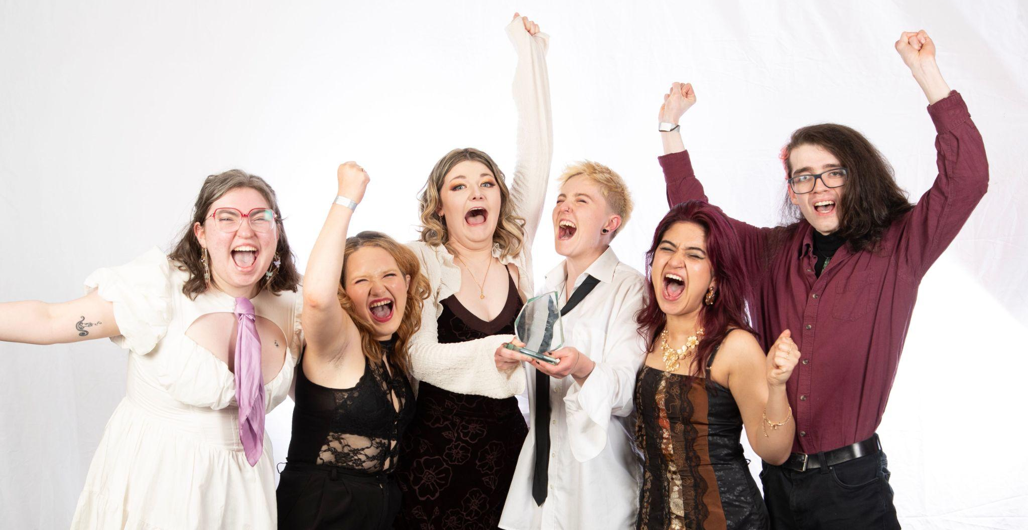

Society
Awards & Badges
We won 4 BICS National Society Awards Last year
Committee Training
Society Leadership Award
&
Digital Badge
for committee members.
Society Engagement Award
Sign up in yourspace
Notes:
5

Slide 6
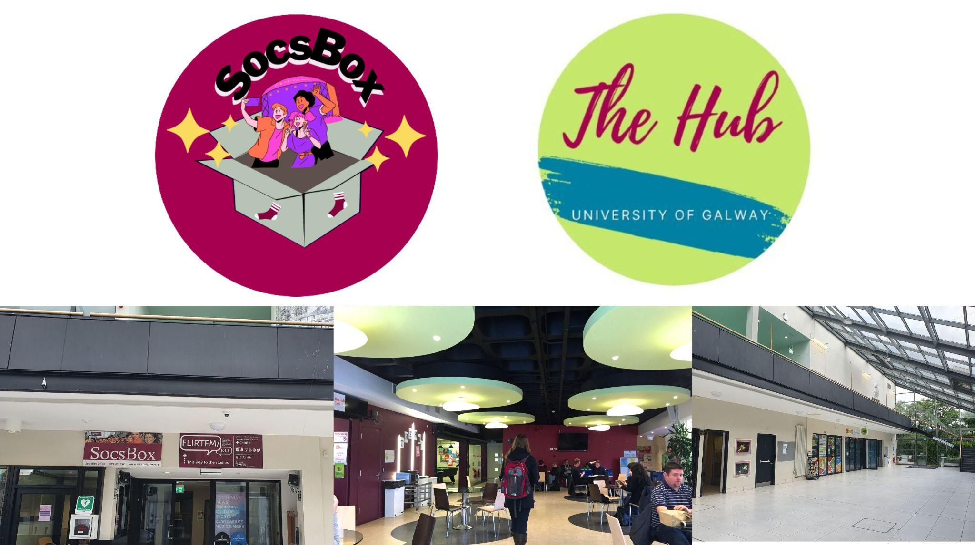

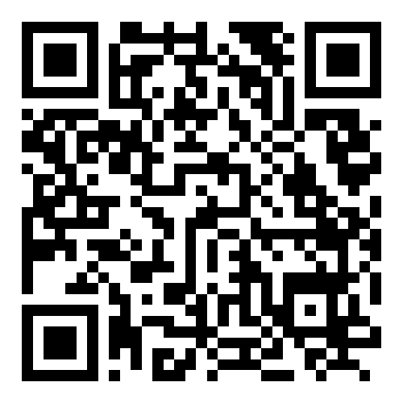
The SocsBox
10am - 8pm Mon - Thur
10am - 5pm Fridays
Email: socsbox@socs.universityofgalway.ie
Tel: 492852
Scan to sign up

Slide 7

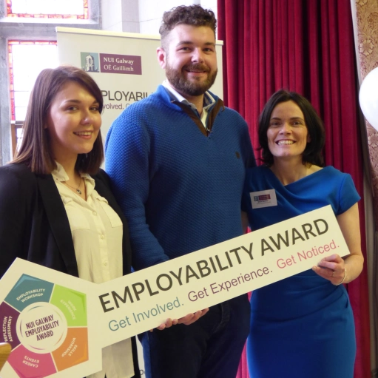
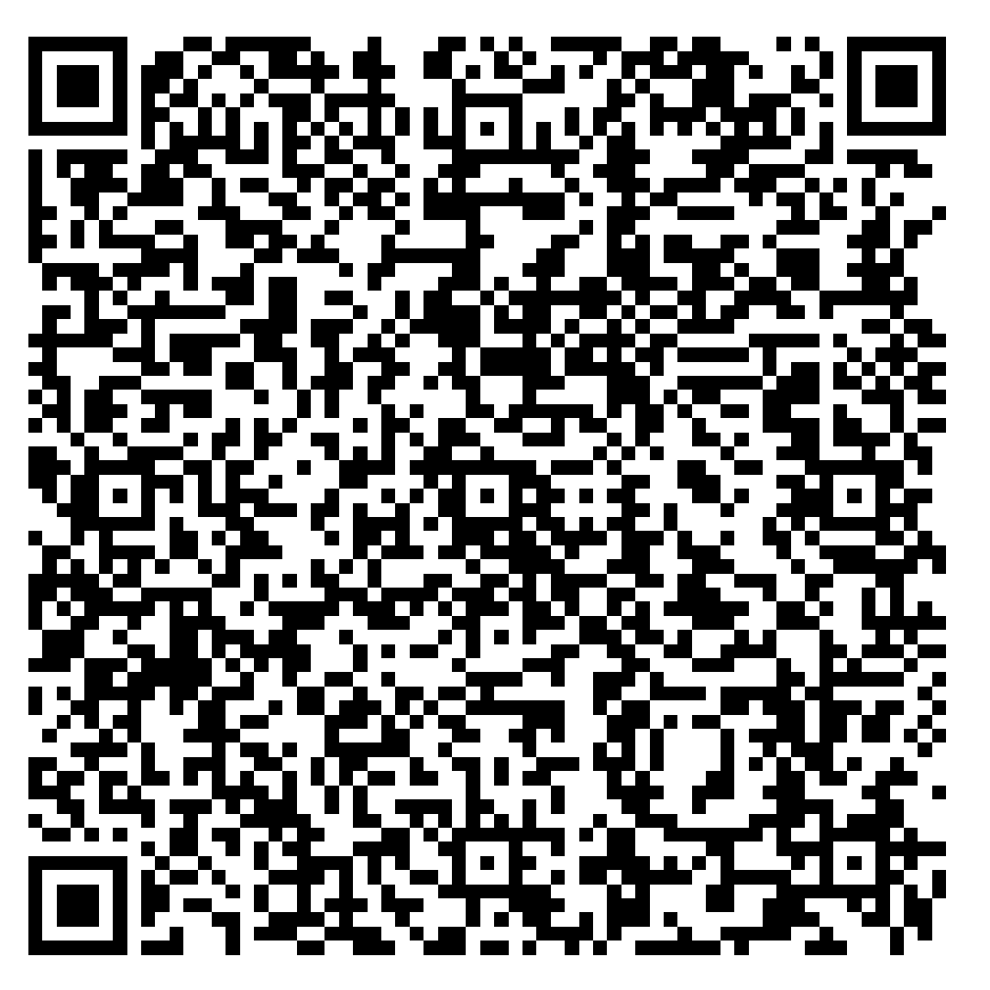
www.yourspace.universityofgalway.ie
YourSpace
YourSpace is your online portal to all extracurricular life at University of Galway!
Just log on using your student email and Computer Services password.
Join Clubs & Societies
Get involved
Know what’s happening
Create your Society ALIVE portfolio
Enter for awards
Find your Mentors & Class reps
Get your SU lockers, grinds, books etc
Get your personalised calendar
E-learning Modules
Success Quiz
Notes:
7

Slide 8
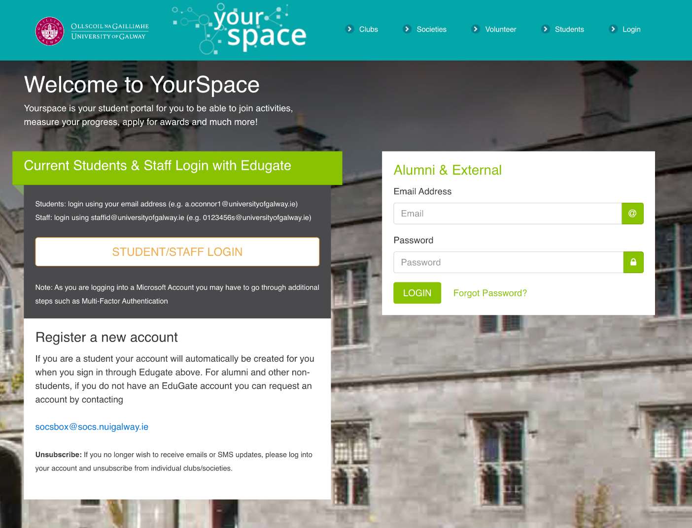

Slide 9
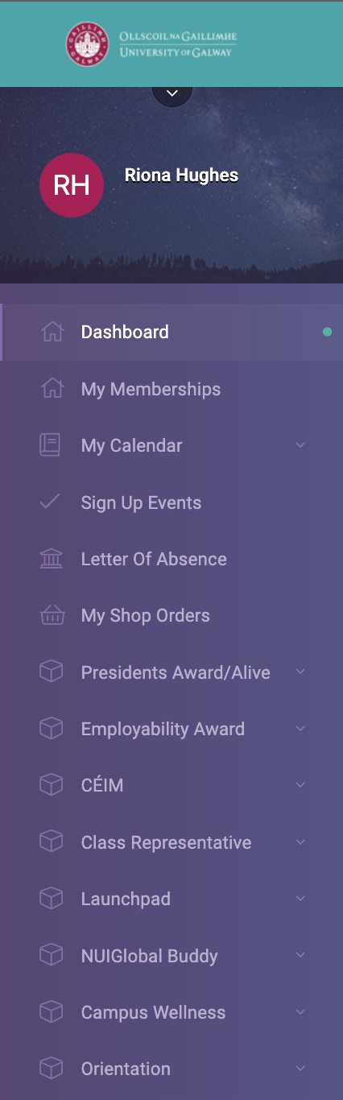
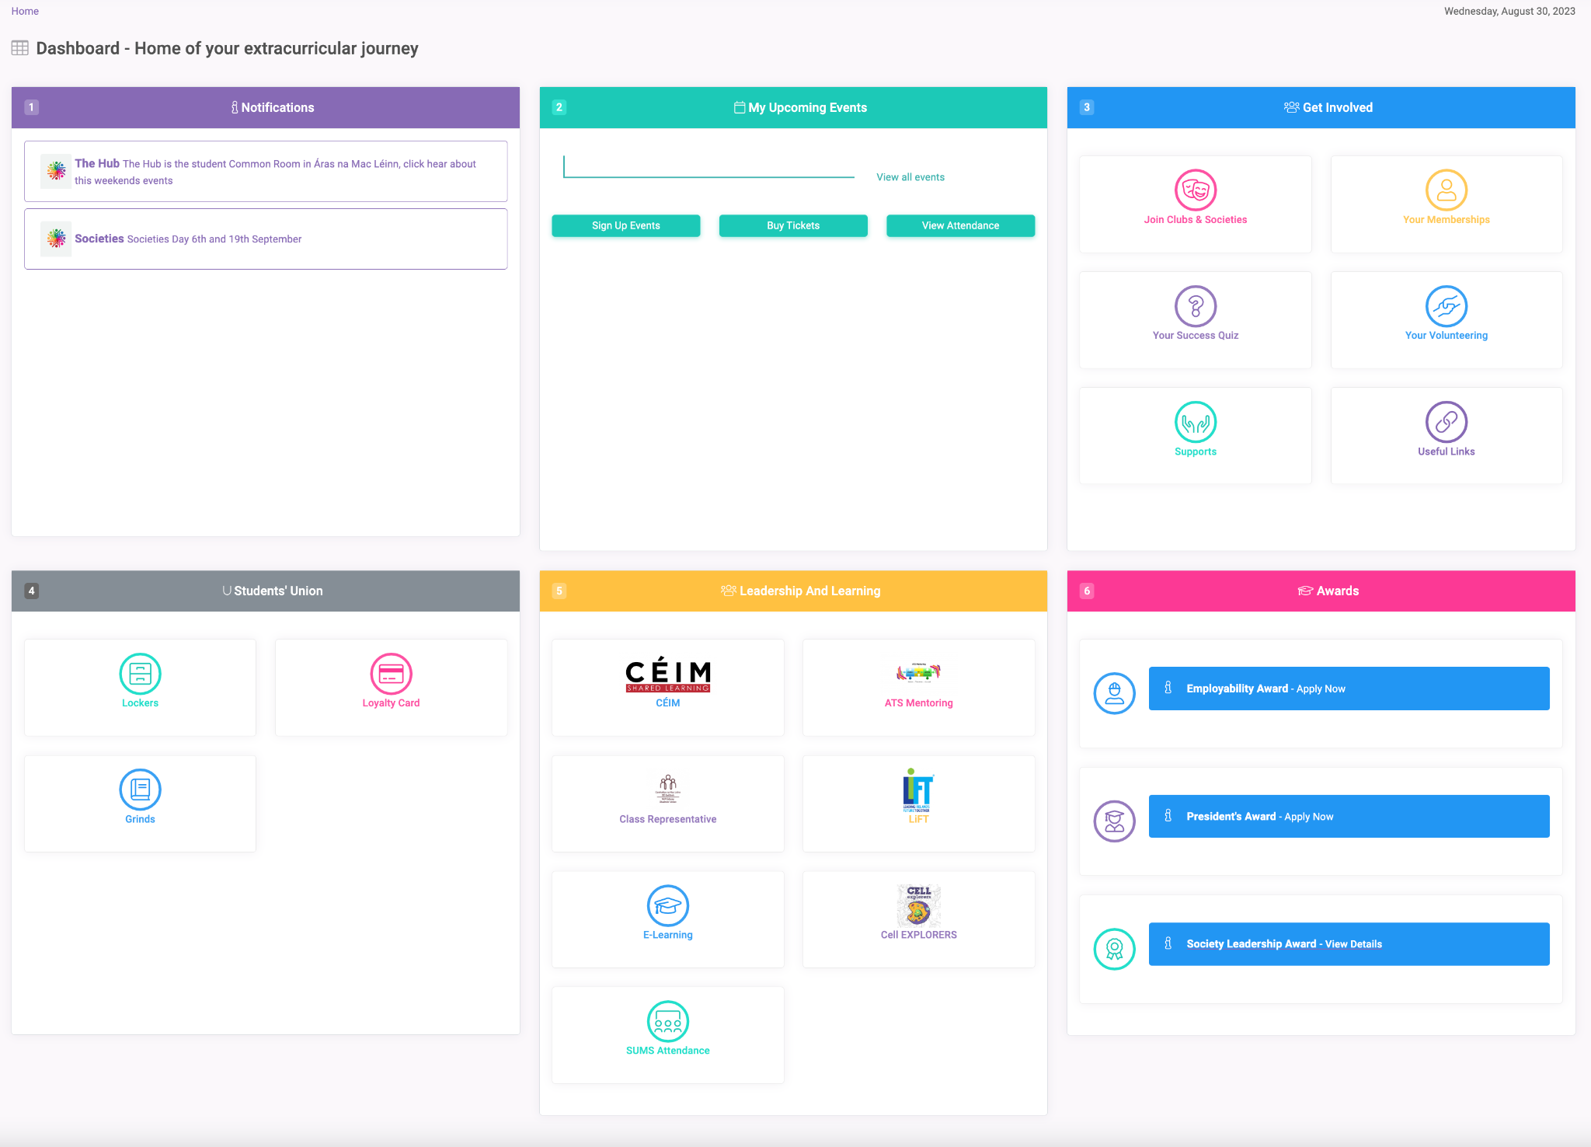
Manage your contact data
Join Clubs, Socs & More
& Manage your memberships
Sign up for events
Students’ Union
Services
Personalised Calendar & add your own events
Notifications, know what is happening.
Success Quiz
Helpful links
Students’ Union
Services
Get help
with maths
Check out the e-learning modules
Find your mentor, Céim Leader & Class Reps
Join loads of extracurriculars
Participate in Awards

Slide 10
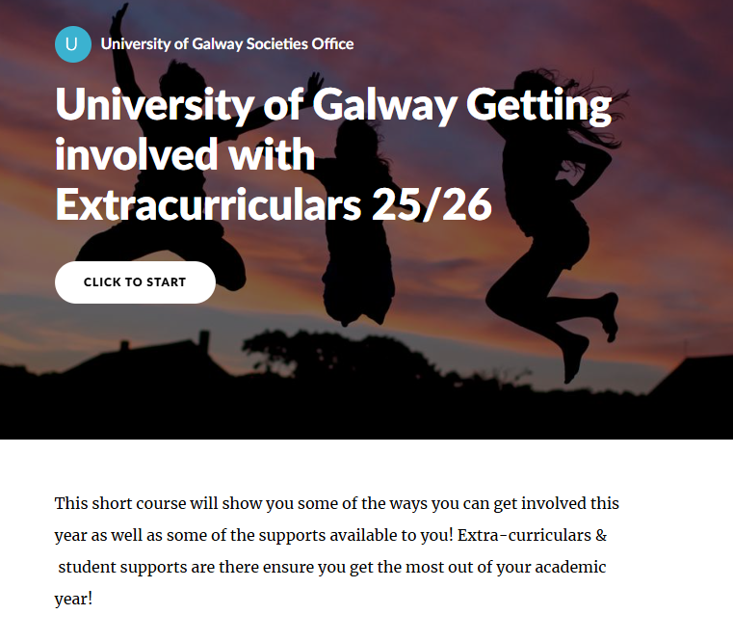
E-modules in YourSpace
Accommodation & Financial Support
Sustainability
Eat well at University
Irish Traditions, Language and Places to See
Your online world-Safety online
Leadership & Team Building Skills
Organising Events
Public Relations
Conflict Resolution
Academic & Exam Success
Sexual Violence & Harrasment: How to support yourself and your peers.

Slide 11

Follow us on Social Media
www.instagram.com/universityofgalwaysocsbox
www.facebook.com/universityofgalwaysocsbox
www.tiktok.com/@TheSocsBox
www.snapchat.com/add/socsbox
discord.com/invite/vh48C3nTu7
Twitter @socsbox
Website
socs.universityofgalway.ie
Students.universityofgalway.ie
Email
socsbox@socs.universityofgalway.ie

Slide 12
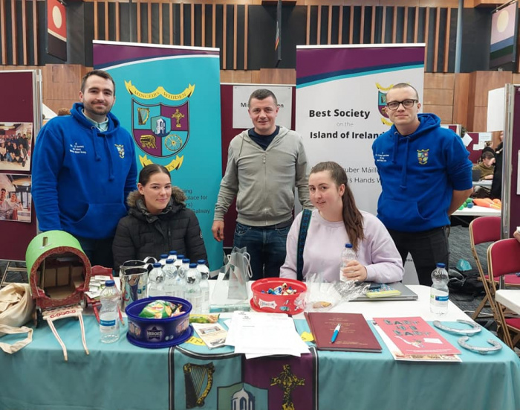
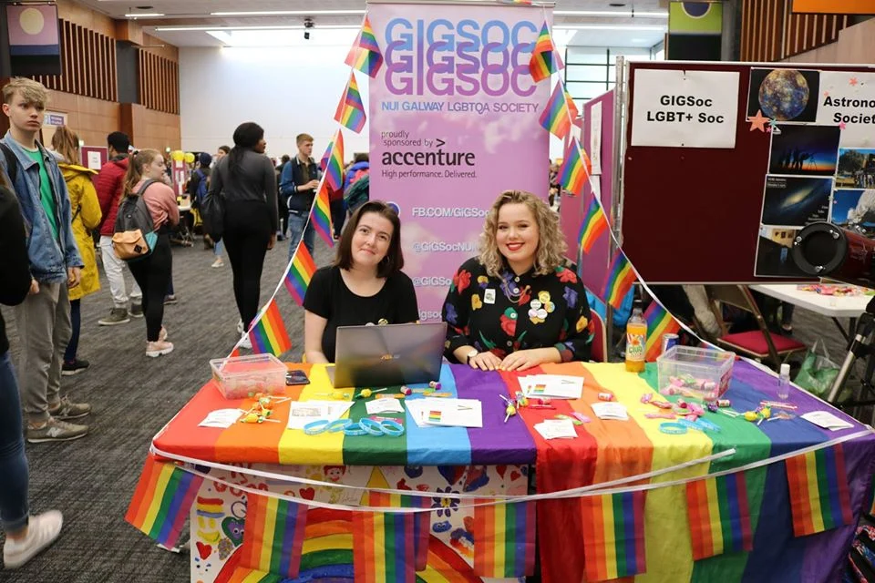
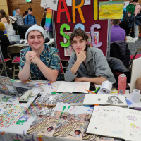
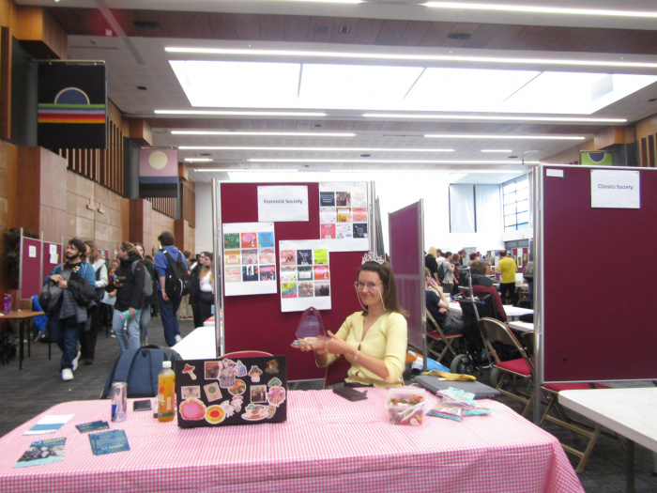
Socs Day
& Volunteer Fair
Jan 14th
In Áras na Mac Léinn 12pm – 5pm

