Slide 1


COMHALTAS NA MAC LÉINN OLLSCOIL NA GAILLIMHE
(OR UNIVERSITY OF GALWAY STUDENTS’ UNION!)

Slide 2
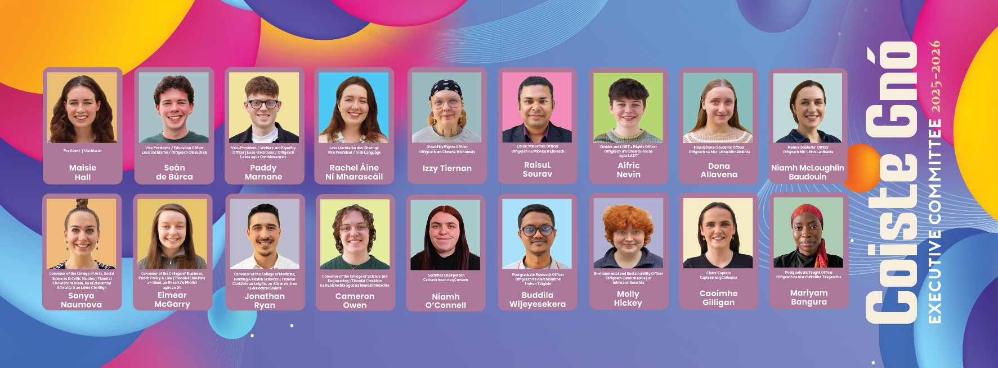
THERE ARE 18 OFFICERS WHO ARE DEMOCRATICALLY ELECTED TO THEIR POSITIONS EACH YEAR.
WHO?

Slide 3

BUT ALSO
YOU!

Slide 4




WHAT DO WE DO??

Slide 5


06
MISSION STATEMENT
TO REPRESENT ITS MEMBERS AND PROMOTE, DEFEND AND VINDICATE THE RIGHTS OF ITS MEMBERS AT ALL LEVELS OF SOCIETY​
BUT WHAT DOES THAT MEAN!

Slide 6
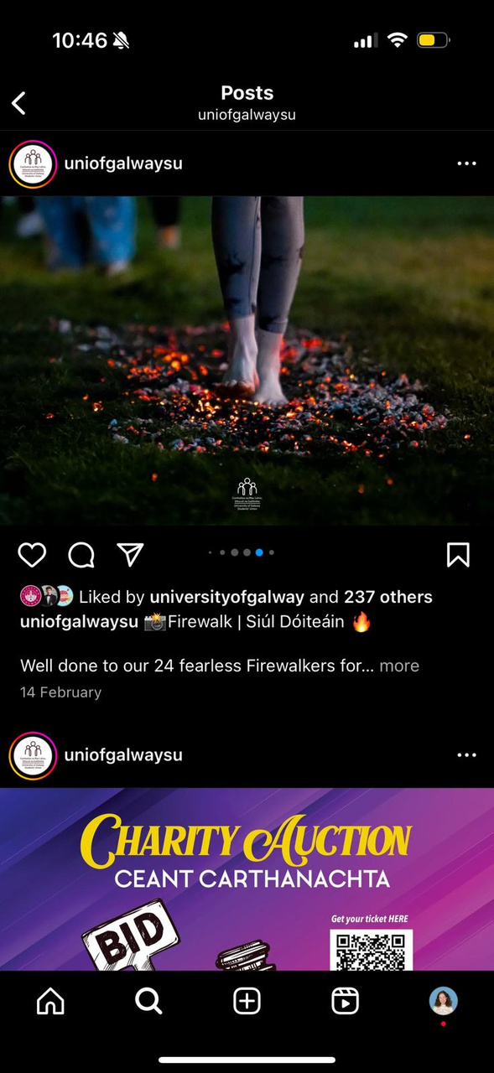
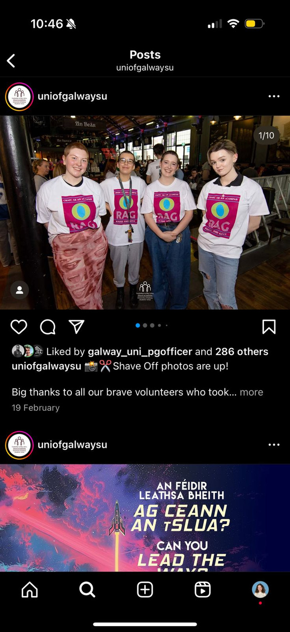
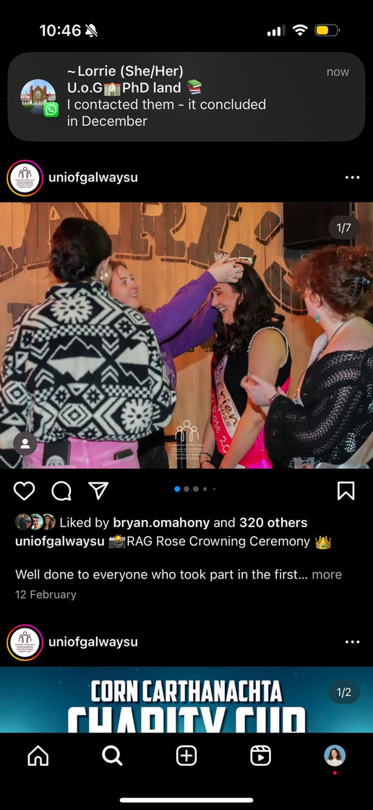

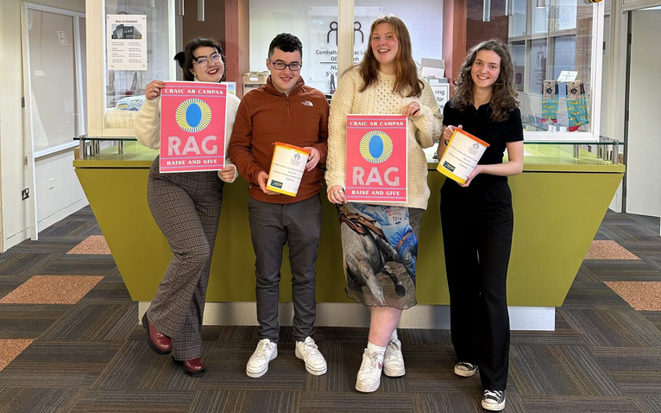
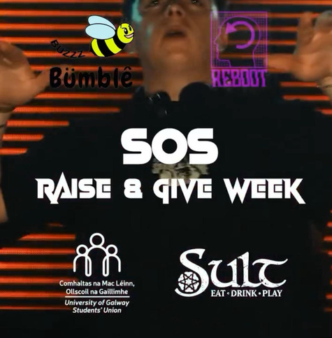
WHAT DO WE DO??
ORGANISE EVENTS AND CAMPAIGNS

Slide 7
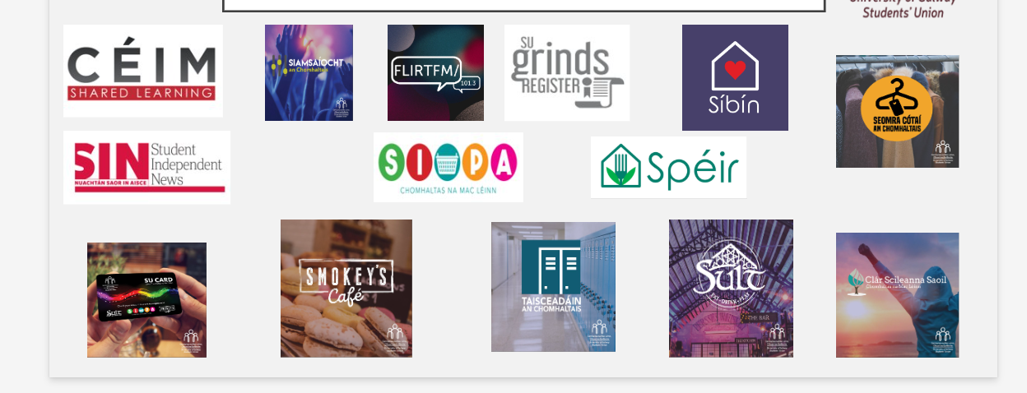
WHAT DO WE DO??
OFFER SERVICES AND SUPPORTS

Slide 8
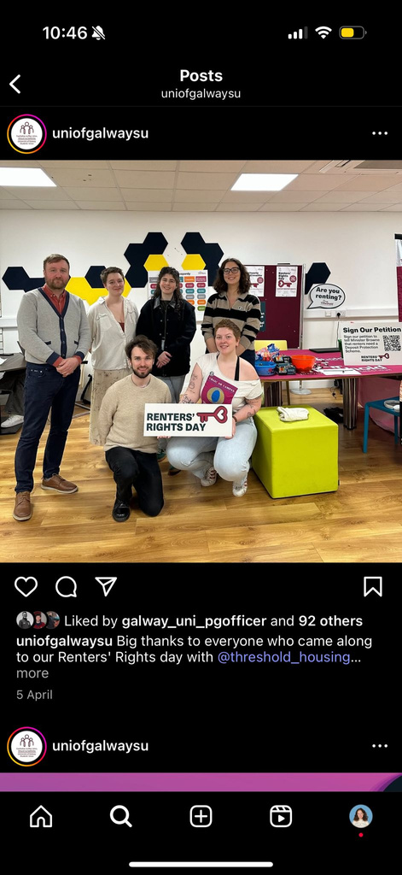
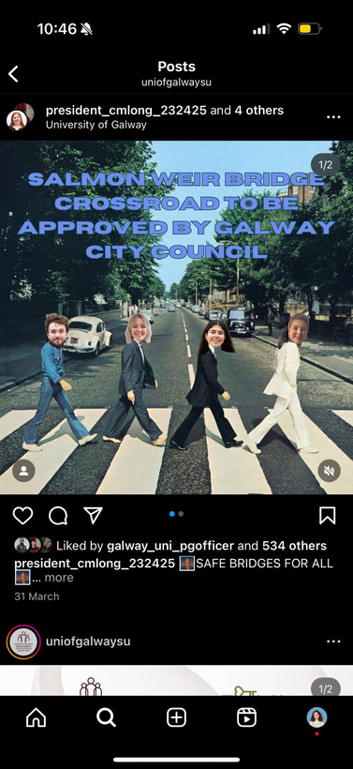
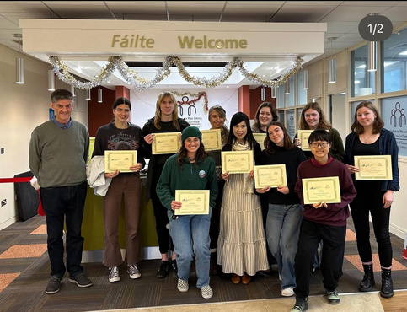
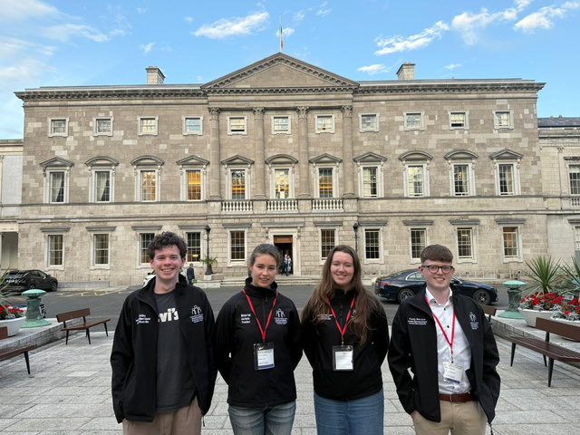
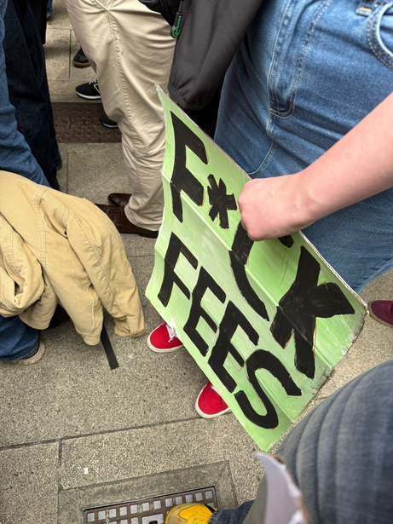
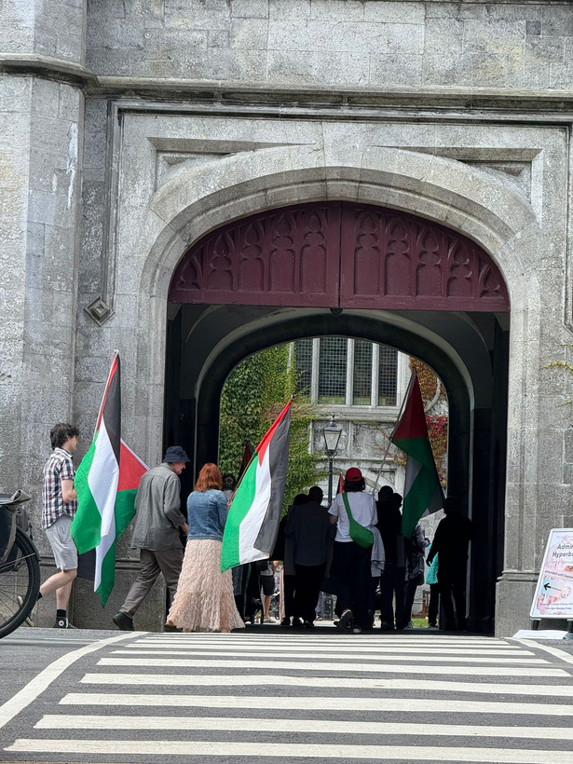
PROTECT/PROMOTE YOUR RIGHTS
WHAT DO WE DO??

Slide 9
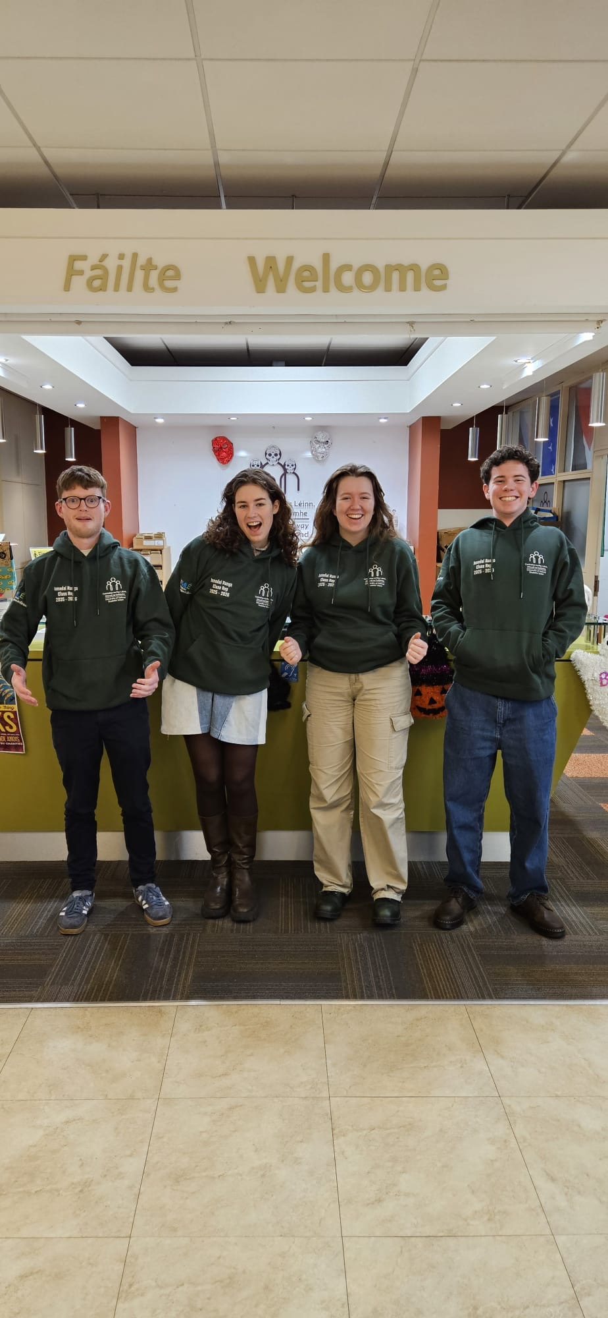

IT COULD BE YOU!!
CLASS REPS

Slide 10
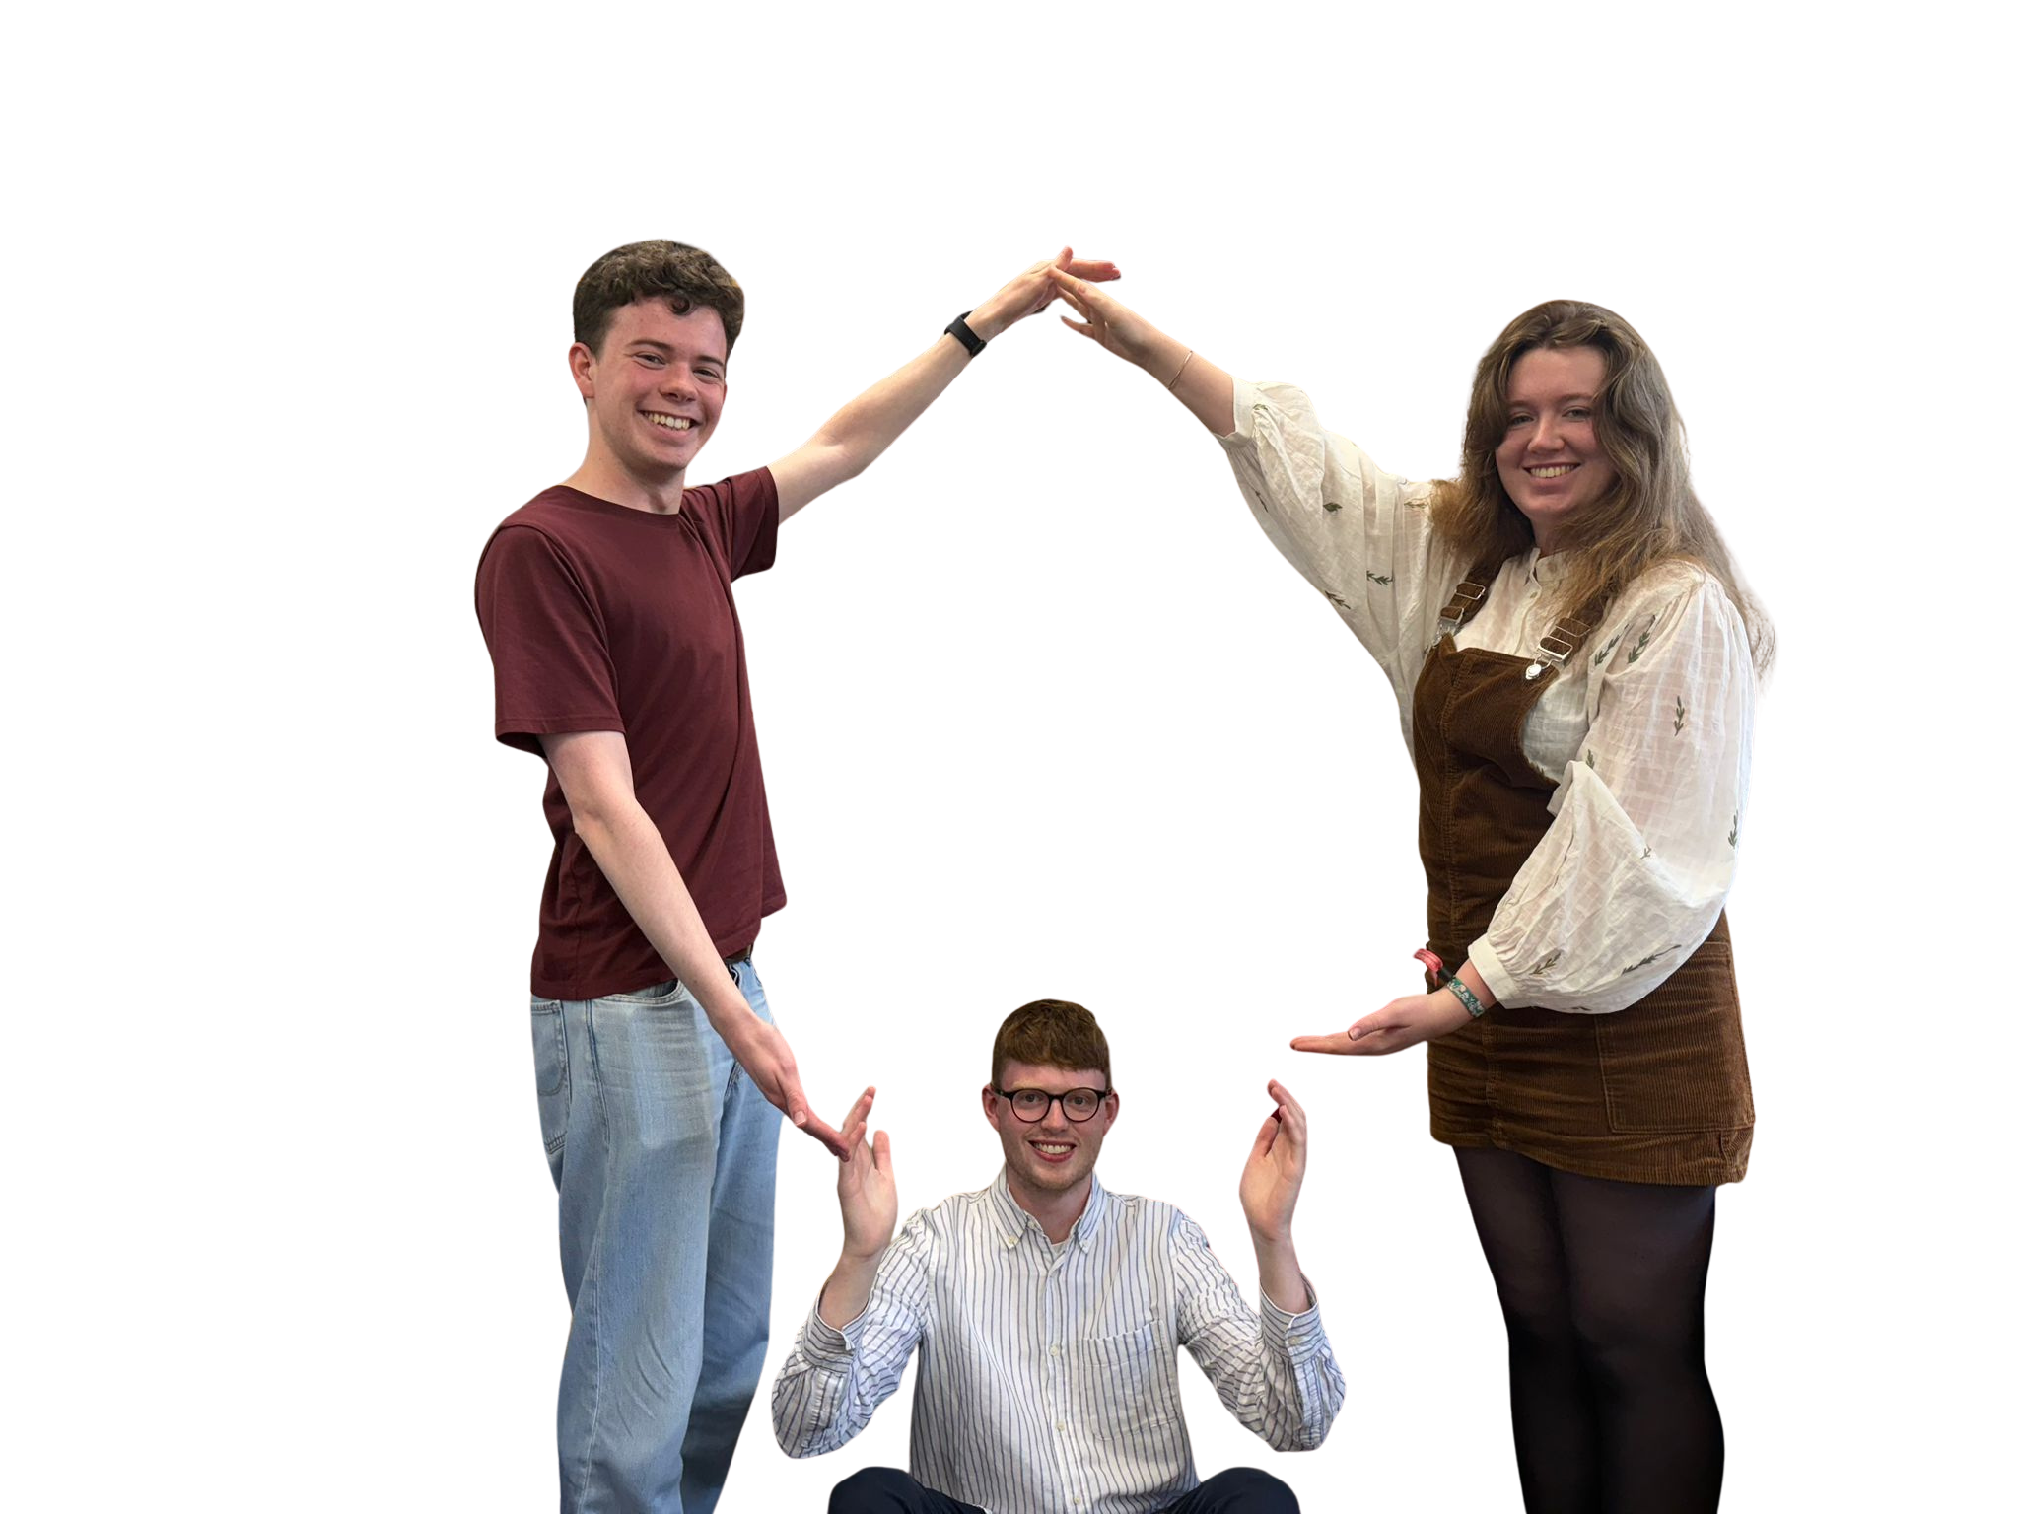

GO RAIBH
MAITH AGAIBH!

