Slide 1
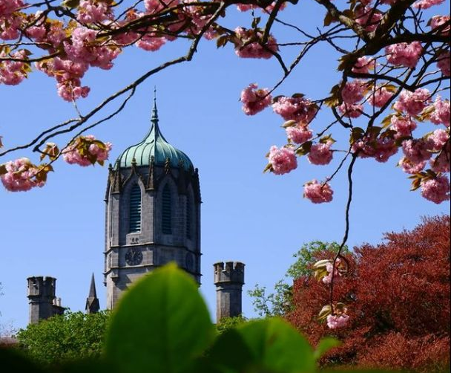
Introduction to Sustainability
Photo Credit: @KishanM2020
Dr Richard Manton, Michelle O’Dowd Lohan,
Sustainability Office

Slide 2
Our commitment to sustainability
Sustainability in practice
How can I get involved?

Slide 3





OUR CORE VALUES
RESPECT
SUSTAINABILITY
EXCELLENCE
OPENNESS
BELONGING
Notes:
The first thing I would say is that as a university we are committed to sustainability at the institutional level. Sustainability is one of our 4 core values and a key pillar of our Strategeic Plan, and we have 10 flagship actions across the university mission. These four core values emerged during a period of extensive campus wide consultation in 2019 and the value of sustainability emerged because of the very strong student voice so our students have done more than any other cohort to progress forward the sustainability vision. The day we launched the Strategic Plan our University president also signed the SDG Accord. What that means is that we have committed publicly to aligning all our major efforts in teaching and learning, research operation and planning and engagement activities to the UN SDGs. starting in earnest with the launch of the Strategic Plan in 2020 and signing the SDG Accord

Slide 4
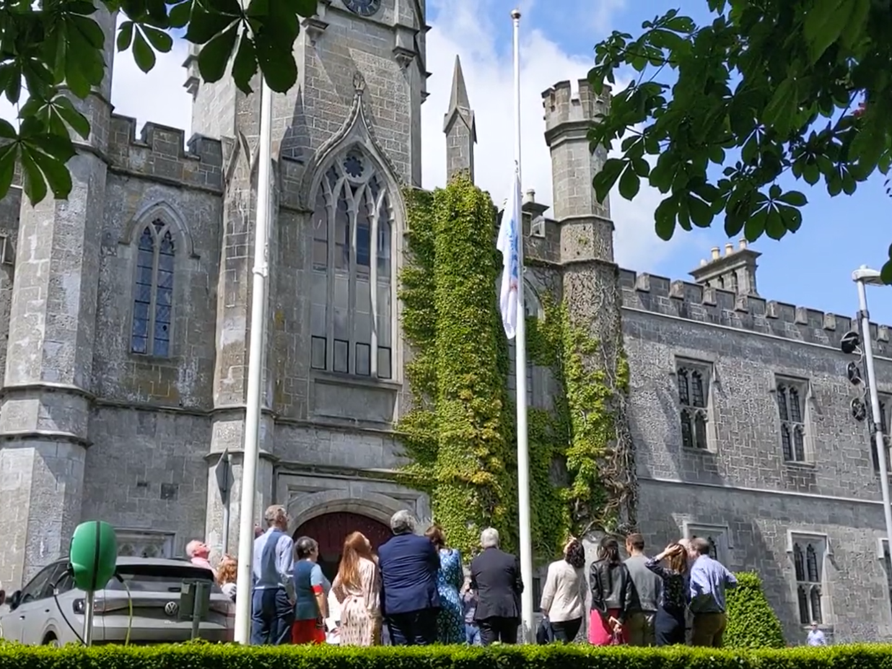
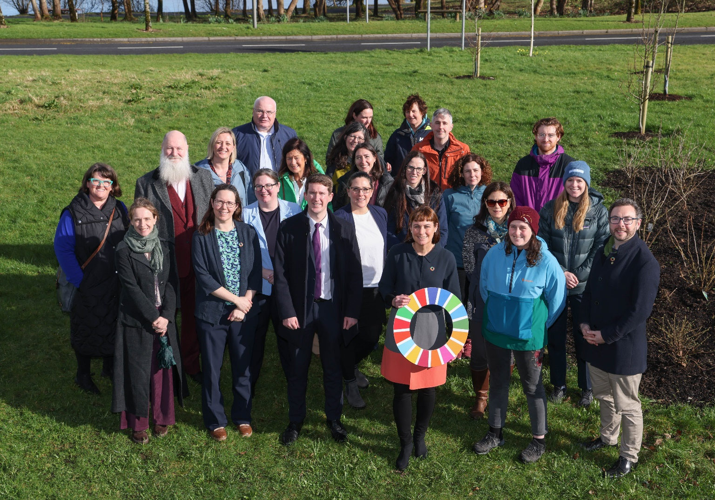

University of Galway
National
SDG Ambassador
Notes:
We are an SDG Champion for Ireland and the first University to hold this honour. Tasked with being an advocate, a role model and a leader for Ireland in progressing the SDGs.

Slide 5
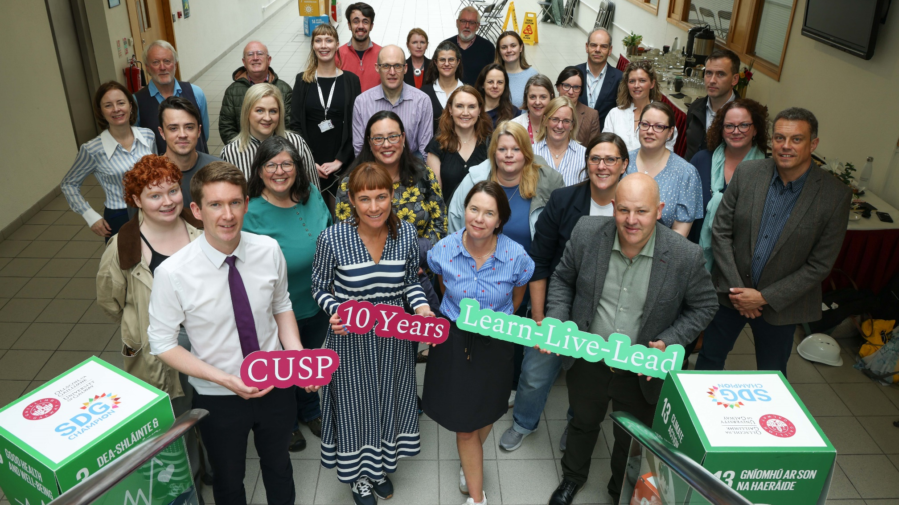

Slide 6
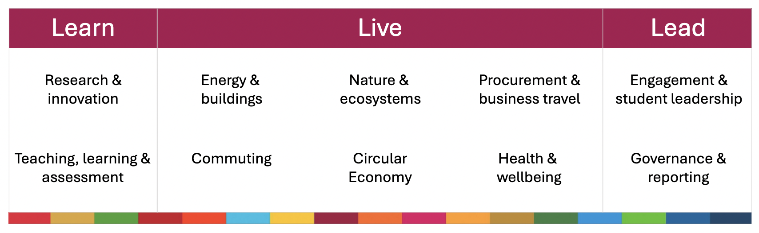

Slide 7

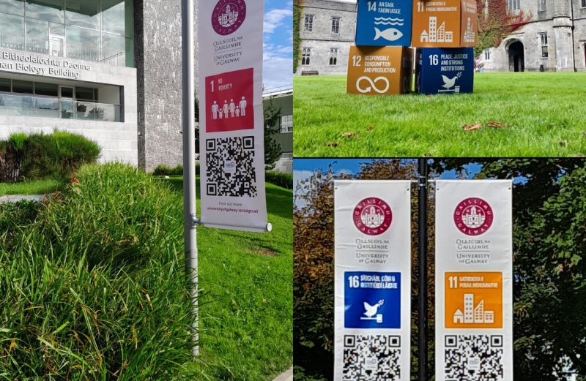
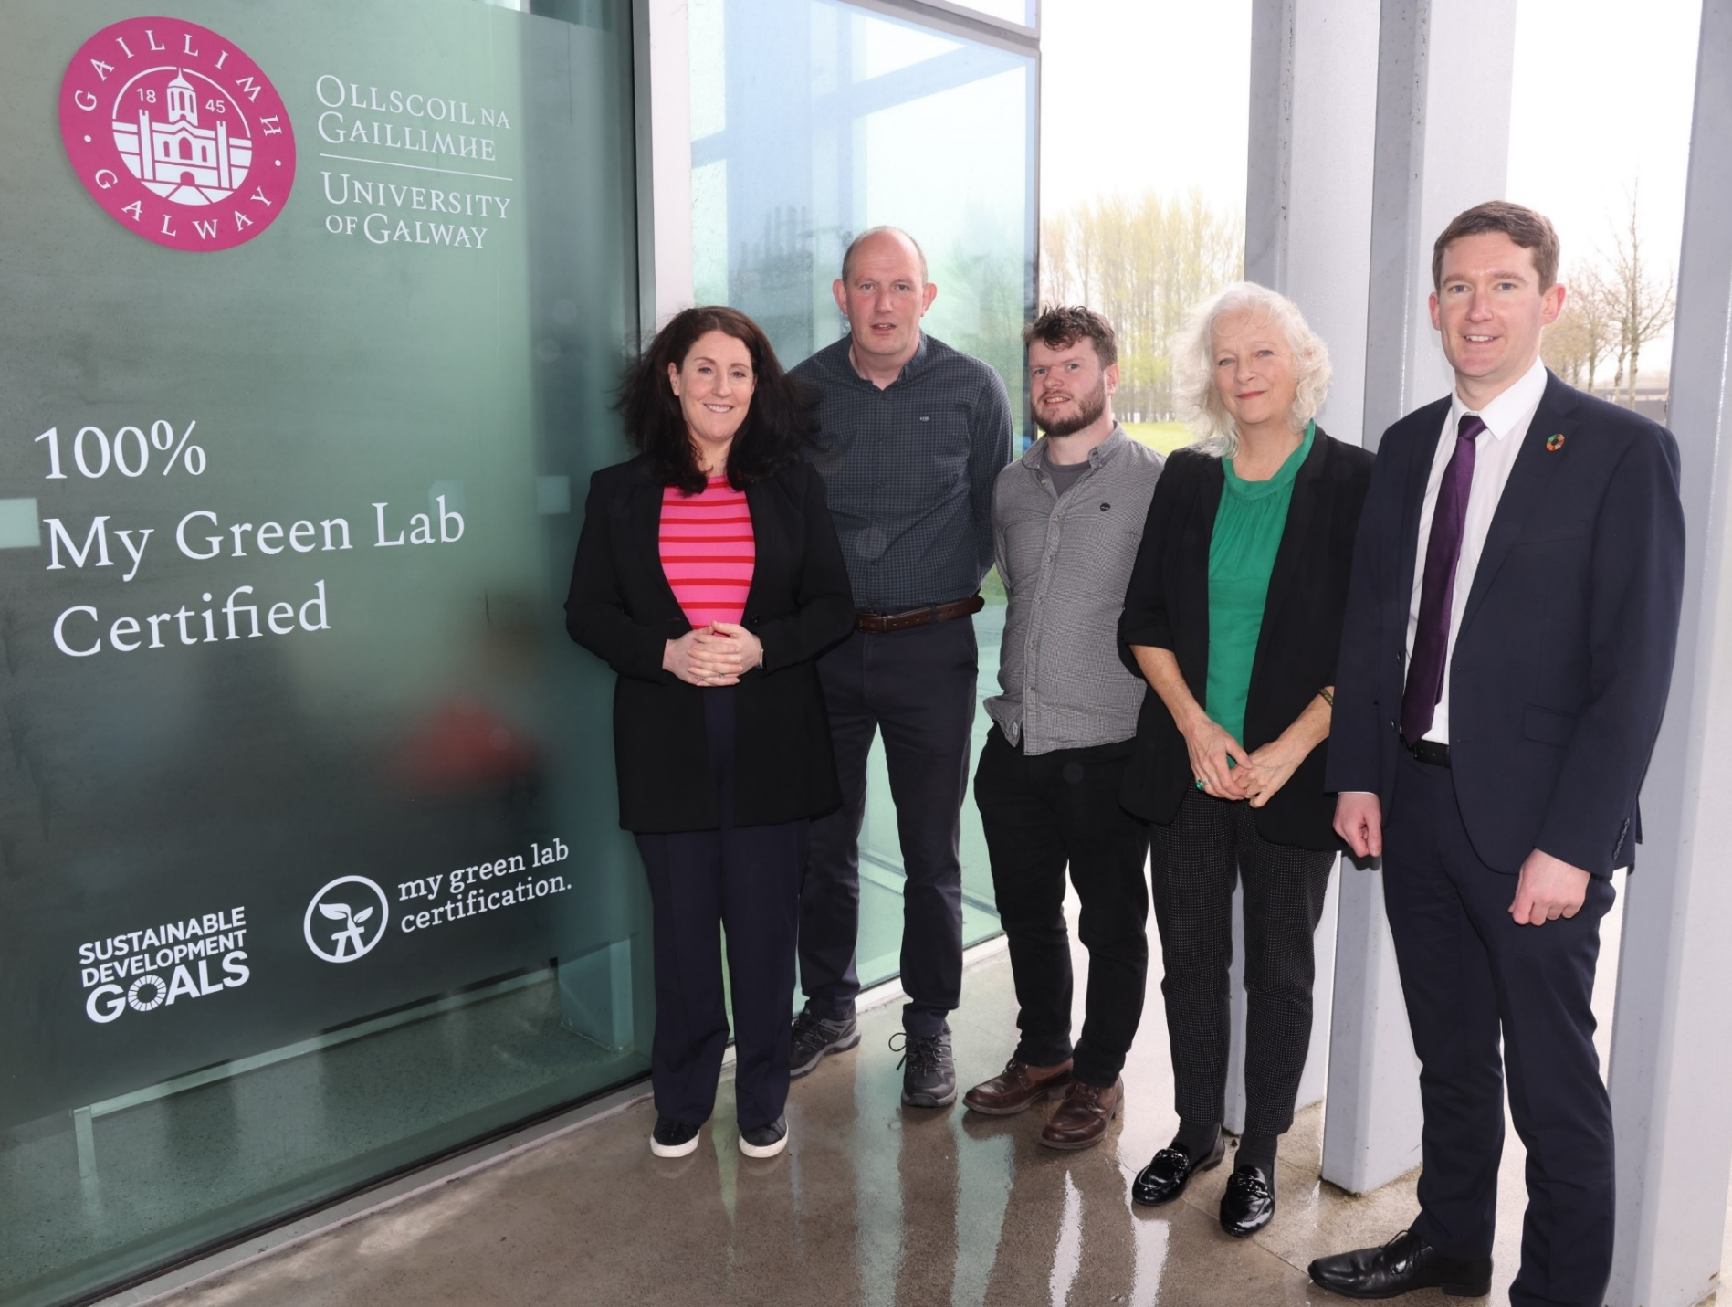

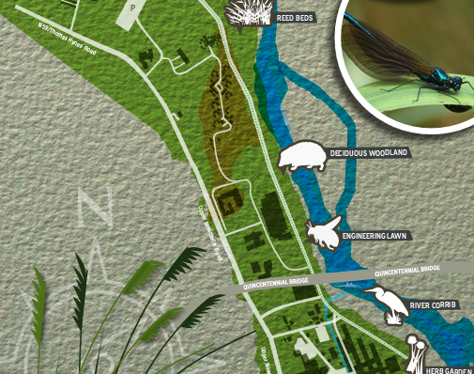

Slide 8
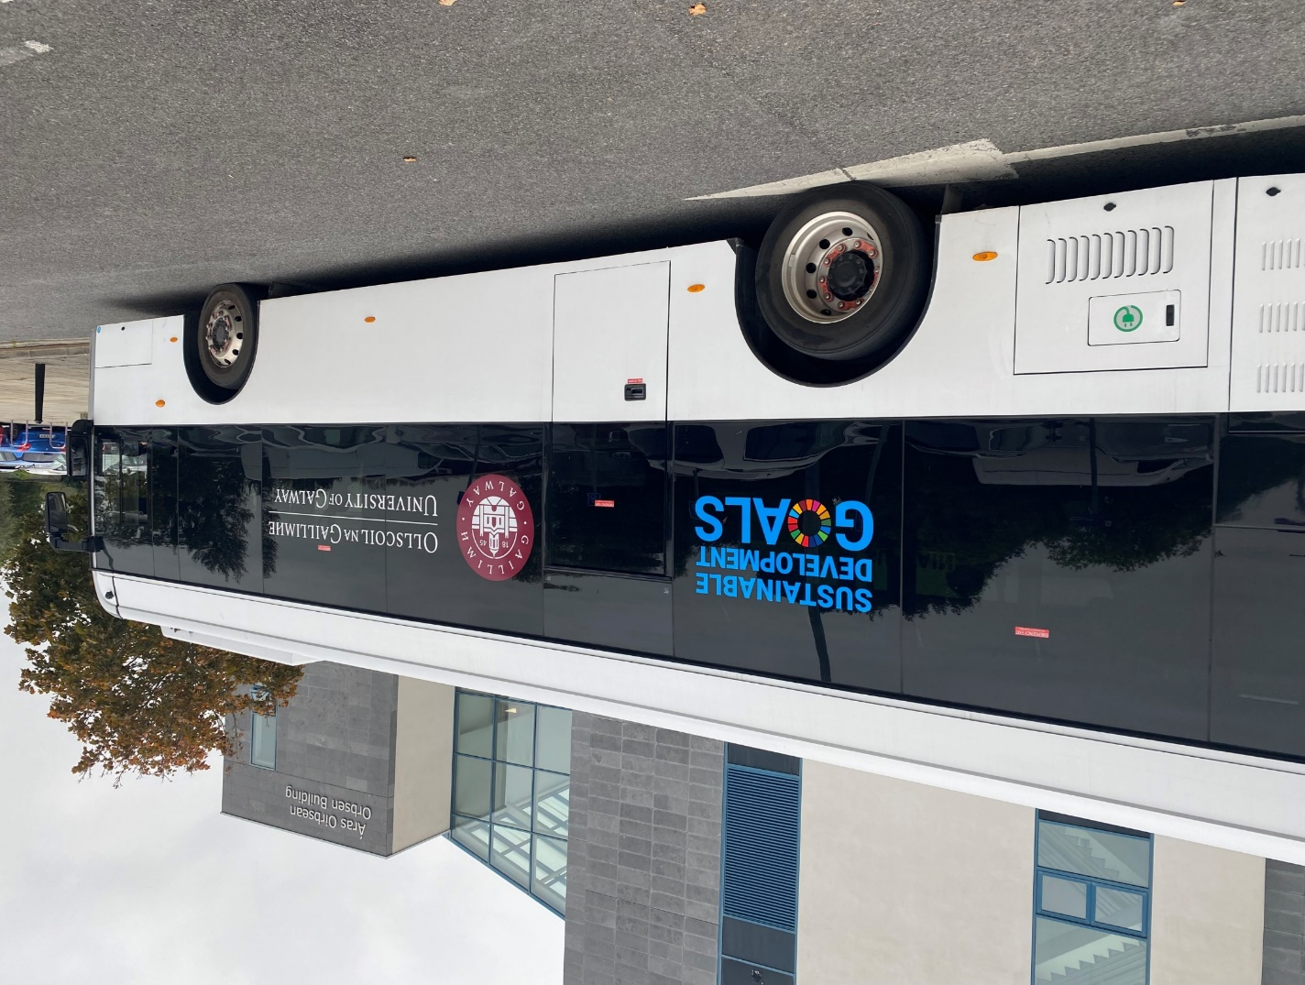
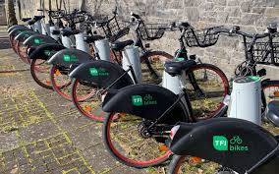
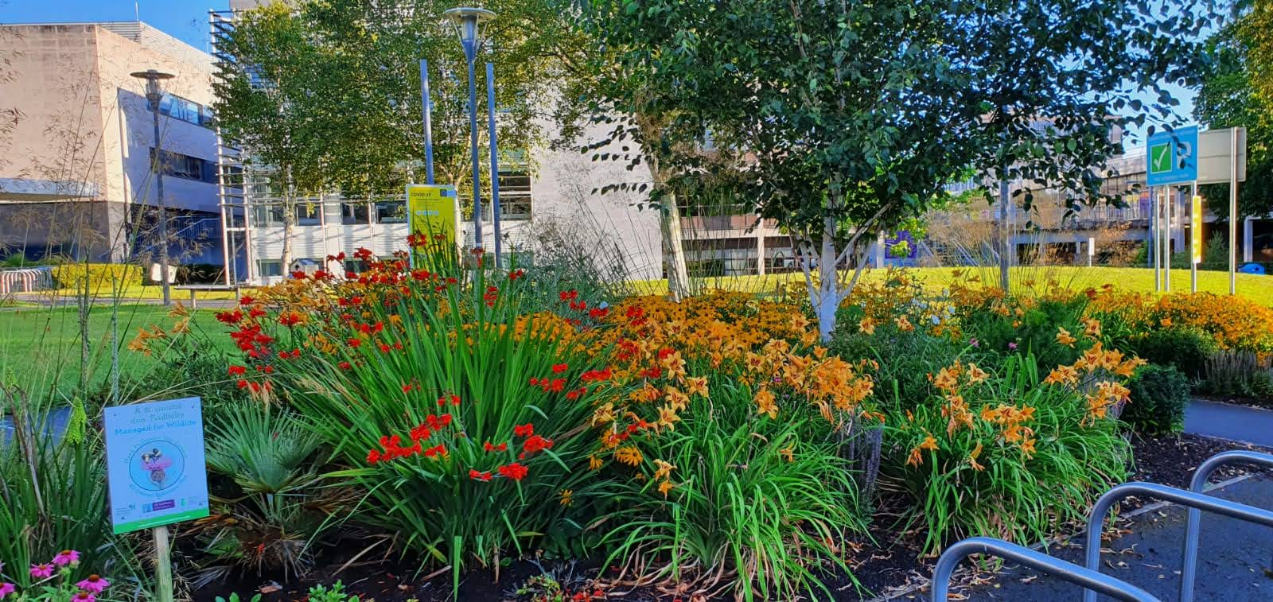


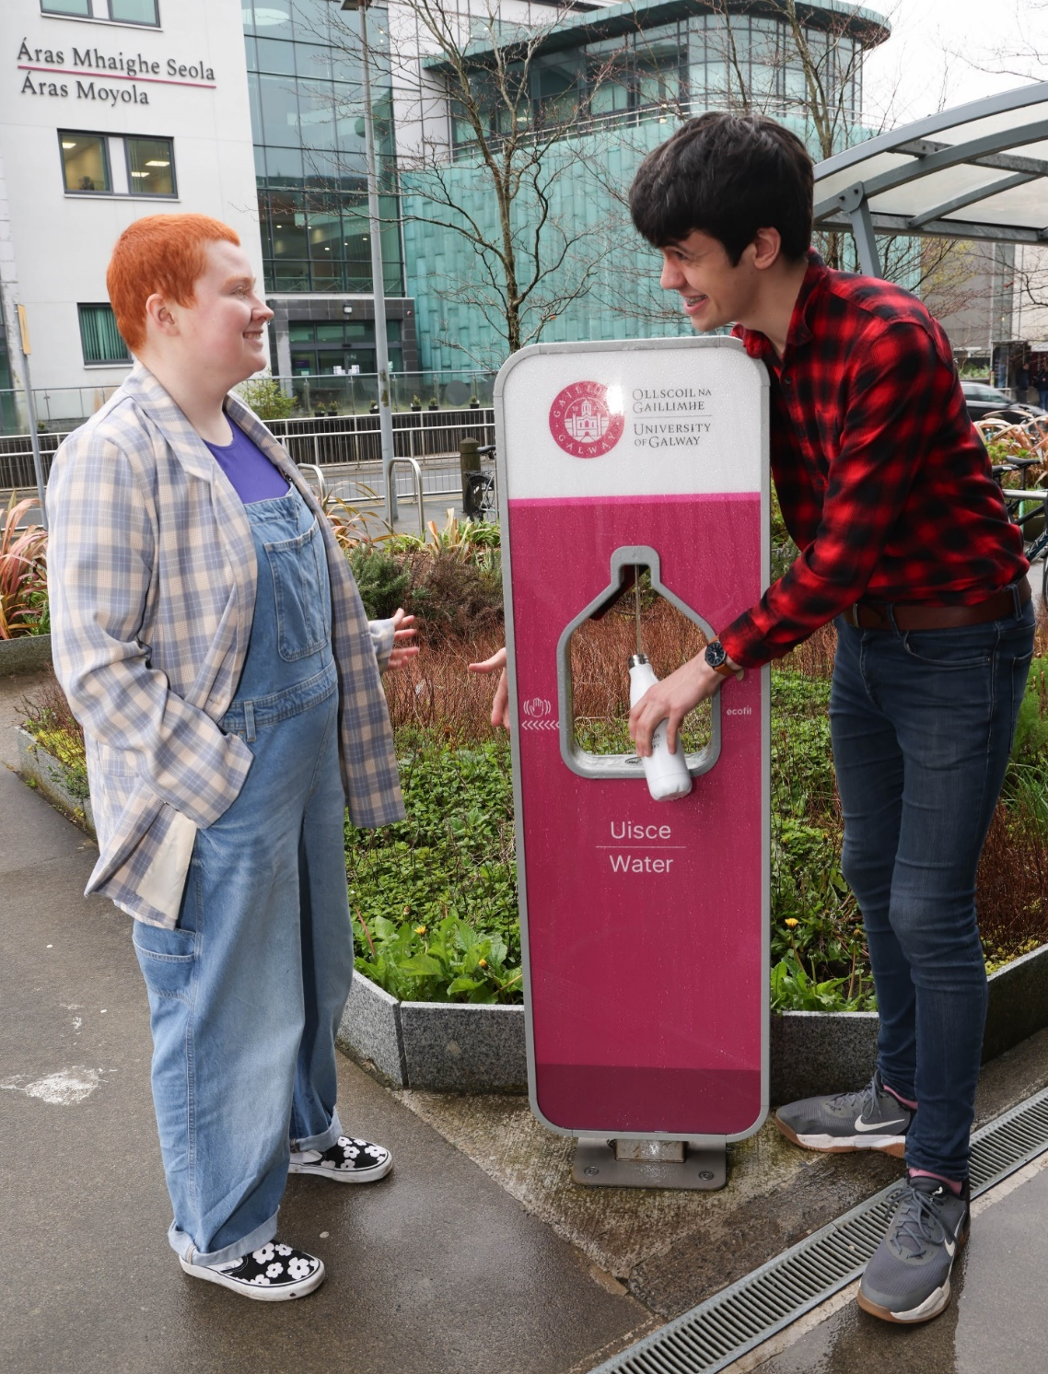
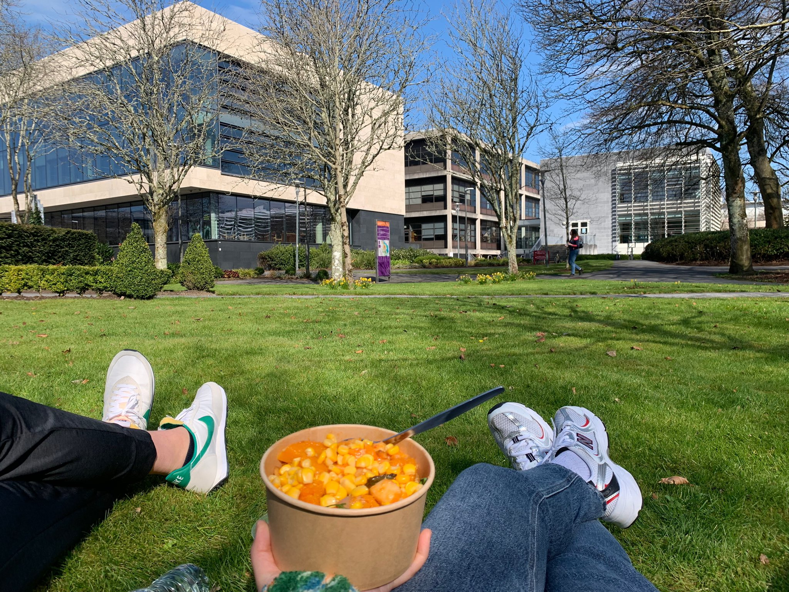
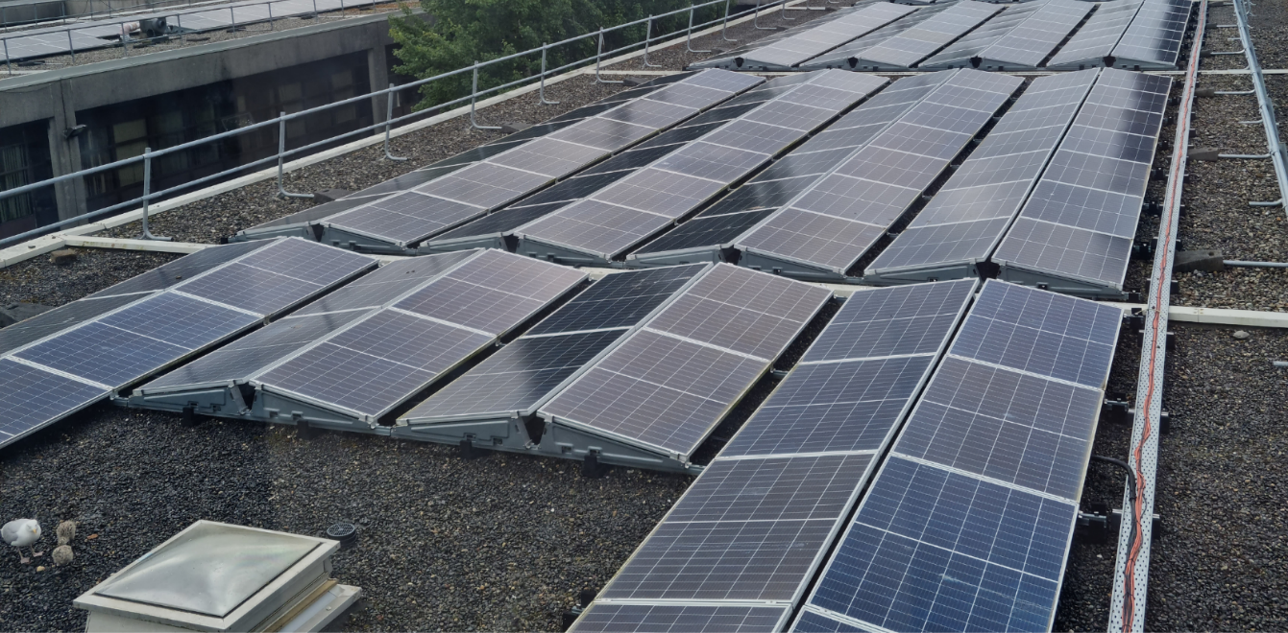
Photo Credit: @JenniferPage_Z
Notes:
20,00 people on the campus and everyone has a role to play. Student activism and voice is key.

Slide 9
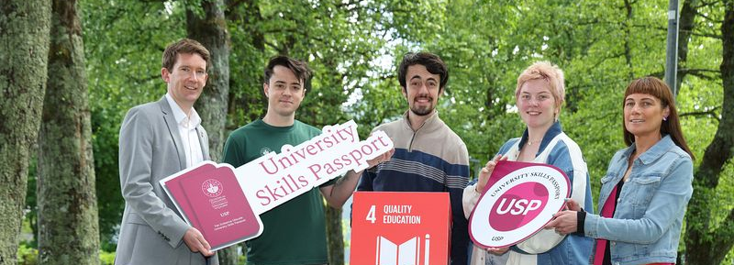

1. Attend Introduction to Sustainability induction.
2. Participate in:
the Community & University Sustainability Partnership (CUSP) (6hrs)
OR Get active in the SU Climate Crew (6hrs)
OR Achieve a Student Sustainability Leadership Awards
OR Be a Student Residences Sustainability Champion
3. Write a short reflection paragraph (max 300 words).

Slide 10
How can I get involved?
Get involved in a sustainability-themed society
Join Climate Crew
Take on a community volunteering role
Earn a Sustainability Champion Digital Badge
Apply for a Sustainability Leadership Award
Stay connected with us

Slide 11

How to Stay in Touch
Check out our Sustainability Website
www.universityofgalway.ie/sustainability
Follow us on Instagram @Uniofgalwaysustainability
Follow us on Linkedin University of Galway Sustainability Office
Email sustainability@universityofgalway.ie

