Slide 1


Student Services & Supports Jane Ennis Acting Student Support Manager

Slide 2
An exciting time...
But challenges can arise!

Slide 3



Áras na Mac Léinn (Student Centre)
Hub Common Room
Societies (Socs Box)
Volunteering ALIVE
Students’ Union
Flirt FM Campus Radio
Student Health Unit

Slide 4


Student Health Unit
Áras na Mac Léinn (upstairs)
Monday – Friday 9.15am - 12.30pm and 2.30pm - 4.30pm
Appointment only - book online
Consultations with the Doctor and Nurse are usually free – some services incur a charge

Slide 5



Student Services are here to support your success
www.universityofgalway.ie/student-services/

Slide 6
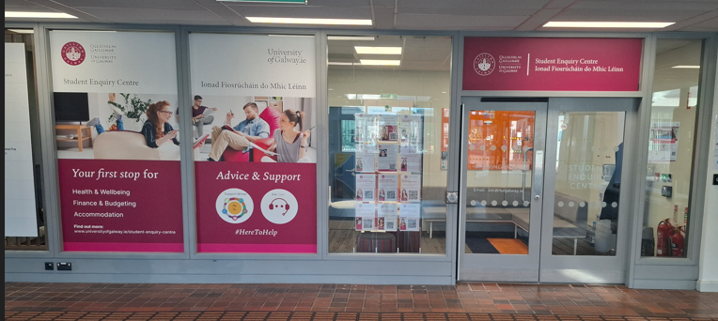


Student Enquiry Centre
Arts/Science Concourse
Your first stop for help on campus
Friendly, trained staff will assist with any query, including help with directions
Charging ports for your phone or laptop
Refill your reusable water container at our water cooler
Financial Support & Advice

Slide 7
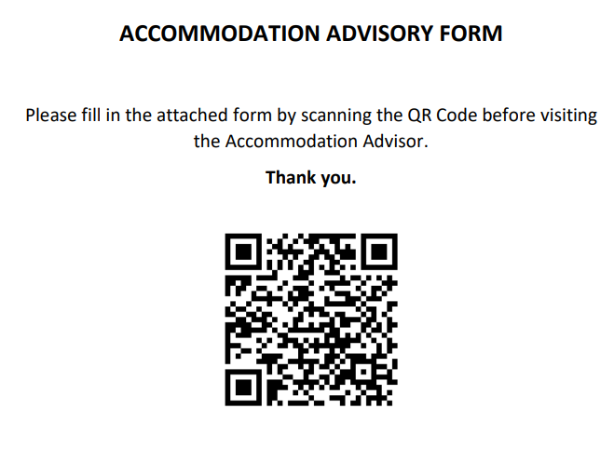
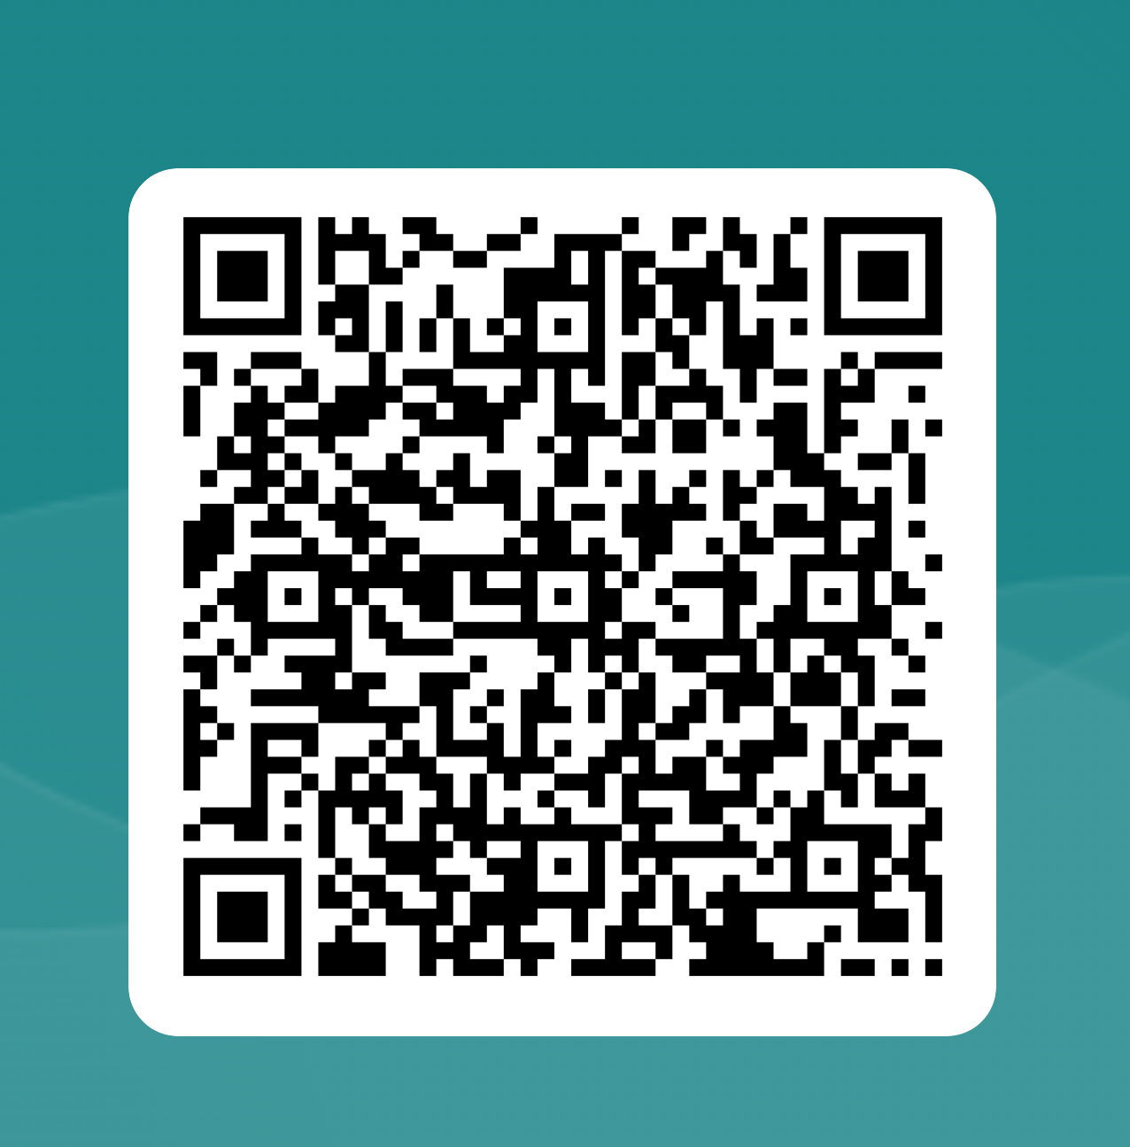
Accommodation Advisory Service
Support and guidance with your search for accommodation
Provide advice when problems arise
Open Monday – Friday 10am – 12.30pm & 2pm – 4pm, no appointment necessary
Áras Uí Chathail

Slide 8


Disability Support Service
Available to students who need support or reasonable accommodations for study and exams
Registration is REQUIRED to avail of supports
Supports are determined by an individual needs assessment
Áras Uí Chathail

Slide 9



Student Support Officers
Rosemary Crosse
College of Arts, Social Sciences & Celtic Studies
Teresa Lydon
J.E. Cairnes School of Business & Economics
Mary Cairns
School of Law
https://www.universityofgalway.ie/student-support-officers/

Slide 10


Student Support Officers
AnnMarie Gilchrist
College of Medicine, Nursing & Health Sciences
Kelly Moore
College of Science & Engineering
https://www.universityofgalway.ie/student-support-officers/

Slide 11

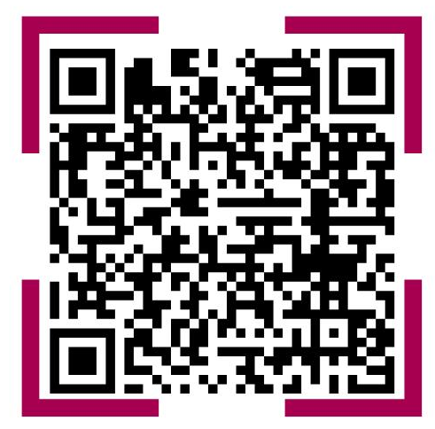
Support Wheel
The University of Galway Support Wheel is an online resource that shows the different supports available to you
It’s designed to help you quickly find the right service—whether you need academic advice, financial help, health and wellbeing support, or just someone to talk to

Slide 12

Don’t hesitate to seek or ask for help
Help is at hand – please reach out early!
No question or concern is too big, small or silly to be shared…

Slide 13


Slide 14
Thank you

