Slide 1
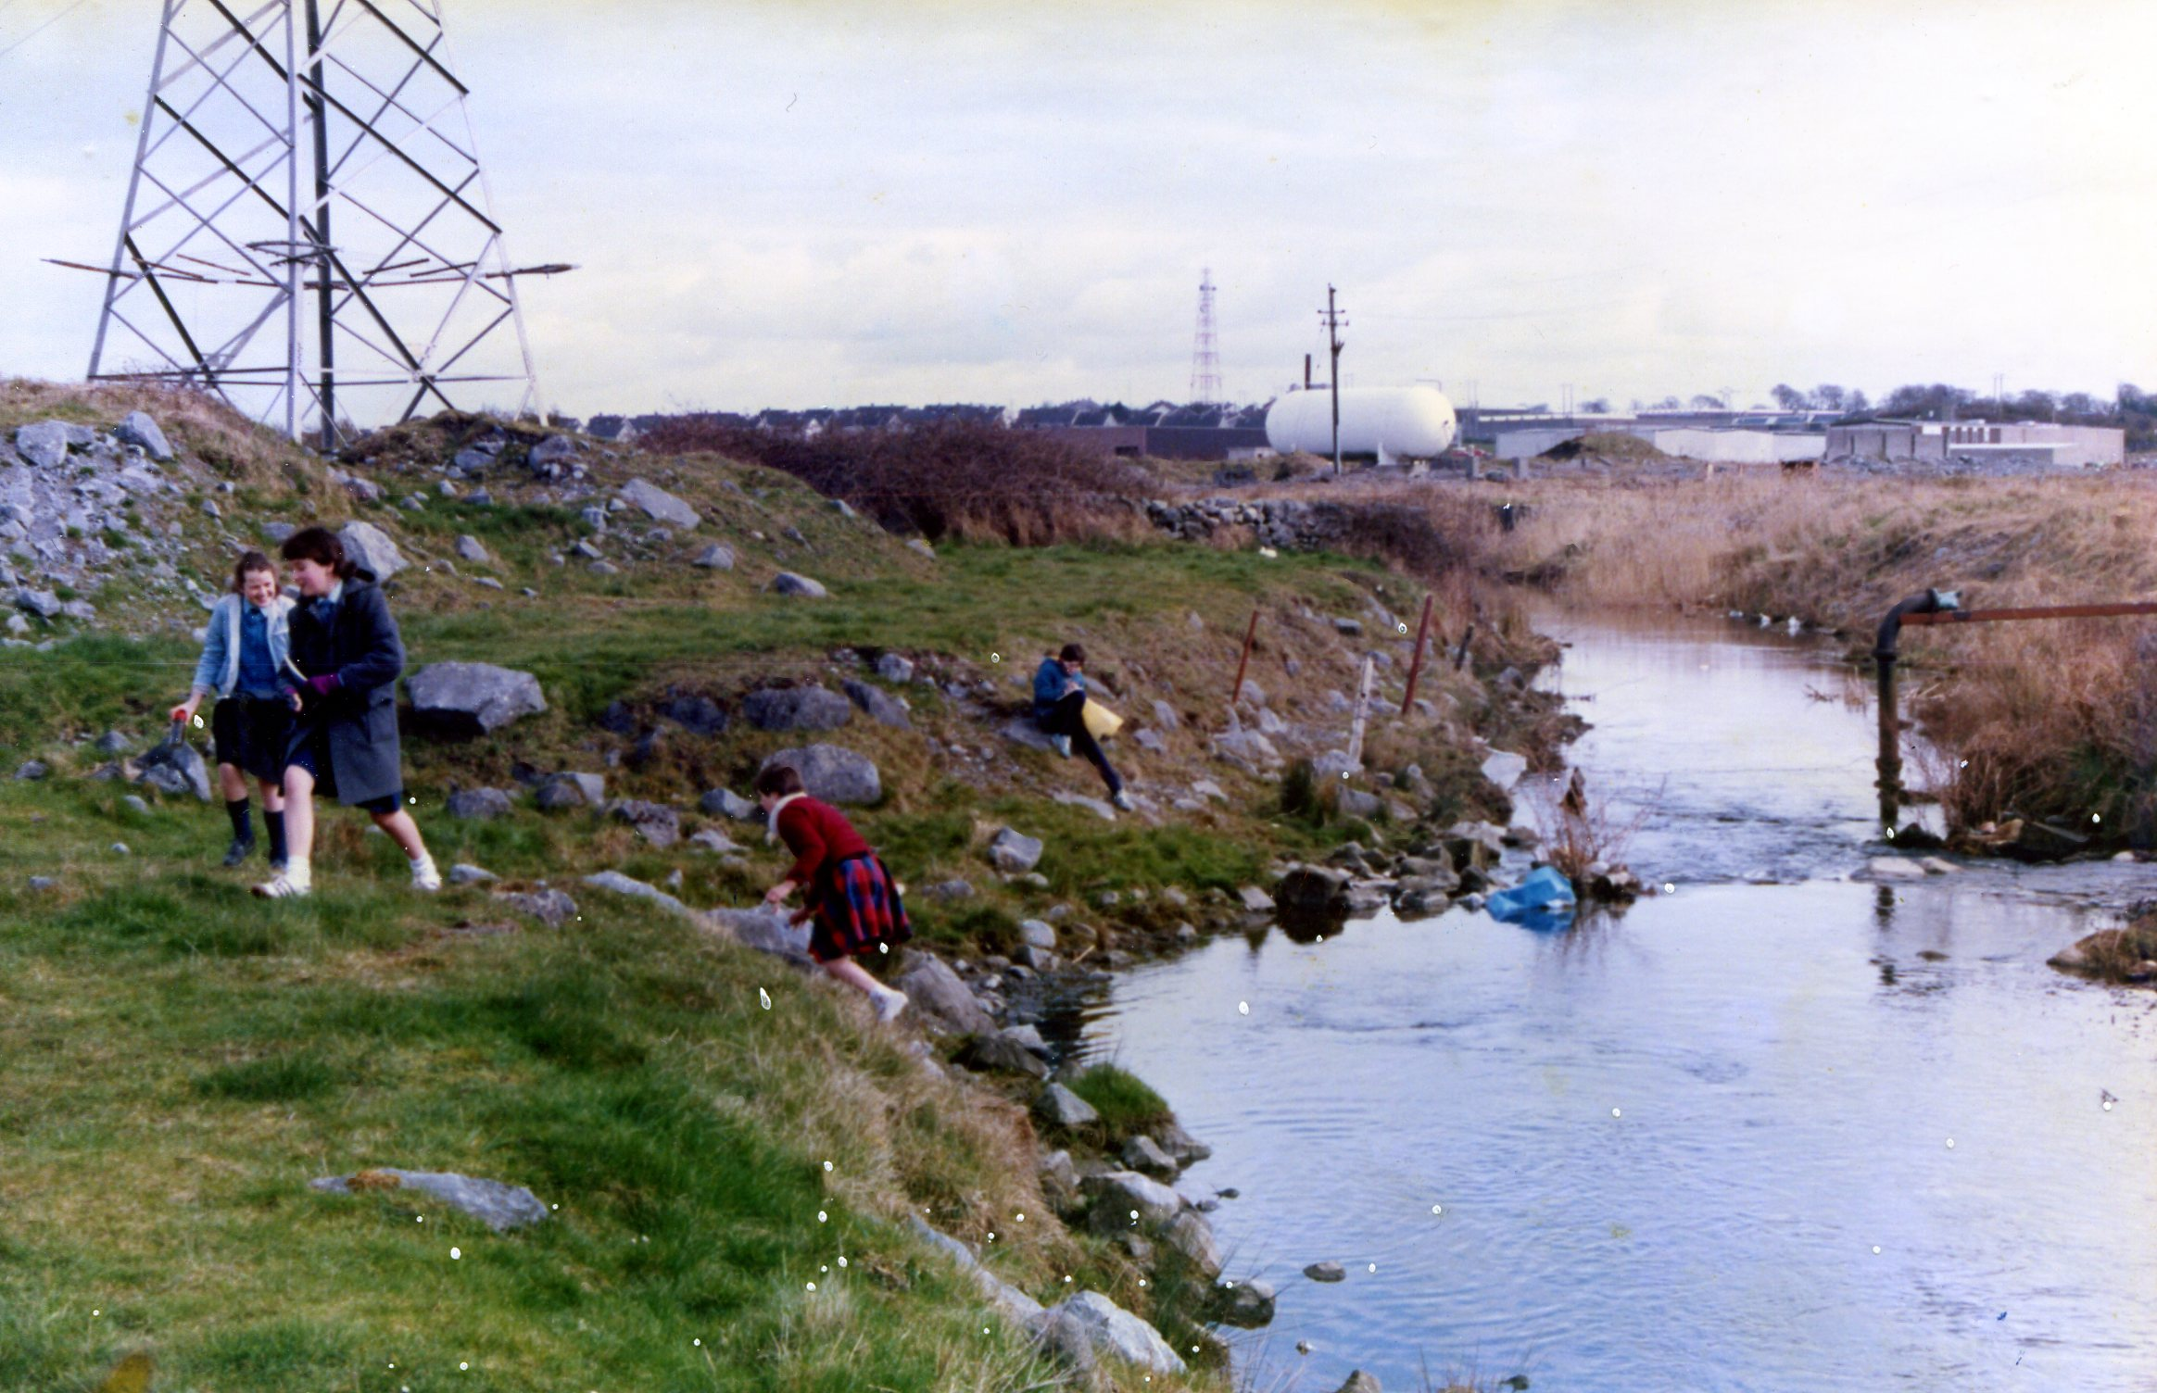
Pre 2000, it was a wasteland

Slide 2
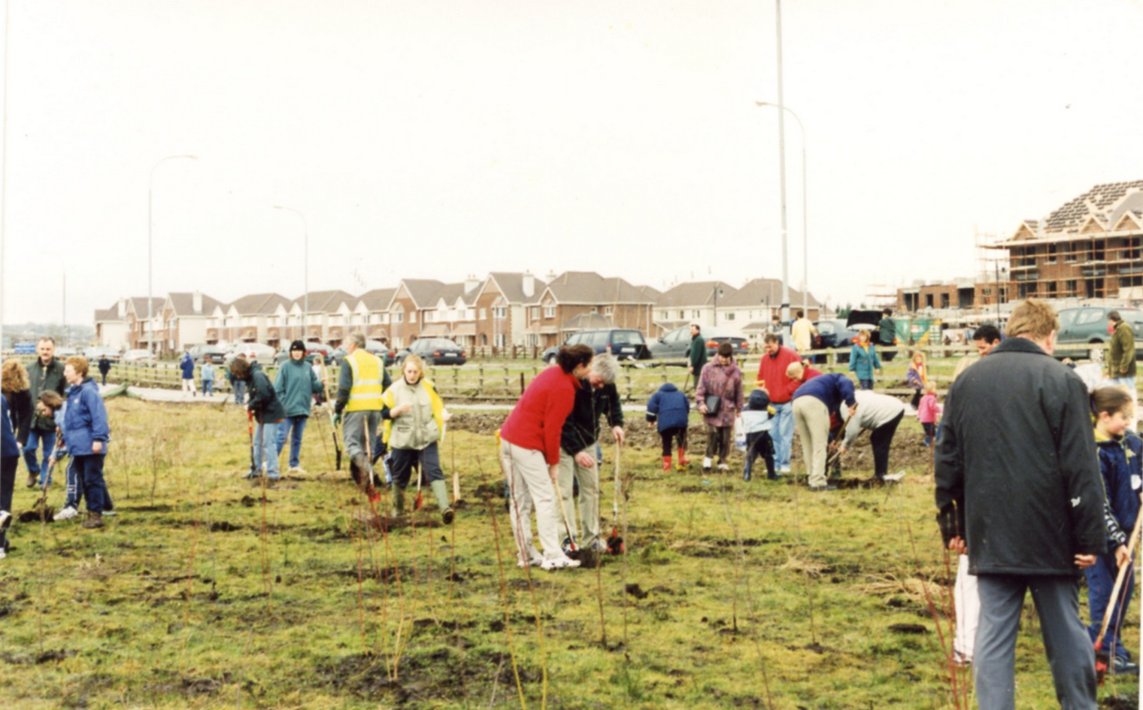
Mar 12th 2000: 3,000 people of all ages came to a field & left behind a forest

Slide 3
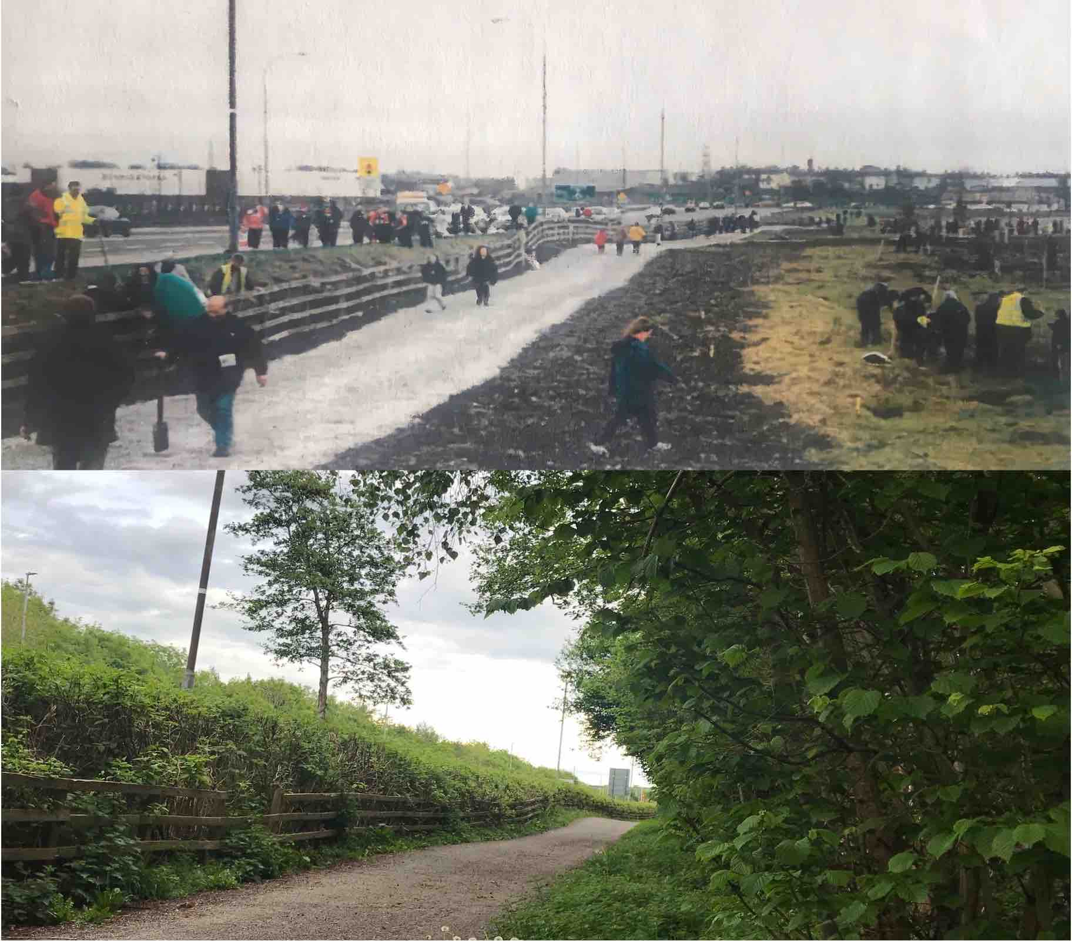
2000
2025

Slide 4
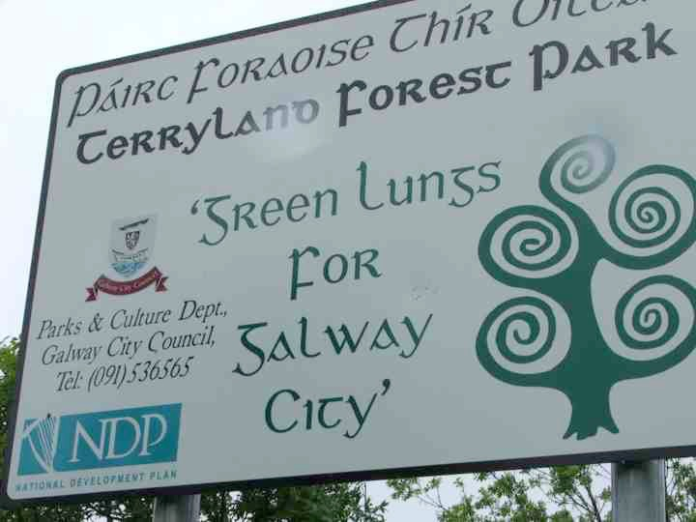
Green Lungs of the Galway City, 2000-2025

Slide 5
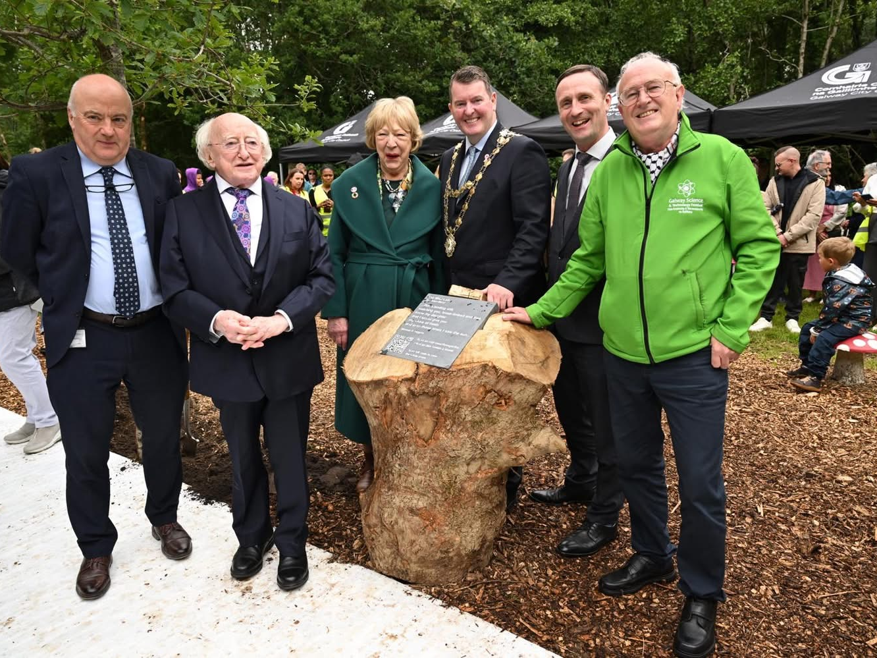
President of Ireland celebrates Terryland Forest Park’s 25 years, June 2025 & unveils his poem

Slide 6
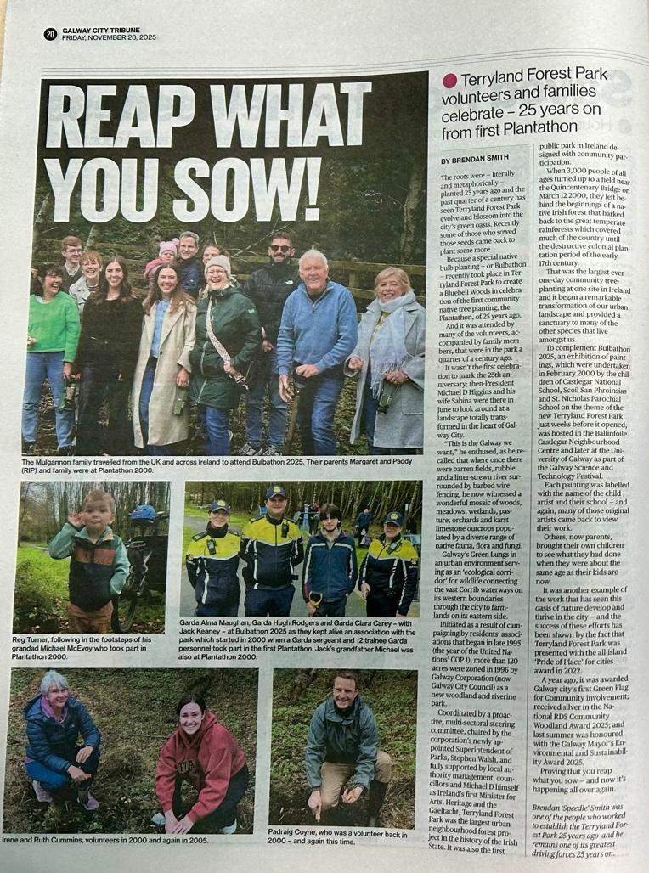
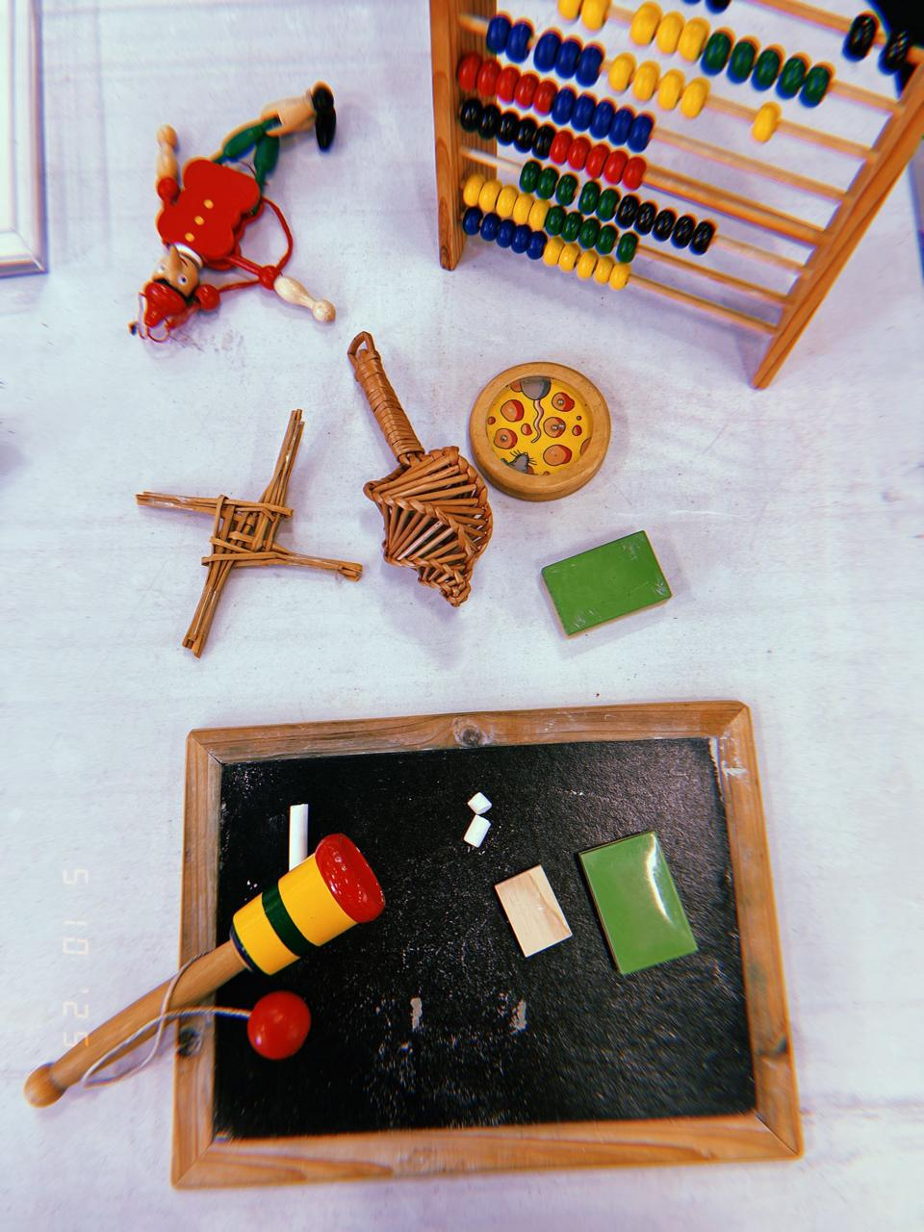
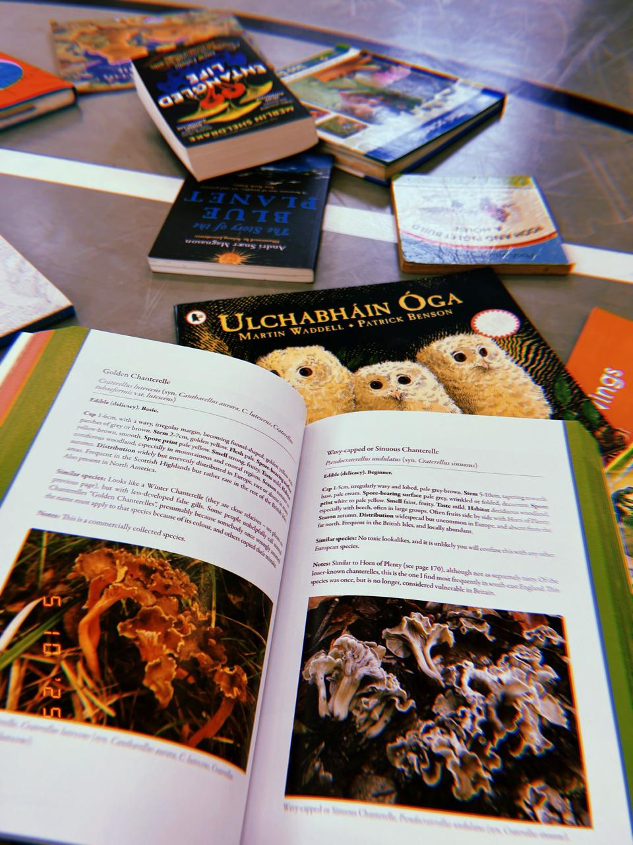
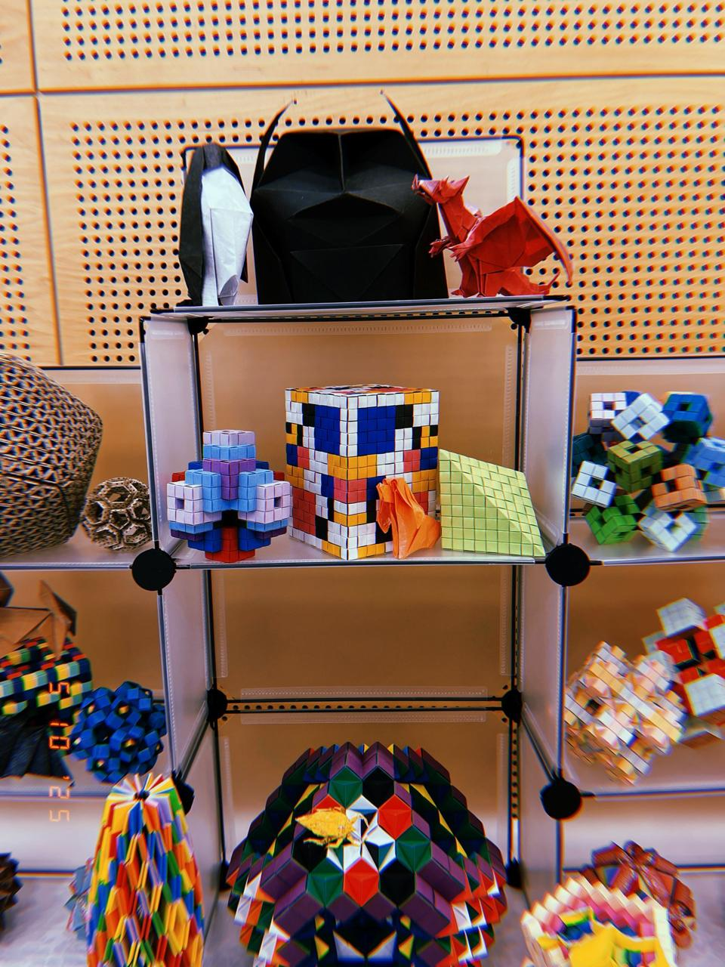
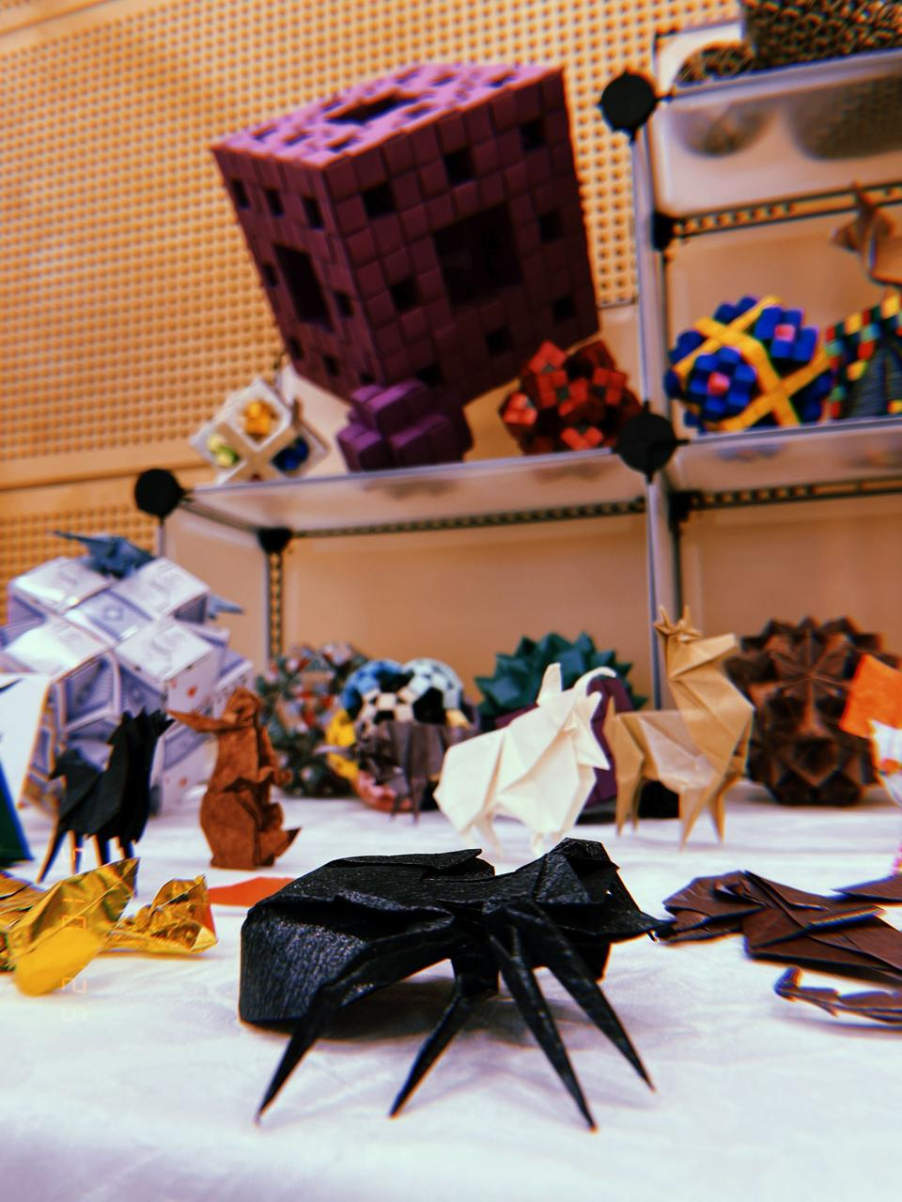
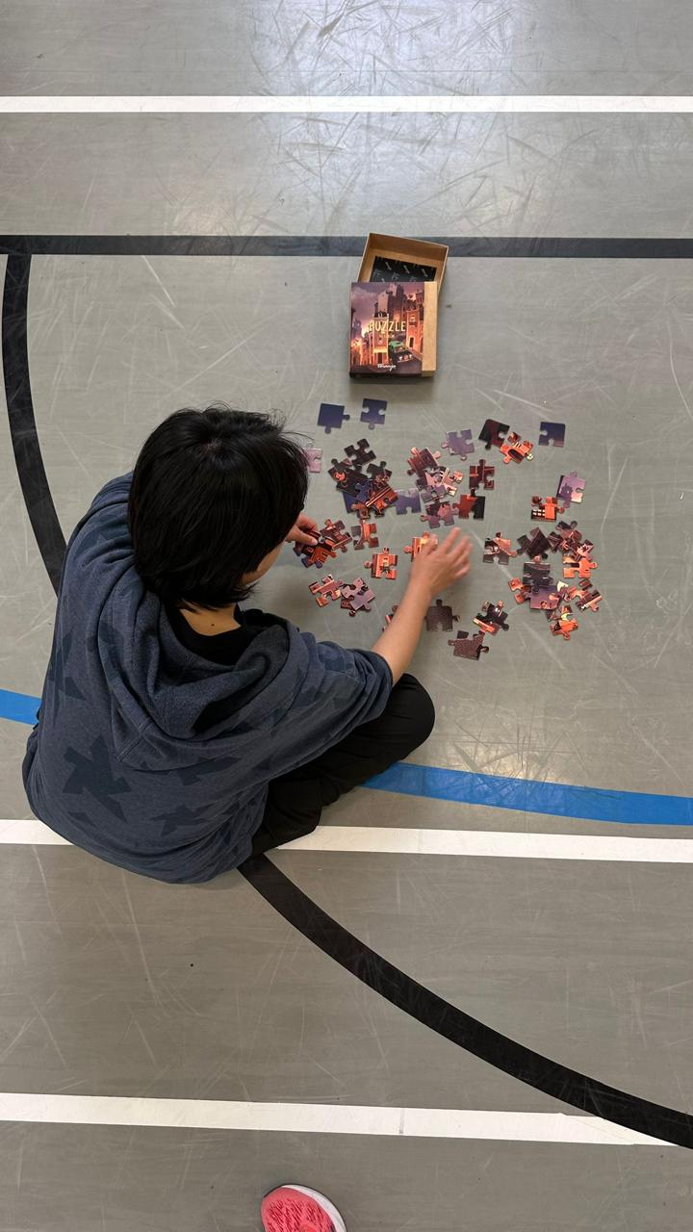
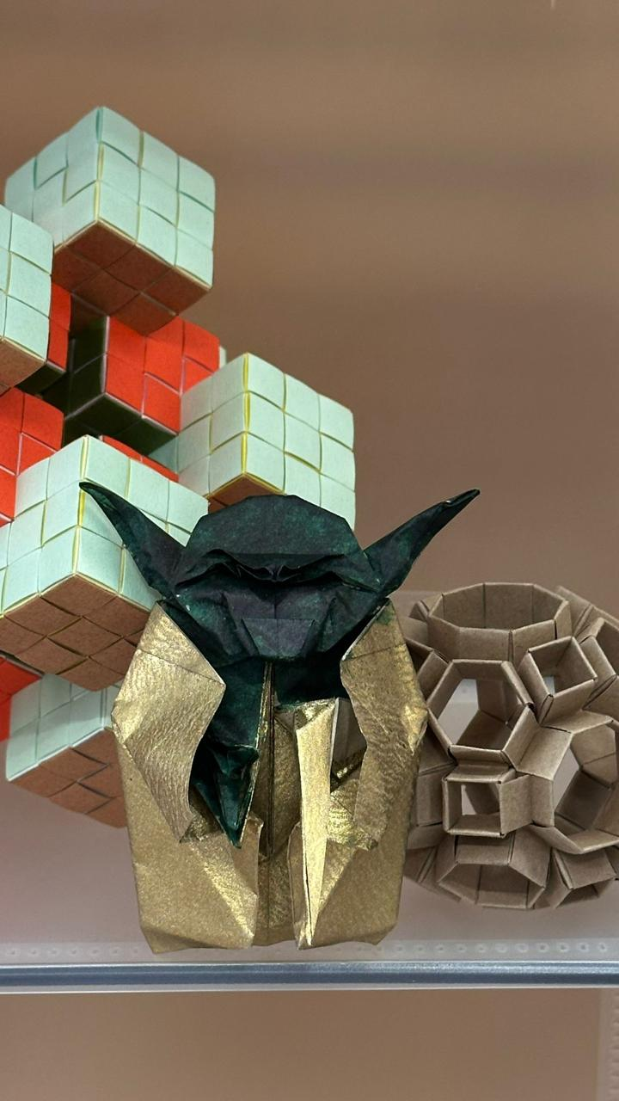
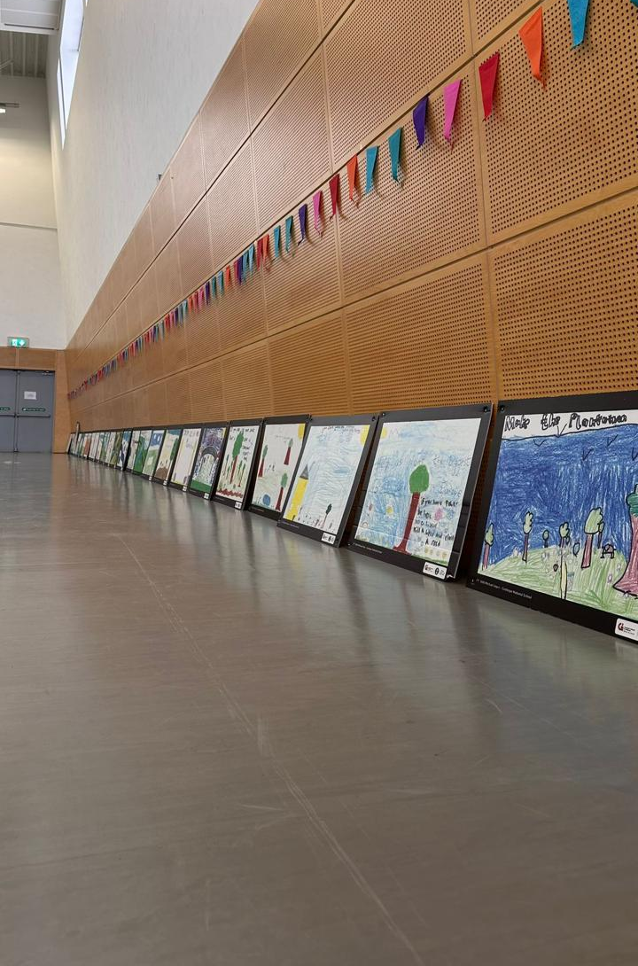
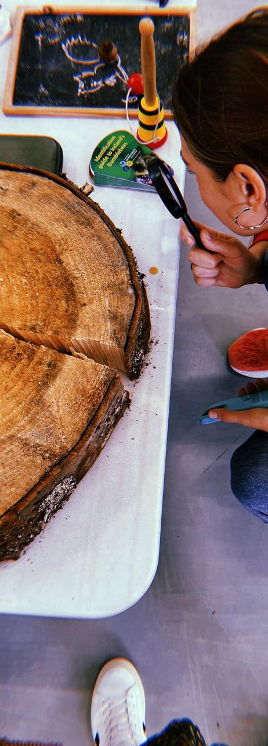
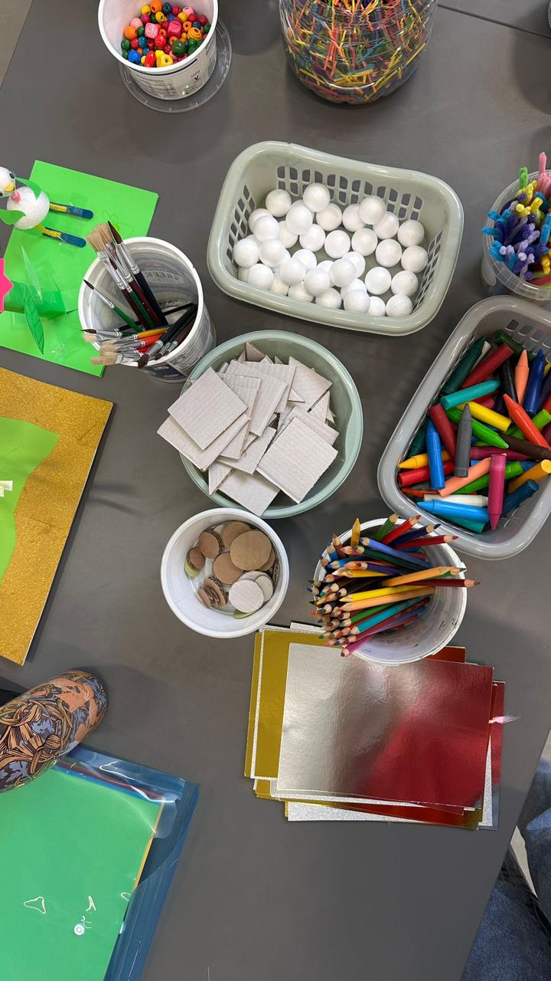
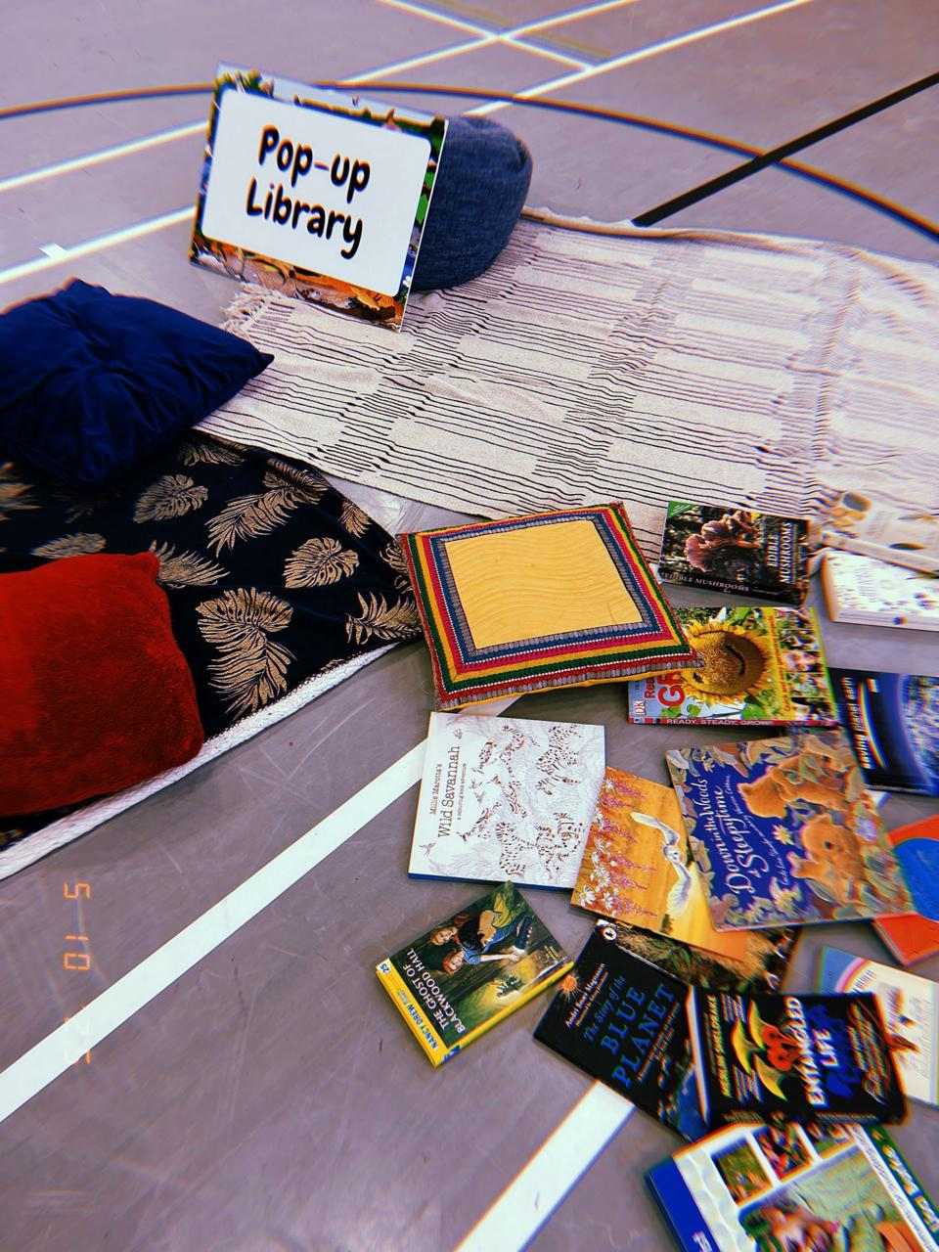
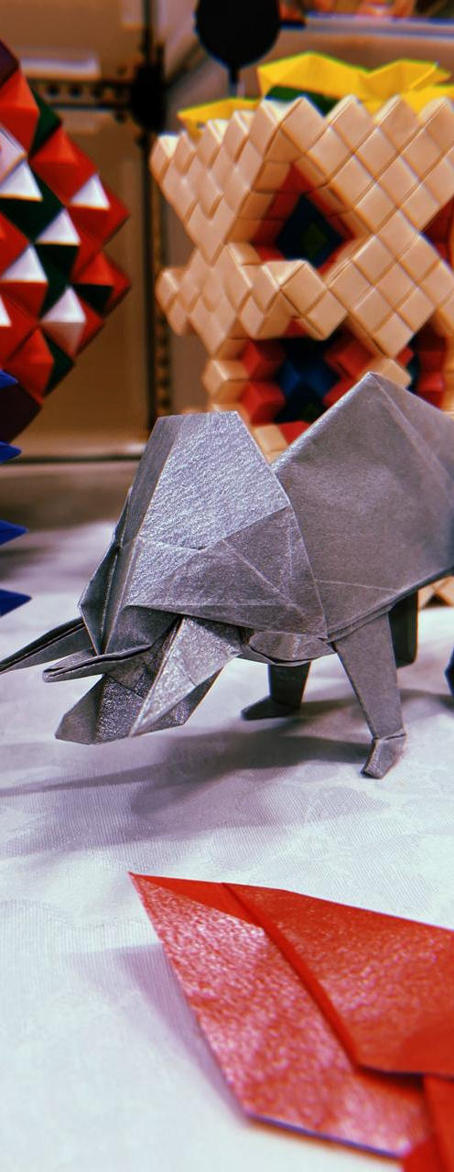

Slide 7
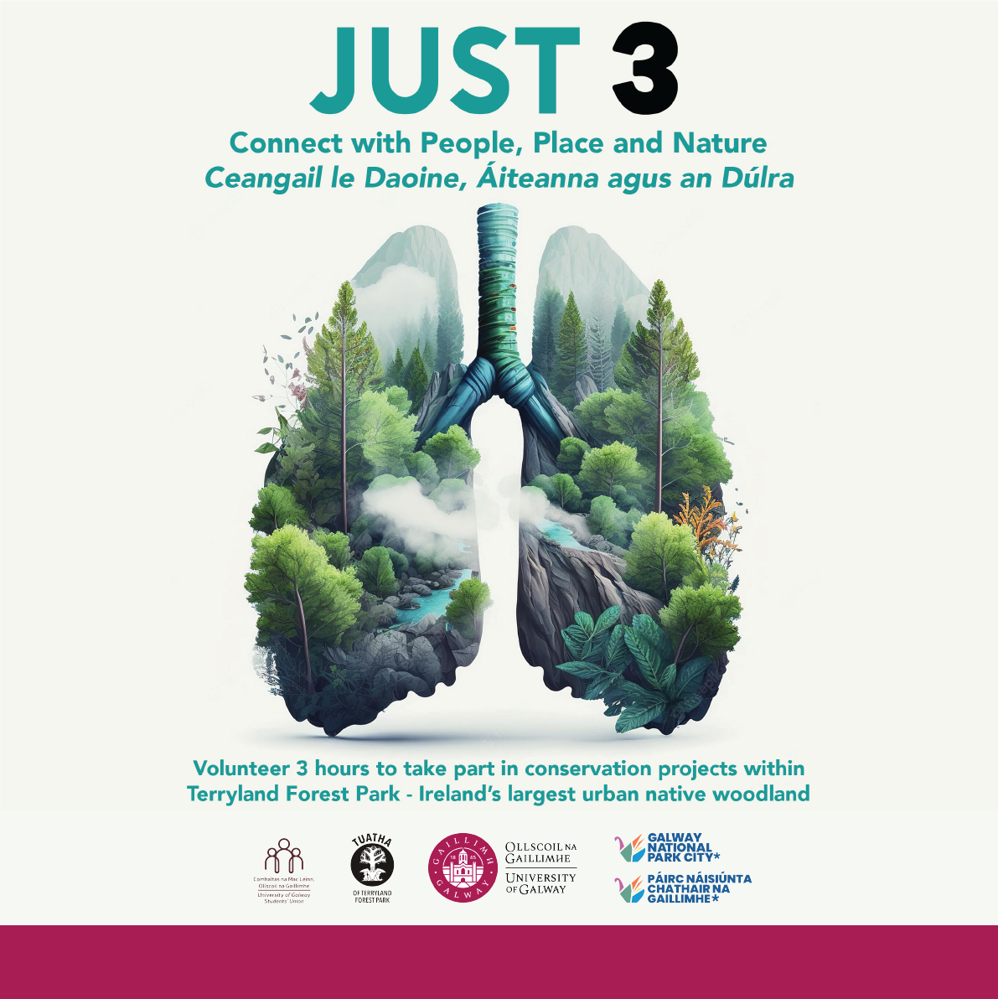

Slide 8
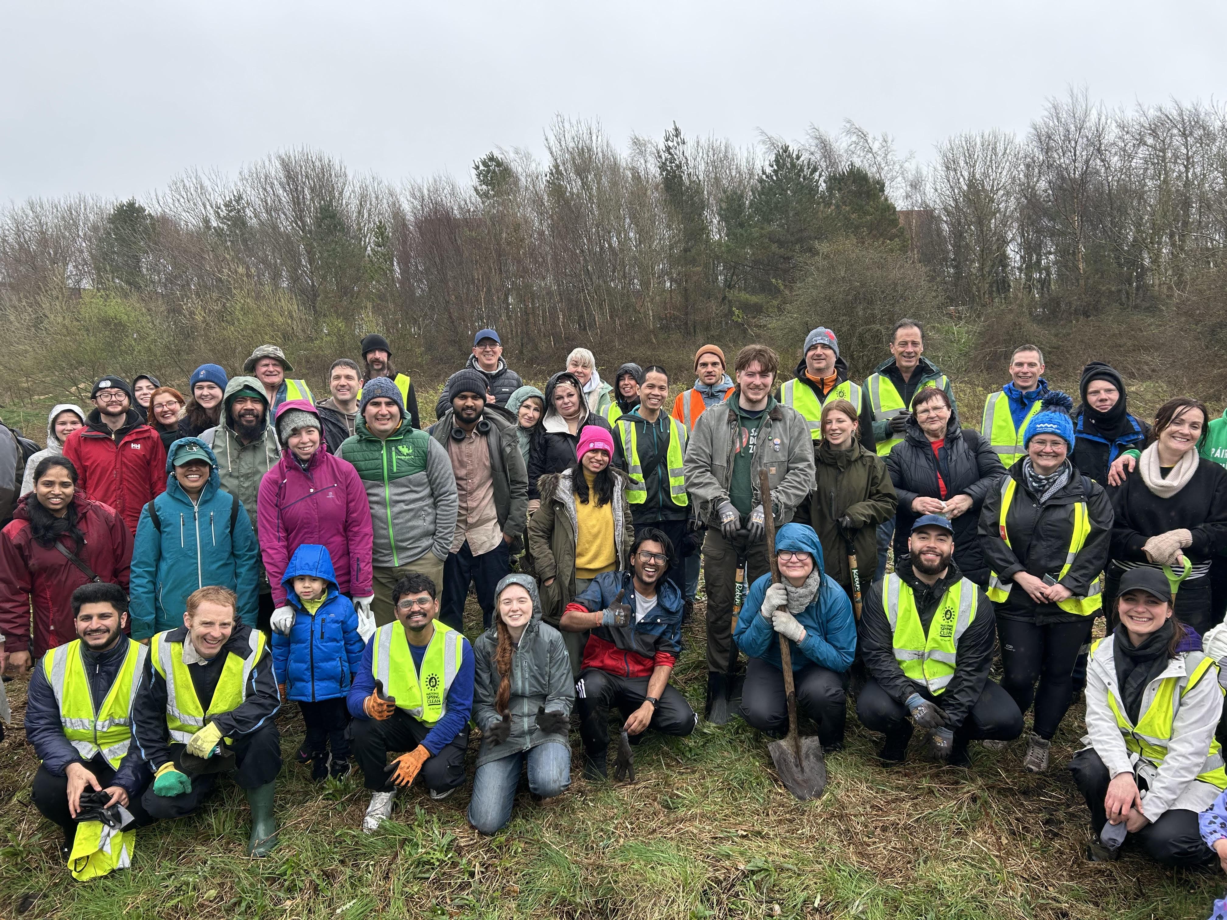
Just 3 students are part of this greening of Galway city

Slide 9
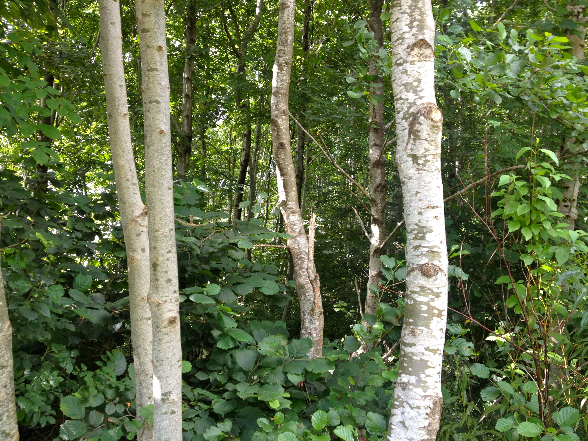
Creating Woodlands

Slide 10
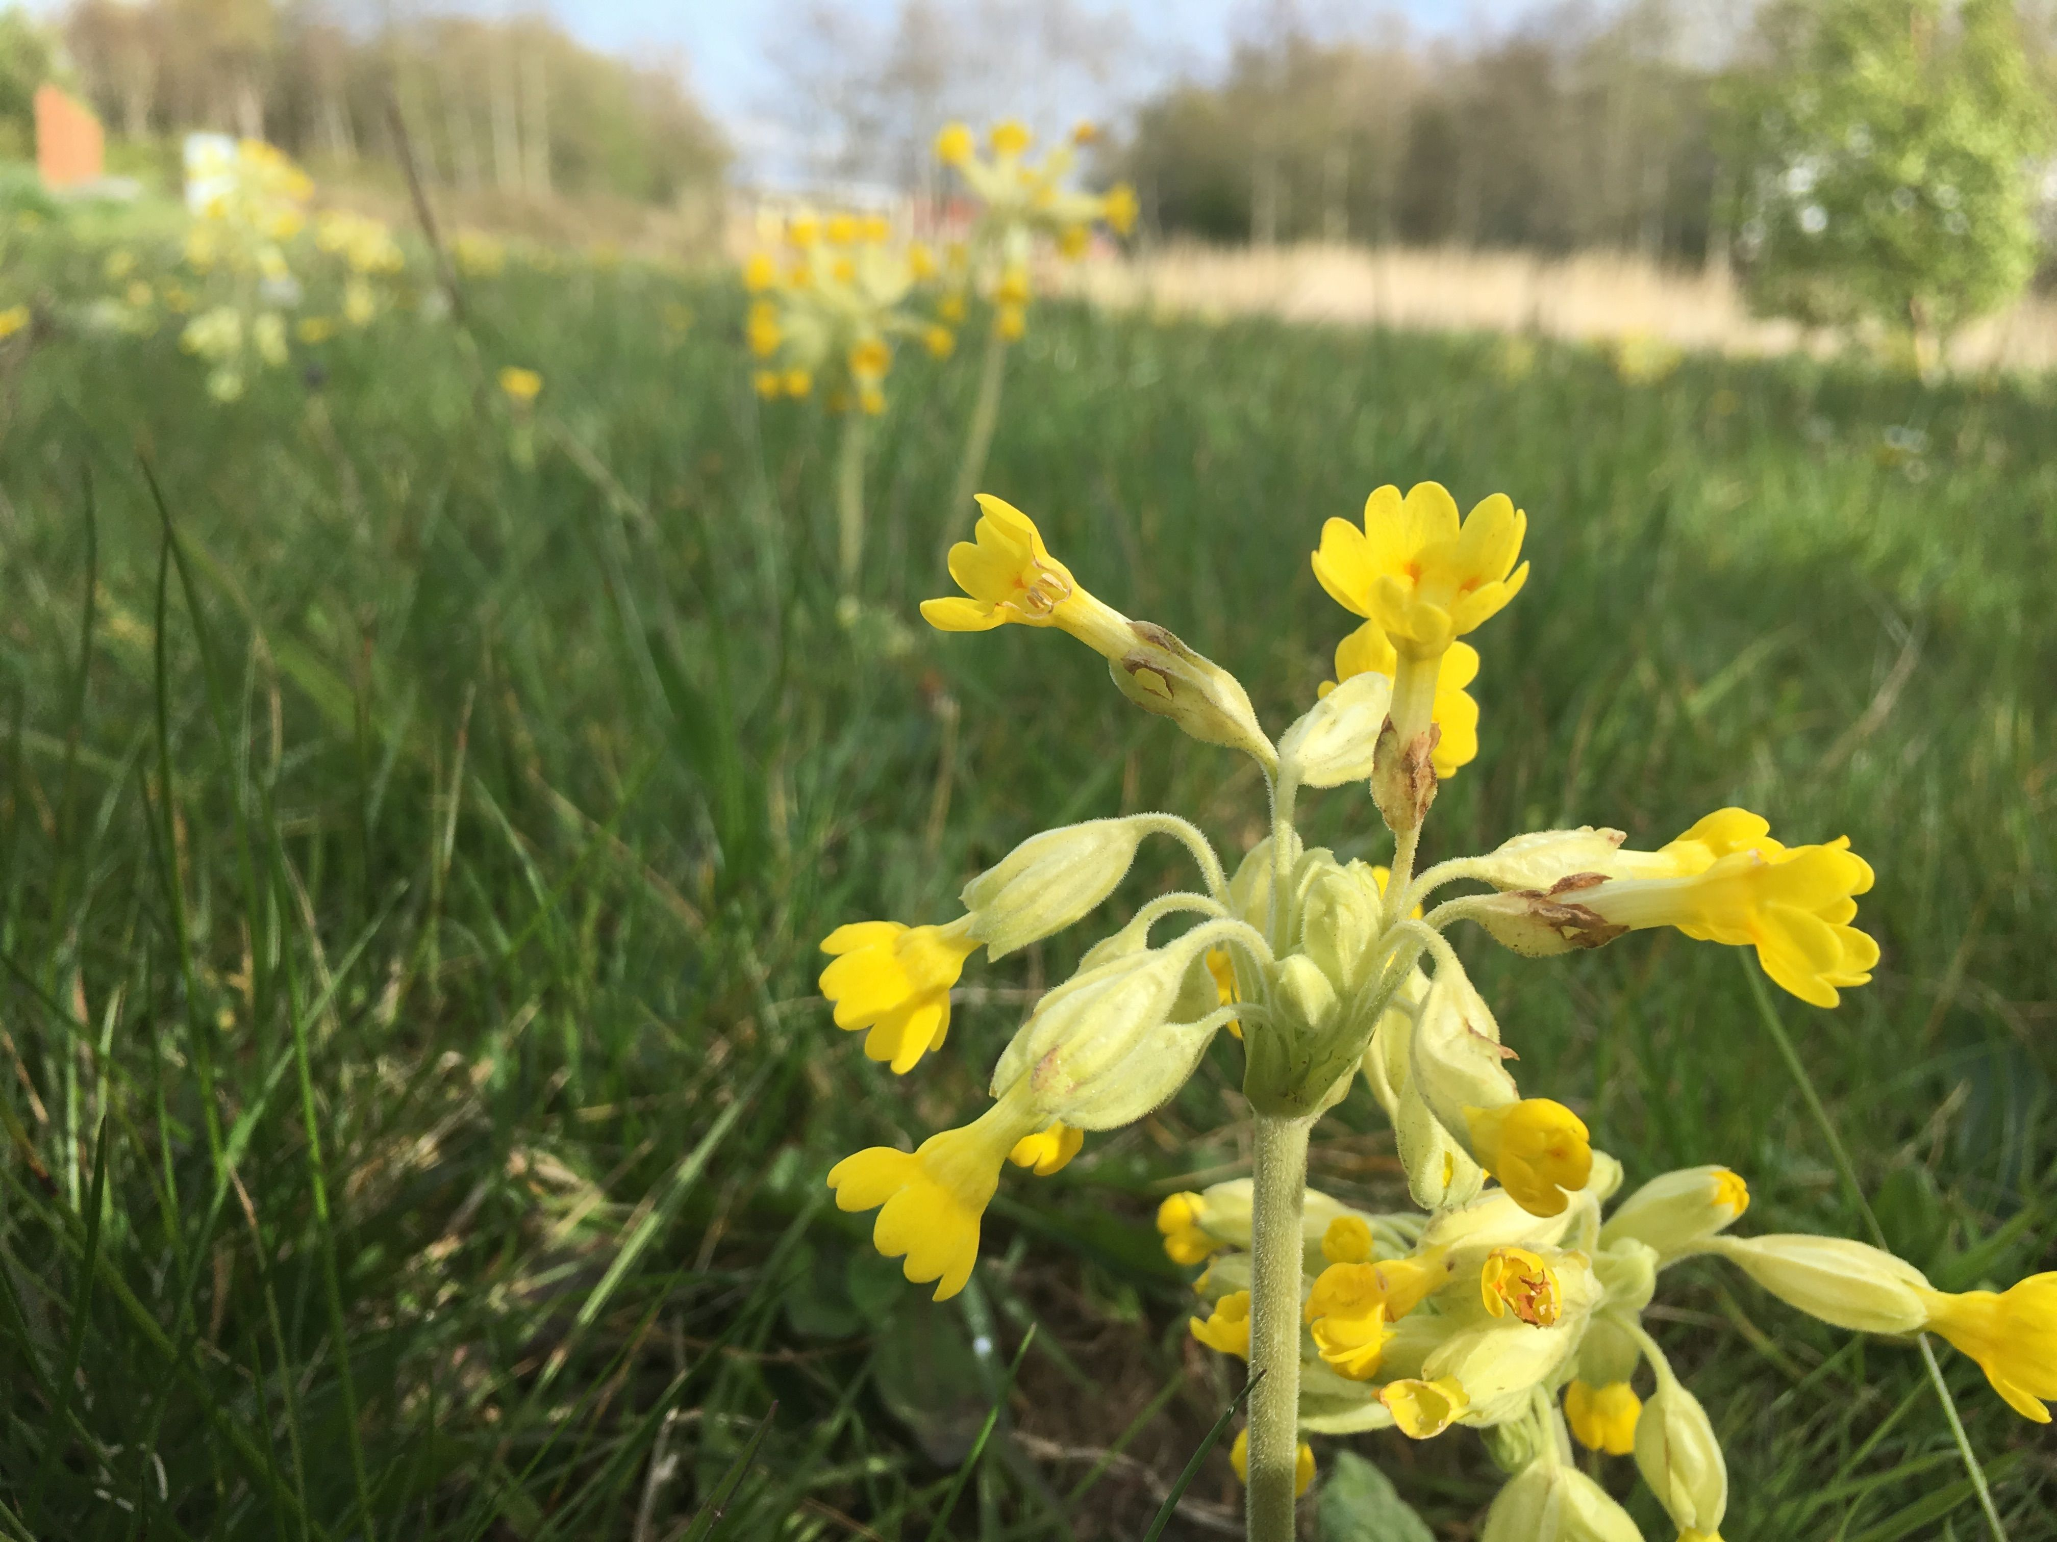
Creating Wildflower Meadows

Slide 11
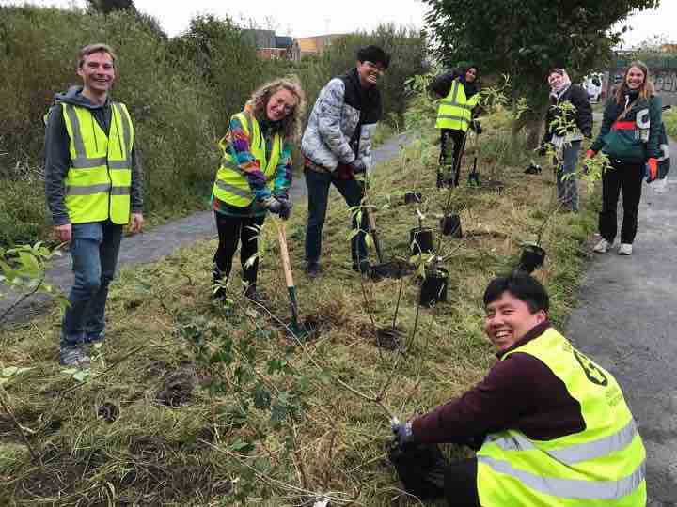
Creating Orchards

Slide 12
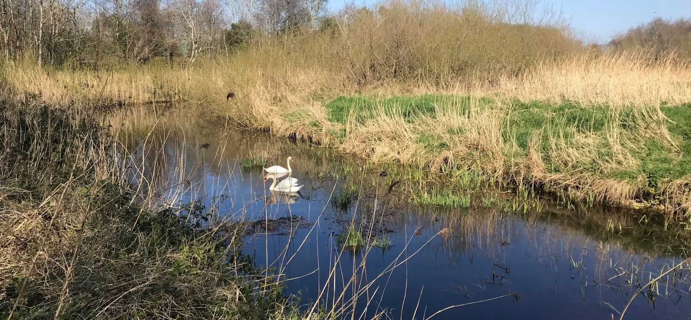
Cleaning up Wetlands

Slide 13
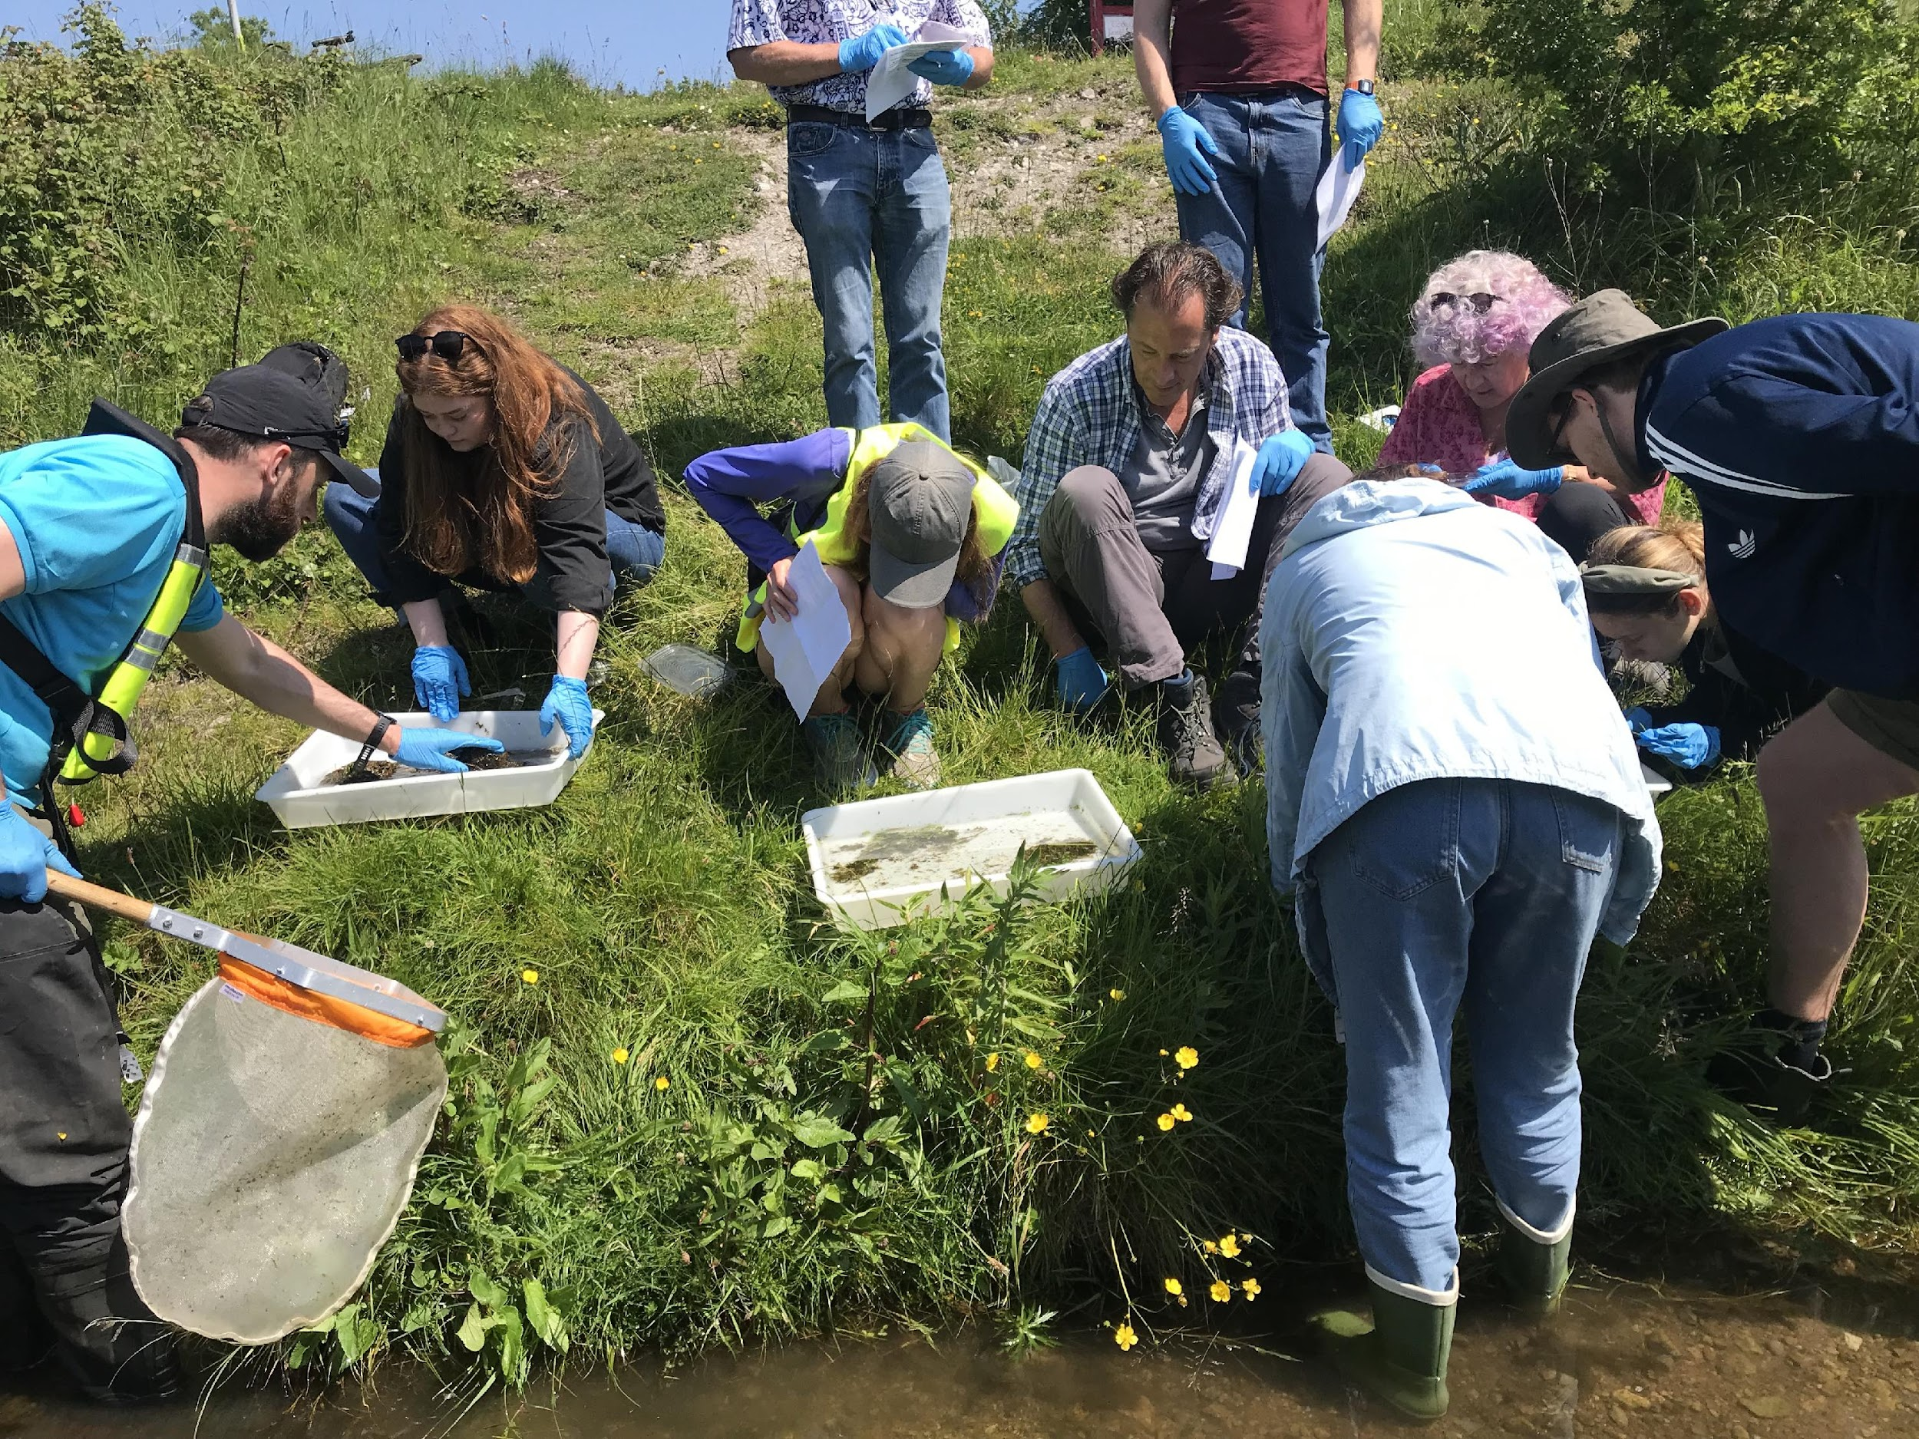
Undertaking Scientific Monitoring

Slide 14
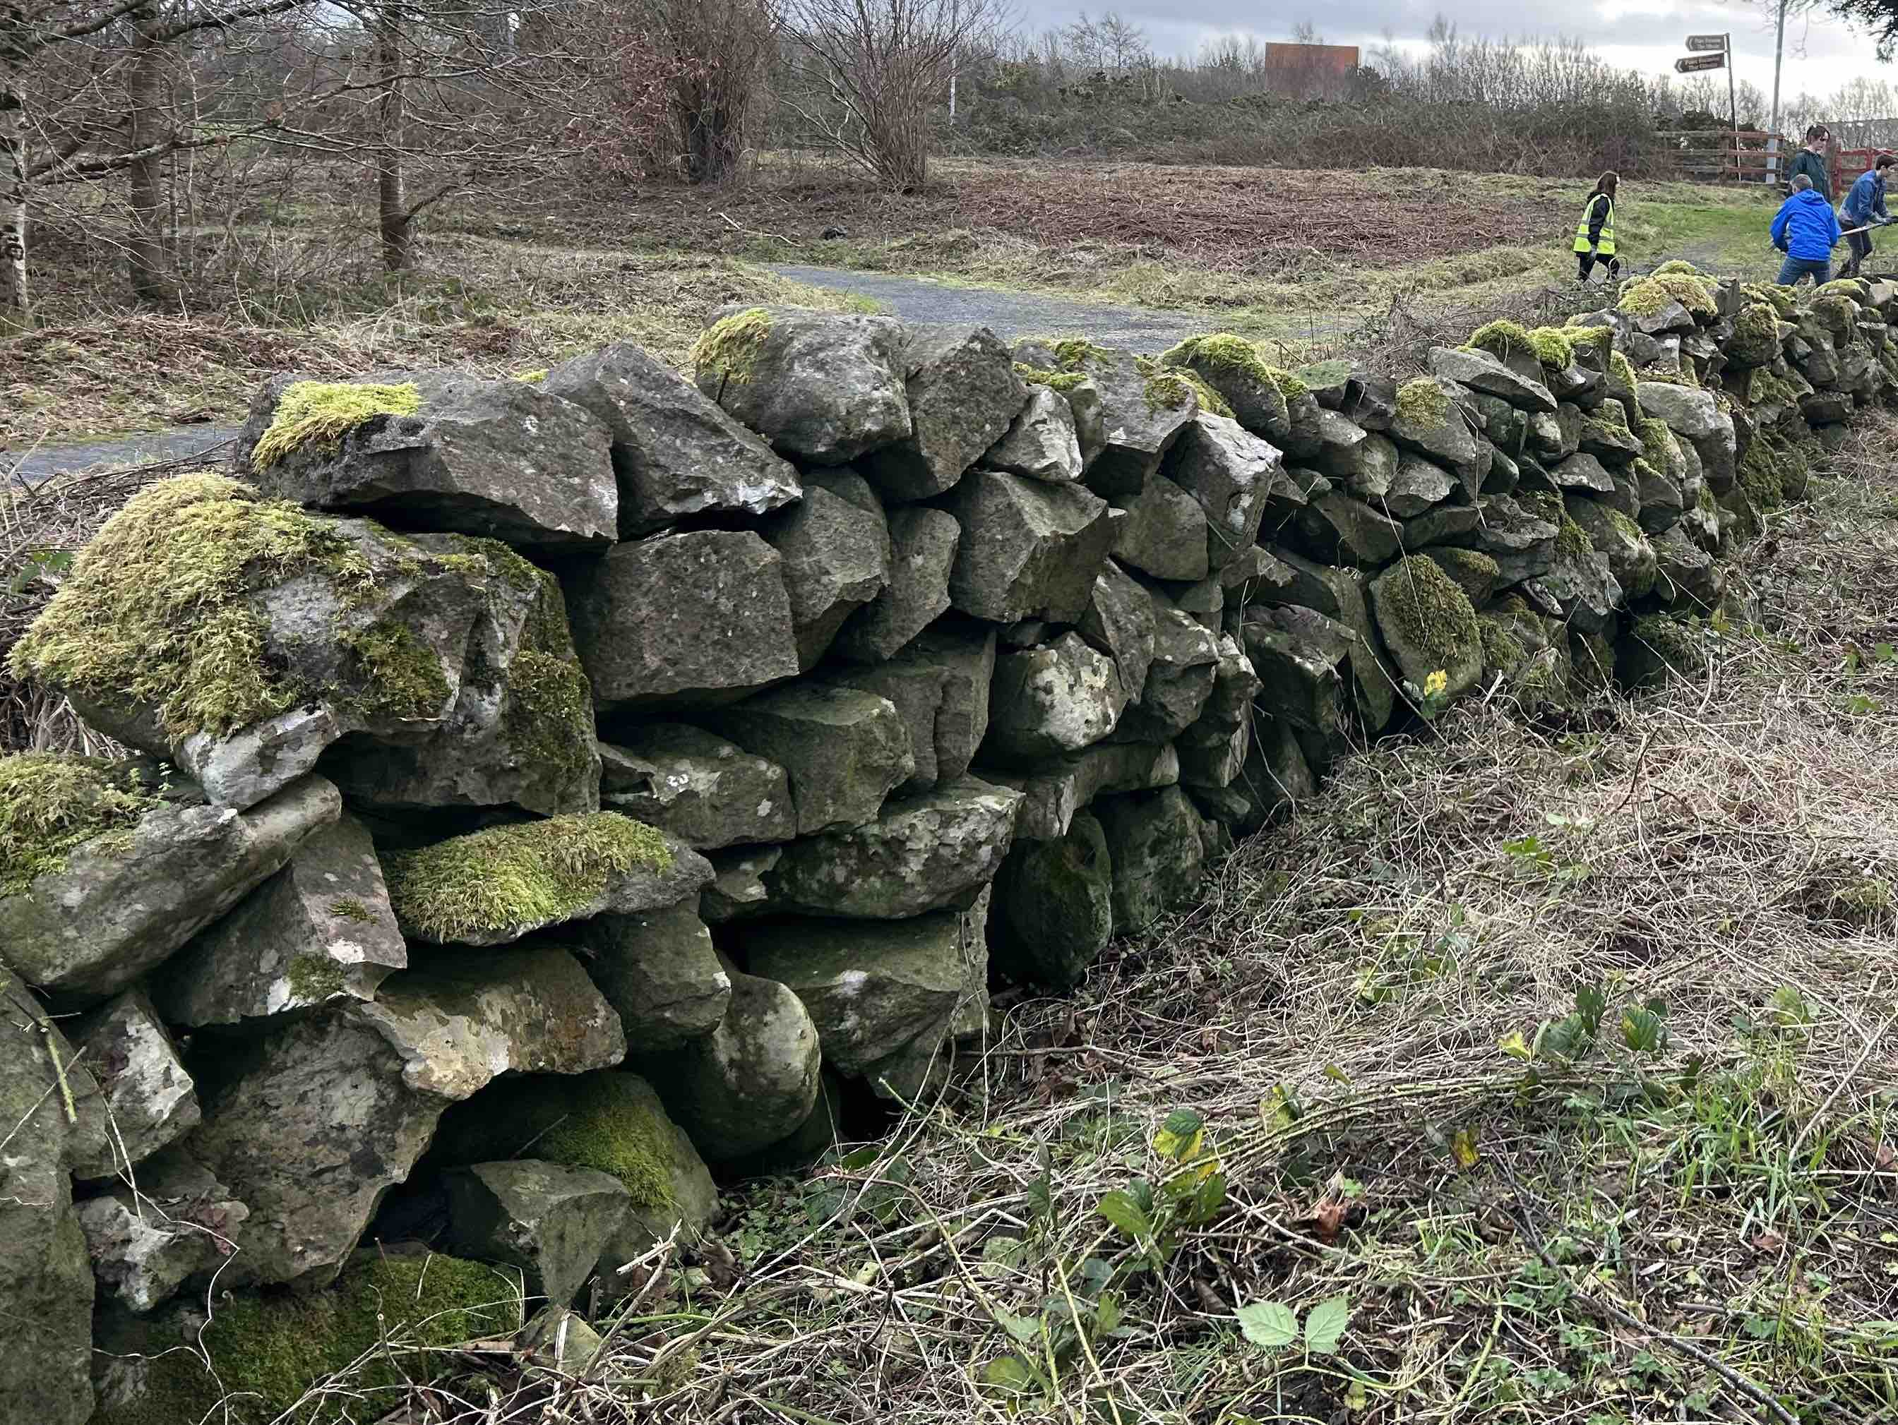
Restoring Ancient Farmland features

Slide 15
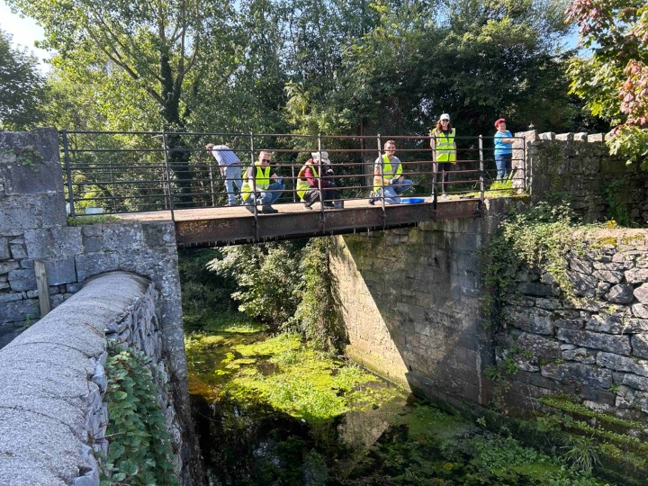
Enhancing Park Infrastructure - Before

Slide 16
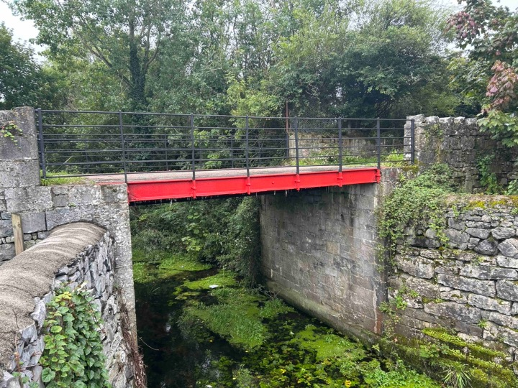
Enhancing Park Infrastructure - After

Slide 17
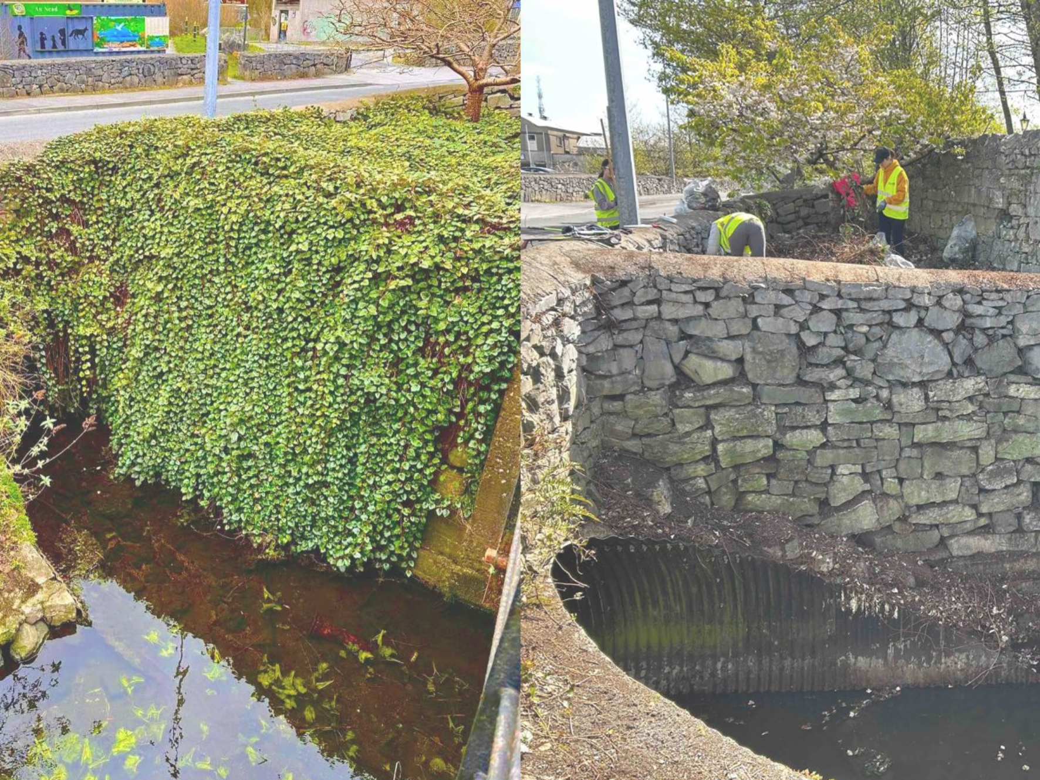
Removing Invasive Species

Slide 18
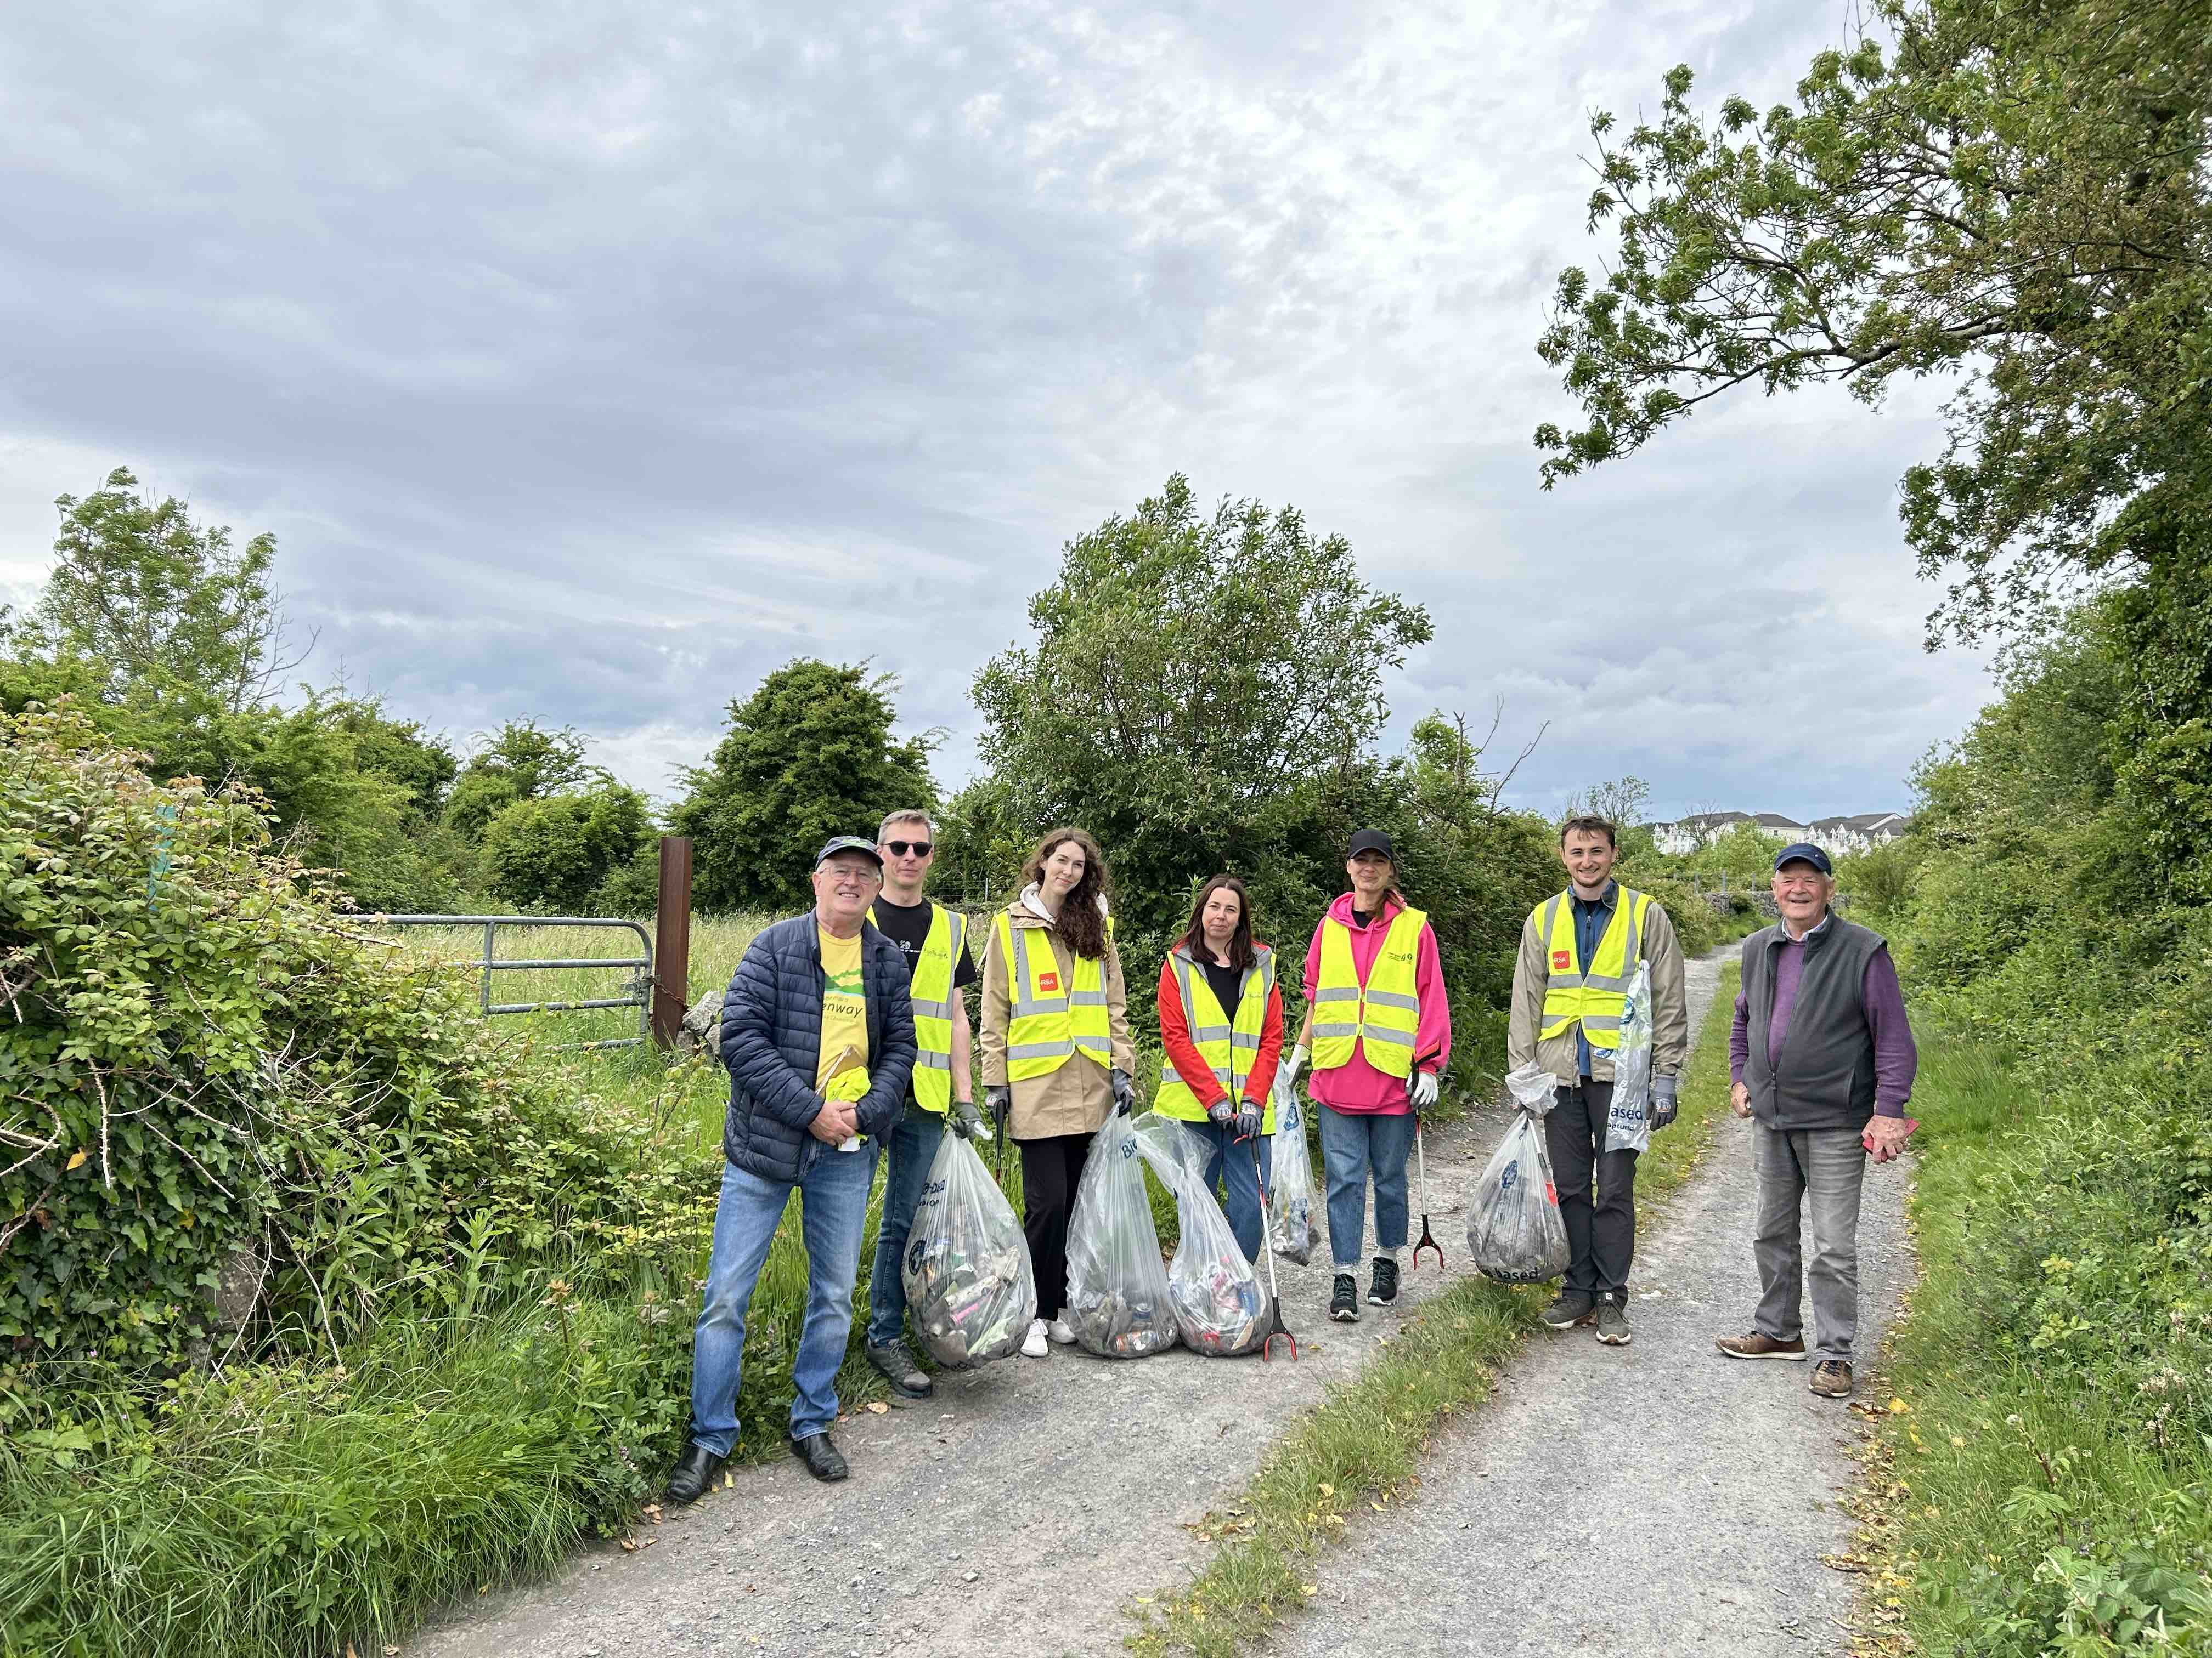
Removing Litter from Terryland Forest Park

Slide 19
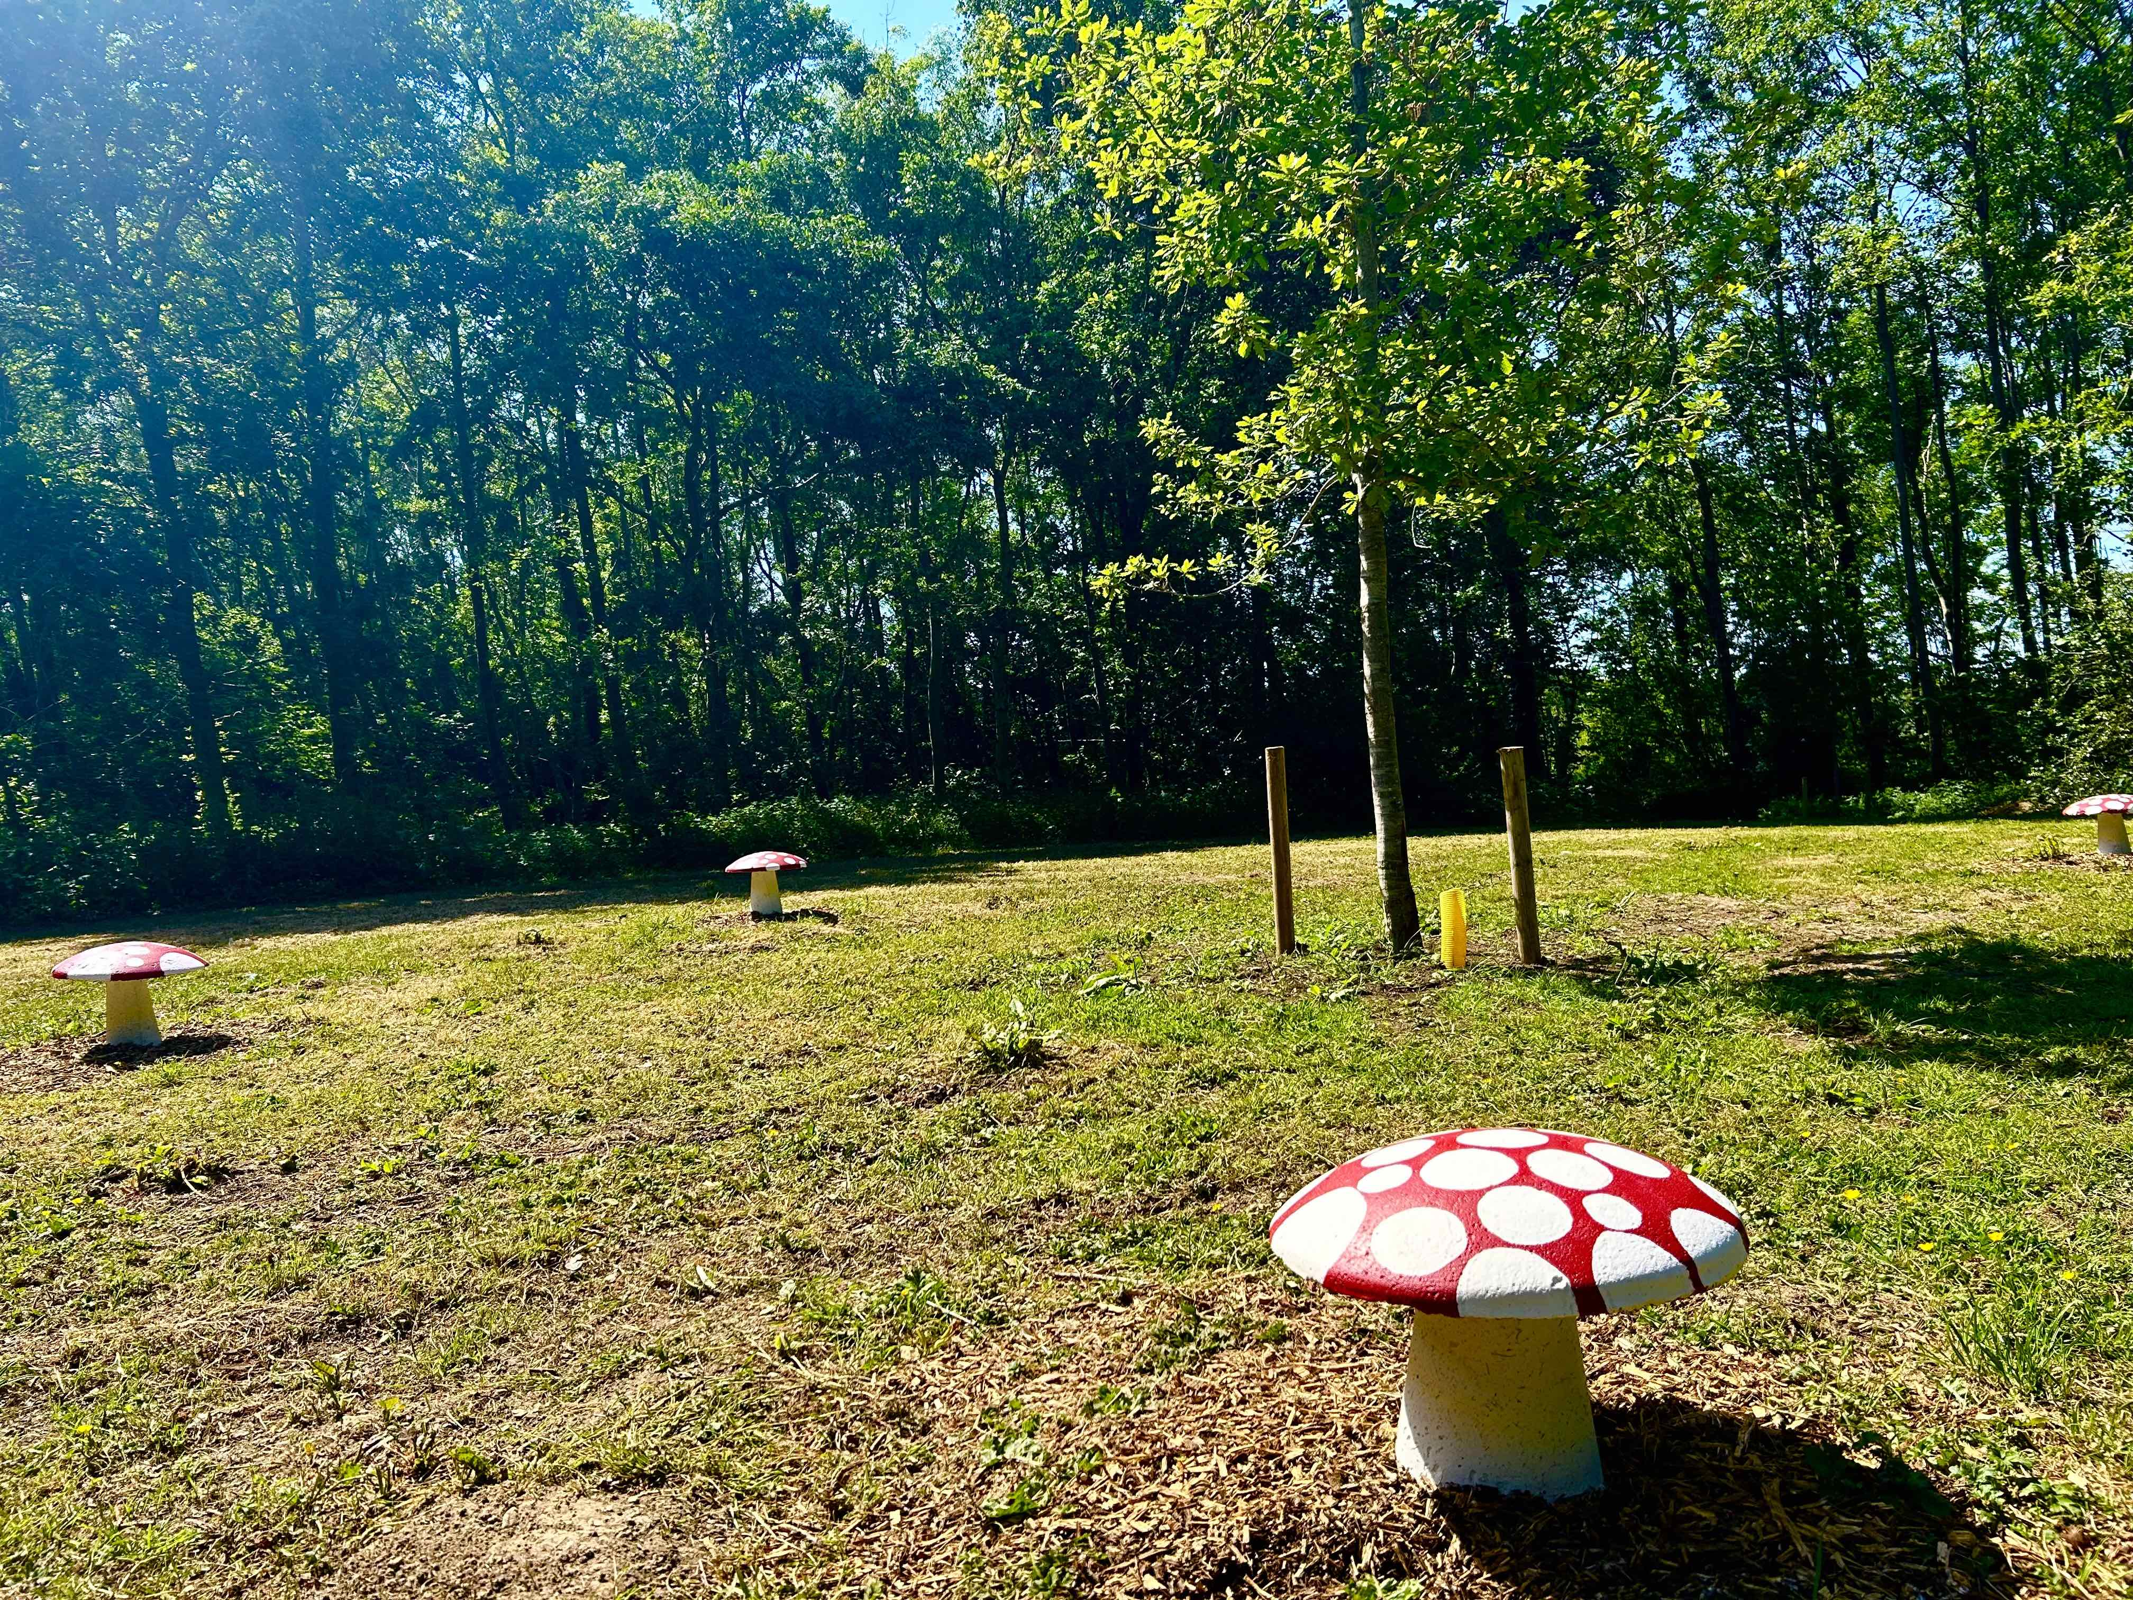
‘The Fairy Ring’ – part of the Outdoor Classroom for schools

Slide 20
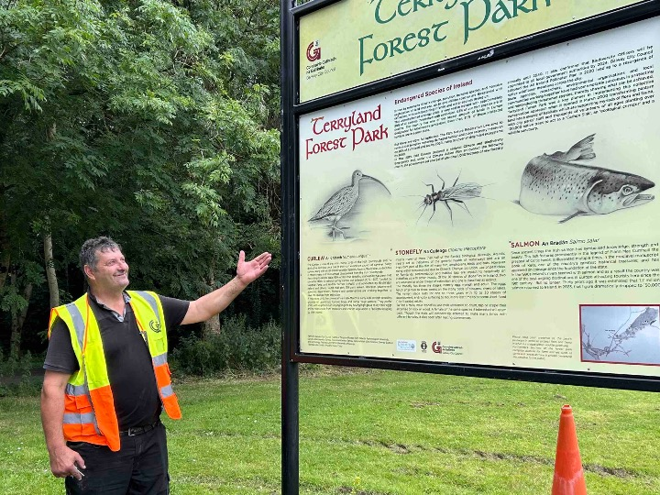
Developing Eco-Heritage Trails

Slide 21
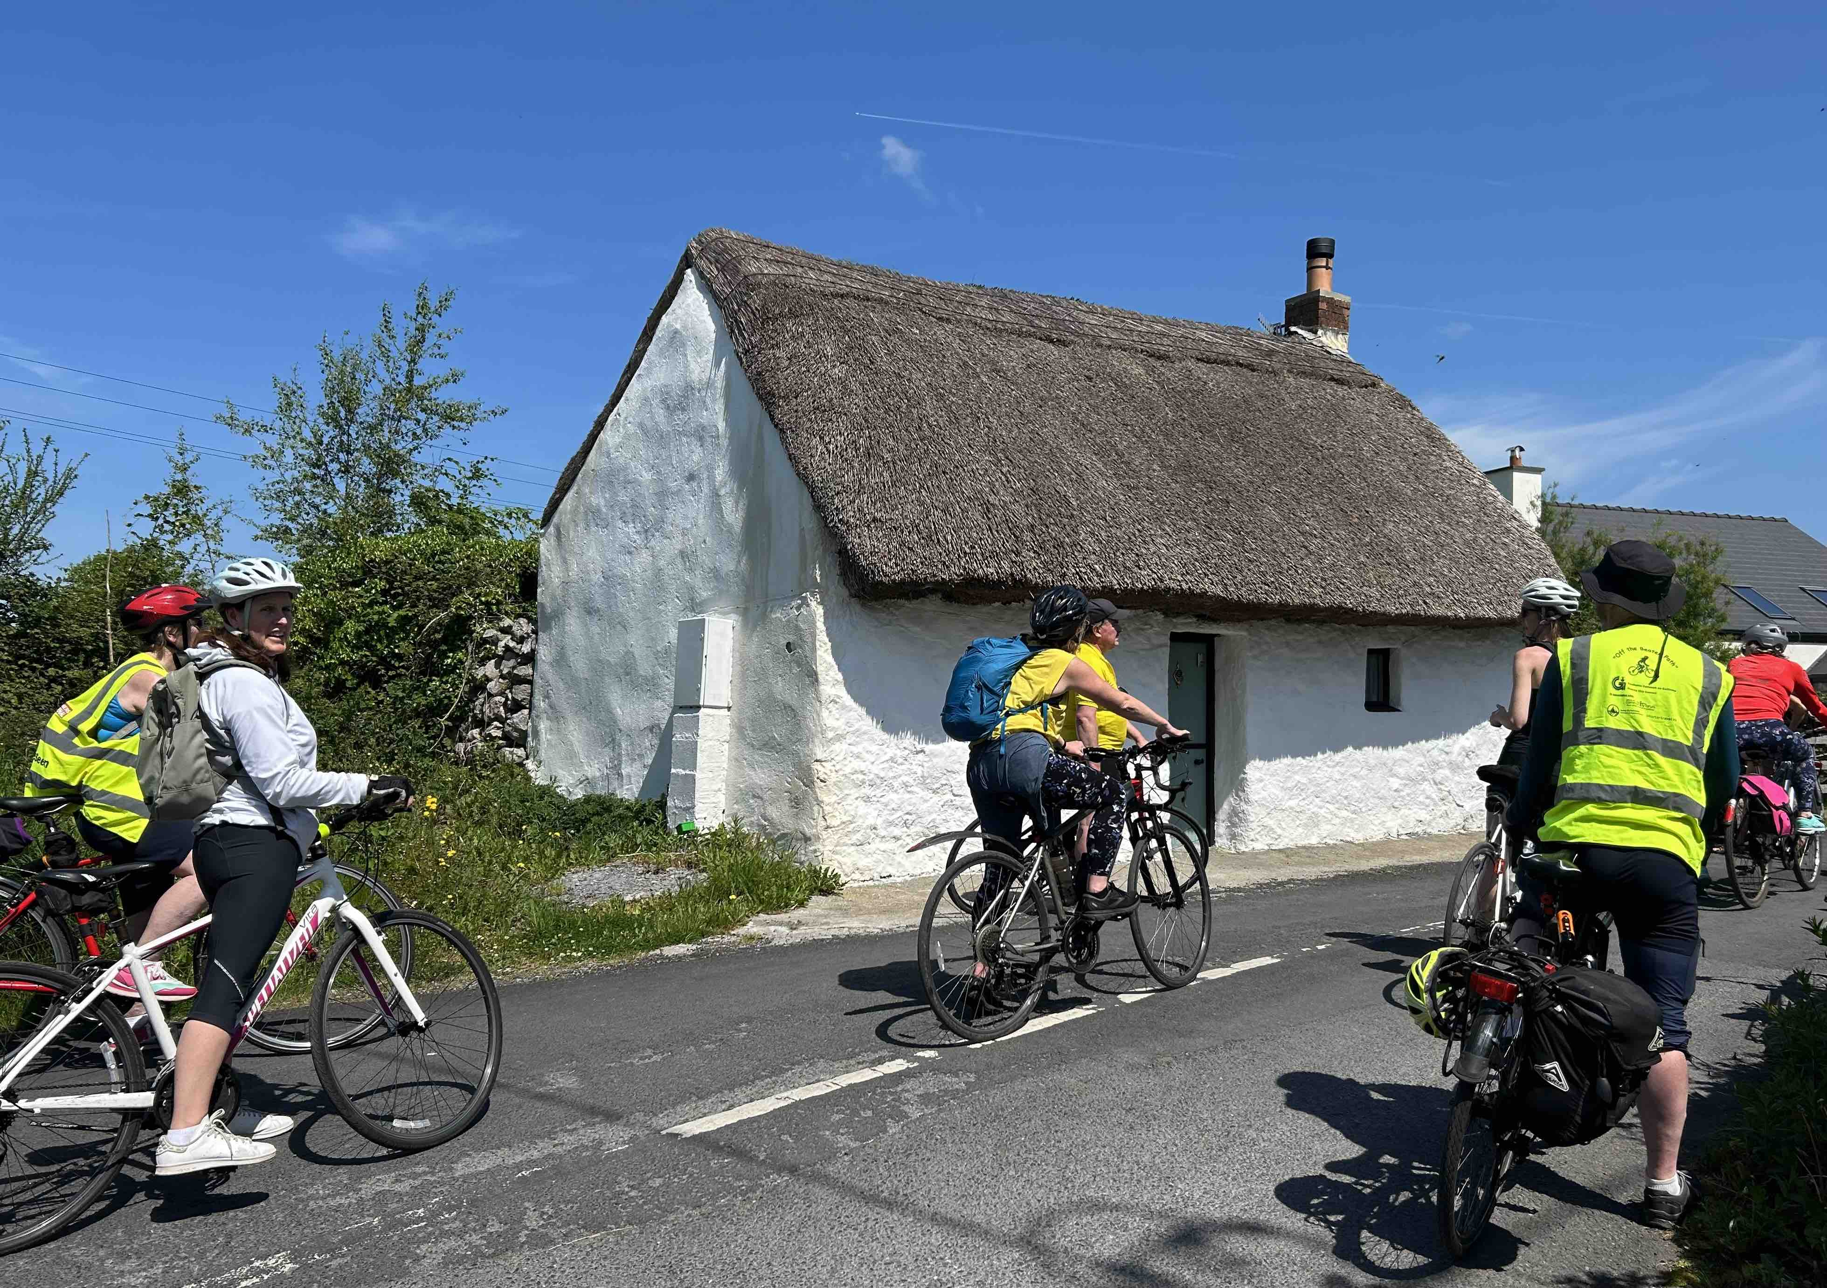
Terryland volunteers enjoy heritage cycle tours (May)

Slide 22
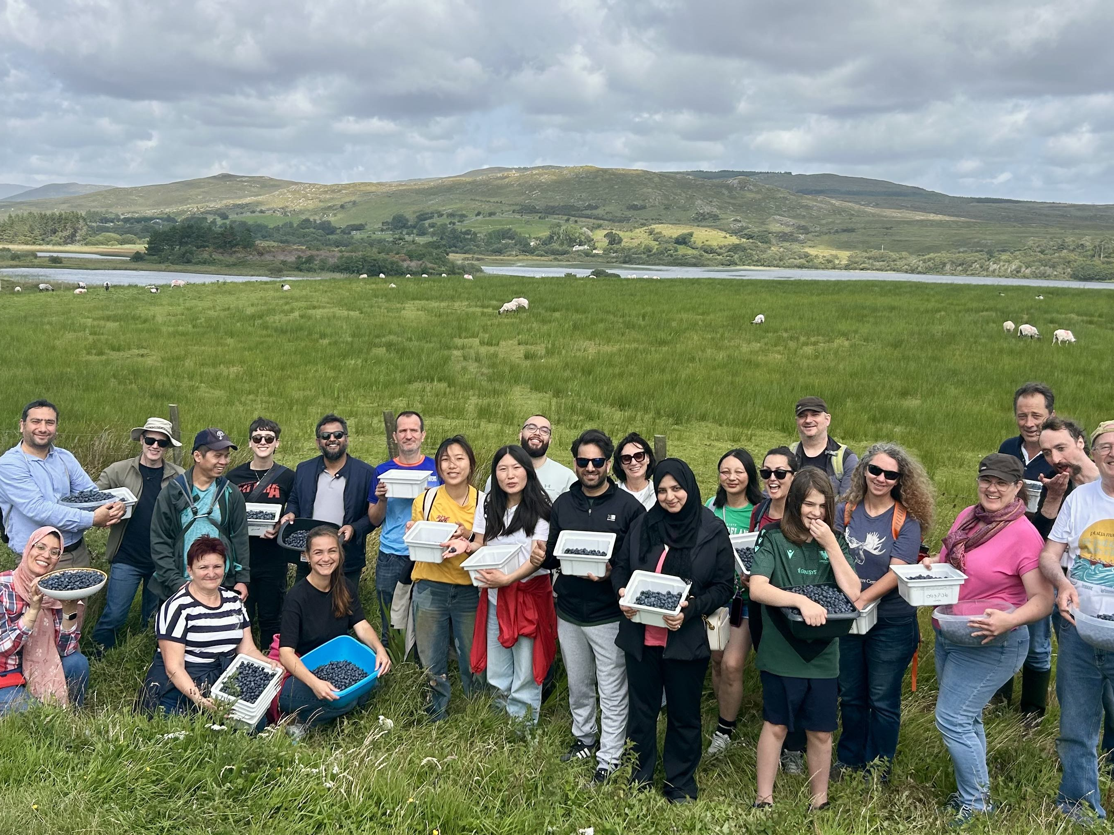
Just 3 Terryland volunteers also work on a farm in Connemara

Slide 23
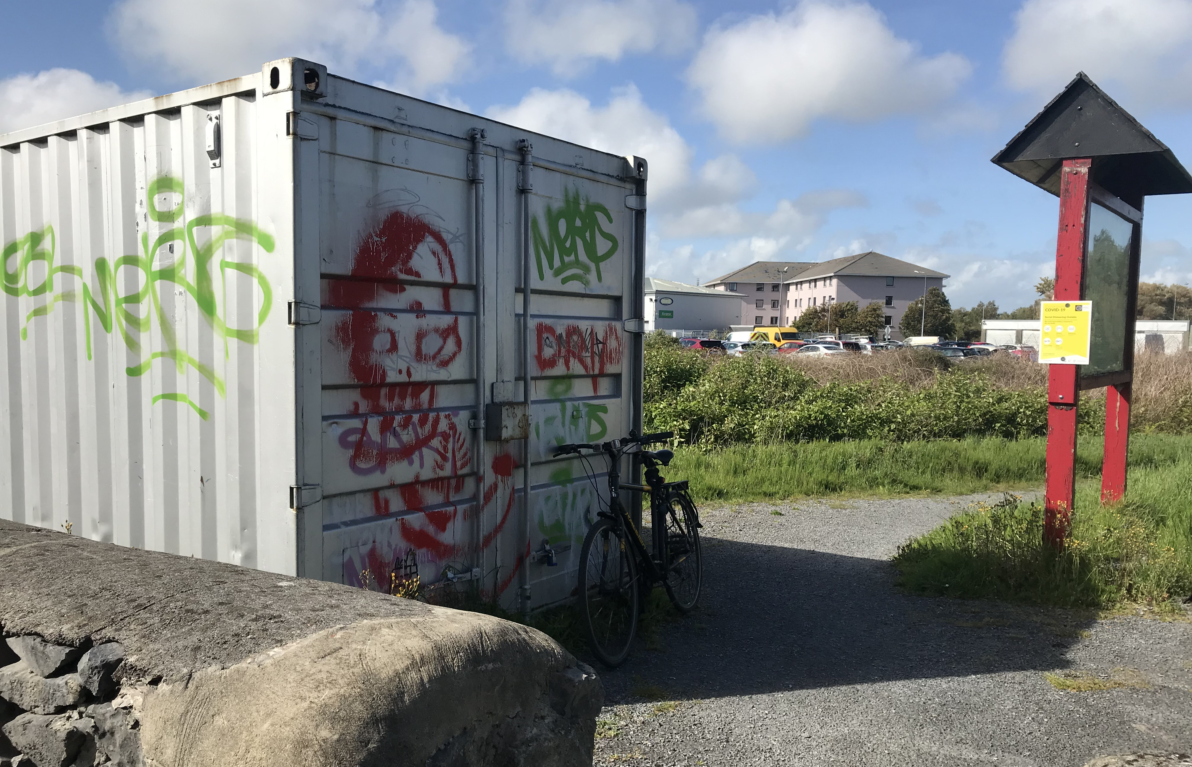
Making a HQ out of an old shipping container

Slide 24
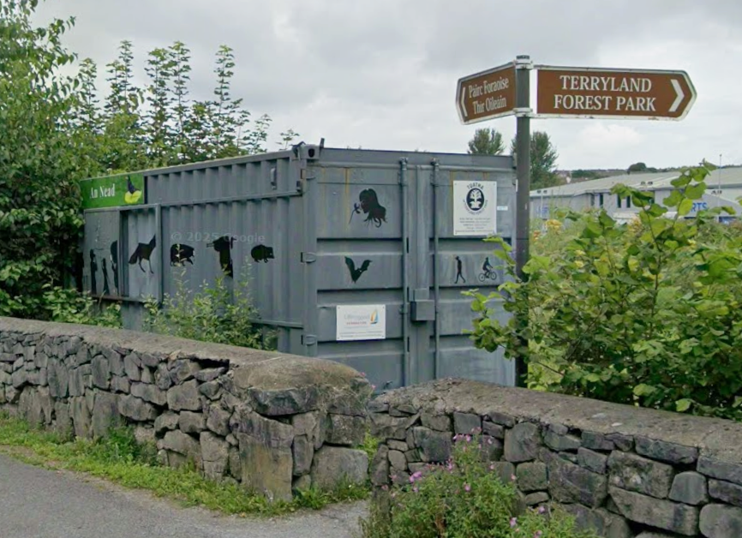

Slide 25
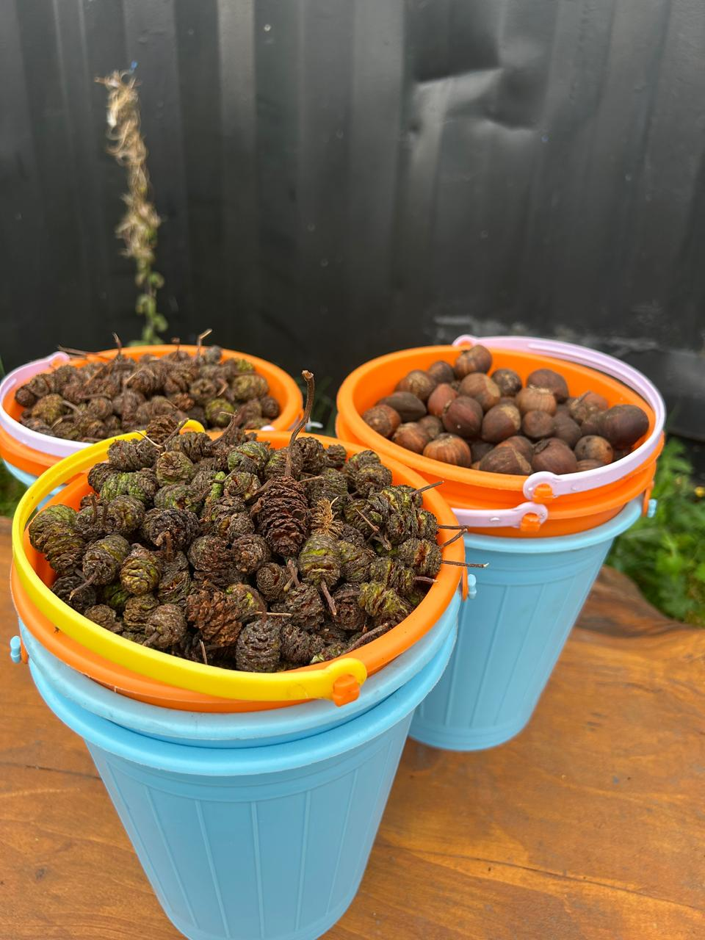
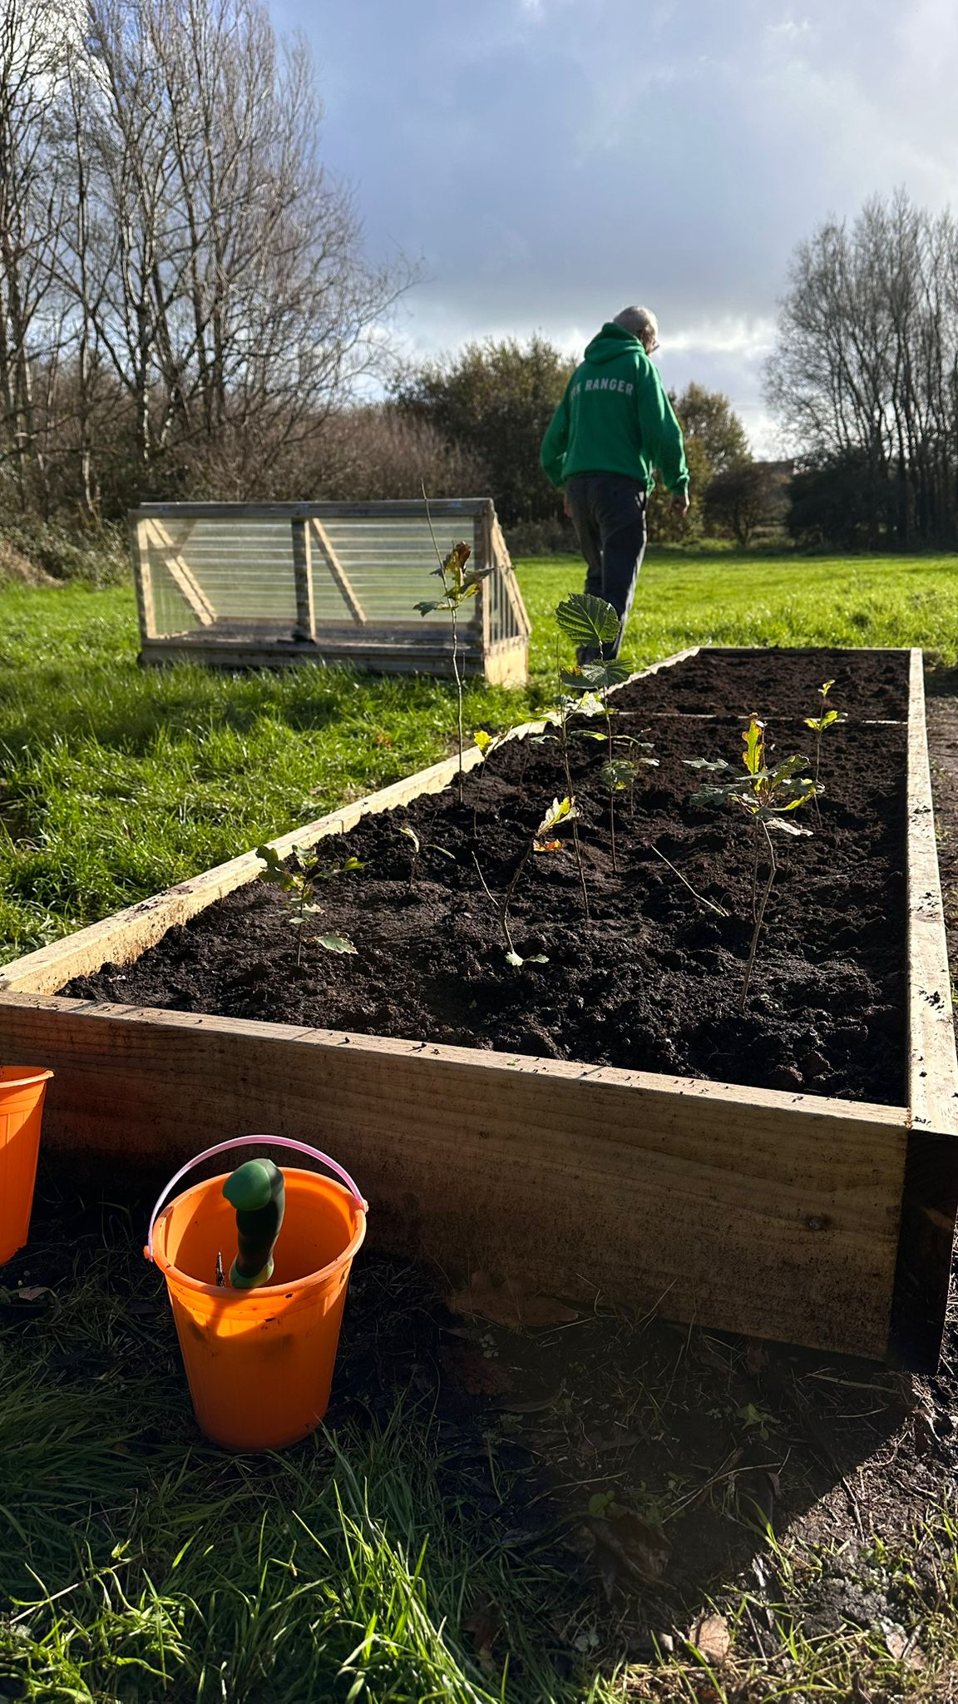
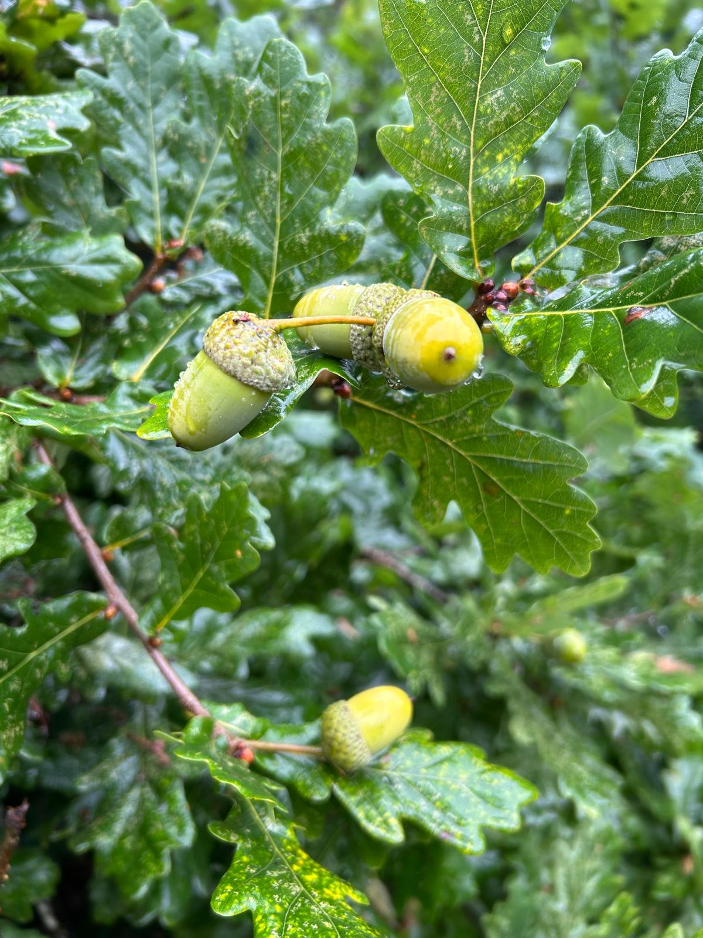

Slide 26
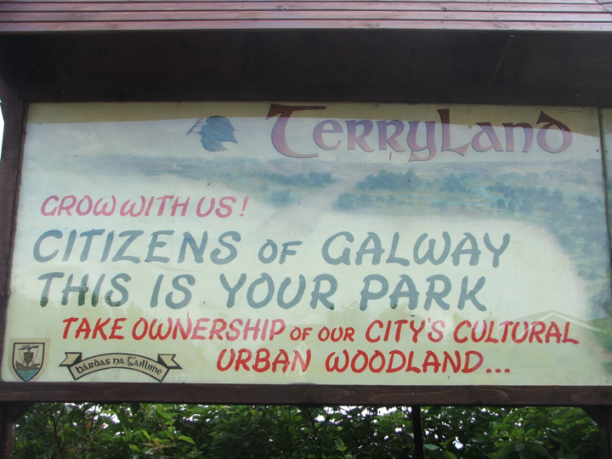
A Forest Park in the heart of the City Created by volunteers

Slide 27
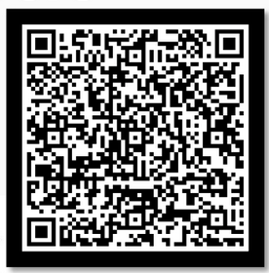
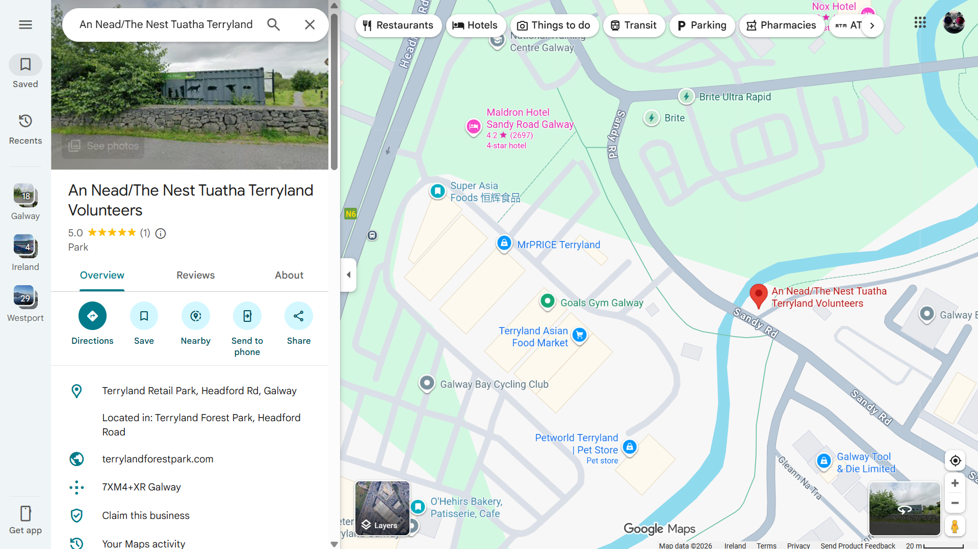
Join Us at Tuatha!
Find us at An Nead/The Nest Tuatha Terryland Volunteers
(Saturdays 10 am to 12 pm)
Registeration form. You could also register next week at the Society’s day

