Slide 1
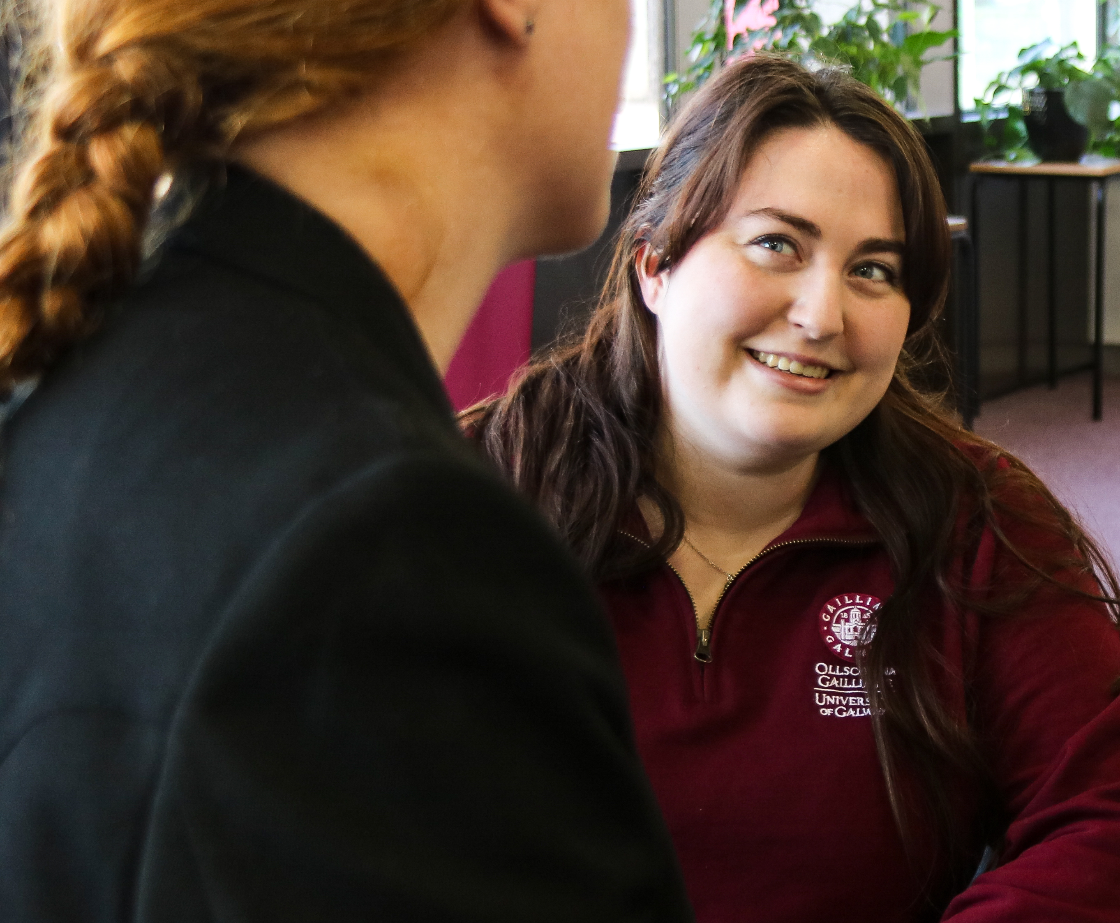
Welcome to The Library
Notes:
You are very welcome to our Library presentation. We would like to introduce you to a number of key Library services that will help you during your time in University of Galway

Slide 2
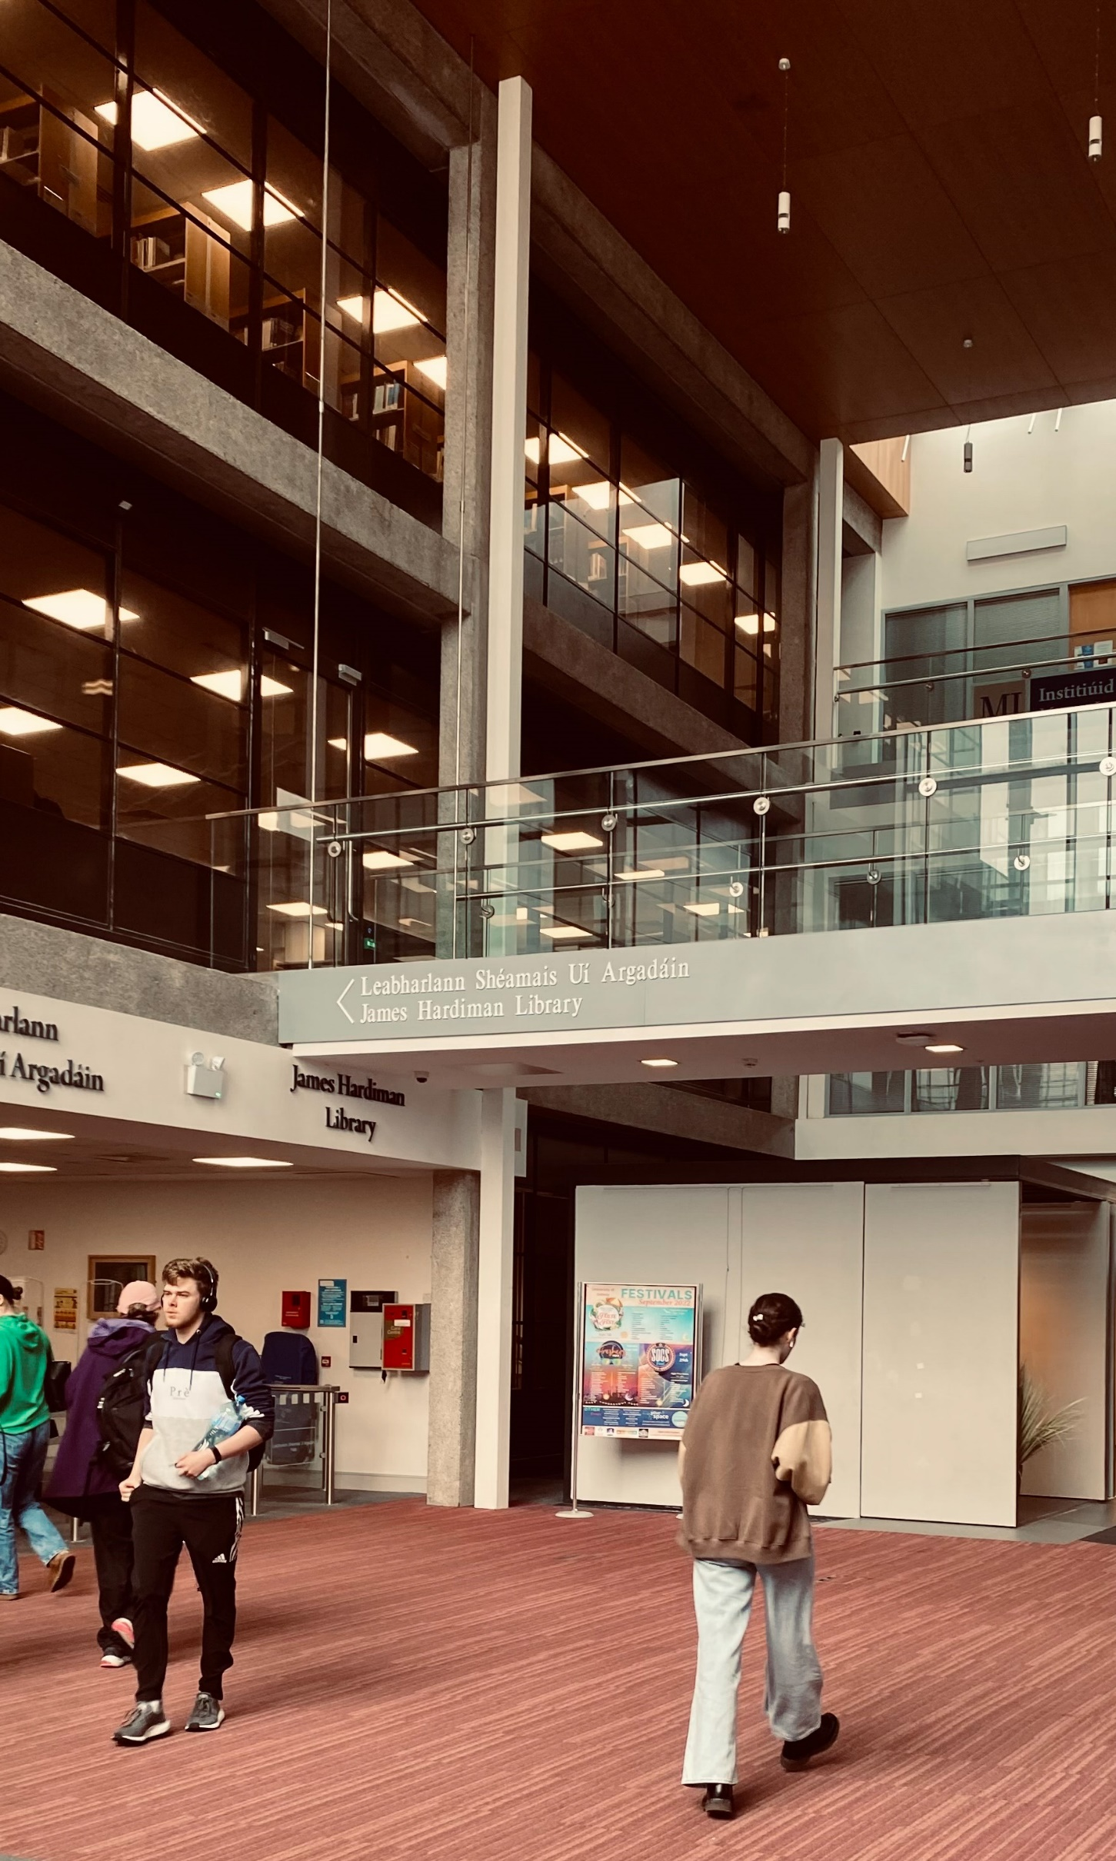


Opening Hours
Main Campus Library:
Monday – Friday: 08:30 – 22:00
Saturday: 08:30 - 17: 30
Sunday: 10:00 – 17:30
Main Campus Library
Monday – Friday: 08:30 – 22:00
Saturday: 08:30 - 17:30
Sunday: 10:00 – 17:30
Notes:
Our opening hours are available on our website, from Monday 8th September the Library will be open until 10pm Mon-Friday and until 5:30pm on Saturday and Sunday

Slide 3
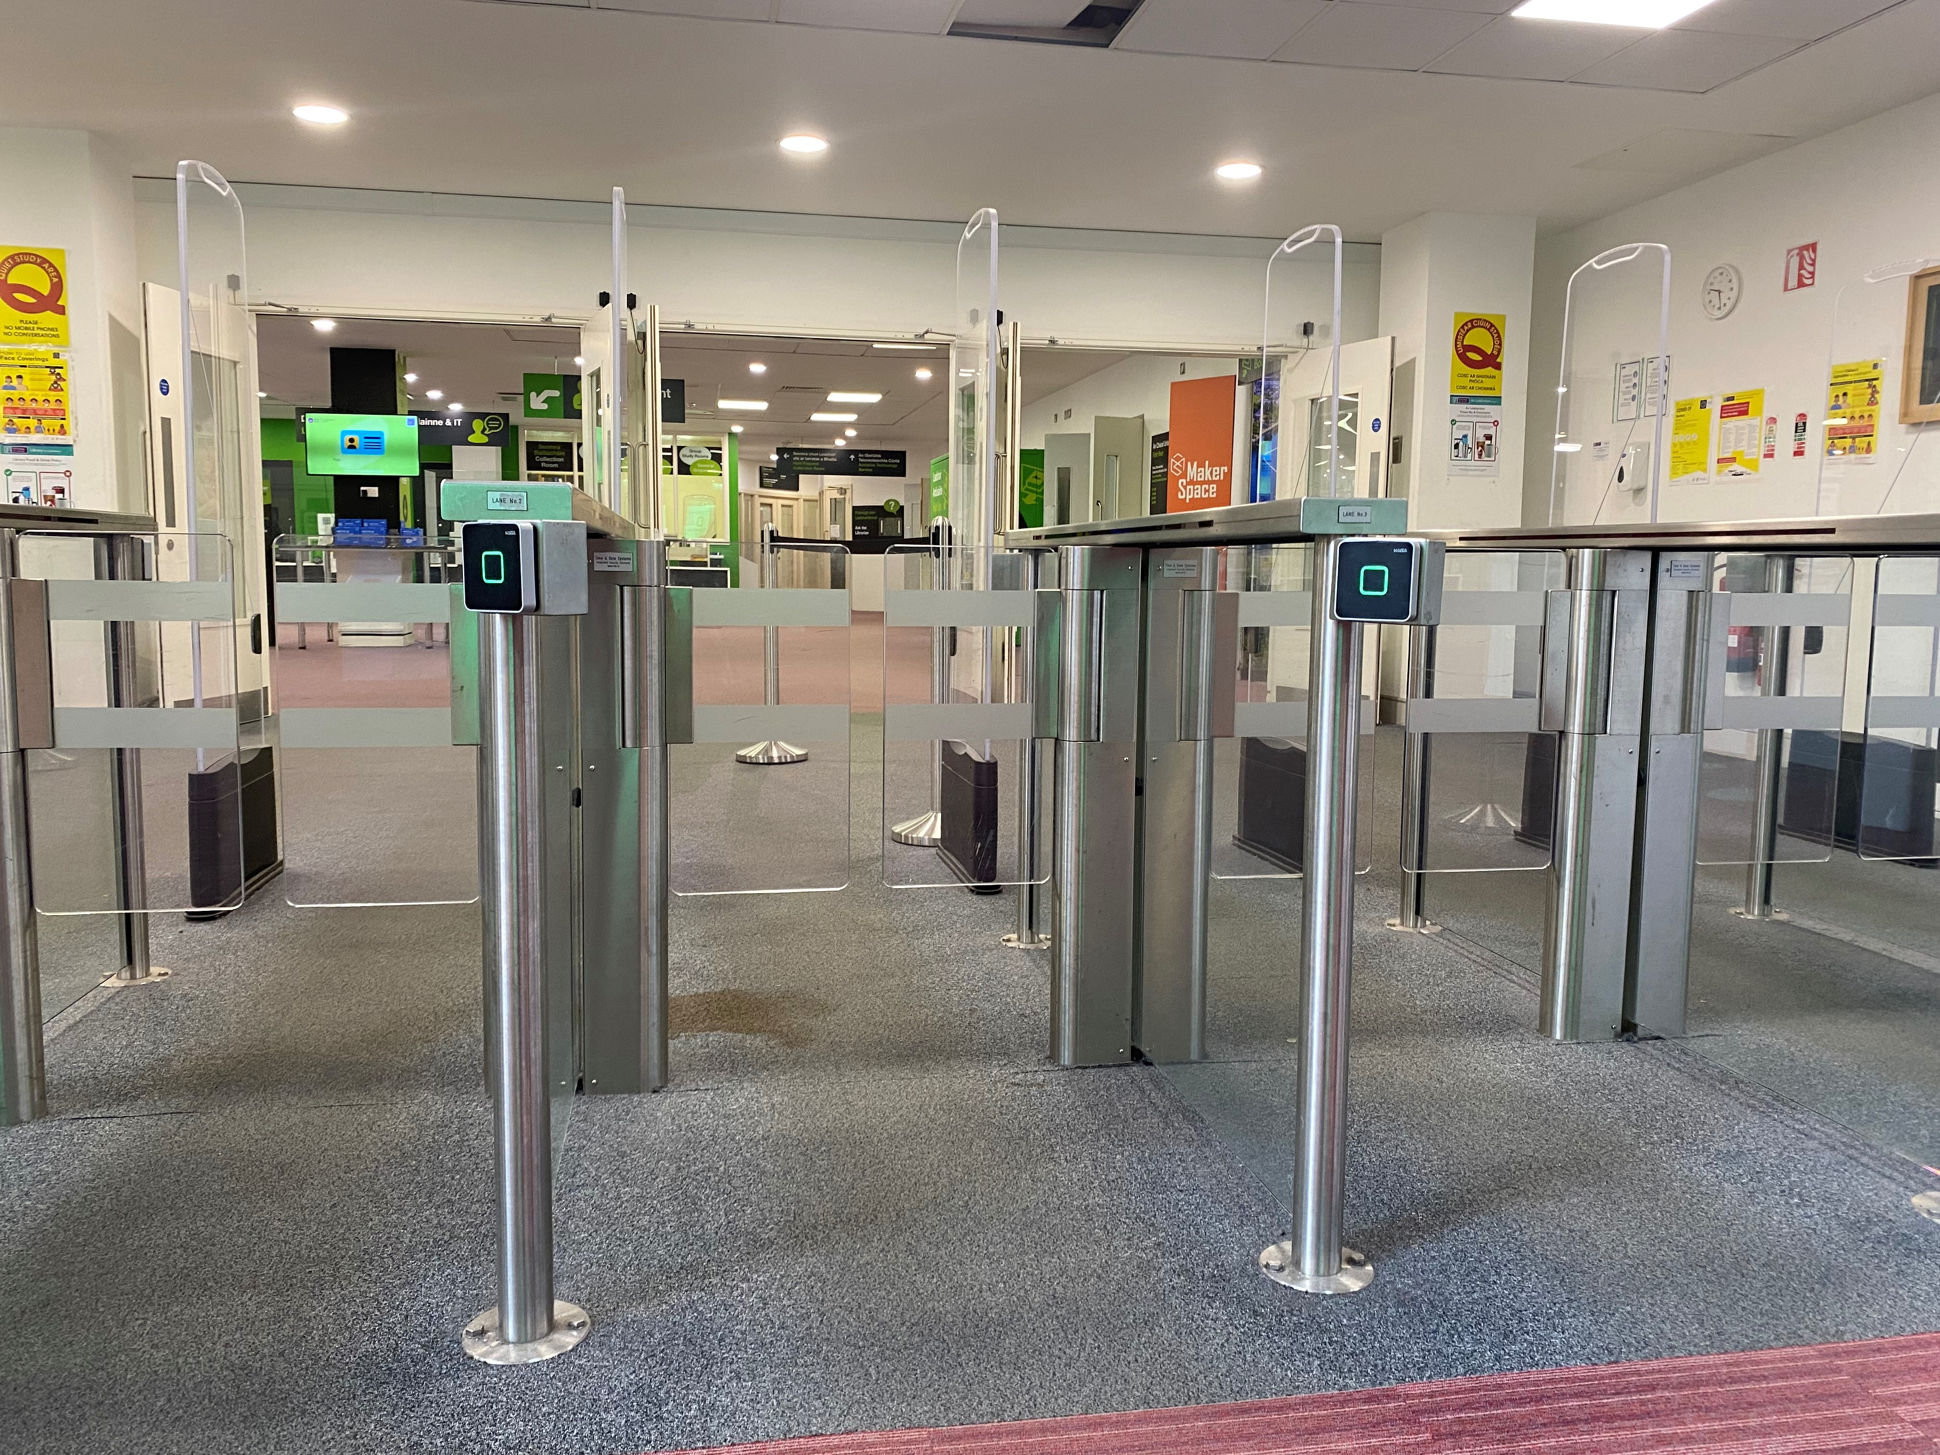
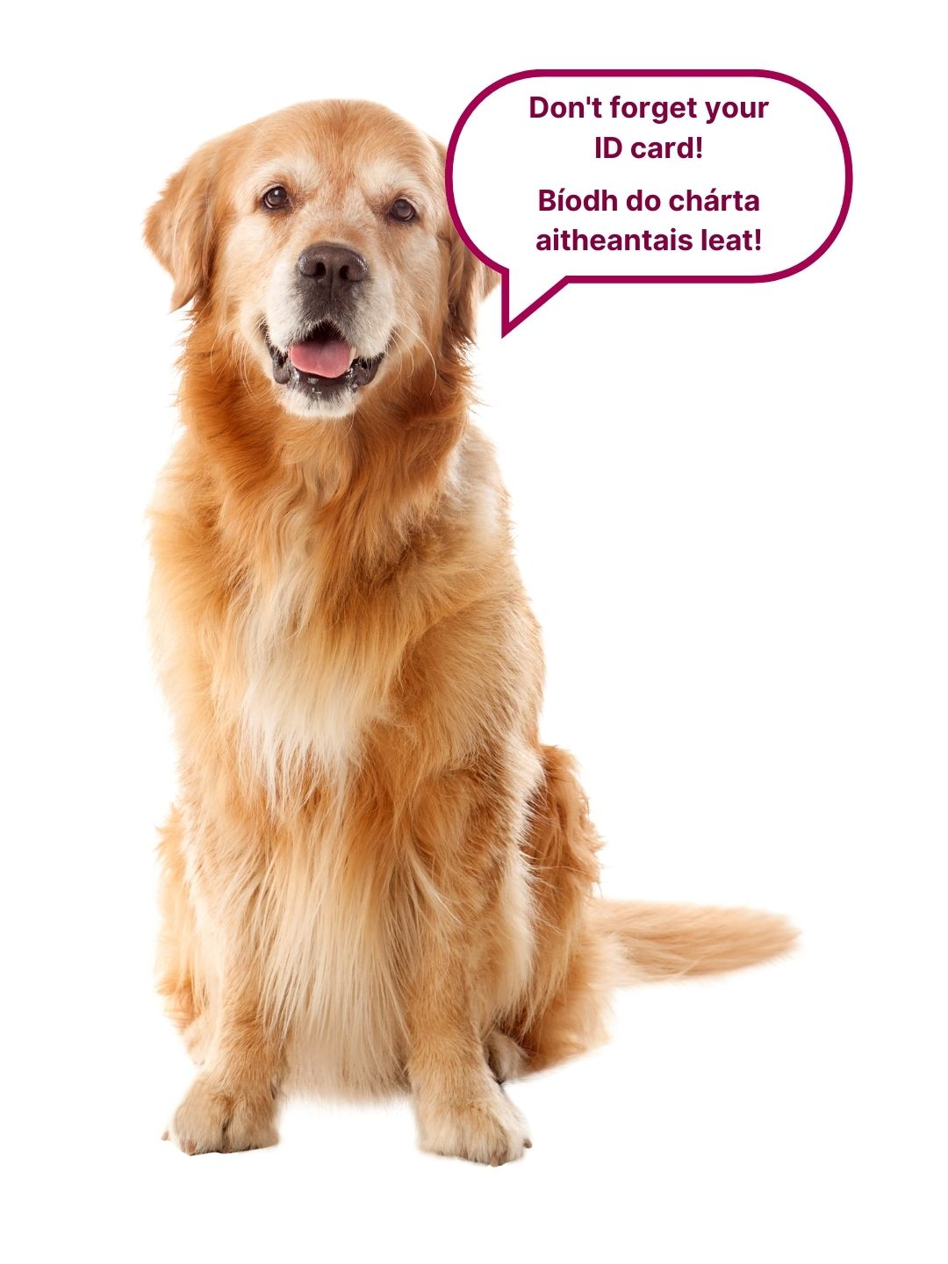
Notes:
You will need your student card to enter and exit the library.

Slide 4
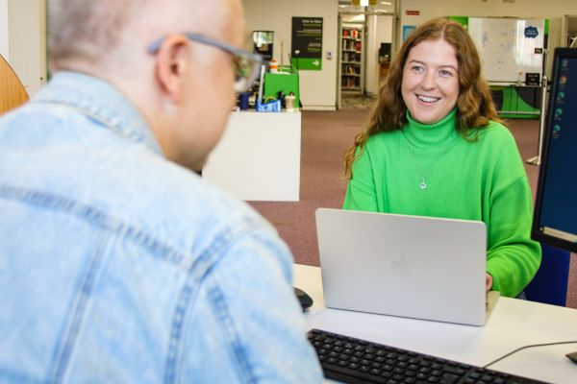
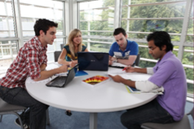
Supporting Your Academic Success...
Access to millions of academic and scholarly resources such as books and journal articles that your lecturers will expect you to use in your essays and assignments
Support services for further assistance in specific areas such as help finding resources
or academic writing
Physical library and virtual space
This is your library and we are here to help you!
Notes:
As a student of the University of Galway you have:
access to millions of academic and scholarly resources such as books and journal articles that your lecturers will expect you to use in your essays and assignments // support services for further assistance in specific areas such as help finding resources
or academic writing// physical library and virtual space
this is your library and we are here to help you!

Slide 5

Supporting Your Academic Success...
A quiet place to study
Group Study Rooms for group work (need to book)
Photocopying and Printing Facility (be sure to put credit on your account)
Notes:
The library is also a great place to study, use group study rooms for group projects and avail of the printing and photocopying facilities.

Slide 6
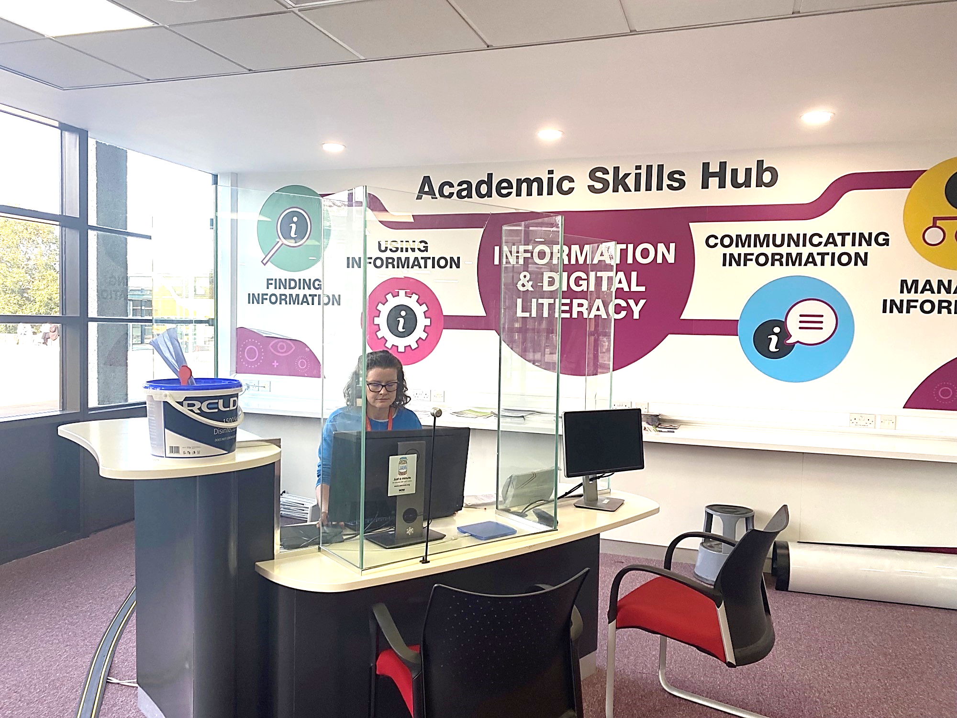
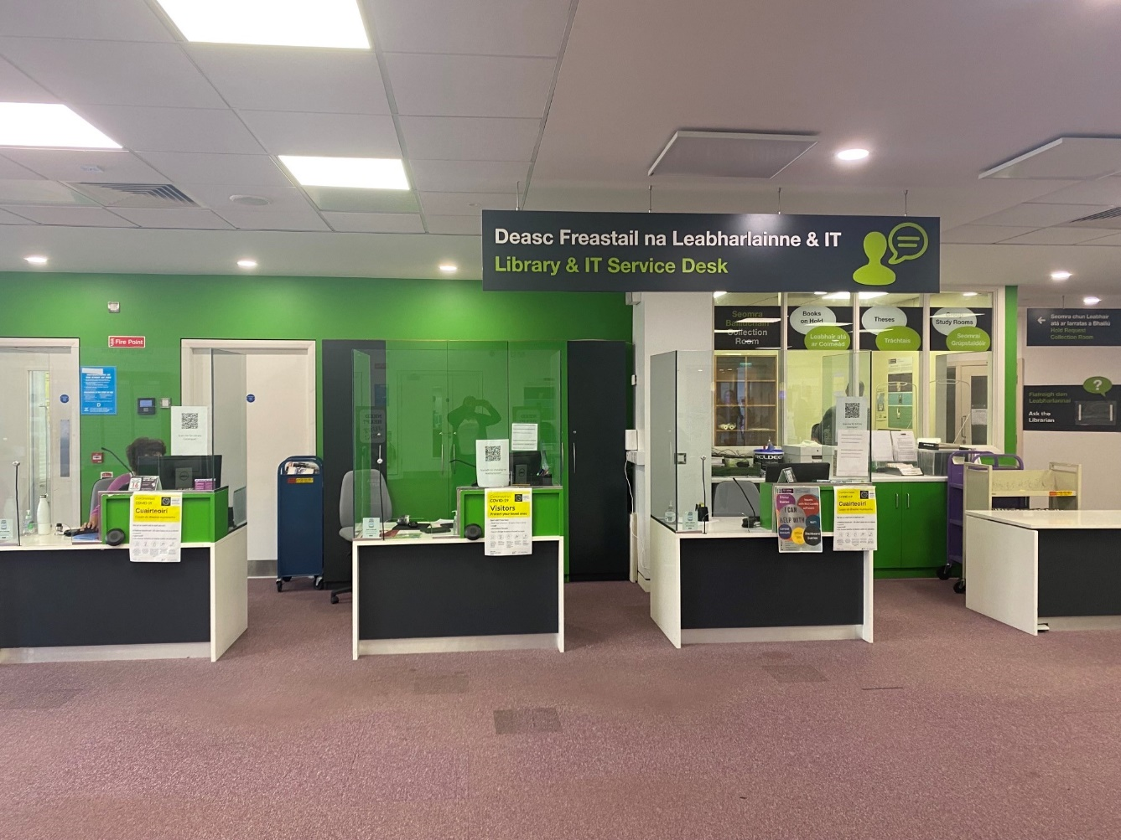
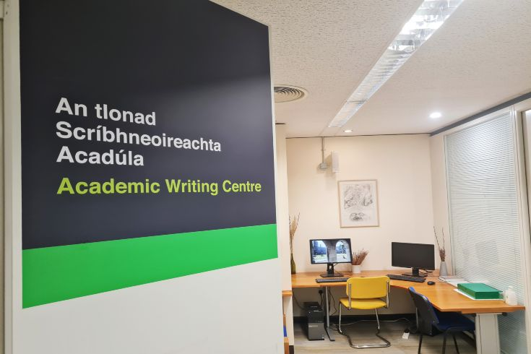
Services and Supports
Check out the “Studying” tab on the Library Website, there is lots of information and resources available there
Academic Skills Team: support all Undergraduate and Taught Master’s Students in finding, using, and managing information
Academic Writing Centre: provide one-on-one tutorials and email consultations on essay writing
Library & IT Service Desk: advice on all Library services and collections and a wide range of IT services
MakerSpace: be creative, collaborate, share develop ideas, innovate, 'make stuff’!
Notes:
Info on the slide.

Slide 7



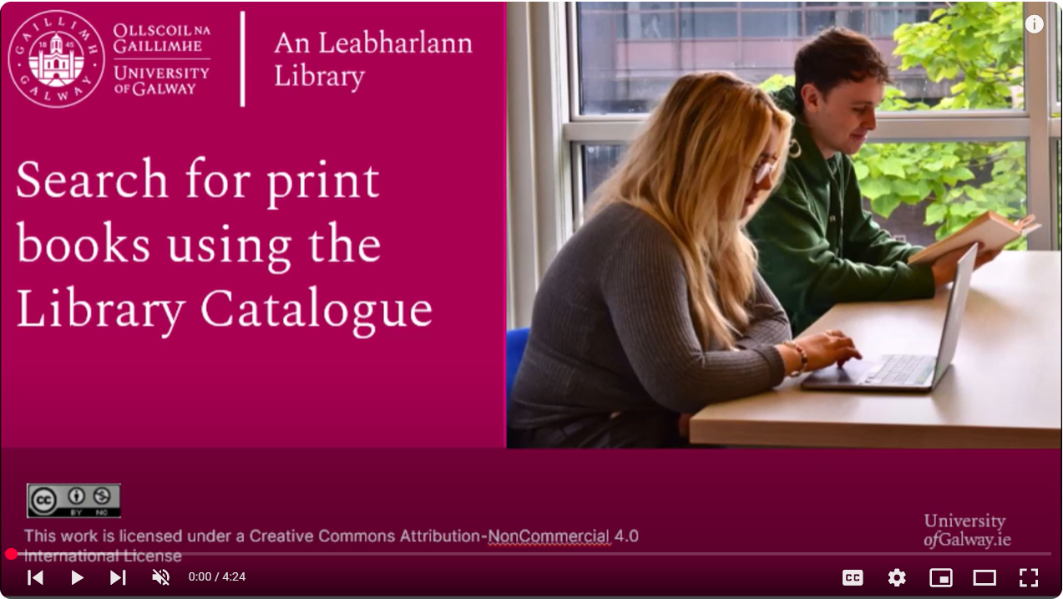
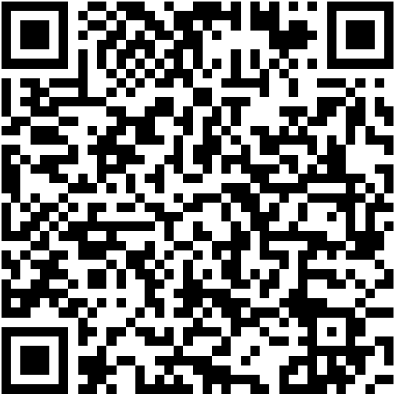
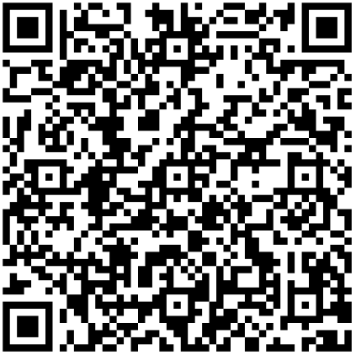
Library Resources
First Year In: FYI
Research Skills for Students
Academic Integrity
Master the Library Catalogue
/library.universityofgalway.ie/studying/academicskills/
Notes:
Our Academic Skills Team have created a wide range of guides to help you on your academic journey. –
Our First Year In Guide is A dedicated library guide for first year students which focuses on providing you with key supports in using the library, finding resources and developing your skills around critical thinking and academic integrity.
Our Research Skills for students is a self-directed guide that will provide you with the skills you will need to find, evaluate and correctly cite information sources. The guide includes a series of self-directed Workshops and Tutorials and is aimed at students who are being asked to use Library Resources independently by your lecturer.
We also have an academic integrity guide which outlines the university policy on academic integrity as well as supports for citing and referencing, avoiding plagiarism and academic writing.
“Master the Library Catalogue” with a suite of videos, split into chapters, that will show you how to log in to the catalogue, search for books and articles, carry out a keyword search, apply filters to results, carry out an advanced search, and more!

Slide 8
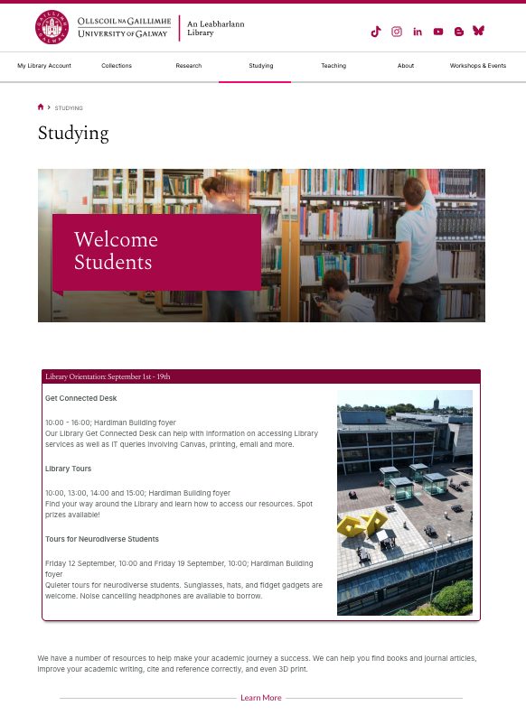
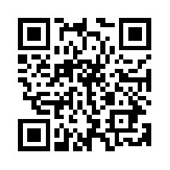
Getting Started in the Library library.universityofgalway.ie/studying
Notes:
Please take your time to review our Getting Started in the Library guide, this online guide will give you all the information you need on using the Library and all the services we have to offer.
We provide support, help, and training to enable you to get to discover the best resources for you.

Slide 9
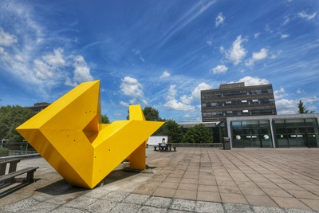
Orientation Supports
Library Tours
Friday, Monday, Tuesday
12:00, 13:00, 14:00
Meet in the Hardiman Building Foyer
Notes:
Info on the slide.

Slide 10




Phone
(091) 49 3399
Email
library@universityofgalway.ie
Instagram
uniofgalwaylib
TikTok
uniofgalwaylib
Notes:
There are many ways to contact us, email – Library@universityofgalway.ie – ONLINE Chat, Phone: 091 – 493399 – Social Media
Services are liable to change so please keep an eye on our website for up to date information
if you are not sure about anything PLEASE JUST ASK! – WE ARE HERE TO HELP

Slide 11
Go raibh maith agat! Thank you!

