Slide 1
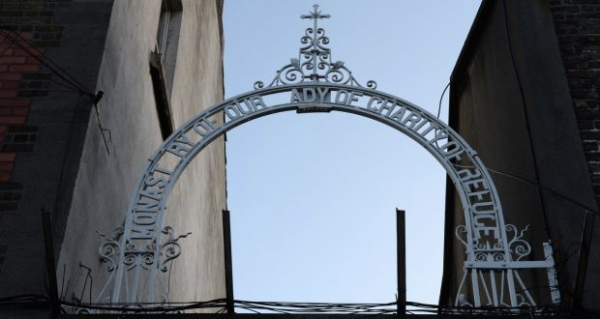
Lesson Plan: The Right to Identity and Ireland’s Dark Institutional History
Notes:
Architecture of containment - James Smith

Slide 2
‘On admission her clothes were removed, her hair was cut. She was told: “You’re here for your sins”’
Notes:
Source: https://www.thejournal.ie/mother-baby-homes-testimonies-5322581-Jan2021/

Slide 3
By the end of this lesson, students will have:
A deeper understanding of the human rights abuses suffered by women and children in Irish institutions and the obligations of the state
Gained knowledge about each of the institutions
Learned ways in which you can make a change and stop the secrecy surrounding these issues

Slide 4

Name, Nationality, Family and Human Rights
Convention on the Rights of the Child
Article 7
1. The child shall be registered immediately after birth and shall have the right from birth to a name, the right to acquire a nationality and. as far as possible, the right to know and be cared for by his or her parents.
Article 8
1. States Parties undertake to respect the right of the child to preserve his or her identity, including nationality, name and family relations as recognized by law without unlawful interference.
Universal Declaration of Human Rights
Article 15
1. Everyone has the right to a nationality.
2. No one shall be arbitrarily deprived of his nationality nor denied the right to change his nationality.
Notes:
Step 1: get answers from the class and show them the articles on identity in the UDHR and the CRC
Activity 1: ask them how they would feel if they did not know who their parents are or what their nationality is. Get them to write down their emotions using online forum
Step 3: highlight how this was a reality for those living in mother and baby homes. If the father was black he was generally listed as ‘african’ rather than his country of origin. Africa is a huge continent, it would be like identifying us as solely european as opposed to irish

Slide 5
Arbitrary Detention:
People were detained without consent and without legal authority
Right to Remedy:
Individuals and their families are entitled to an effective remedy
Discrimination:
Gender-based, racial, basis of disability, basis of socio-economic background
Private & Family Life:
Forced institutionalisation, forced separation and lack of access to information
Right to life:
Children, babies and women died in these institutions
HUMAN RIGHTS VIOLATIONS
Torture & Ill Treatment:
Mental and physical abuse - pain inflicted intentionally
Enforced disappearances:
No access to birth certs or a registered place of burial
Modern slavery/forced labour:
Forced to work under threat of abuse
Notes:
These are the human rights abuses outlined in the ICCL press briefing on the report of the Mother and Baby Homes Commission
https://www.iccl.ie/wp-content/uploads/2021/03/Press-briefing-ICCL-analysis-of-MBHC-report.pdf
Step 1: discuss each human rights violation with the students and continue highlight the abuses throughout the class

Slide 6

IDENTITY
What makes a person?
Notes:
Step 1: put them into a breakout room
Activity 1: get them to discuss what they think makes up your identity and nominate a speaker
Step 2: bring them pack into the main room and get their answers
Activity 2: ask them how they would feel if they did not know who their parents are or what their nationality is. Get them to write down their emotions using online forum
Step 3: highlight how this was a reality for those living in mother and baby homes. If the father was black he was generally listed as ‘african’ rather than his country of origin. Africa is a huge continent, it would be like identifying us as solely european as opposed to irish

Slide 7
Name
Nationality
Home
Family
Age
Dislikes
Likes

Slide 8
Facts:
1950 - 3 reformatories and 51 schools.
Children generally arrived at 5 years old and stayed 9 years
Sexual abuse, emotional abuse and neglect were huge problems
Industrial Schools
Education
Facts:
56,000 women gave birth to 57,000 babies in 14 homes & 4 county homes
5,616 pregnant children
15% of babies died before first birthday
Last one closed in 1998
Irish Institutions
Religion
Mother and Baby Homes
Government
Facts:
Run by religious orders
Commercial and for-profit business
10 different locations all over Ireland
Between 1922 and 1996 - 10,000 women and girls were imprisoned
Magdalene Laundries
Notes:
Explain the diagram of Irish institutions and who ran each institution. Explain how schools are also an Irish institution

Slide 9
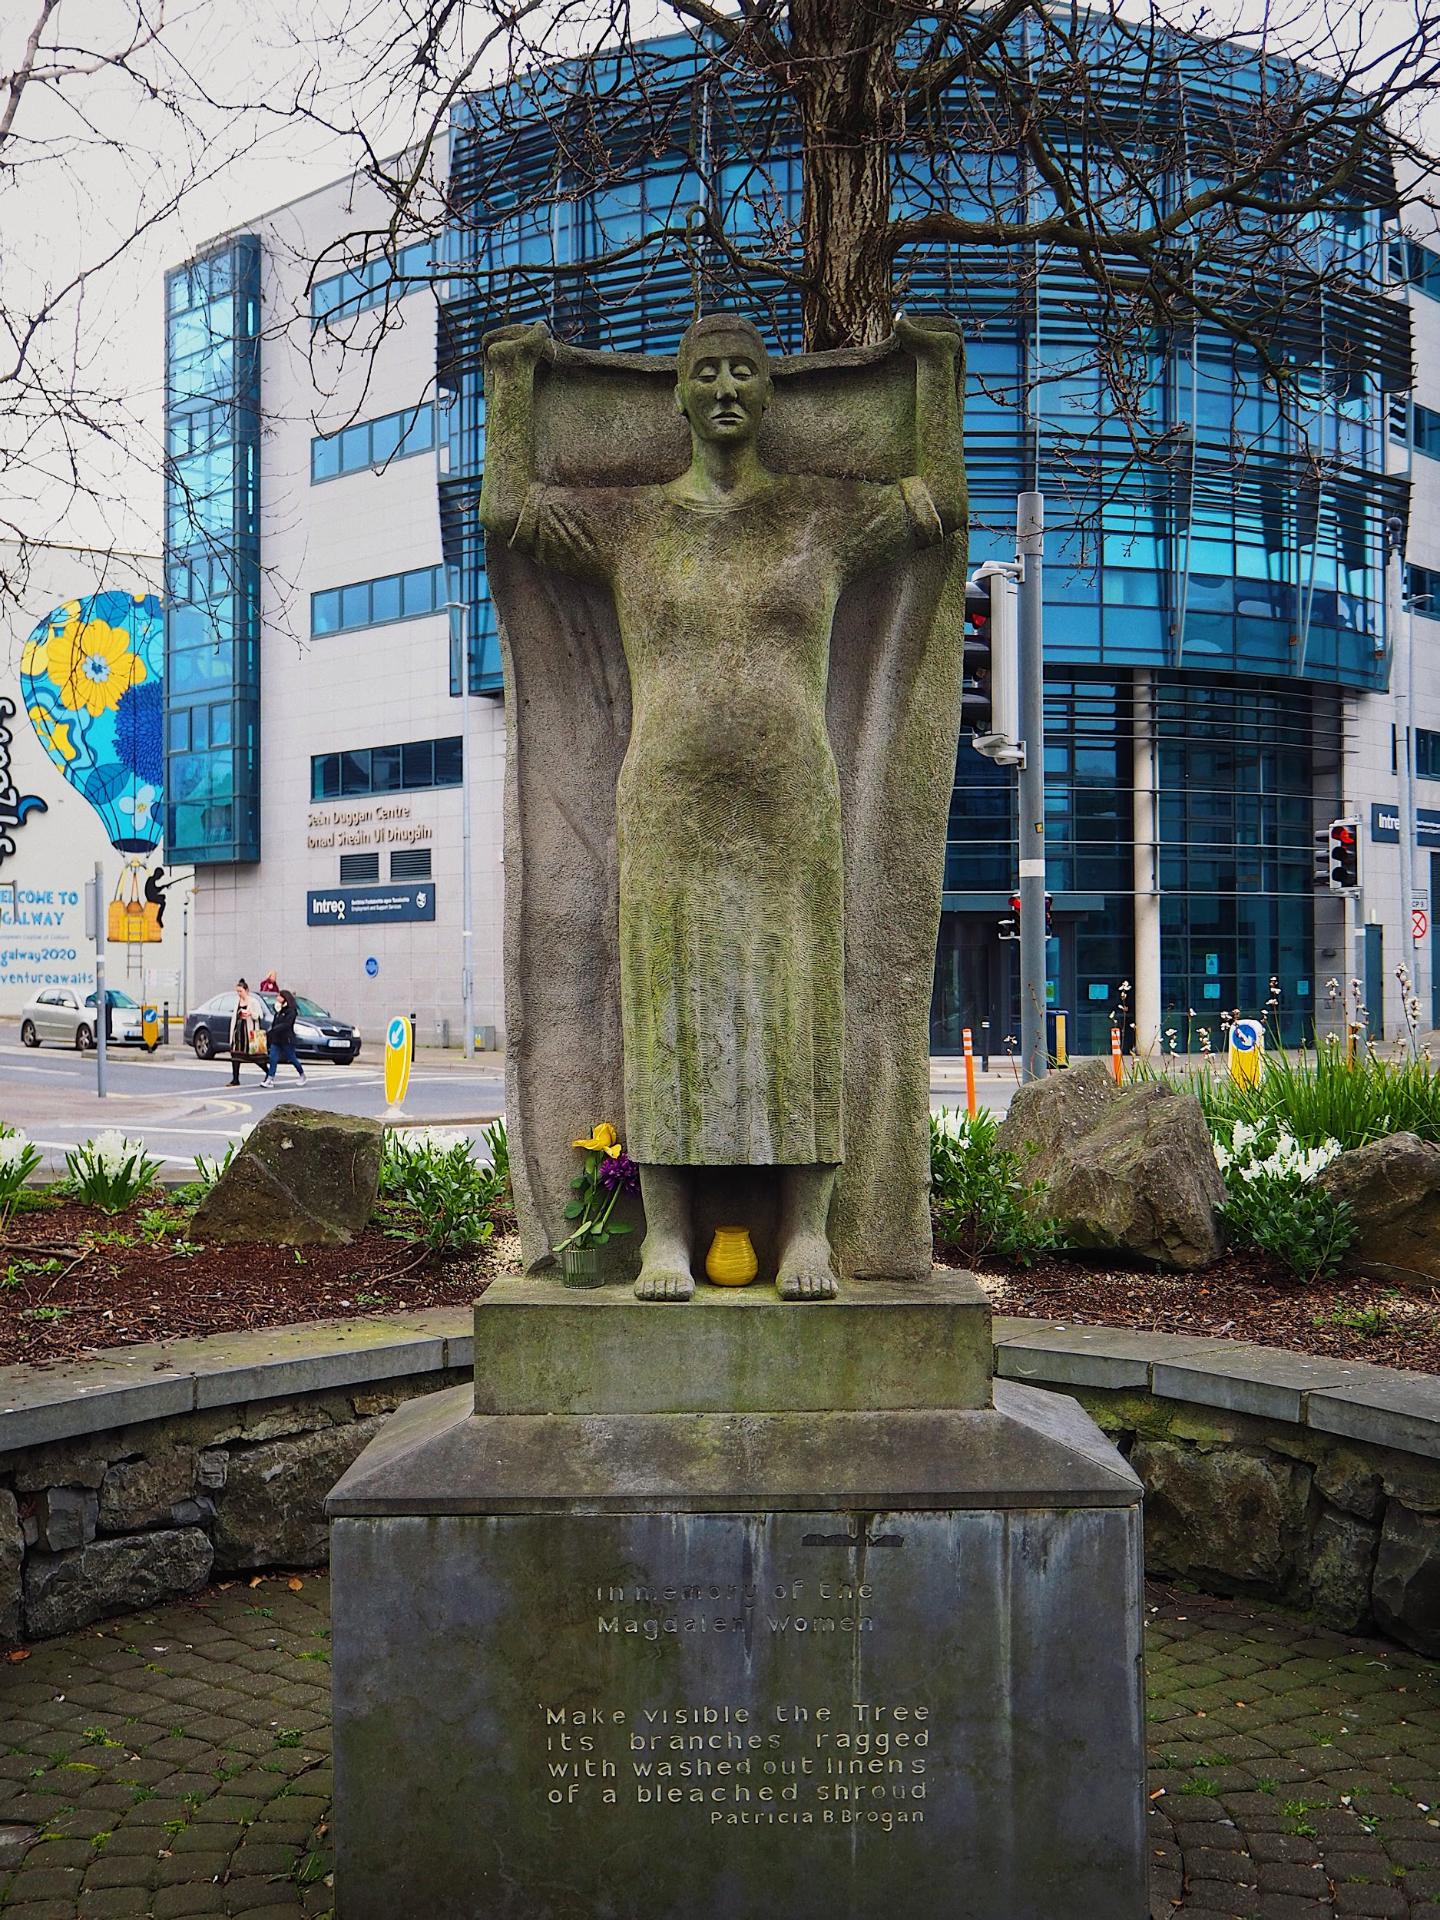

Ireland’s Institutions and Identity
Survivors of Ireland’s Institutions are Fighting For:
The Right to Identity
The Right to Truth
The Right to Redress
The Right to access their own birth certificates
Notes:
PC Sijia
Facts: Many survivors have brought cases to the courts in relation to access to birth certificates
The Court has recognised that survivors have the right to know their identity but insists that this right must be balanced against their birth mother’s right to privacy
This means that survivors do not get access to their own birth certificates despite the fact that birth certificates are public documents in Ireland
Activity: If you didn’t know you name or your nationality, who would you be? How do these two things form part of your identity?

Slide 10
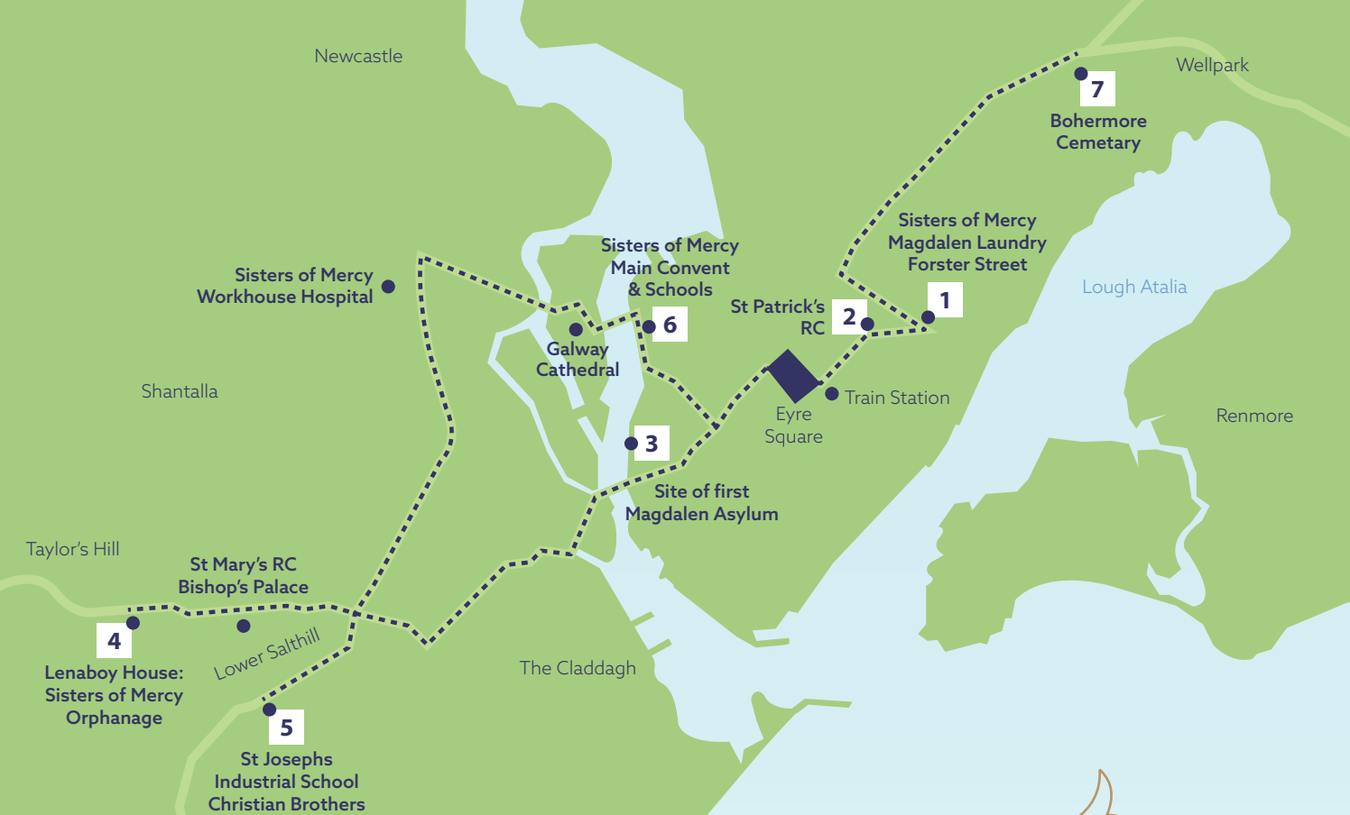
Map of the main sites related to the Magdalene Laundry in Galway city in the 20th and late 19th centuries.
Historical sites of Galway
Sisters of Mercy Magdalene Laundry
St Patrick’s RC
Site of First Magdalene Asylum Galway
Lenaboy House Sisters of Mercy Orphanage
St Joseph’s Industrial school Christian Brothers
Sisters of Mercy Main Convent and School
Bohermore Cemetery
(Not on Map) Bon Secours Mother and Baby Homes Tuam.
(Not on Map) St Joseph’s Industrial School Letterfrack

Slide 11
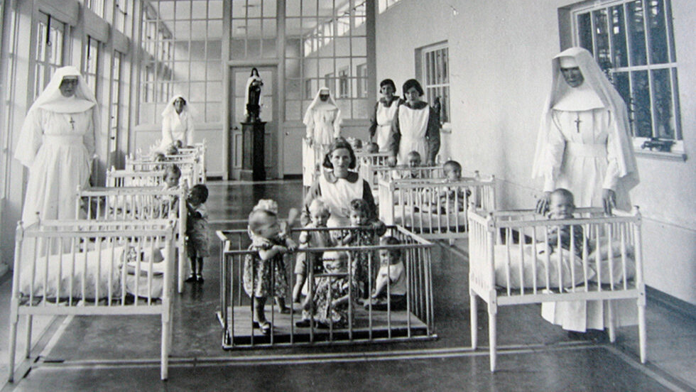
Mother and Baby
Homes
‘He is not hers, although she bore
For him a mother’s pains;
He is not hers, although her blood
Is coursing through his veins!’
Notes:
Image: https://thegloss.ie/mother-and-baby-homes-report-ireland/
Video of Beth reading The Slave Mother by Ellen Watkins Harper
*Put a lyric from the song on the slide
Activity: Take two minutes and write down how this poem make you feel. What words come to your mind? If you were to draw a picture to illustrate this poem what would it look like, what type of colours would you use?
Question: What story is the poem telling? What happened the Mother? How does she feel?
Discussion: What do you think happened in MBH? What have you heard about them before? Where have you heard about them before?

Slide 12
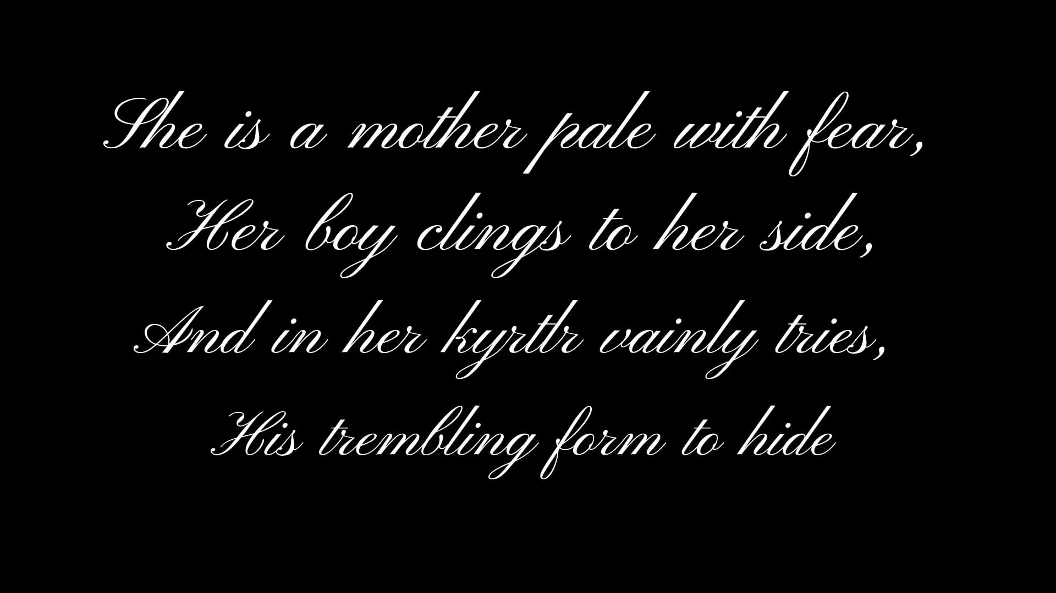

Slide 13
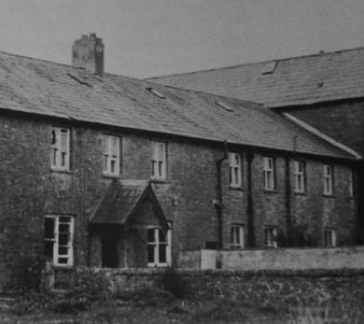
Tuam Mother and Baby “Home”
Notes:
Pictured: Tuam Mother and Baby Home
Image source: Tuam survivors network

Slide 14
Not a Home but an Institution
What do you think of when you think of home?
What do you think of when you see the picture of the Tuam Mother and Baby Institution?
Notes:
“Now I just want to have an open discussion with you guys and ask what sort of feelings you get when you look at the so-called home in the slide beforehand? If you could write them in the chat that would be great
Now; what do you think of when you think of your own home? What feelings does that conjure?
from now on we will be referring to these as mother and baby institutions”

Slide 15
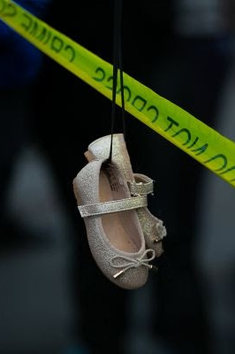
Mother and Baby Institutions and County Institutions
At least 170 institutions, organisations and agencies involved with unmarried mothers in 20th Century Ireland
56,000 mothers gave birth to 57,000 babies in 14 mother and baby institutions and 4 county institutions
5,616 pregnant children
Approximately 15% percent of the babies born in these institutions died before their first birthday
The last institution closed in 1998
Notes:
P.C https://www.tuamhomesurvivors.com/gallery#!14963160_1204691672935417_3101152392875261129_n
Step 1: Describe what happened in this institution and the abuses that occurred.
Activity : ask the students to picture 56 000 mothers and 57 000 children – is there any stadium in Ireland where they could all fit - ask them how big they think Croke Park is
youngest person who was admitted was 9 years old.

Slide 16
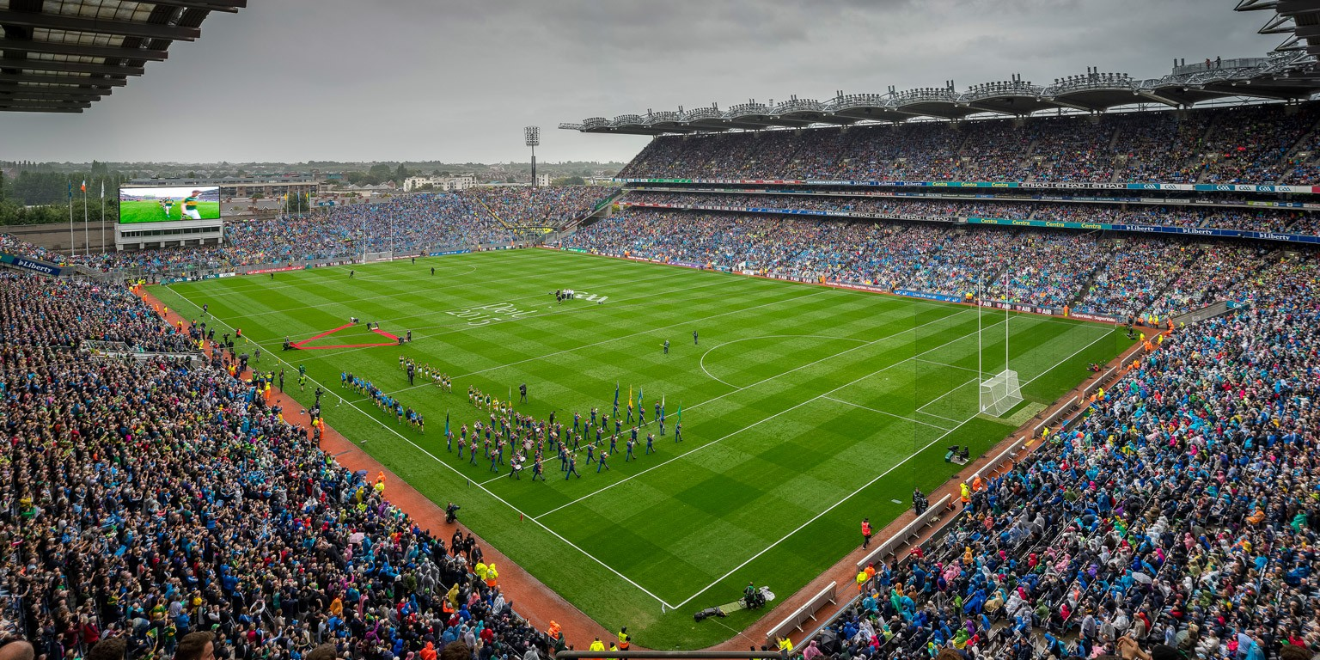
Croke Park only holds 82,300 people....
Notes:
There were approx 113 000 people that entered MBH – aprx 30 700 more than can fit in Croke Park
PC https://crokepark.ie/stadium/about

Slide 17
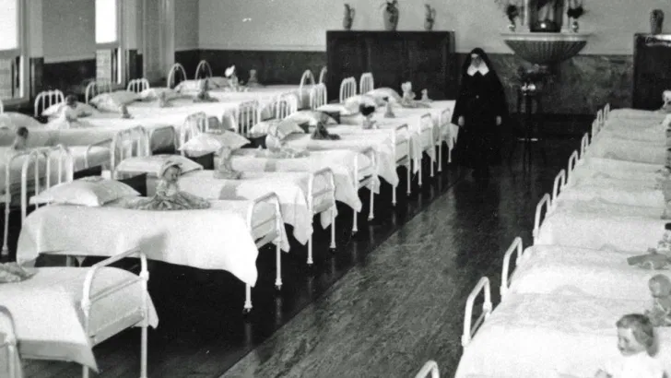
“To quote one harrowing statistic from the recent Mother and Babies report, 75.19% of all babies admitted to, or born in the home in 1943 died in infancy”.
Notes:
Source: https://www.irishexaminer.com/news/spotlight/arid-40216631.html

Slide 18
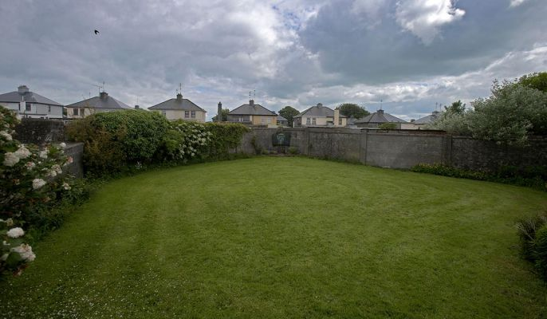
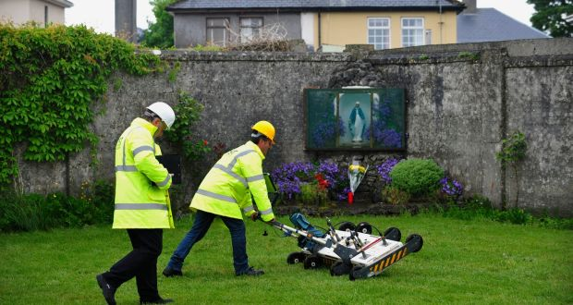
Burial and Loss of Identity
Tuam Burial Site
Notes:
Tuam burial image source: Tuam Survivors Network
Left: Tuam before excavation
Right: Engineers using ground-penetrating radar at the site of a mass grave of children at the former Mother and Baby home in Tuam, Co Galway.

Slide 19
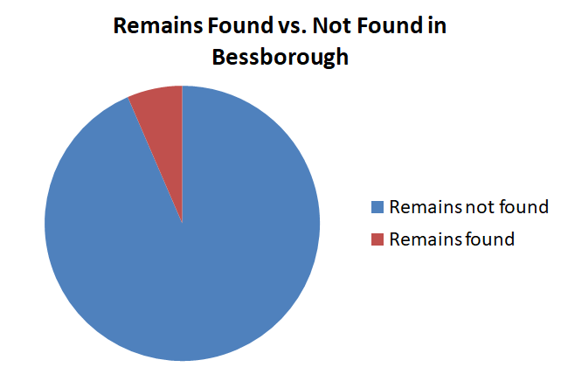
64
923
Notes:
Source: https://www.irishexaminer.com/news/arid-30918325.html

Slide 20
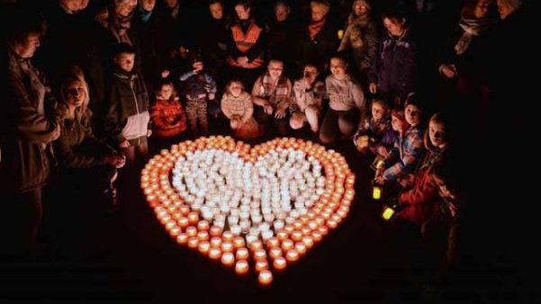
Tuam Mother and Baby Home
2,219 women and 3,251 children
978 children died - 80% before their first birthday
The high rate of infant mortality in Tuam MBH was never discussed at GCC meetings
Notes:
Extra Information
MBH could be run by either the local health authorities or religious orders/ private institutions
Tuam was run by Galway local authorities but the Sisters of Bon Secours were responsible for the day to day running of the institution
Galway county council went against the views of the Department of Health and allowed the Sisters of the Bon Secours to keep children in the institution until they reached either five (boys) or seven (girls) years old
In 1935 a maternity unit was opened in Tuam after GCC concluded that unmarried mothers should not be allowed give birth in the Central hospital
GCC argued that the presence of unmarried mothers deterred ‘respectable’ married women
20

Slide 21
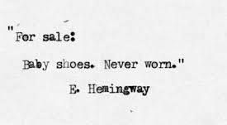
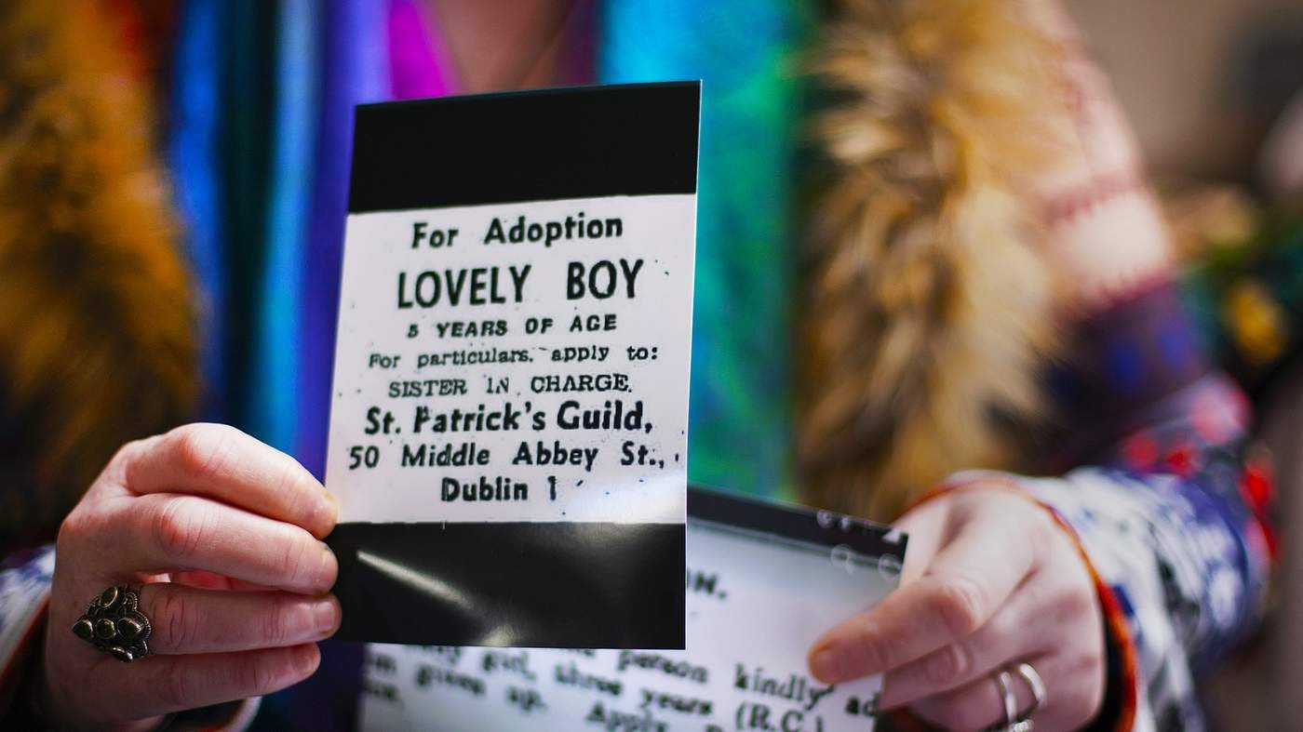
Adoption
Notes:
PC https://www.bbc.co.uk/news/resources/idt-sh/the_girls_of_bessborough
Explanation: Hemingway is believed to have written this story in response to a challenge whereby a group of friend told him that he could not write a full story in 6 words. After hearing a little bit about the history of Ireland’s Institutions, what type of story do you do envision when you read Hemingway’s words?
When you look at the story and the picture beside it, does that story change? How?

Slide 22
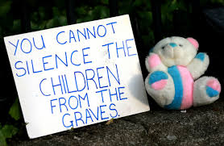
I, […] of […] in the county […] being the mother to the infant […] do hereby surrender the said infant to Mrs […] of […], and do renounce absolutely and forever all rights of whatever kind over the said infant and I understand that I shall make no claim upon the body or effects of the said infant at any time hereafter. Signed this [date] nineteen hundred and forty nine by me […] in the presence of the Reverend […] signature: witness […], Clerk, The Rectory
Example from Bethany House
Prior to 1953 there was no legislation regulating adoptions in Ireland
In January 1953, the Adoption Act 1952 came into force
Many of the adoptions were carried out without the consent of the infant’s natural mother
Notes:
Facts Pre 1953
In general natural mothers were not told the name or address of their child’s foster parents
Foster parents sometimes only needed a letter from the clergy in order to take in a child
Reports from Department of Local Government and Public Health suggest some societies were careless and put children in inappropriate homes of Local Government and Public Health
Example taken from the MBHC Report
Post 1953
The introduction of legislation was delayed significantly because the State did not want introduce any legislation without the approval of the clergy
After the introduction on the 1952 Adoption Act, the majority of children born outside of wedlock in Ireland were placed for adoption
While the Act calls for consent many victims of mother and baby homes state that they were unaware of what they were signing. Others have stated that the signatures on adoption applications are not theirs.
The Adoption Act also required foster parents to be the same religion as the birth mother.
Adoption Orders did not contain information pertaining to the child’s natural parents, surname at birth or place of birth
According to research carried out in TCD by Vivienne Darling in 1974, 50% of those working for adoption agency did not have Social Work training
Question: Some social workers were working on over 90 cases at one time Why do you think the lack of legislation is problematic? Why do you think there was a delay in introducing legislation? – Discuss

Slide 23
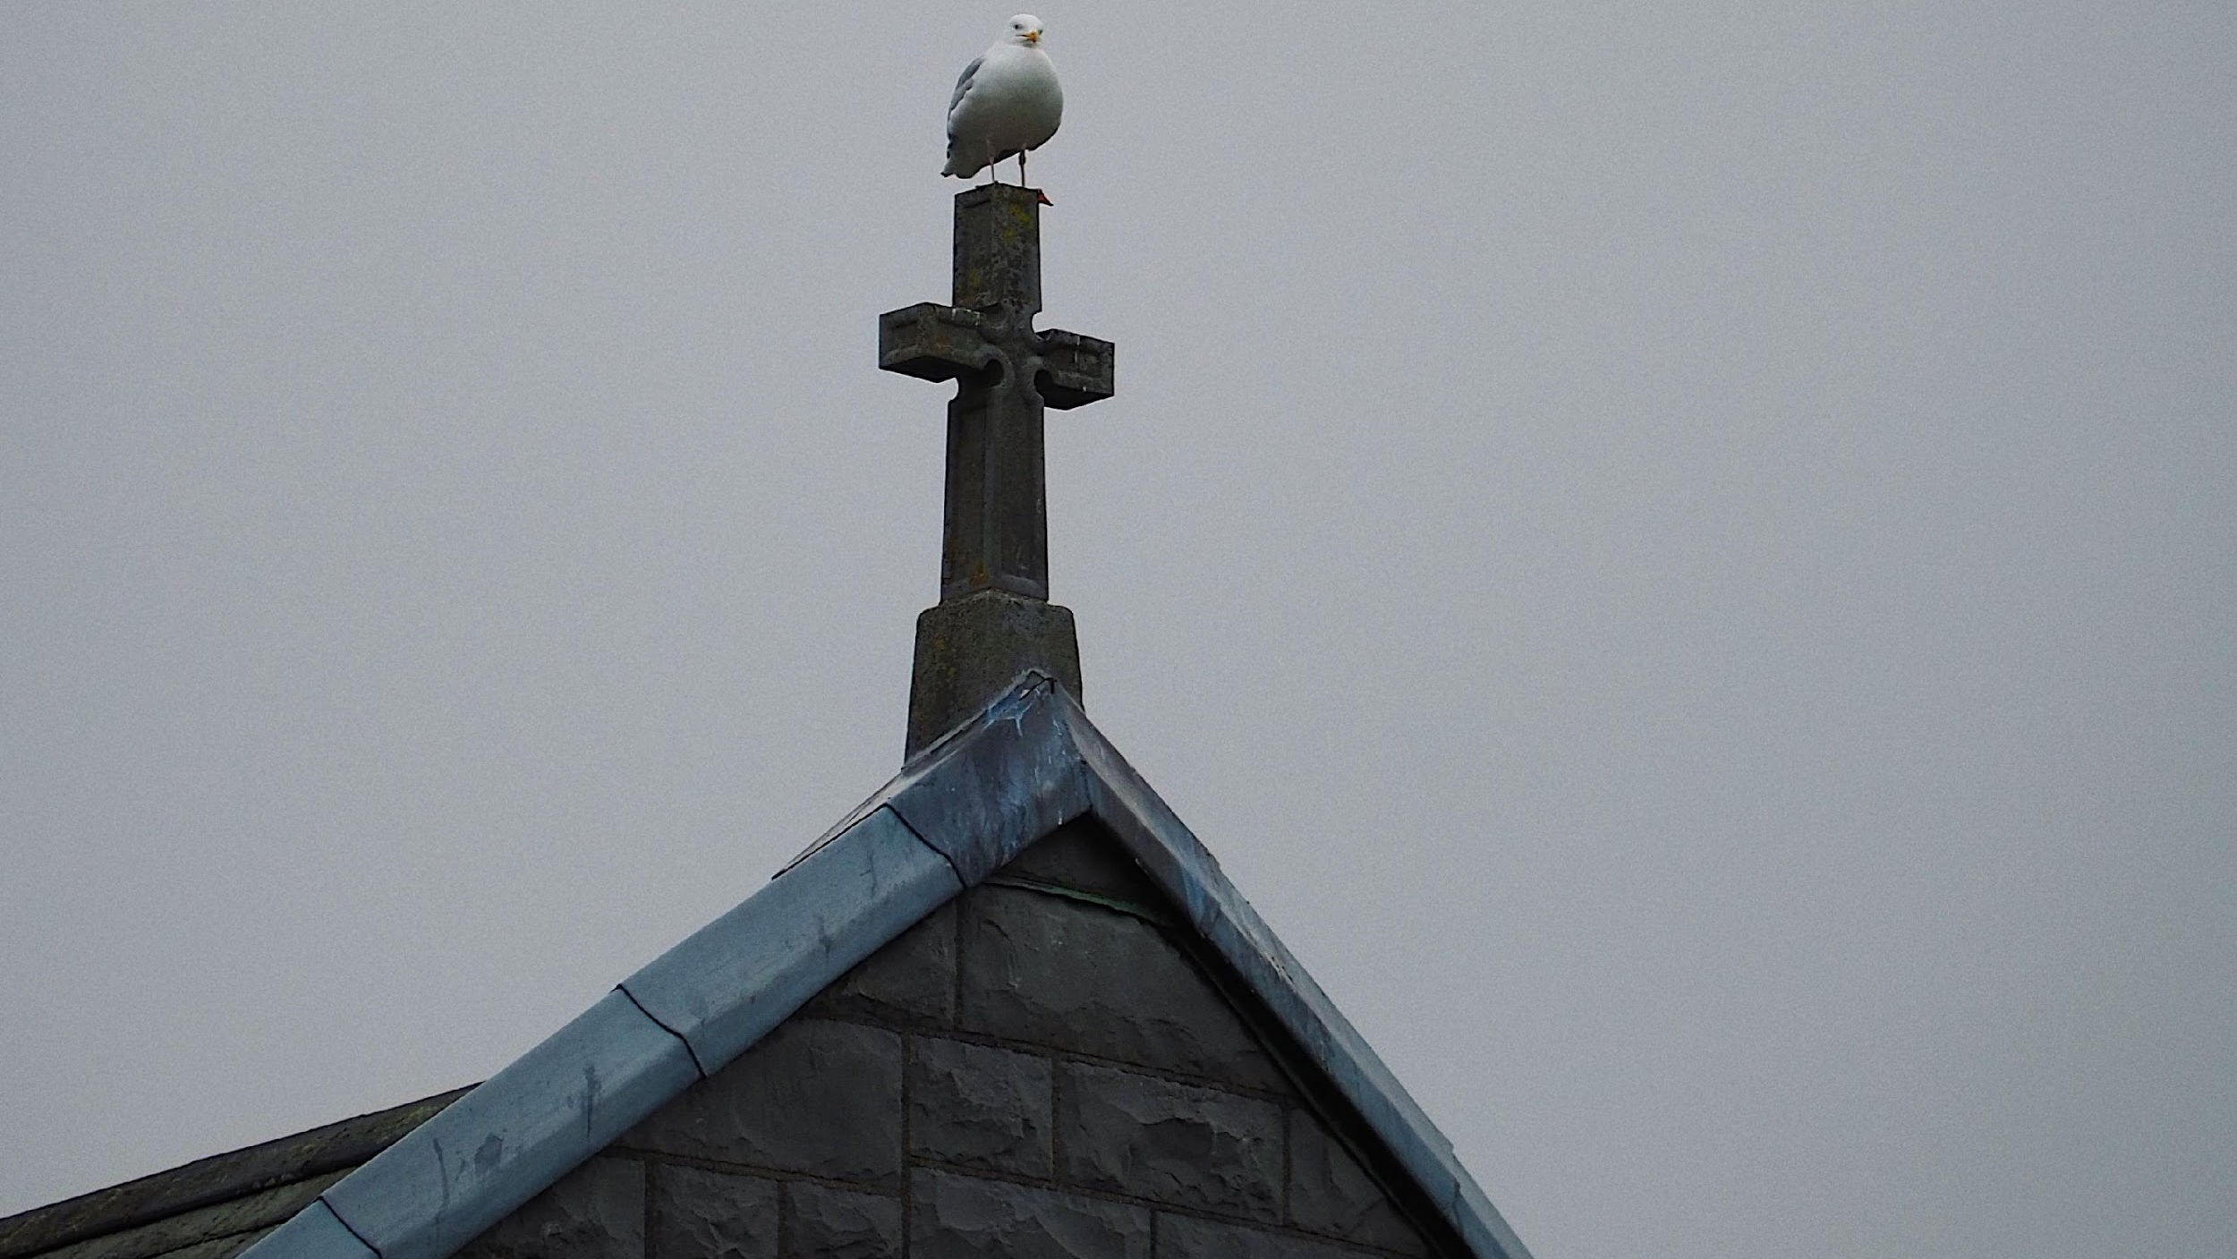
The Department of External Affairs created over 2000 passports which allowed Irish children to be adopted by foreign couples living outside Ireland
Notes:
PC Mannix Flynn
Facts : Foreign Adoptions
Between 1922 and 1998, at least 1427 Irish children were sent to the United States
The DFA files in the National Archives of Ireland contain over 2000 separate passport applications made on behalf of foreign couples looking to adopt Irish children
Sometimes the only requirement was for the parents to be the same religion as the natural mother of the child
It was not until 1956 that the DFA decided that they should only agencies that were licensed and approved as child-placing agencies by local state authorities

Slide 24
“In early February 1968, when my baby boy was six-seven weeks old, he was wrenched from my breast by one of the nuns whilst I was breastfeeding him and taken away for adoption”.
“She was asked to dress him up for a photograph and leave him with staff for the photograph”.
“I later learned from my sister that she had tried to call but was never allowed to speak to me” and that the Mother Superior had lied to her sister “that I had changed my mind and I wanted to give my baby up for adoption”
“I was adopted without a birth registration even though my mother turned up at Sean Ross Mother and Baby Home alone with a baby, with no legal proof that she was the baby’s mother. I was adopted 2 months later on the basis of a letter of non-registration and my baptismal certificate. … It is impossible to imagine a child without a birth certificate being adopted today. It should have happened when I was adopted. As a child born to an unmarried mother, I obviously wasn’t worth registering’’
Notes:
Maeve O'Rourke, Claire McGettrick, Rod Baker, Raymond Hill et al., CLANN: Ireland's Unmarried Mothers and their Children: Gathering the Data: Principal Submission to the Commission of Investigation into Mother and Baby Homes. Dublin: Justice For Magdalenes Research, Adoption Rights Alliance, Hogan Lovells, 15 October 2018.
http://clannproject.org/wp-content/uploads/Clann-Submissions_Redacted-Public-Version-October-2018.pdf
Para 1.84, statement provided by Witness 12
Para 1.85 statement provided by Witness 29
Para 1.54 statement provided by Witness 26
Para 1.149 statement provided by Witness 16
When watching this video, think about consent - jot down anything that you think be used to suggest that the women in these institutions were not given the opportunity to provide fully informed consent.

Slide 25
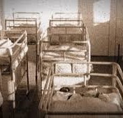
What is Consent?
If a woman is incarcerated in an institution, do you think she is capable of giving ‘full, free and informed consent’?
What about a girl who has not told her family that she is pregnant, do you think she is capable of giving consent? What do you think might be on her mind?
Notes:
PChttps://www.flickr.com/photos/irishmotherbabyhomes/
*Emphasise consent to what (consent to giving away her baby)

Slide 26
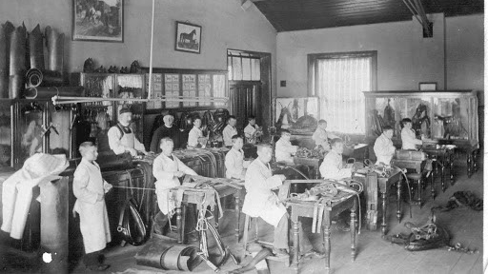
Industrial Schools
Notes:
PC Child abuse commission Chp 7
Activity 1: Play the song Sunday’s Well: A reimagining of the Irish Ballad Weile Weile Weile by Connie Roberts https://www.youtube.com/watch?v=ZEC28IHnVeU - Discuss the Song
Discussion: What roles do schools play in your lives? How has your school shaped your identity?

Slide 27
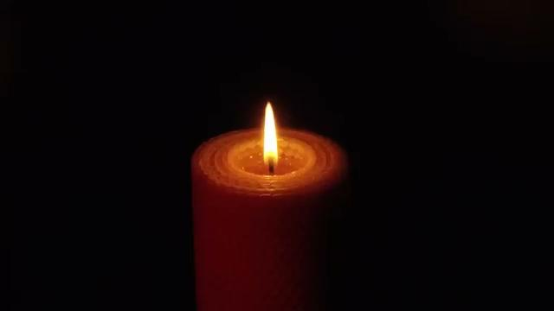

Slide 28
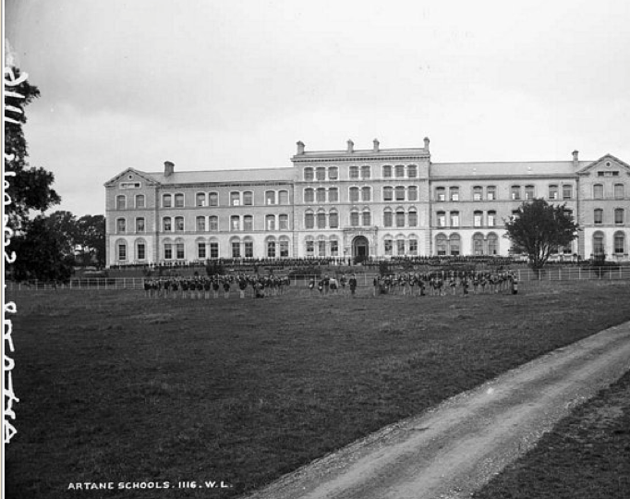
What were Industrial Schools?
•Industrials Schools housed neglected, orphaned and abandoned children, as well as children who had been charged with begging.
•These institutions were run by religious orders and funded by the public.
•At their peak they held 8,000 children across 71 “schools”.
•Sexual abuse was a ‘chronic’ problem in many schools while neglect and emotional abuse were ‘endemic’
•Schools often ran enterprises such as commercial farms, staffed by these children. These children were trained in agriculture, shoe and dress making, domestic services and intensive household labour.

Slide 29
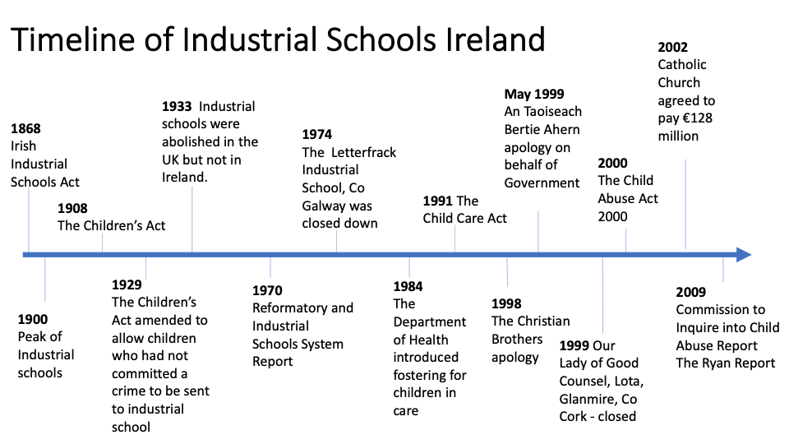
Notes:
This section will look at a brief timeline of the Irish Industrial Schools and how child protection policy has been developed, also highlighting that these institutions were around up until the late 90s.
Timeline of Irish Industrial Schools
1868 Irish Industrial Schools Act
Industrial schools were established to care for ‘neglected, orphaned and abandoned children.’ They were run by religious orders, both Catholic and Protestant, and funded by the public.
1900 This was the peak of industrial schools with 8,000 children in 71 schools.
1908 The Children’s Act
Also known as the Children and Young Persons Act,
was a piece of government legislation passed as part of the British Liberal Party’s liberal reforms package.
It defined reformatories as responsible for feeding, clothing, housing and teaching young offenders.
‘The expression “industrial school” means a school for the industrial training of children, in which children are lodged, clothed and fed, as well as taught.’ (section 44 of the Children Act, 1908)
1929 The Children’s Act was amended to allow destitute children to be sent to industrial schools, even if they hadn’t committed a crime.
1933 Industrial schools were abolished in the UK but not in Ireland.
1970 Reformatory and Industrial Schools System Report (The Kennedy Report)
Recommended: ‘The present institutional system of Residential Care should be abolished and be replaced by group homes which would approximate as closely as possible to the normal family unit. Children from the one family, and children of different ages and sex should be placed in such group homes.
1974 The Letterfrack Industrial School, Co Galway was closed down.
1984 The Department of Health introduced fostering for children in care.
1991 The Child Care Act ( the only children’s policy introduced in 83 years)
This brought in considerable changes in relation to children in care.
This Act focused on the child and the promotion of the child’s welfare.
It also placed a specific duty on Health Boards (now the Health Service Executive) to identify children who were not receiving adequate care and protection and in promoting their welfare to provide child care and family support services.
This Act underpinned the basic belief that the welfare of the child is of paramount importance.
1998 The Christian Brothers apology
the christian brothers made a public apology to those who were physically or sexually abused in their care, they also took out a half page advertisements in newspapers to admit some people’s claims had been ignored.
‘We the Christian Brothers in Ireland wish to express our deep regret to anyone who suffered ill-treatment while in our care. And we say to you who have experienced physical or sexual abuse by a Christian Brother and to you who complained of abuse and were not listened to, we are deeply sorry.’
May 1999 An Taoiseach Bertie Ahern apology
Taoiseach, Mr Bertie Ahern, apologised on behalf of the government to the survivors of child abuse in industrial schools, acknowledging the responsibility of the Irish State in providing services for children and announced a package of measures to tackle such abuse.
These included the establishment of a Commission to inquire into child abuse and the establishment of a €5 million professional counselling service for victims.
2000 The Child Abuse Act 2000
This act established a commission to investigate child abuse in institutions in the State to enable persons to give evidence to committees of the Commission.
2002 Catholic Church agreed to pay €128 million
The catholic church agreed to pay €128 million which went into a special State fund for victims of abuse.
In return, the State arranged that people seeking compensation from the Residential Institutions Redress Board were barred from suing the Church directly.
20th May 2009 Commission to Inquire into Child Abuse Report (The Ryan Report)
The Commission to Inquire into Child Abuse Report was published. (Also known as the Ryan Report) This report found that ‘The system of large-scale institutionalisation was a response to a nineteenth century social problem, which was outdated and incapable of meeting the needs of individual children.
The failure of the system was a result of the poor management of the various congregations, that then led to the institutional abuses of the children in care, resulting in their developmental, emotional and educational needs not being met.

Slide 30
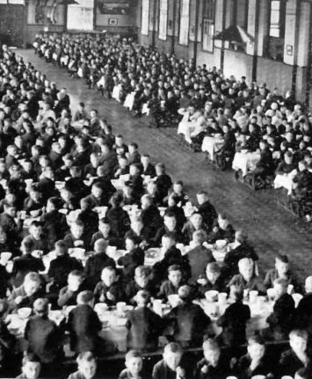
‘’… housed in great big factory-like places, where individuality has been, and is being, snuffed out with no development of the personality … and where little children became a great army of child slavery in workshops’’ - Fr. Edward Flanagan: Irish-American pioneer
Notes:
Image: https://www.theirishstory.com/2016/08/24/whose-idea-was-it-state-policy-clerical-abuse-and-the-intellectually-disabled-in-1950s-ireland/industrial-school/#.YGxWbRNKj-Y
Fr. Edward Flanagan could be a good Research Study Report for History students

Slide 31
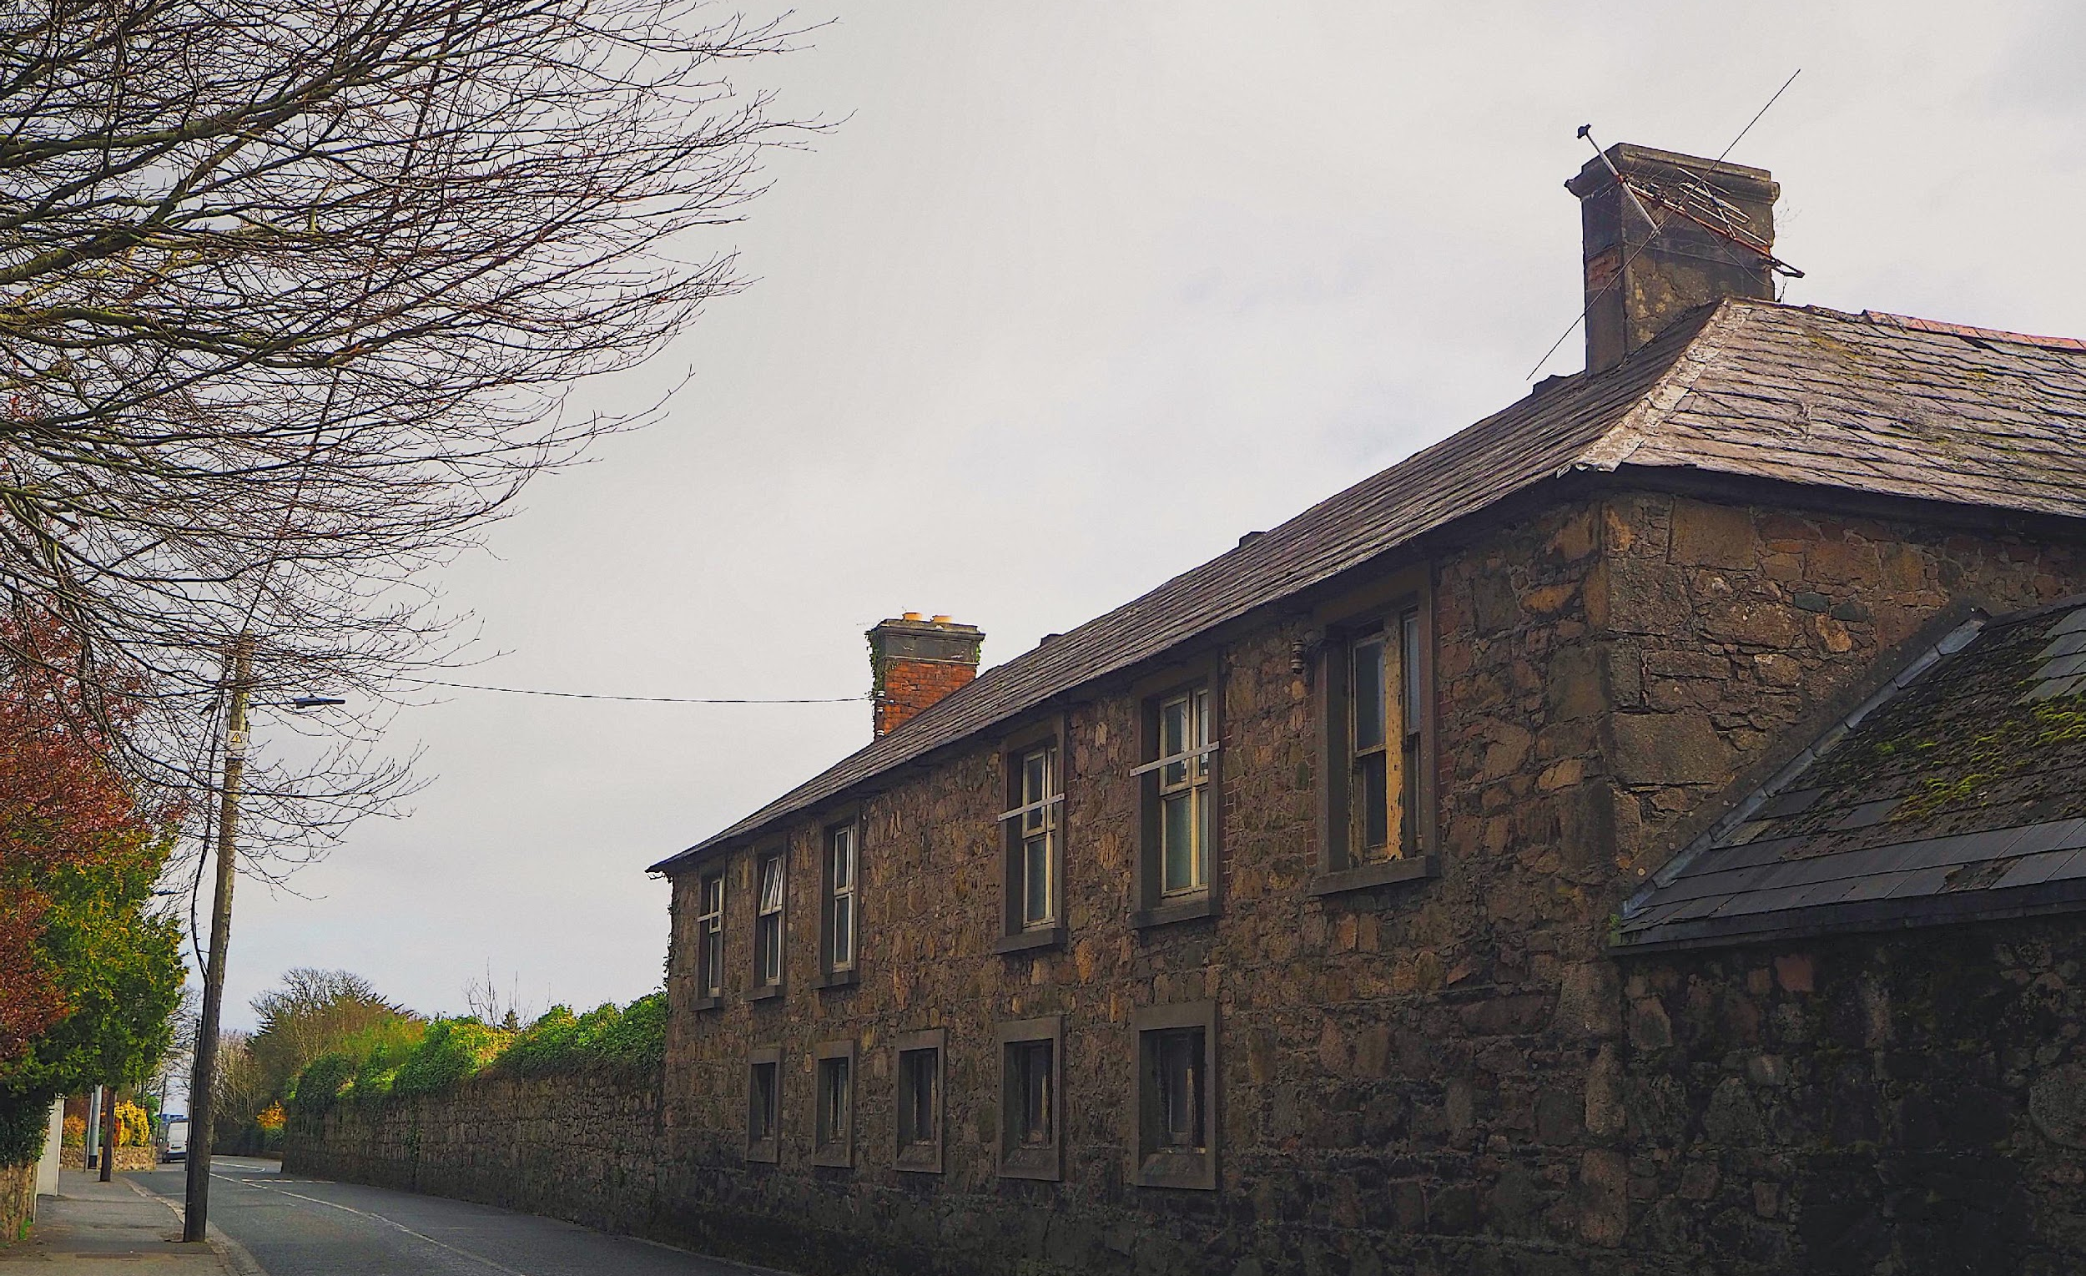
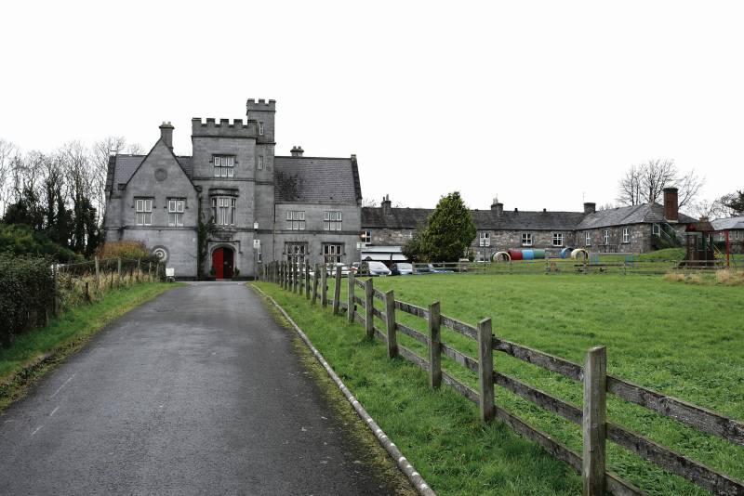
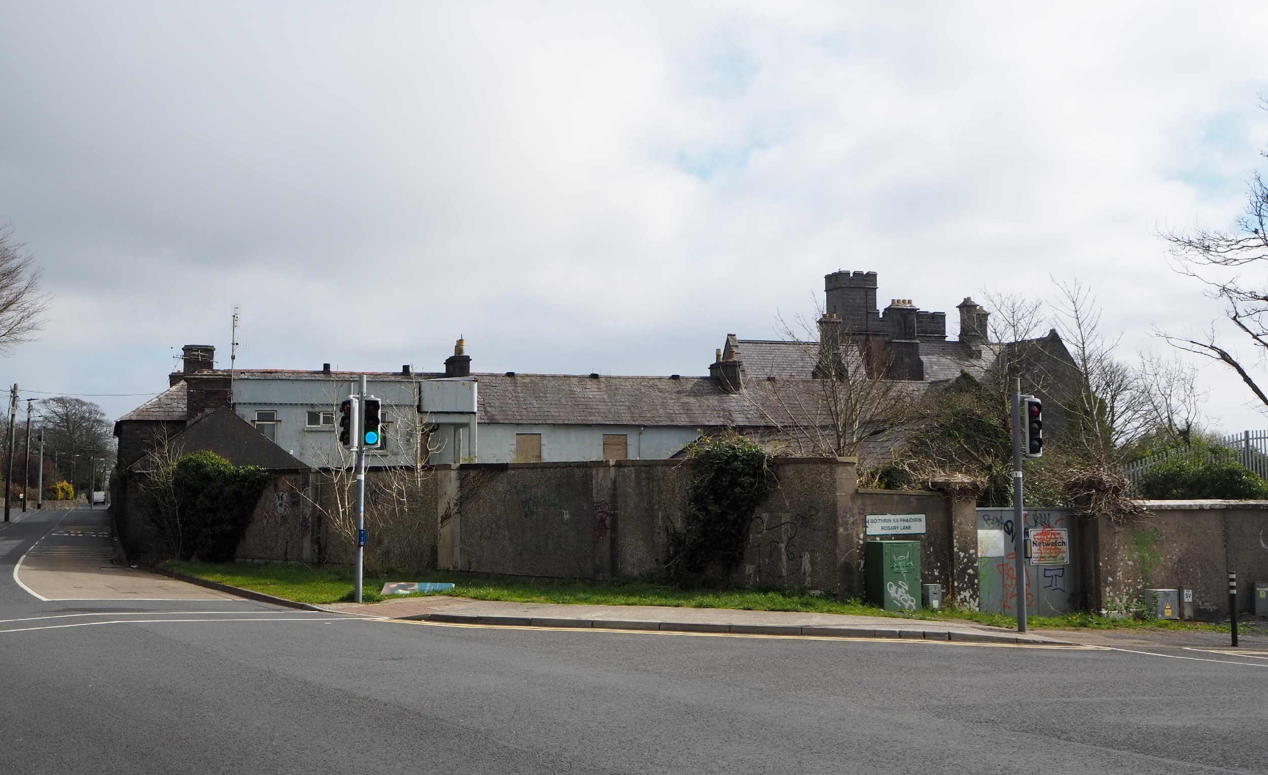
St. Anne’s Industrial School,
Taylor’s Hill, Salthill Galway

Slide 32
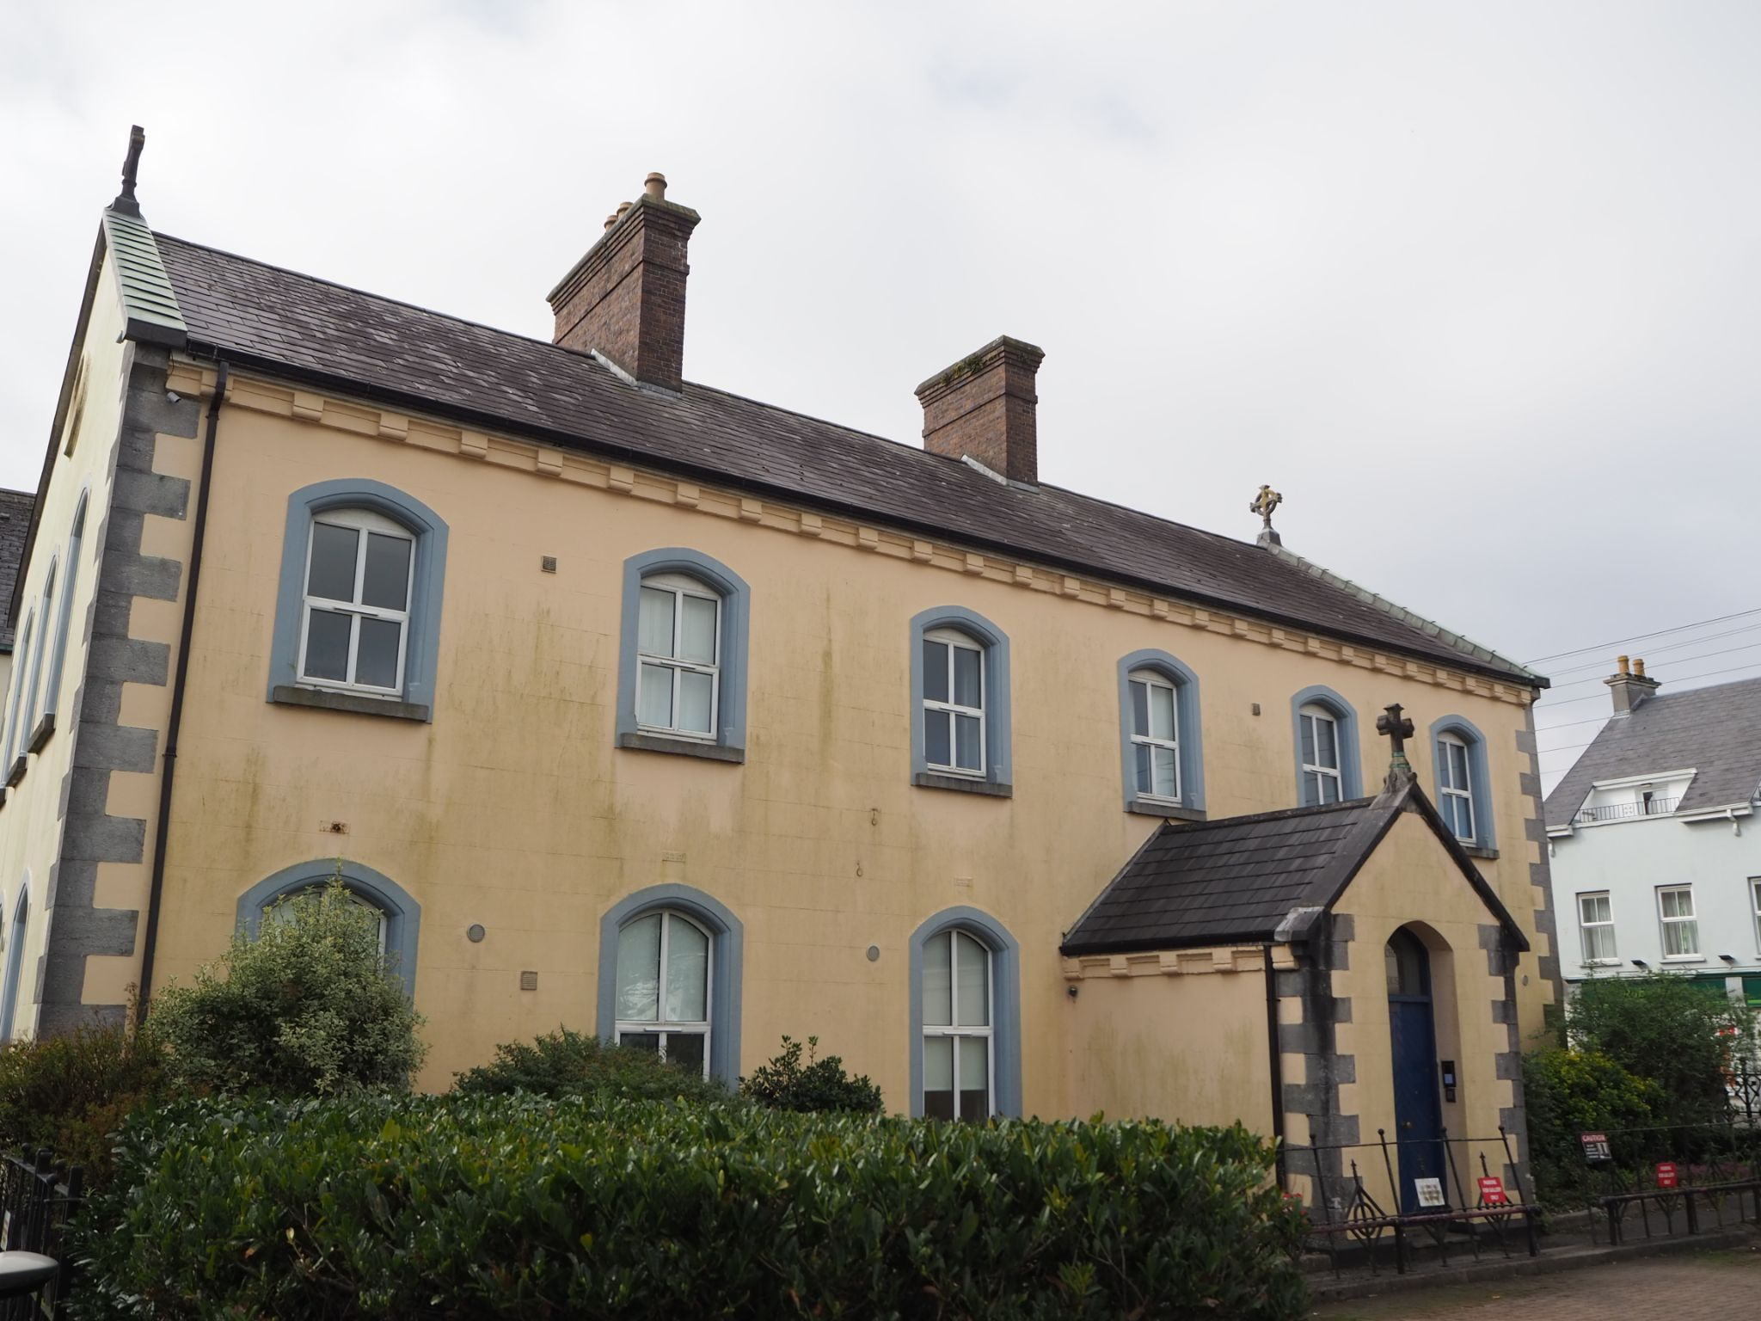
St Joseph’s Industrial School Salthill

Slide 33
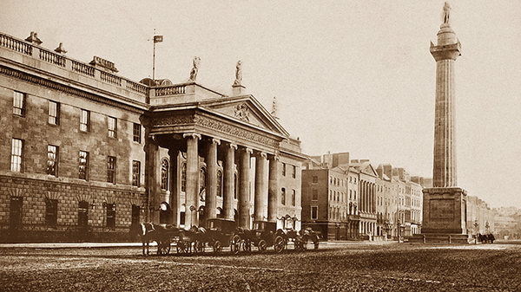
Life for Women in the 1920’s and 1930’s
Censorship
Divorce was illegal
Ban on contraceptives
Ban on women sitting on juries
Civil service marriage bar
Extremely Catholic Ireland – enshrined in Bunreacht na hEireann
Women’s place in the home
Stigma against unmarried mothers
Notes:
Image: https://www.historyireland.com/volume-26/issue-3-may-june-2018/gpo/
Censorship- suppression of speech, public communication etc. – women’s voices were not being heard
Civil service marriage bar – ban on married women joining the civil service, ended in 1973.
Extremely catholic Ireland – new Irish free state, Cumann na Gaedheal (in power for 10 yrs) followed by Fianna Fail, they and Eamon DeValera adhered to the hierarchy.
What do you think life was like for unmarried mothers? They were not afforded the rights of married women and were often kept a secret and put in Magdalene laundries by their families.

Slide 34
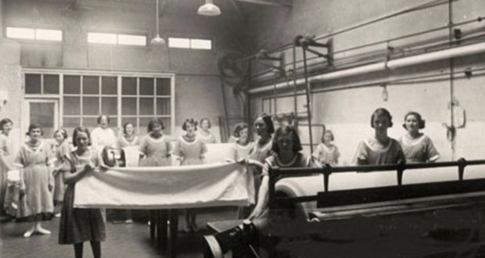
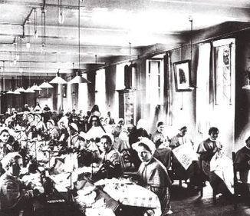
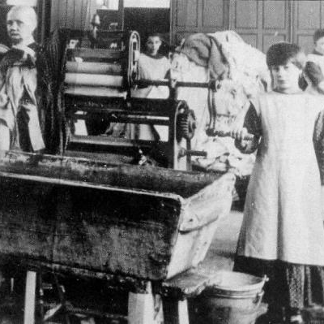
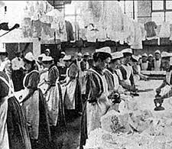
The Magdalene Laundries
“You took away my name
You took away my identity
In a landscape full of shame
There’s no place left for dignity”
Notes:
Image sources:
https://www.irishtimes.com/culture/books/valuable-addition-to-history-of-magdalene-laundries-uses-private-records-1.3202262
https://en.wikipedia.org/wiki/Magdalene_Laundries_in_Ireland x2
https://www.rte.ie/news/2018/0111/932442-ni_magdalene/
Add song : Breeda Murphy : You took away my name
https://www.youtube.com/watch?v=7z1ycjNh6IM

Slide 35


Slide 36
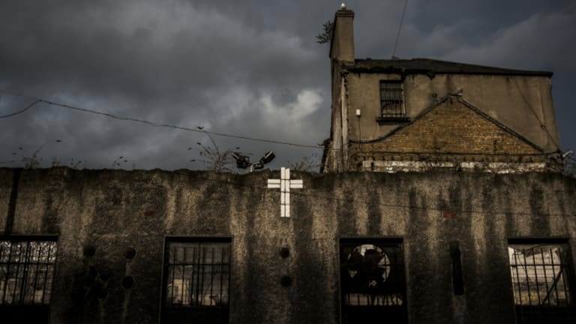
Key Facts:
Operated by four religious orders (The Sisters of Mercy, The Sisters of Our Lady of Charity, the Sisters of Charity, and the Good Shepherd Sisters) in ten different locations around Ireland
Commercial and for-profit businesses
Between 1922 and 1996, at least 10,000 girls and women were incarcerated in these laundries
Notes:
Image: https://www.history.com/news/magdalene-laundry-ireland-asylum-abuse
10,000 – underestimate

Slide 37
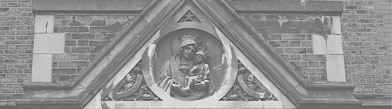
Who was incarcerated there?
Those deemed to be ‘promiscuous’
Unmarried mothers
The daughters of unmarried mothers
Those considered to be a burden on their families or the State
Those who had been sexually abused
Those who had grown up in the care of the Church and State
Notes:
Image source: http://openheartcitydublin.ie/

Slide 38
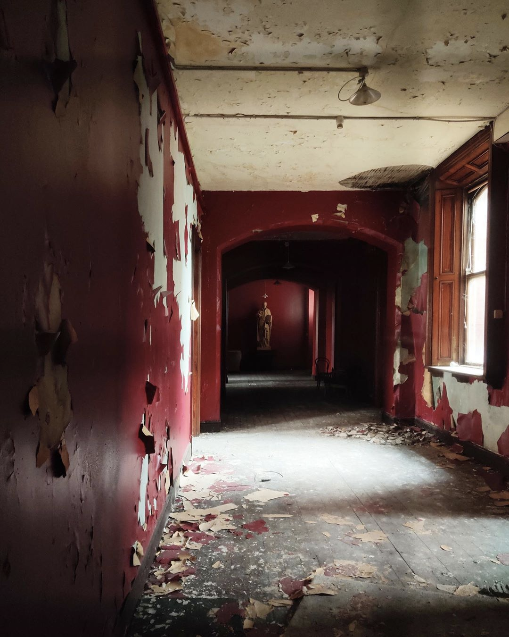
Treatment:
The treatment of these women is well documented, what do you know about it?
Menti Meter Code: 3501 0442
Notes:
Image: http://openheartcitydublin.ie/
Treatment:
Imprisoned, never told when they would be released, their names were taken, their clothes were taken, uniform, rule of silence, friendships were forbidden, told not to speak of home, visits were discouraged and monitored, outside correspondence was prohibited, manual labour from morning until evening, worked without pay, poor diet, inadequate hygiene, no education- stripped of any opportunity to further themselves. Intergenerational effects.
Break-out rooms: What kind of treatment do you think those imprisoned here suffered? Split into 5 groups, give instructions to 4, visit only 4 groups - leave out group 5. (Marginalisation) Bring back and discuss.
Stripped of any opportunity to further themselves
Inter-generational effects
*Reflective question on slide in terms of treatment and get them to think about it in break out rooms “the treatment of women imprisoned is well documented, what do you know about it?”

Slide 39
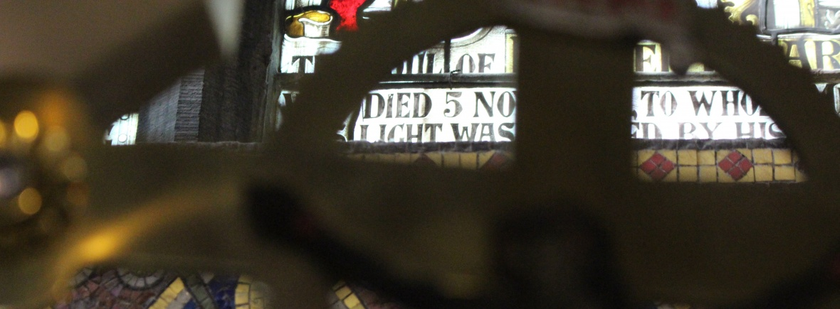
Punishment:
Deprivation of meals
Solitary confinement
Physical and verbal abuse
Forced kneeling for long periods
Humiliation rituals, including the shaving of hair
Escapees were often transferred to a different laundry upon their capture
Notes:
Image: http://jfmresearch.com/
Refusal to work, trying to escape

Slide 40
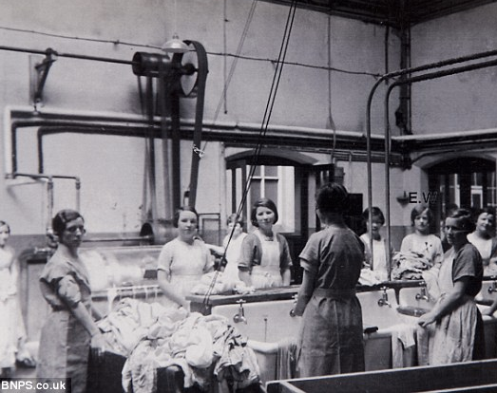
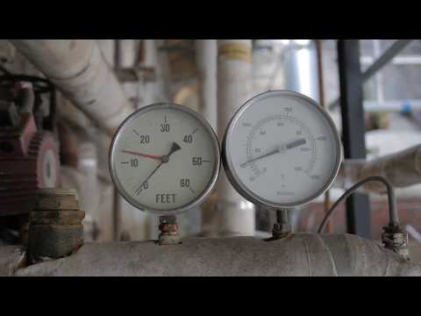
Call for Memorialisation
Notes:
Image: https://www.irishpost.com/life-style/new-research-aims-to-gather-experiences-of-survivors-of-irelands-magdalene-laundries-199634
Dublin Honours Magdalenes video

Slide 41
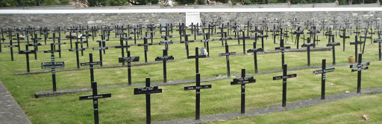
Deaths
Over 1,600 women died in the laundries
Incomplete records
Unmarked graves
Death Certificates
Notes:
Image: http://jfmresearch.com/home/preserving-magdalene-history/donnybrook/
Exact figure cannot be determined due to incomplete records in some institutions – Sisters of Mercy in Tuam and Dun Laoghaire. JFMR- 1,663
McAleese report didn’t include the women who died before 1922 or those who died in the care of religious orders after the laundries were closed.
Death registration -

Slide 42
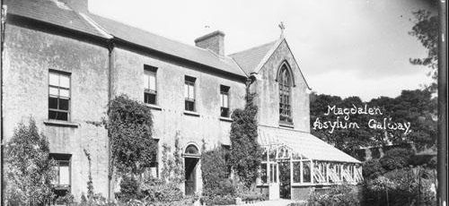
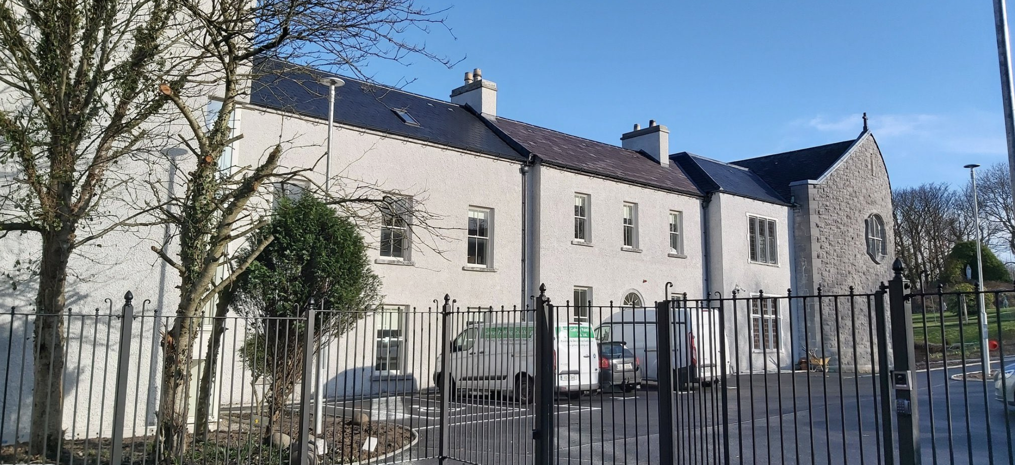
Sisters of Mercy Magdalene Laundry
The Magdalene Laundry was first established in Galway in 1824 and was managed by the Ladies of the Saint Magdalene Society. The Sisters of Mercy took over the operation of the institution in 1845, until the institution closed in 1984.
The former convent of the Sisters of Mercy Convent was given to the Galway Charity Cope, where it was renovated into a refugee for domestic violence victims.

Slide 43
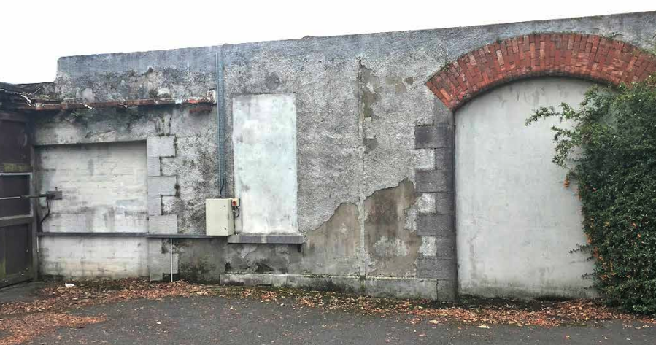
The west boundary wall of the Convent site is one of the only surviving portions of the 20th century laundry building.

Slide 44
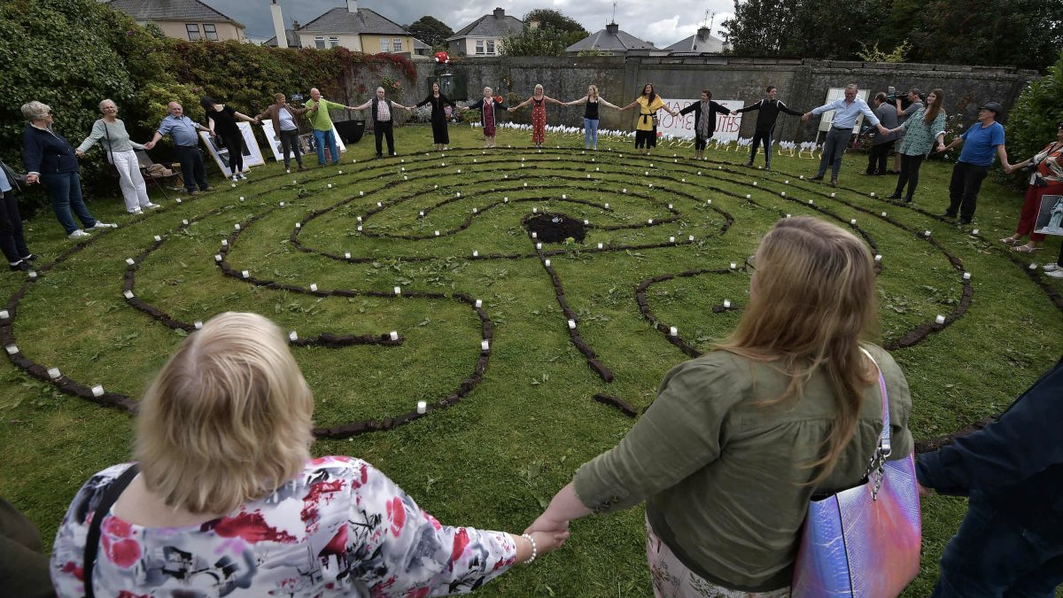
Moving Forward
The Right to Truth
The Right to Access Justice
The Right to Reparation
Memorialisation
Preventing Repetition
Notes:
Image: https://edition.cnn.com/2020/10/30/europe/ireland-mother-baby-homes-commission-intl/index.html
Memorialisation: Sean McDermott St., History classes
Preventing Repetition: Direct Provision, Nursing Home, intergenerational impacts
Get students to design a poster advocating for one of the rights outlined above; right to adoption, birth certs, preventing repetition, advocating for it to be incorporated into the curriculum

Slide 45
“Those who do not remember the past are condemned to repeat it”
George Santayana

Slide 46

If you have been affected by any of the issues raised today, please contact:
Barnardos Origins, Post Adoption and Bereavement Services
T: 01 – 8134100
Post Adoption Helpline, 01 - 4546388 (Tuesdays and Thursdays, 10am - 1pm)
Samaritans
Telephone: 116 123
Childline
Telephone: 1800 66 66 66
Text: 50101
Jigsaw
Text: 086 180 3880
Helpline: 1800 JIGSAW (544729)
Notes:
Childline, Barnardos, Pieta House, Samaritans, TULSA (ask Mary)
“If you have been affected or upset by any of the issues that we raised today then please talk to somebody or use the following helplines”

