Slide 1


Disability Rights and the Review of the Disability Act 2005: Key Findings from the National Survey 3rd of December 2025 Dr Charles O’Mahony, School of Law

Slide 2


Slide 3
Scope of Presentation
Background and Context for this Research
Some Findings
Thematic Analysis: Emerging Themes for Qualitative Data Reform Priorities
Spotlight on Assessment of Need
Reform Priorities
Reflections

Slide 4
1. Background and Context for this Research

Slide 5
Why This Survey?
As Shivaun has noted it is 20 years since the Disability Act 2005
Government committing to reform in the Programme for Government
Need to centre lived experience & stakeholder perspectives
Survey is a core element of our CEI fundedproject

Slide 6
This Research?
This project has three interconnected components that together provide a comprehensive review of the Disability Act on its twentieth anniversary.
First, the national survey, Disability Rights and the Review of the Disability Act 2005: Your Views, Your Voice, gathers perspectives from disabled people, families, professionals, policymakers and advocates. It forms the empirical backbone of the project and is the main focus of today’s presentation.
Second, a national conference held today at the University of Galway on 3rd of December 2025 bringing you together for in-depth reflection and discussion; the insights from today complement and deepen the survey findings.
Third, the report for this project will includes a brief legal and policy analysis examining the Disability Act in its national and European context, including Ireland’s CRPD obligations and the evolving influence of EU disability law.
We hope this report will be of use to policy makers, disabled people, NGOs, and DPOs as they engage with the reform of the Disability Act 2005

Slide 7
Who Responded? (154 respondents, multiple roles allowed)
Multi-select nature:
231 total role selections
Shows people occupy overlapping identities (disabled people, carer, advocate, professional)
Then headline numbers:
68 persons with disabilities
53 family members/caregivers
40 health/social care professionals
30 NGO/advocacy
16 educators
12 policymakers
2 legal professionals
10 other specialised roles

Slide 8
What we asked?
Eight categories – 34 questions:
General Information
General Questions on the Disability Act 2005
Assessment of Need (AON)
Accessibility under the Disability Act 2005
Enforcement and Implementation of the Disability Act 2005
Other Parts of the Disability Act 2005
International and European Perspectives
Review and Reform of the Disability Act 2005

Slide 9
2. Some Findings

Slide 10
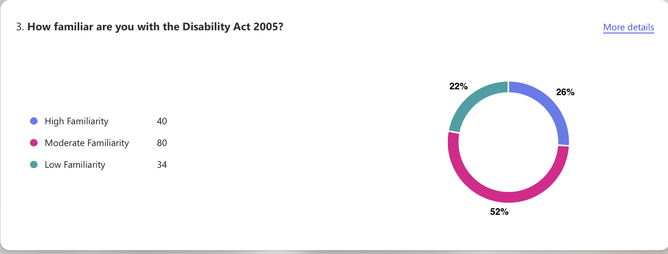
Familiarity vs Effectiveness (1)

Slide 11
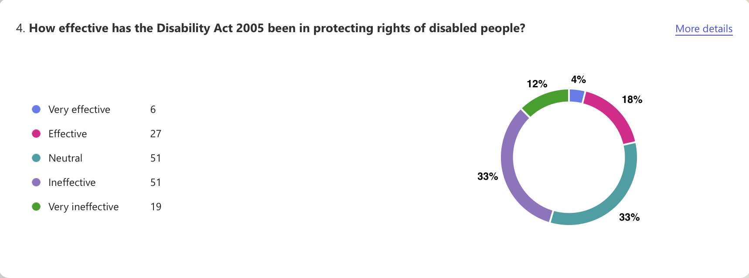
Familiarity vs Effectiveness (2)

Slide 12
Familiarity vs Effectiveness (3)
78% moderately or highly familiar
But only 18% think Act is effective
33% rate it ineffective, and 12% rate it as very ineffective
This indicates that knowledge does not translate into confidence in the 2005 Act.

Slide 13
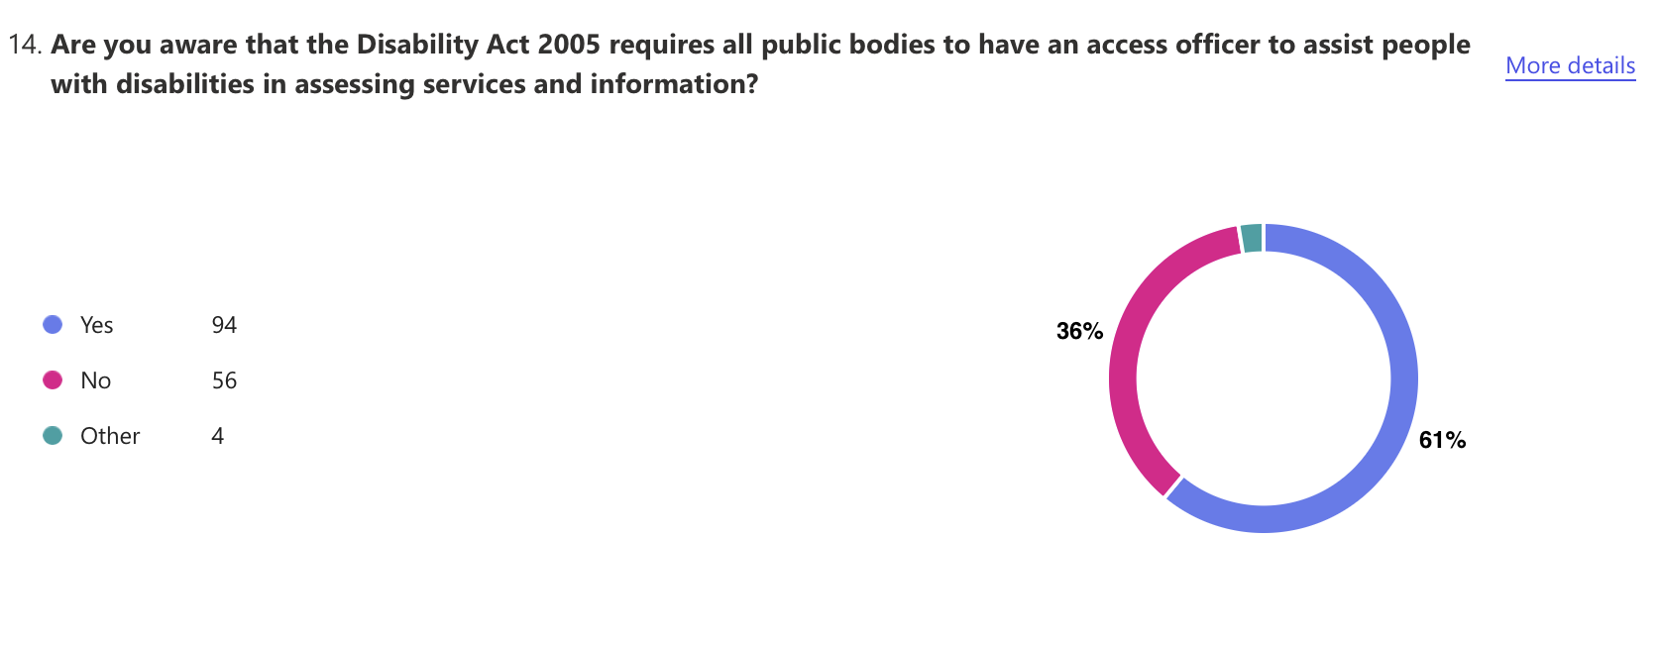
What People Told Us (in Numbers) | Awareness of Access Officers is low

Slide 14
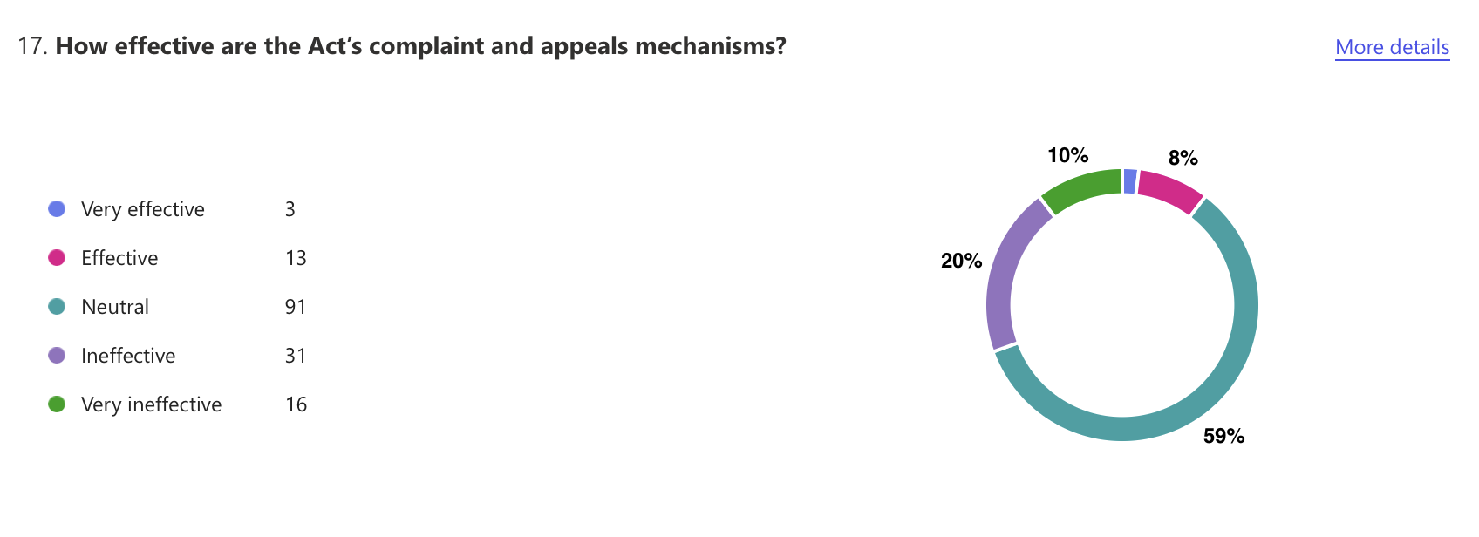
Complaints: unclear, intimidating, under-used

Slide 15
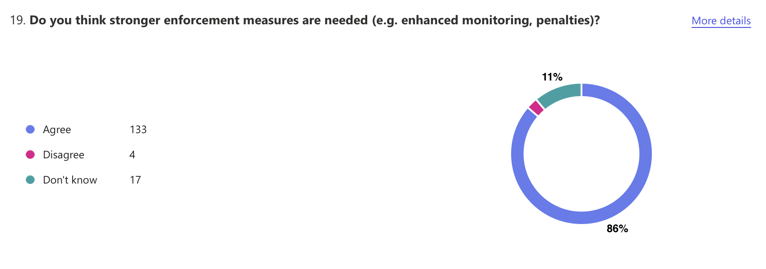
The Need for Stronger Enforcement Measures

Slide 16
3. Thematic Analysis: Emerging Themes for Qualitative Data

Slide 17
Emerging Thematic Analysis (Work in Progress)
Thematic analysis has started (Clarke & Braun).
However, several patterns are already emerging from the qualitative responses.
The coding and theme construction is ongoing, early readings reveal clear areas where respondents consistently describe gaps in implementation, emotional burden and systemic failures within the Disability Act 2005.

Slide 18
Emerging Theme: Symbolic Law and Lack of Enforcement
An emerging theme is that the Disability Act functions more as symbolic law than as a rights-based framework.
Respondents describe it as “toothless”, “paper rights” and “not fit for purpose”, emphasising that obligations are procedural rather than enforceable.
Many express feeling let down by a system that appears to guarantee rights on paper but does not secure those rights in practice.
Concerns about the absence of meaningful enforcement, particularly in relation to Assessment of Need, accessibility and complaints, are emerging in this early pattern.

Slide 19
Emerging Theme: Accessibility and Lack of Enforcement
Accessibility emerges as a theme, with respondents describing improvements as patchy and dependent on individual service areas.
Physical, digital and information-related barriers persist, and Access Officers are often invisible or powerless, creating the sense that accessibility depends more on luck than law.

Slide 20
Emerging Theme: CRPD Alignment and Desire for Structural Reform
Respondents repeatedly reference the CRPD as the benchmark for modern disability legislation and express a strong desire for comprehensive, rights-based reform.
Early themes highlight demands for enforceable service rights, an adult AON process, a robust independent enforcement body, mandatory universal design and meaningful participation of DPOs and disabled people in governance.
These emerging patterns point to a clear appetite for a new legislative model that moves beyond the welfare model and aligns with CRPD principles of autonomy, equality, inclusion and independent living (the human rights model of disability).

Slide 21
4. Spotlight on Assessment of Need

Slide 22
Focus on Assessment of Need
I am giving several slides to the Assessment of Need because it is emerging as one of the strongest and most dominant theme emerging from both the quantitative and qualitative data.
AON is the only statutory entitlement under the Disability Act, yet it is consistently described as the point at which the system fails most acutely.

Slide 23
Assessment of Need (1)
Just under half of respondents had direct experience with the Assessment of Need process, with 15 people (10%) undergoing an AON themselves, 34 (22%) doing so for a child or family member, and 31 (20%) encountering it in a professional capacity.
62 respondents (41%) reported no experience of AON, and 10 (7%) selected “Other”.
This indicates the range of different ways people interact with or are affected by the AON system.

Slide 24
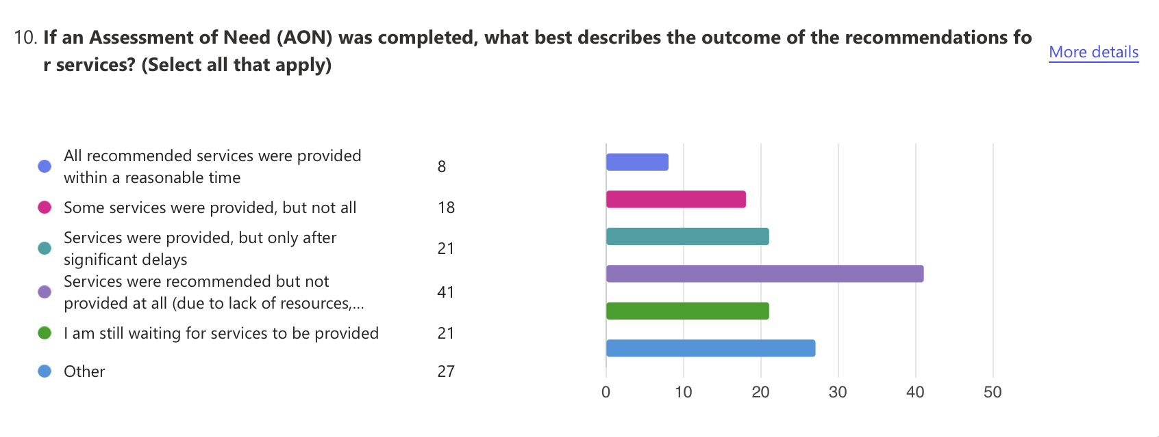
Assessment of Need (2)

Slide 25
Assessment of Need (2)
Among those who received an Assessment of Need, only 8 respondents (6%) reported that all recommended services were provided within a reasonable time.
A further 18 respondents (13%) received some but not all services, while 21 respondents (15%) said services were provided only after significant delays.
The largest group, 41 respondents (30%), reported that recommended services were not provided at all, and 21 respondents (15%) were still waiting for services.
An additional 27 respondents (20%) selected “Other”, again reflecting a range of complex or unclear outcomes of AON.
This data on AON outcomes confirms what the research has told us… procedural mechanisms without corresponding service entitlements inevitably produce systemic failure in accessing services.
The statistics illustrate a consistent pattern here in Ireland; when assessments “diagnose” needs that the State does not guarantee to meet, the AON process becomes meaningless for people and families.

Slide 26
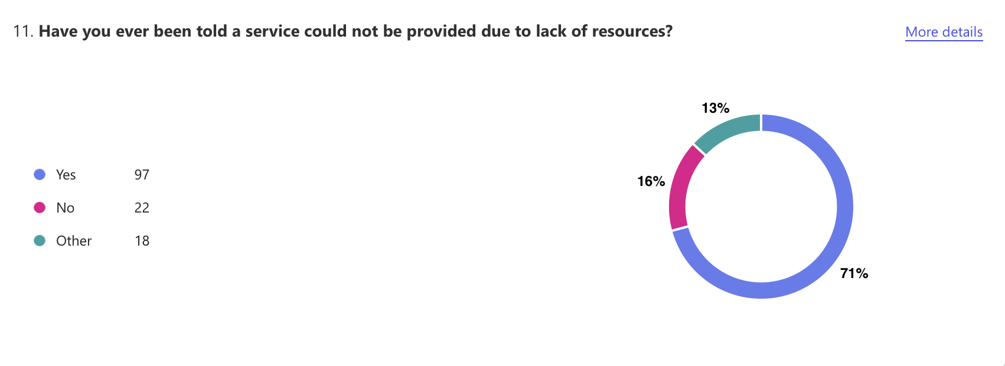
Assessment of Need (3)

Slide 27
Assessment of Need (3)
The data show that service refusal due to lack of resources is a systemic issue, with 97 respondents (71%) reporting they had been denied a service on this basis.
Only 22 respondents (16%) had not experienced this, while 18 (13%) described other / mixed or unclear situations.
This pattern indicates that the Disability Act creates a right to assessment but no enforceable right to services, resulting in unmet need and resource-based exclusions.

Slide 28
Assessment of Need (4)
Optional Question: Please feel free to share your comments on the Assessment of Need.
51 responses to this question.
A powerful thread ran across the responses is that AON identifies need but rarely leads to service provision.
The process was widely described as “a piece of paper” (respondent 27), “tick-box” (respondent 1), “a useless provision” (respondent 10), and “not worth the paper it’s written on” (respondent 35).
Respondents emphasised that assessments do not trigger interventions and that families endure years-long delays, sometimes receiving no services at all.
Several explicitly state that AON gives parents a “false sense of hope” (respondent 2).
This theme reflects a system that the 2005 Act recognises disability but does not resource it, creating emotional harm, administrative burden, and a sense of being completely let down.

Slide 29
5. Reform Priorities

Slide 30
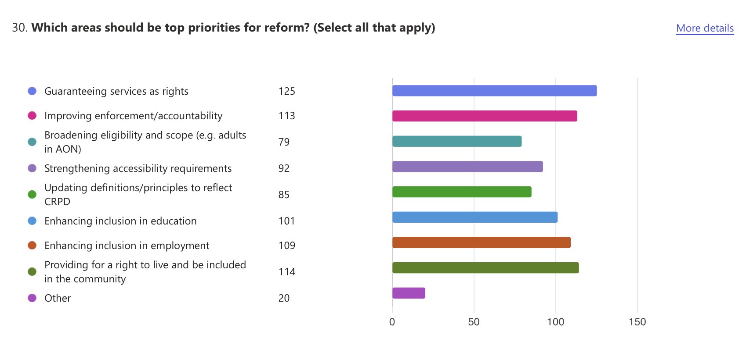
Reform Priorities (multi-select options)

Slide 31
Reform Priorities (multi-select options)
125 want guaranteed rights to services
114 want a statutory right to live in the community
113 want stronger enforcement and accountability
Strong priorities also: employment, education, accessibility, broadening scope of AON, and CRPD alignment.

Slide 32
6. Reflections

Slide 33
Reflection 1: Setting the Scene for Today’s Discussions
These survey findings are not intended to close the conversation on the Disability Act but to open it.
What we have presented today reflects the early, emerging patterns in the data, patterns that show deep frustration with processes that assess need without guaranteeing support, uneven accessibility, a lack of enforcement, and a strong desire for CRPD aligned reform.
These initial insights highlight the urgency and importance of the dialogue we are beginning here this morning and this afternoon.
They provide a starting point, not an end point, for the discussion that will unfold throughout this conference and indeed the reform of the 2005 Act.

Slide 34
Reflection 2: Why Today Matters
As Shivaun mentioned today’s conference brings together disabled people, families, advocates, policymakers, legal experts and professionals at a moment of real opportunity.
The Disability Act has reached its 20th year at a time when government has committed to reform, and when the CRPD frameworks demand a shift toward enforceable rights and meaningful inclusion (human rights model of disability).
The survey findings offer evidence of where the Act falls short, but it is your expertise, lived experience, professional experience and reflections today that will shape the recommendations in our report, refine the emerging themes and drive a shared vision for a fit for purpose rights-based disability law in Ireland.
So, I hand over to you.

