Slide 1



Slide 2
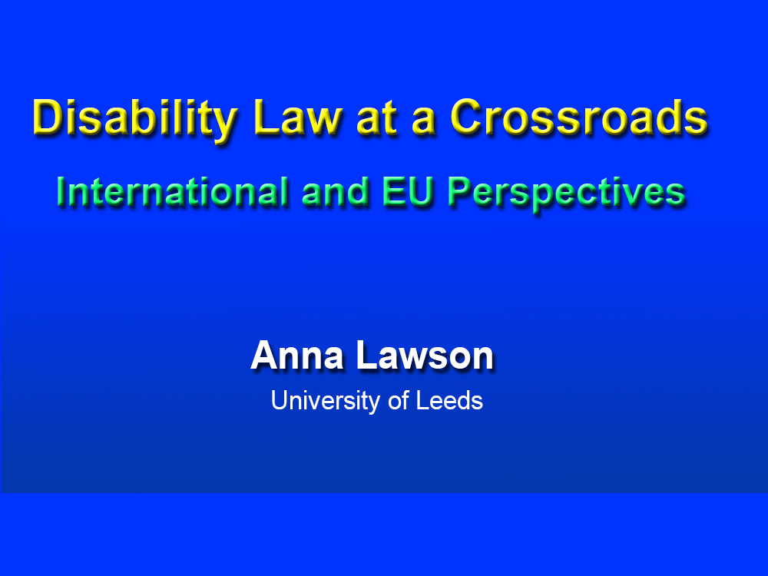
2
2

Slide 3
Outline
1. Anniversaries and Crossroads
2. International Perspectives: Article 19 of the UN Convention on the Rights of Persons with Disabilities
3. EU Perspectives: The Significance of the UN Convention on the Rights of Persons with Disabilities
4. Concluding Thoughts
3

Slide 4

4

Slide 5
International Perspectives: Article 19 of the
UN Convention on the Rights of Persons with Disabilities
5

Slide 6
International Perspectives: Article 19 of the
UN Convention on the Rights of Persons with Disabilities
The Significance of the UN Convention on the Rights of Persons with Disabilities
The relevance of the right to live independently and be included in the community
accessibility and non-discrimination – Article 19C
choice over where and with whom to live – Article 19A
support services and personal assistance – Article 19B
The importance of this right
The interconnectedness of this right with other rights
6

Slide 7
International Perspectives: Article 19 of the
UN Convention on the Rights of Persons with Disabilities
Article 19B: Nature and Scope
Text
Breadth of activities across which
support services should be provided
Individualised personal assistance
Across life-course
Rural as well as urban
7

Slide 8
International Perspectives: Article 19 of the
UN Convention on the Rights of Persons with Disabilities
Article 19B: Practical Implementation
Eradication of practical barriers to full realisation
Training and availability of relevant professionals
Assessment and eligibility
Monitoring and service delivery
Complaint/appeal mechanisms and access to justice
Involvement
Common barriers/challenges
8

Slide 9
International Perspectives: Article 19 of the
UN Convention on the Rights of Persons with Disabilities
Article 19C: Nature and Scope
Text
Breadth of services and facilities covered
Accessibility – Article 9
Non-discrimination – Article 5
9

Slide 10
International Perspectives: Article 19 of the
UN Convention on the Rights of Persons with Disabilities
Article 19C: Practical Implementation
Eradication of practical barriers to full realisation
Strategies, timelines, monitoring
Training and availability of relevant professionals
Enforcement and access to justice
Involvement
Common barriers/challenges
10

Slide 11
EU Perspectives: The Significance of the
UN Convention on the Rights of Persons with Disabilities
11

Slide 12
EU Perspectives: The Significance of the
UN Convention on the Rights of Persons with Disabilities
The EU as a party to the CRPD
Accession
Implications for matters within exclusive competence of EU
Implications for other matters
– relationship with Member States
12

Slide 13
EU Perspectives: The Significance of the
UN Convention on the Rights of Persons with Disabilities
Influence of the CRPD on EU caselaw
CRPD’s quasi-constitutional status
Consistent interpretation – eg
Komisia za zashtita ot diskriminatsia, 2022
Bervidi, 2025
13

Slide 14
EU Perspectives: The Significance of the
UN Convention on the Rights of Persons with Disabilities
Influence of the CRPD on EU strategy
EU Disability Strategy 2021-2030
Chapter 4 - Quality of life and living independently
Chapter 2 - Accessibility
13

Slide 15
EU Perspectives: The Significance of the
UN Convention on the Rights of Persons with Disabilities
European Pillar of Social Rights 2017 – principle 17
Guidance on independent living and inclusion in the community of persons with disabilities in the context of EU funding, 2024
European Accessibility Act
Accessibility requirements in other legislation
14

Slide 16
Concluding Thoughts
15

Slide 17
16

Slide 18
2
2

