Slide 1

The Disability Act in Practice at the University of Galway
Dr Deirdre Mc Hugh
Universal Design Manager and Access Officer
Office of the Vice-President for Equality, Diversity and Inclusion
3rd December 2025

Slide 2
Outline
The Disability Act 2005: Parts 3 and 4
The Disability Act 2005 and Universal Design
Universal Design in education
The Disability Act in Practice

Slide 3
Part 3: Access to Buildings and Services and Sectoral Plans
Section 25: Access to public buildings
Section 26: Access to services
Section 27: Accessibility of services supplied to a public body
Section 28: Access to Information
Section 29: Access to heritage sites

Slide 4
Part 3, Section 26: Access to Services
(1) Where a service is provided by a public body, the head of the body shall—
  (a) where practicable and appropriate, ensure that the provision of access to the service by persons with and persons without disabilities is integrated,
  (b) where practicable and appropriate, provide for assistance, if requested, to persons with disabilities in accessing the service if the head is satisfied that such provision is necessary in order to ensure compliance with paragraph (a), and
  (c) where appropriate, ensure the availability of persons with appropriate expertise and skills to give advice to the body about the means of ensuring that the service provided by the body is accessible to persons with disabilities.
(2) Each head of a public body referred to in subsection (1) shall authorise at least one of his or her officers (referred to in this Act as “access officers”) to provide or arrange for and co-ordinate the provision of assistance and guidance to persons with disabilities in accessing its services.

Slide 5
Part 3: Complaints and Inquiry Officers
38.—A person may by himself or through a person referred to in section 9 (2) make a complaint in writing to the head of a public body in relation to the failure of the body to comply with section 25 , 26 , 27 , 28 or 29 of this Act.
39.—(1) The head of a public body may authorise such and so many officers of the body as he or she considers appropriate (referred to in this Act as “inquiry officers”) to perform the functions conferred on inquiry officers by this section.

Slide 6
Part 4: Employment in public service
47.-(1) A public body shall—
(a) in so far as practicable take all reasonable measures to promote and support the employment by it of persons with disabilities,
(b) have regard to any relevant codes of practice approved under section 50 and section 10A of the Act of 1999 by the relevant Minister.

Slide 7
Part 6: Universal Design
The design and composition of an environment so that it may be accessed understood and used –
To the greatest extent possible
In the most independent and natural manner possible
In the widest possible range of situations
Without the need for adaptation, modification, assistive devices or specialised solutions, by any persons of any age or size or having any particular physical, sensory, mental health or intellectual ability or disability

Slide 8
Disability Act 2005 parameters
(Part 6) Centre for Excellence in Universal Design established (National Disability Authority)
Domains (Part 3)
The built environment
Communications and the digital environment
Products and Services
Applies to:
Public bodies
Products and services procured by public bodies

Slide 9
Universal Design in Education (UDE)
‘… a whole system design so that the physical and digital environments, the educational services and the teaching and learning can be easily accessed, understood and used by the widest range of learners and all stakeholders, in a more inclusive environment.’ (CEUD)
Learning
Services
Digital
Physical

Slide 10
Human Ecological Systems Approach (Bronfenbrenner, 1979)
Macro level: Legislation, policies, directives
Meso level: Institutional policies and strategies
Micro level: Implentation on the ground

Slide 11
Macro level - national
Disability Act 2005
CEUD- Centre for Excellence in Universal Design
National Plan for Equity of Access to Higher Education('National Access Plan 2022-2028')
PATH 4: Universal design - “We will set aside €12 million (€3 million over 4 years) for a new PATH 4 stream to strengthen universal design for students in higher education”.

Slide 12
Meso level - insitutional
University Values Strategies 2020-2025 and 2025-2030
Equality Diversity and Inclusion Strategy (EDI) 2020-2025 and 2025-2030
University of Galway Universal Design & Accessibility Policy (QA182)
Universal Design and Accessibility Action Plan and Working Group
Campus Masterplan

Slide 13
Micro level actions
Step-free access provided to all large lecture theatres and power-assisted doors enroute.
Upgrade of emergency evacuation facilities across campus and training provided.
70 power-assisted doors installed across campus, improved access to lifts and ramps installed.
Footpath levelling and reconfiguration across campus.

Slide 14
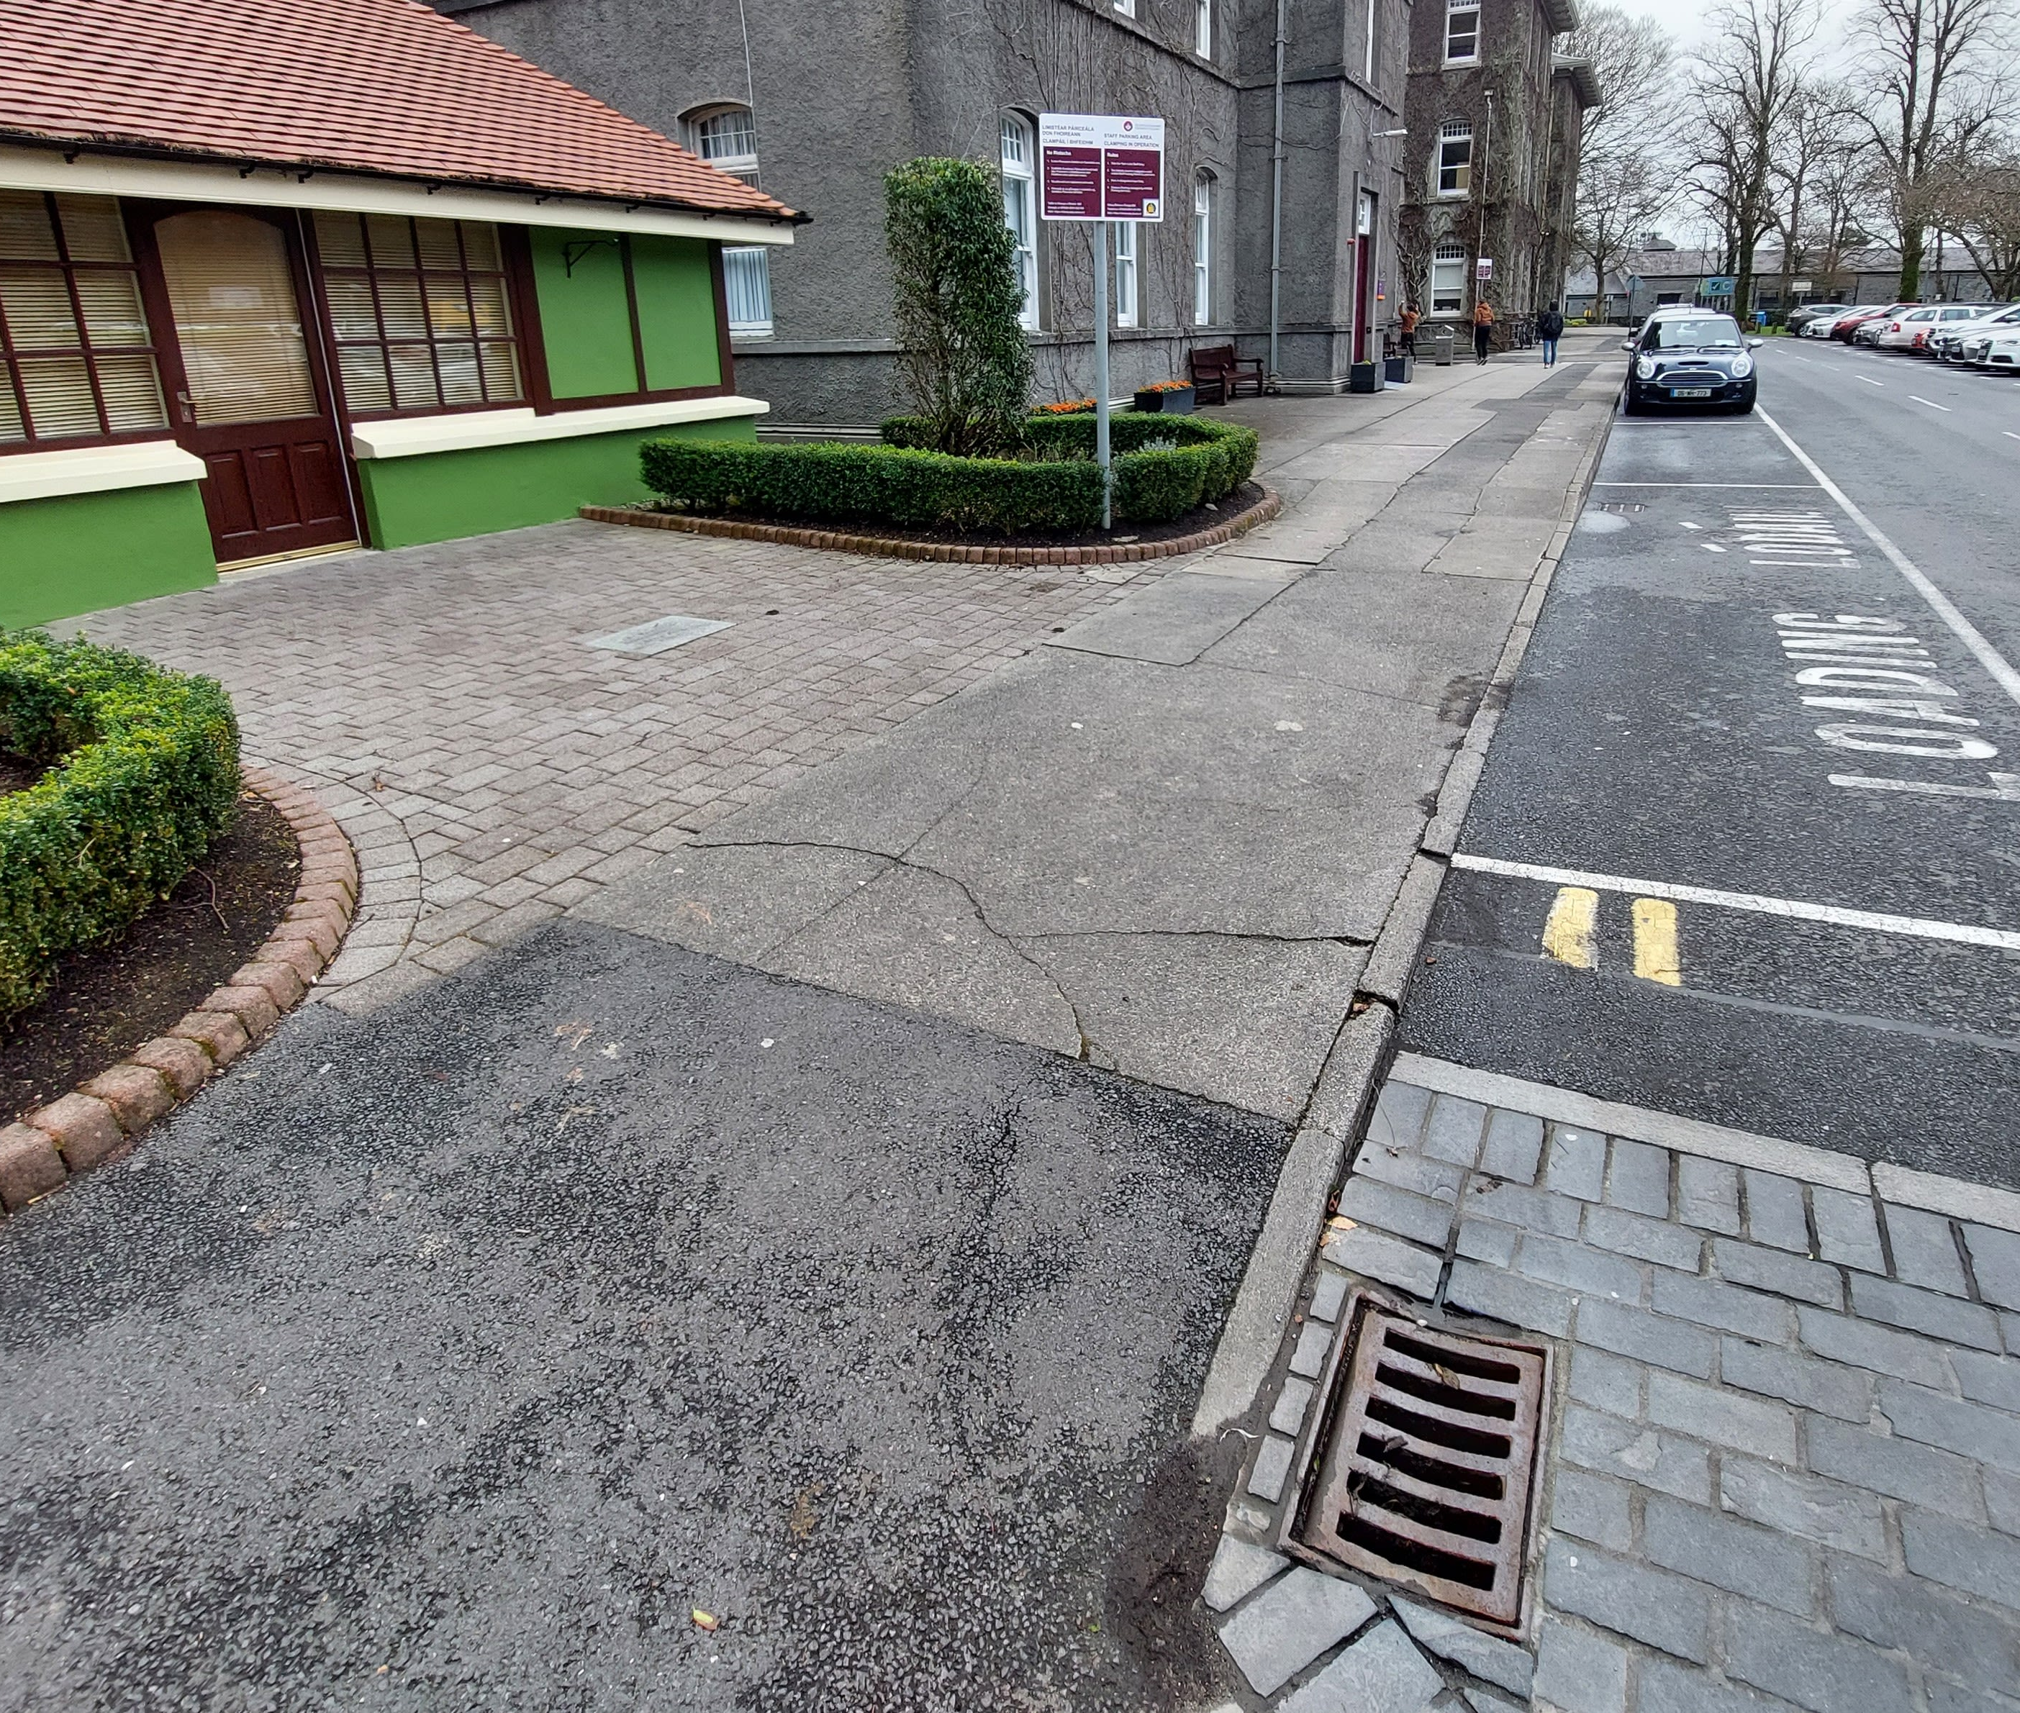
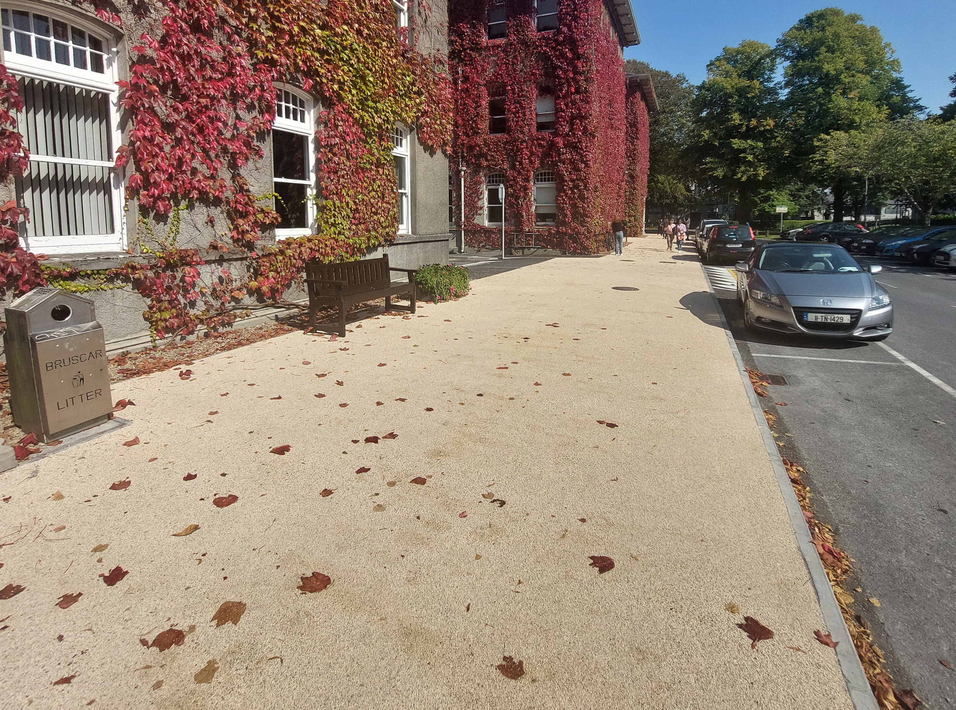
Before and after example

Slide 15
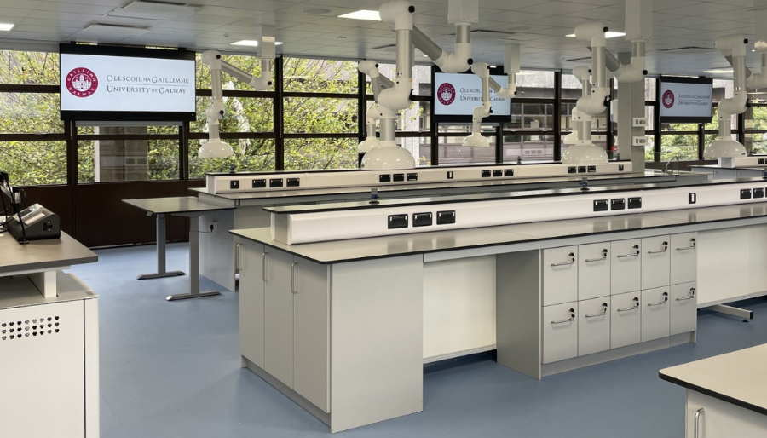
Chemistry Teaching Lab: A universal design Approach

Slide 16
Thank you

