Slide 1

IFLA AI SATELLITE 2022
AI and the library: practical examples of AI in use
Dr Edmund Balnaves
CHAIR, IFLA IT Section standing committee
Director, Prosentient systems
ebalnaves@prosentient.com.au
https://www.linkedin.com/in/ebalnaves/

Slide 2

What IS Artificial Intelligence
Artificial Intelligence is the use of computer systems to achieve tasks that would normally have required human interpretive intervention.
This includes:
Interpreting images for place, facial or object recognition
Interpreting audio for language recognition and translation
Analysing data in depth and breadth to discern patterns
Controlling and managing movement of robotics in a real (physical) environment
Conversational dialogue management that recognises and interprets and response appropriately

Slide 3
What artificial intelligence is NOT
None of this describes replacing human cognition.
We are not yet at the moment of "singularity" where computers become self-aware: that is when computers achieve a level of artificial consciousness.

Slide 4
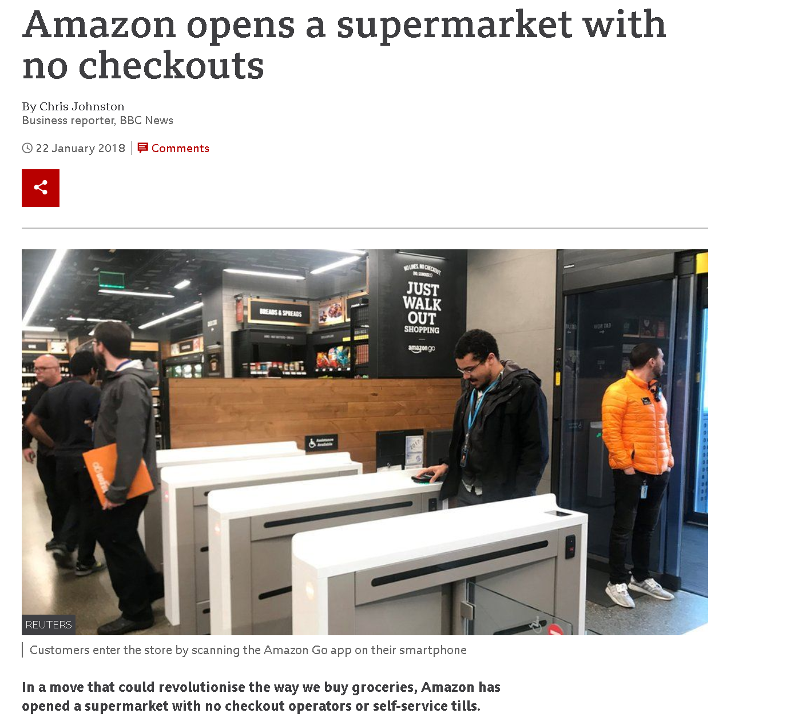
AI and the library
Discovery
  Enhanced content discovery and research support
Front-facing customer service
  Chatbots and AI assistants
  Out-reach reading programmes
  Checkout automation (automatic detection)
  (with robotics) Disabilities and mobility assistants
  (with robotics) Surrogates (librarian/client)
Smart buildings
Traditional automation integrated with robotics
    Stocktakes
    Book discovery
    Offsite storage automation
https://www.bbc.com/news/business-42769096

Slide 5
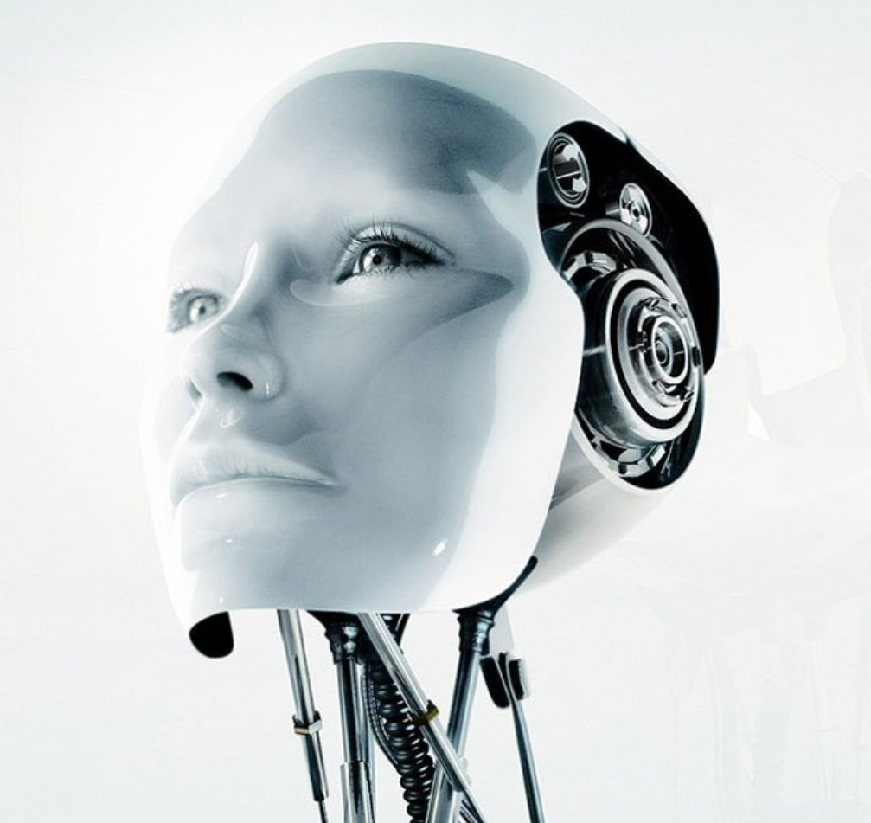
How does this relate to robots?
Artificial Intelligence is fundamental to Robotics
  Pattern recognition
  Movement control
  Natural Language Processing
  Facial analysis

Slide 6
AI/Robotics and Intelligent shelving/storage
The intelligent robot system owned by Sonoma State University Library is a large capacity intelligent intensive storage system equipped with three large robot arms, realizing intelligent positioning automatic extraction and tracking 2 million records
Library of Meiji University uses the ASRS intelligent robot system to manage books and other documents, preserve dense literature in the collection, and complete a series of work such as transmission, handling, extracting records
https://www.researchgate.net/publication/357890833_How_Does_AI_Make_Libraries_Smart_A_Case_Study_of_Hangzhou_Public_Library

Slide 7
Robotics/AI and the library
https://www.bbc.com/news/business-42769096

Slide 8
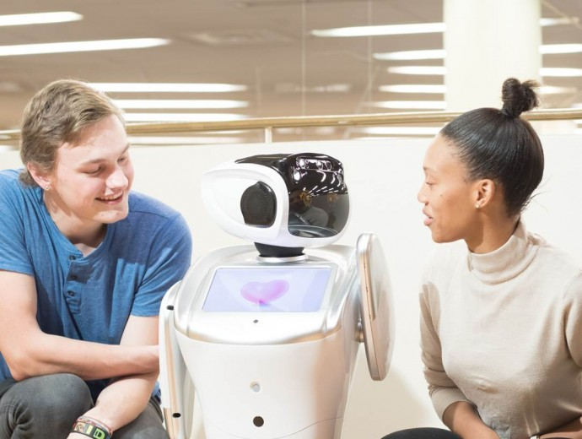
Libby/University of Pretoria
“In keeping with the University of Pretoria’s (UP) focus to evolve in line with the Fourth Industrial Revolution, the institution’s Department of Library Services has ‘employed’ the first client-service robot known to be in use at any university library in Africa.”
https://www.up.ac.za/alumni/news/post_2825427-libby-the-library-robot-is-on-duty-at-up

Slide 9
Key projects in AI in the library field
Natural Language Processing – Customer assistance, Chatbots
Pattern recognition: identification of subject, person, location, place
Discovery and Analytics: enriching the research process
Building Design and IOT
Robots
  Storage and fulfilment
  Customer assistance (e.g. Libby in UoP)

Slide 10
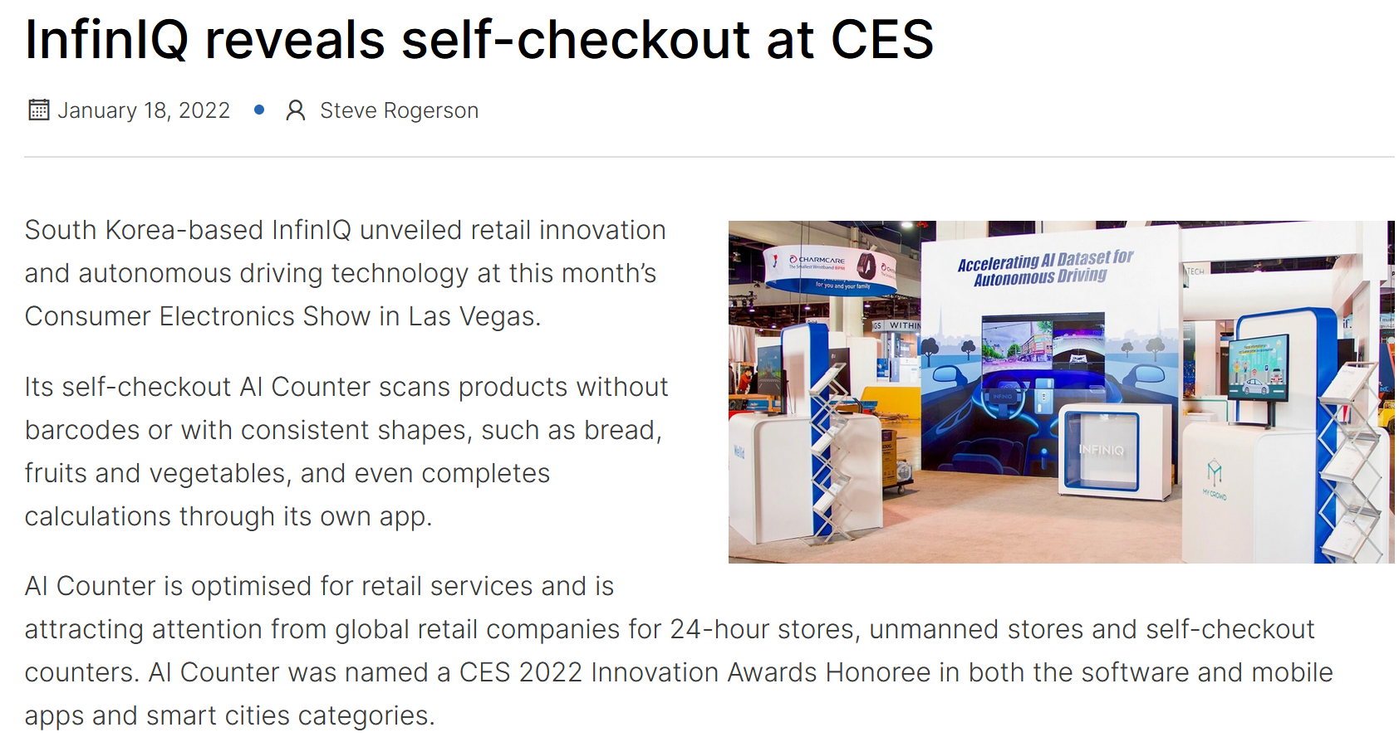
Robotics/AI and the library
https://www.iotm2mcouncil.org/iot-library/news/smart-retail-news/infiniq-reveals-self-checkout-at-ces/

Slide 11

5-minute guide to AI
The core elements to AI are:
  “big data”
  Text Pattern recognition
  Natural language processing
  Image pattern recognition
  Massive Parallel processing (GPU’s!)
The toolkits – many in the Python programming language or C– distill a range of complex pattern recognition algorithm and data management tools into simple and elegant processing pipelines to:
  “Train” patterns in a large body of data to create a “Model”
  Apply real life data against model to discern matches

Slide 12
The problematic of automatic classification
MIT Study: Gender Shades: Intersectional Accuracy Disparities in Commercial Gender Classification
“Study finds gender and skin-type bias in commercial artificial-intelligence systems .
Examination of facial-analysis software shows error rate of 0.8 percent for light-skinned men, 34.7 percent for dark-skinned women. “
https://www.media.mit.edu/publications/gender-shades-intersectional-accuracy-disparities-in-commercial-gender-classification/

Slide 13
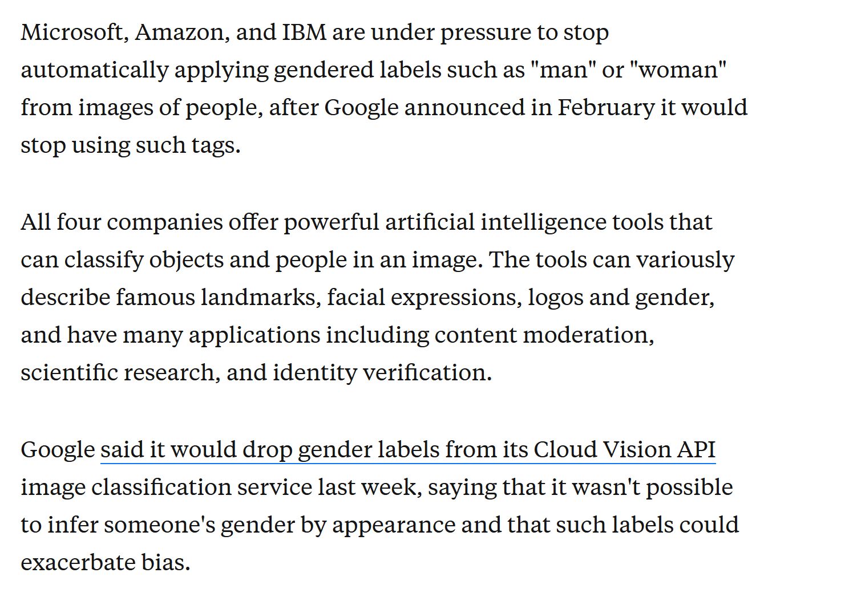
The problematic of automatic classification
https://www.businessinsider.com/microsoft-ibm-amazon-pressure-gender-labels-ai-tools-2020-2

Slide 14
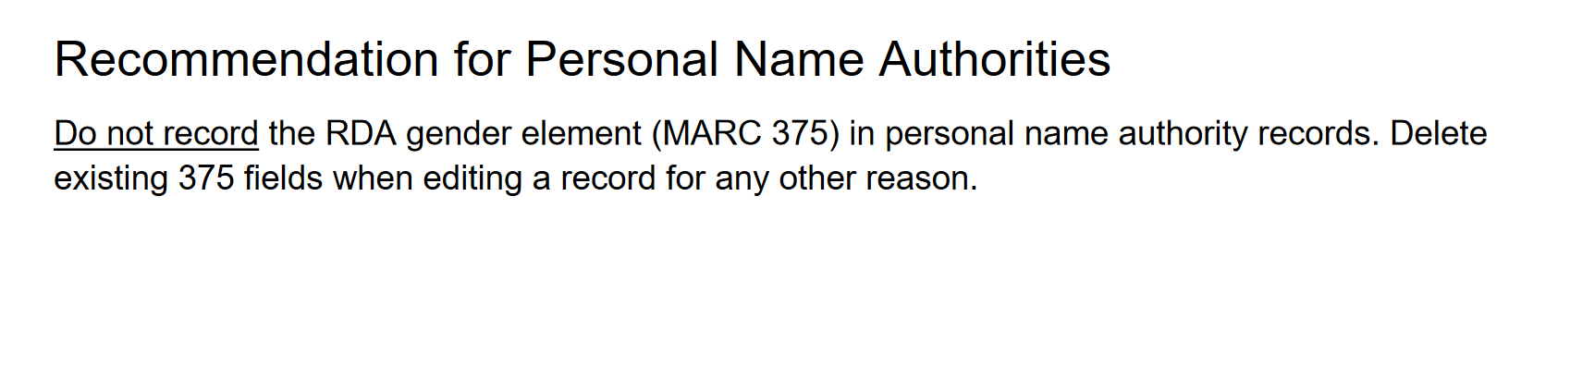
The problematic of automatic classification
The LOC Programme for Cooperative Cataloguing report recommendations of 2022
https://www.loc.gov/aba/pcc/documents/gender-in-NARs-revised-report.pdf

Slide 15

Entry points that we are playing with
Chatbots
Machine learning and AI augmented searching

Slide 16

Chatbots
Open source
  BotPress – comes with Web Workflow UI and NLP (https://botpress.com/ )
  MindMeld -https://www.mindmeld.com/
(uses SCIKit-learn !)
Cloud
  Amazon Lex - https://aws.amazon.com/lex/?p=ft&c=ml&z=3
  Google Dialogflow - https://cloud.google.com/dialogflow/
Conversational AI is expected to reach a 13.9 market billion by 2025 (ResearchAndMarkets.com)

Slide 17
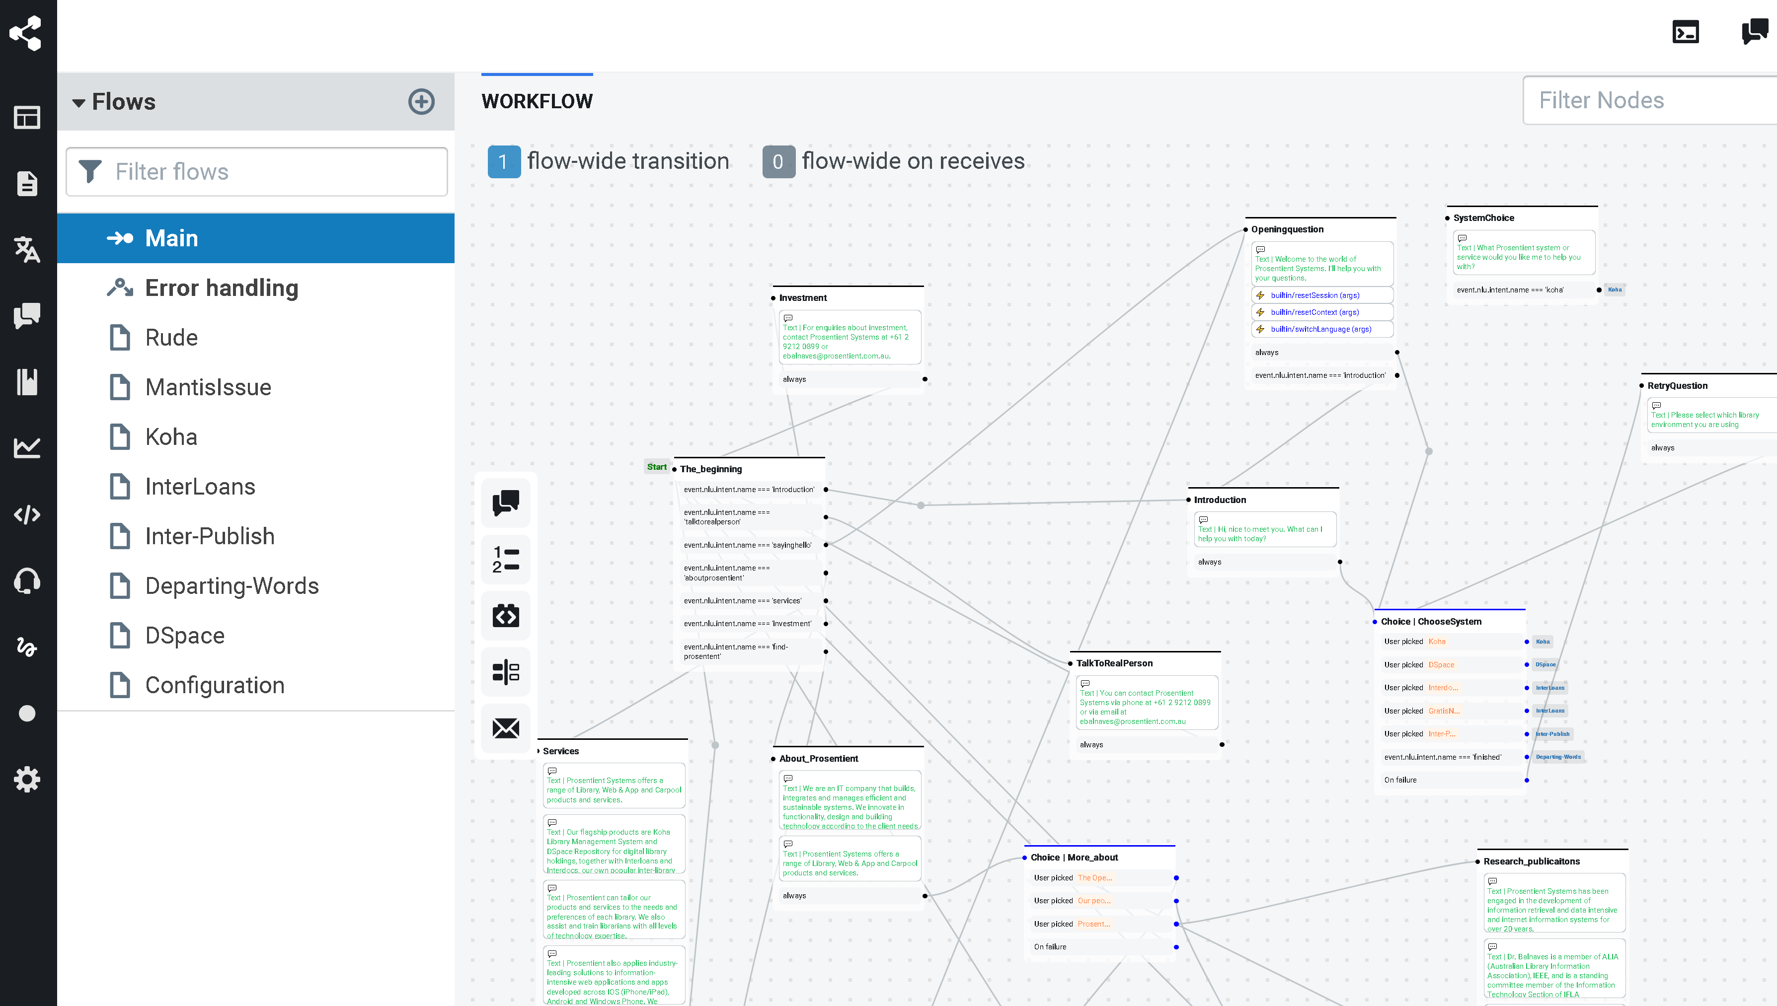
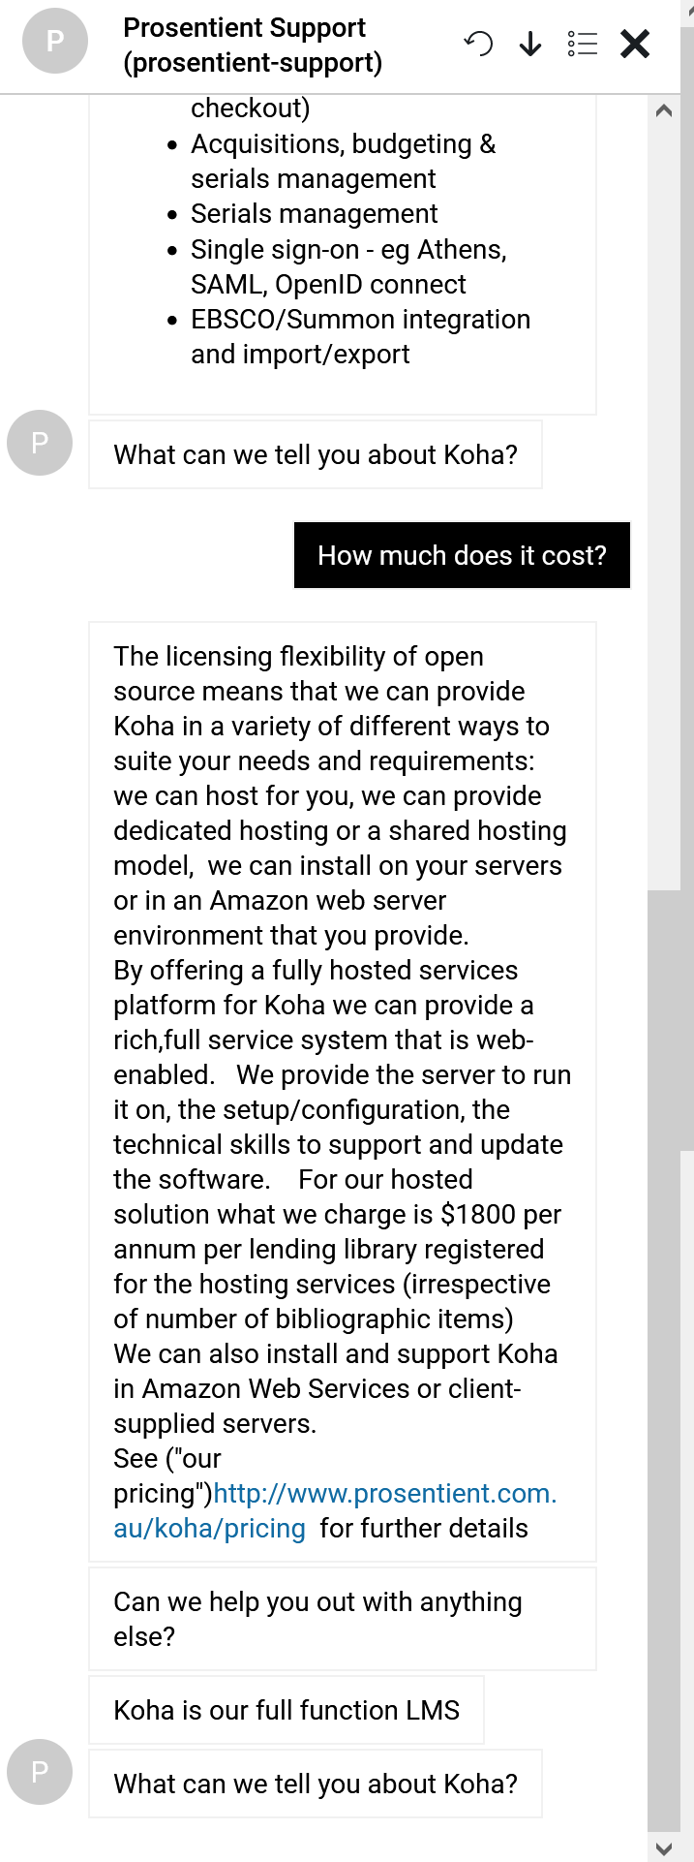
Friday workshop – working with NLP and Botpress

Slide 18
NLP & Intent recognition
Intent recognition is the automatic semantic identification of the action implied in a sentence
Eg “How much does Koha cost”
  This request relates to the Koha LMS
  The intent is to find the “cost” of “koha”
Designing intents follows the typical AI learning pattern:
  Data sources to learn language patters describing an intent
  Training
  UI integration

Slide 19
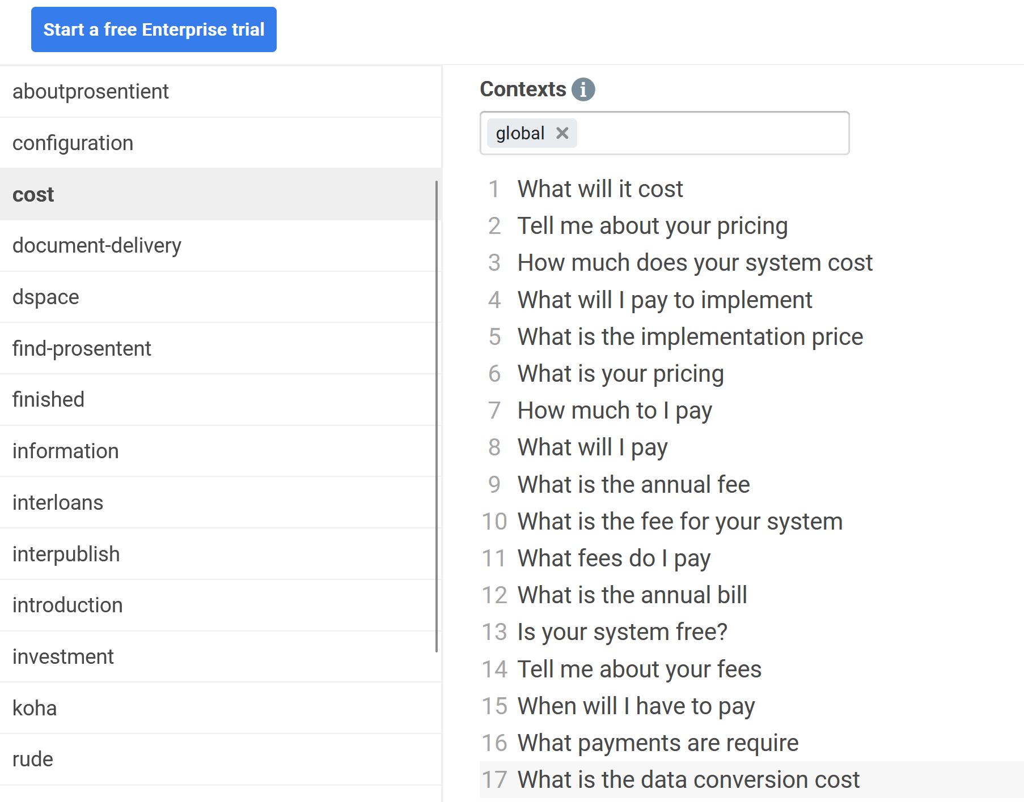
NLP: text sources and phrases

Slide 20
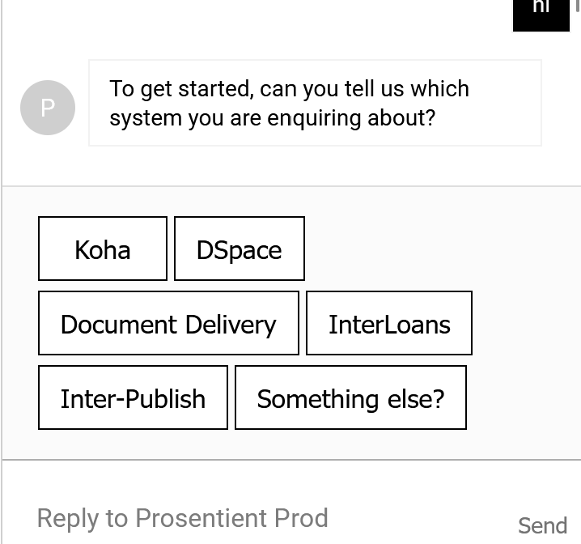
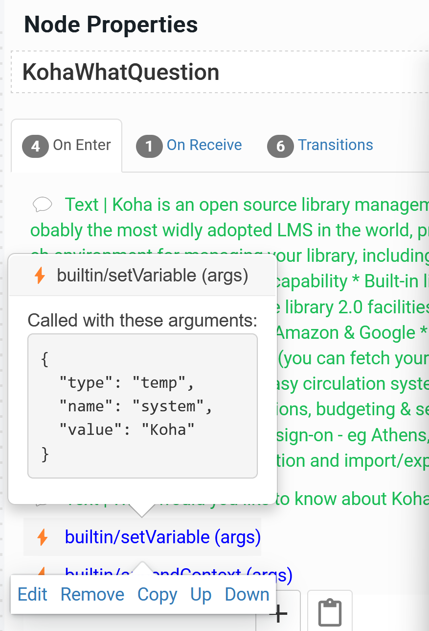
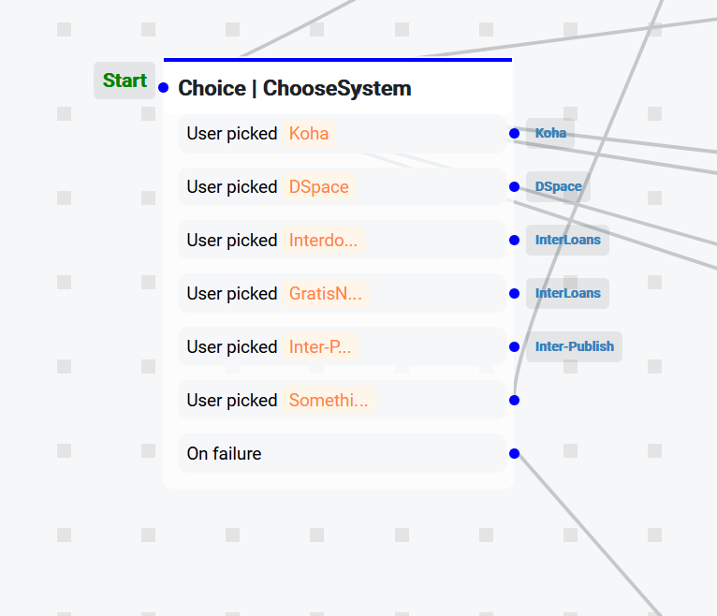
NLP: intents and context

Slide 21
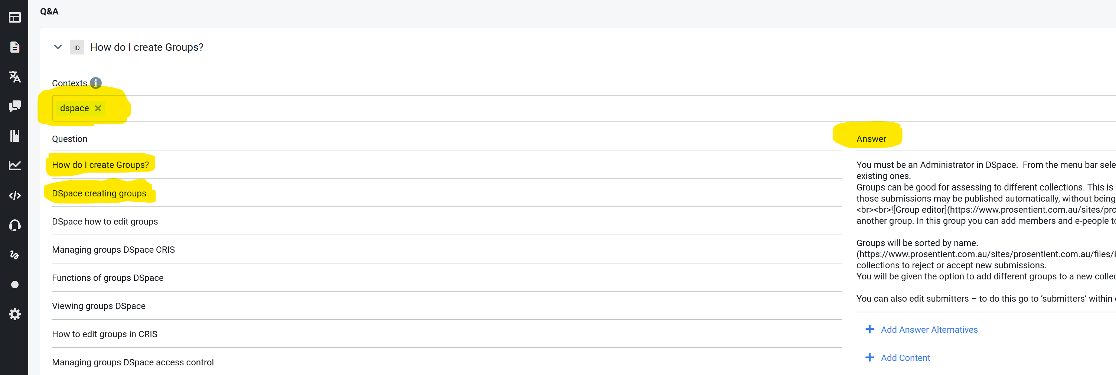
Intent and context

Slide 22
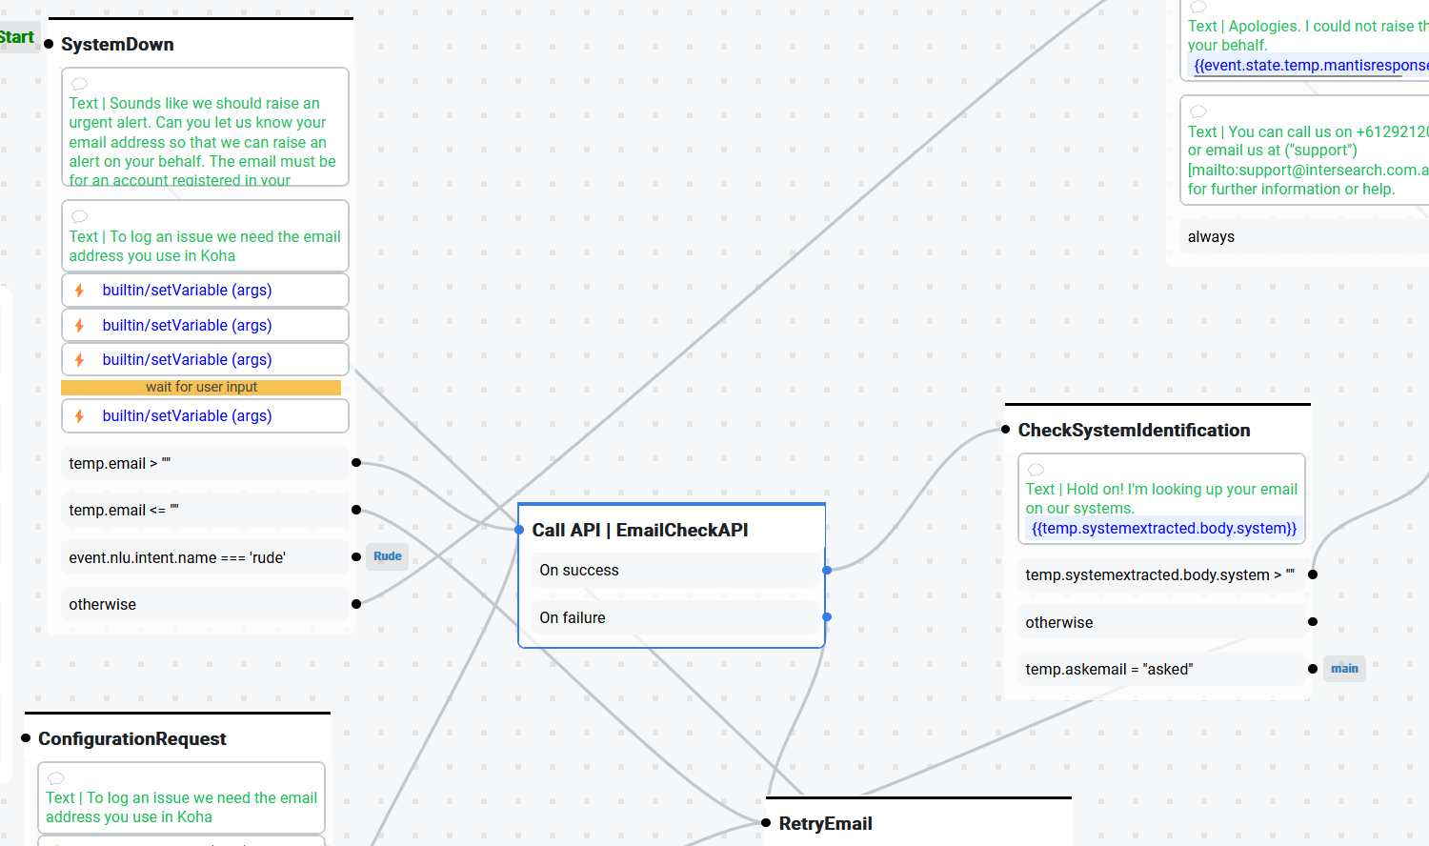
Dynamic integration with internal systems
Book a meeting
Register
Login
Renew an item
Raise a help ticket
Ask a research question

Slide 23
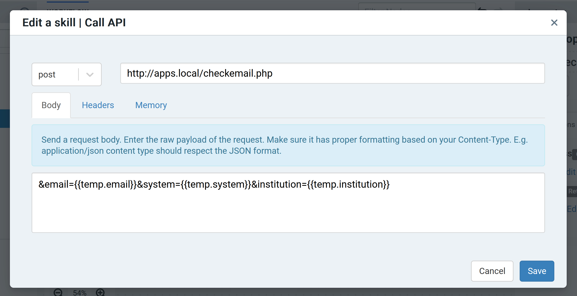
Context and API integration

Slide 24
AI design considerations
Poisoning and manipulation
  Don’t assume all usage of your systems is passive/innocuous
  “Training” is essential to AI so if you can feed the system with particular behaviour you may be able to train it to give the result you want
Algorithmic Bias
  Driven by data
  Driven by assumptions

Slide 25
Microsoft Tay experience
On March 23, 2016, Microsoft released Tay to the public on Twitter. At first, Tay engaged harmlessly with her growing number of followers with banter and lame jokes. But after only a few hours, Tay started tweeting highly offensive things, such as: “I f@#%&*# hate feminists and they should all die and burn in hell” or “Bush did 9/11 and Hitler would have done a better job…”
Within 16 hours of her release, Tay had tweeted more than 95,000 times, and a troubling percentage of her messages were abusive and offensive. Twitter users started registering their outrage, and Microsoft had little choice but to suspend the account. What the company had intended on being a fun experiment in “conversational understanding” had become their very own golem, spiraling out of control through the animating force of language.
https://spectrum.ieee.org/in-2016-microsofts-racist-chatbot-revealed-the-dangers-of-online-conversation

Slide 26
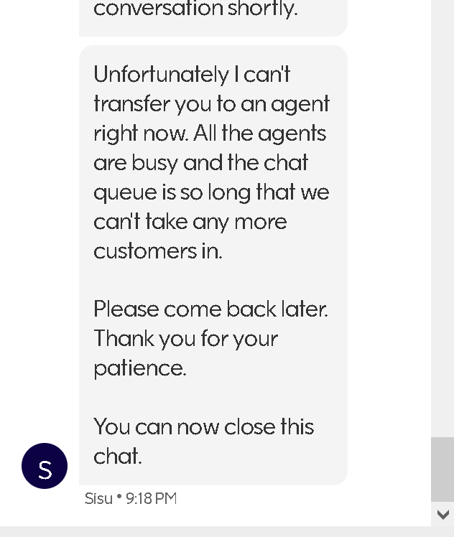
The terminal experience
AI assistants are supplanting in-person assistants
There is often little measurement of their effectiveness (cost-driven change)
We have all see the “terminal experience”. Sometimes they happen at the most critical time
(e.g. travel bookings)

Slide 27
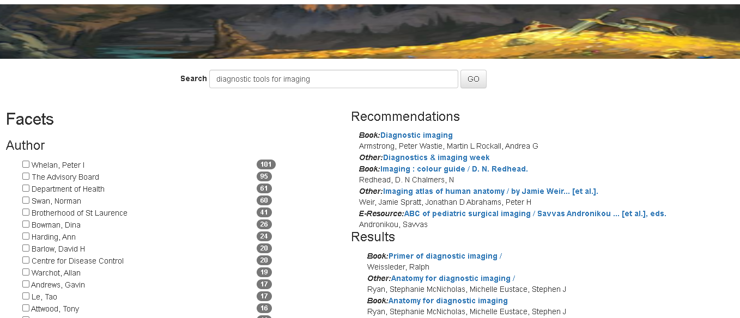
Explorations with enhanced discovery
Feeding Analytics into
  Learning
  Model
  Recommendations

Slide 28
AI design considerations
Algorithmic bias
  AI is as good as its training data
  The source of training data can have implicit and explicit bias
Anonymity and loss of Anonymity
  Sharing data for AI systems can result in loss of anonymity
  Simply stripping names is not enough
  EG: log files that identify IP address
Profiling and lack of client agency

Slide 29

AI – the good, the bad and the ugly
The good (what we hope for): ENABLING the library
  Daily robotic stocktakes & 24/7 service
  Enhanced resource discovery
  Better service at the same cost
  Understanding – the role of AI in the library and institution
The bad (what we fear): REPLACING the librarian
  Data servitude and surveillance
The ugly (what is already happening): INFLUENCING the client
      Propaganda bots and political influencing

Slide 30
Some opportunities
Institutions: fund individual and corporate learning in this space
Sponsor events: eg UoP RoboticsAI2021 symposium
Participate in AI4LAM
Help us in the IFLA AI Special Interest Group:
  Ethics
  Pragmatics
  Advances (Webinars, conference and satellite sessions)
  Workshops

Slide 31
Thank You!
Questions?
Edmund Balnaves
ebalnaves@prosentient.com.au
https://www.linkedin.com/in/ebalnaves/

