Slide 1
Subject cataloguing at the German National Library using AI methods – a project insight
1
Florian Engel (DNB)

Slide 2
Outline
2
Project scope
Requirements
Project implementation
Outlook

Slide 3
Project scope – Backround
3
DNB has legal collection mandate
9300 new entries per working day in 2021 (physical media works and online publications)
Automated subject cataloguing is a strategic priority
Subject headings are used for cataloguing and as search entry points for end-users

Slide 4
Project scope – Schedule
4
Subject cataloguing at the German National Library using AI methods
Project duration: 3 years
Work start: October 2021
Funded as part of the AI Strategy of the Federal Government of Germany

Slide 5
Project scope – DNB approach
5
Machine-based assignment of subject headings carried out by DNB‘s EMa system
Open source tool Annif as an important component
EMa
Annif
AI methods

Slide 6
Project scope – Goals
6
Improving performance of automated subject cataloguing (especially the quality of the results)
Exploring/testing a wide range of innovative methods
Selecting suitable new tools for practical use
Expanding AI competencies in cultural institutions

Slide 7
Project scope – Goals
7
Preparing the vocabulary (proper representation of GND data)
Making better use of the potential of the GND
Concepts without GND representation should also be recognized

Slide 8
Outline
8
Project scope
Requirements
Project implementation
Outlook

Slide 9
Requirements – GND
9
Gemeinsame Normdatei (GND) - Integrated Authority File
GND as a service facilitating the collaborative use and administration of authority data
Vocabulary – comparable with a knowledge graph (entities with attributes that [can] be in relation to each other)
1.3 million possible target labels

Slide 10
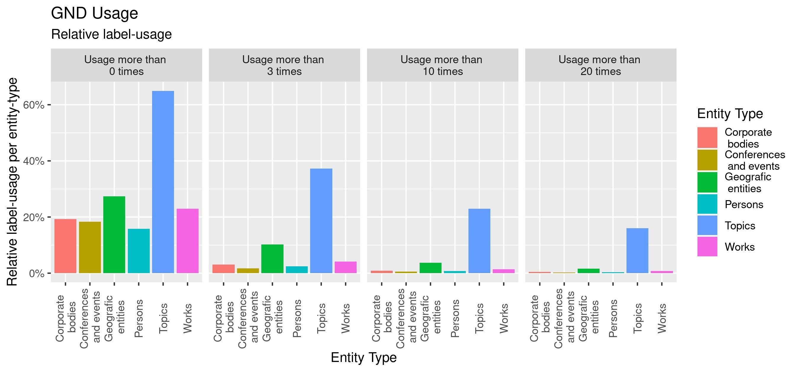
Requirements – GND
10
Notes:
- Different types of entities: persons, corporate bodies, conferences and events, geographic entities, topics and works
- Clear preponderance of topics

Slide 11
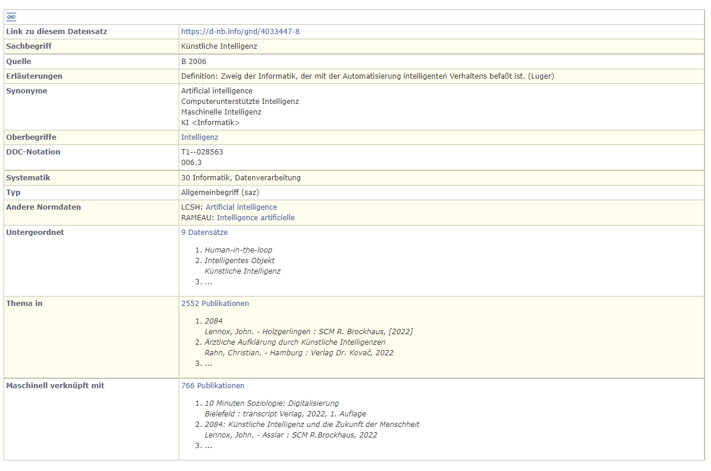
Requirements – GND
11

Slide 12
Requirements – Long-tail problem
12
Many of the GND terms are rarely assigned
Approx. 350,000 of 1.3 million terms are assigned at all
Some subject headings are assigned 10,000 times
  Top of the list: "Germany" (260,000)
Almost 40% of the GND terms are assigned only once

Slide 13
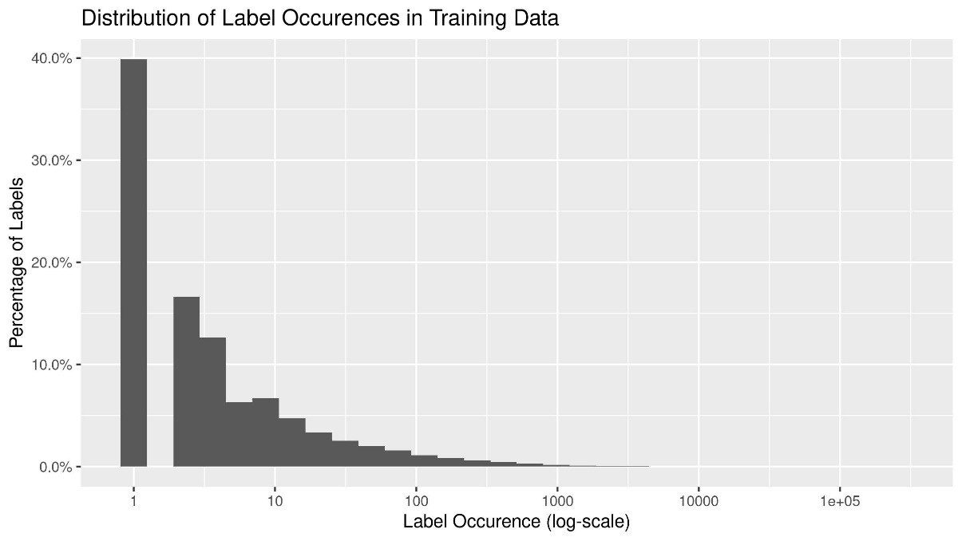
Requirements – Long-tail problem
13

Slide 14
Requirements – Long-tail problem
14
Leads to the problem of Extreme Multilabel Text Classification (XMTC)
Statistical methods require additional information
Notes:
Für zweiten punkt: (Beispiele erwähnen) – siehe Wikiseite

Slide 15
Requirements – Data collection
15
gs
GND
toc
ft
title
iht

Slide 16
Requirements – Data collection
16
type | amount (≈)
ft | 200.000
toc | 650.000
iht | 300.000
title | 1.500.000
ft_idn123.txt
gt_idn123.tsv

Slide 17
Requirements – Interim conclusion
17
Database: representation and pre-processing
Vocabulary: preparation and use of the GND data
Method selection incl. hyperparameter optimisation etc.

Slide 18
Outline
18
Project scope
Requirements
Project implementation
Outlook

Slide 19
Project implementation - Organisation
19
3 different pipelines:
Corpus/ Pre-processing
Methods
Evaluation

Slide 20
Project implementation – Corpus management
20
Organisation via DVC
Different corpora for the same procedure (pre-processing the training material)
Different corpora for different procedures (representation of the training material)

Slide 21
Project implementation – Corpus management
21
Xf
fetch.py
corpus
index.py
split.py
trn_X_Xf
val_X_Xf
tst_X_Xf
preprocess.py
vectorize.py

Slide 22
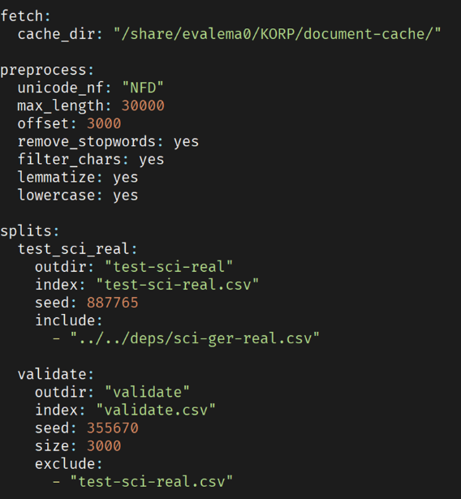
Project implementation – Corpus management
22
Control via params.yaml - file
Notes:
(Vortrag mündlich: Optimierung und Experimente allein dadurch steuerbar – keine Veränderung im Quellcode oder in DVC Stages und Pipelines)

Slide 23
Project implementation – Evaluation
23
Focus on German-language scientific texts
Key questions:
  How do I evaluate?
  What do I evaluate?
Testing of each method in terms of quality and quantity using a data set that is as representative as possible

Slide 24
Project implementation – Evaluation
24
Test data S1
Q1/22
sci-ger-ideal
Test data S2
S1
…
S2
Test data Sn
Q4/23

Slide 25
Project implementation – Evaluation
25
128*18 online publications (50% E-Books + 50% E-Paper)
Originating from 18 DDC Subject Categories, which are particularly relevant for scientific articles (Health/Medicine, Law, Economics, …)
automated subject cataloguing by ZestXML
intellectual subject cataloguing + evaluation of the machine-assigned subject headings: Likert – scale (4)
Test data S2
Notes:
128*18 Online-Publikationen (50% E-Books + 50% E-Paper)
Verteilt auf 18 HSG, die für wissenschaftliche Artikel besonders relevant sind (Medizin/Gesundheit, Recht, Wirtschaft, …)
Maschinell erschlossen mit ZestXML
Intellektuelle Beschlagwortung + Bewertung der automatischen Schlagworte: Likert – Skala (4)

Slide 26
Project implementation – Evaluation
26
Notes:
Qualitative Bewertung der maschinellen Beschlagwortung

Slide 27
Project implementation – Evaluation
27
Overall concept: training and evaluation with the 4-way Holdout method
Train | Calculation of model parameters
Train-Dev | Control of Overfitting
Test-Dev | Control of Concept Drift
Test | Final evaluation without bias

Slide 28
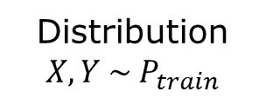
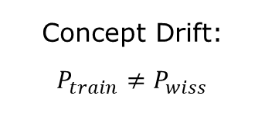

Project implementation – Evaluation
28
Distribution ${X,Y \sim P}_{train}$
Distribution ${X,Y \sim P}_{wiss}$
Concept Drift:
$P_{train}≠P_{wiss}$
Train
Train-Dev
Test-Dev
Test
sci-ger-real
sci-ger-ideal

Slide 29
Project implementation – Methods
29
Annif
KeyBert
GND
Vocabulary
…
ZestXML
Notes:
Zweigeteiltes Problem erwähnen: Beschlagwortung + Matching mit GND

Slide 30
Outline
30
Project scope
Requirements
Project implementation
Outlook

Slide 31
Outlook – Next steps
31
Implementing and exploring promising methods
  Focus on ML methods incl. Transformer models
Further investigation and exploitation of the GND data
  Improvement of lexical methods
Notes:
- Fokus auf lernende Verfahren inkl. Transformer Verfahren
Aber auch lexikalische Verfahren werden nicht ignoriert
Hierbei Fokus auf Nutzung der GND und des Vokabulars

Slide 32
Thank you for your attention!
32
  Florian Engel
  German National Library
  phone: +49 341 2271-134
  mail: f.engel@dnb.de
  http://www.dnb.de

