Slide 1
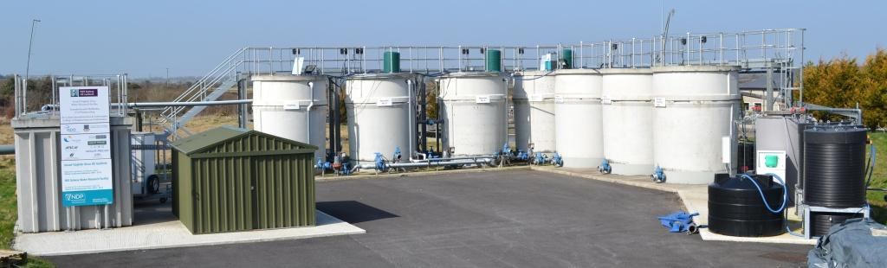

NUI Galway/EPA Water Research Facility
Contacts:
Eoghan Clifford, Edmond O’Reilly
091 492219/091 492762
eoghan.clifford@nuigalway.ie; edmond.oreilly@nuigalway.ie

Slide 2
Water research facility (WRF) Facilities Overview
Control
cabin
Tertiary treatment processes
PFBR system
2 x primary settlement tanks + balance tank
Other pilot-scale
research

Slide 3
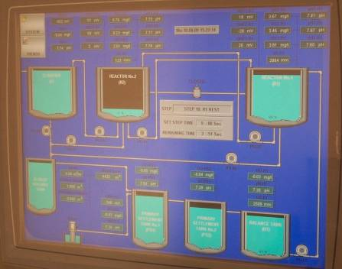
Water research facility (WRF) Facilities Overview (remote control & monitoring)
Human Machine Interface
Full automation of plant
Live readings from all sensors
Data logging
Remote interrogation/operation
Human Machine Interface

Slide 4
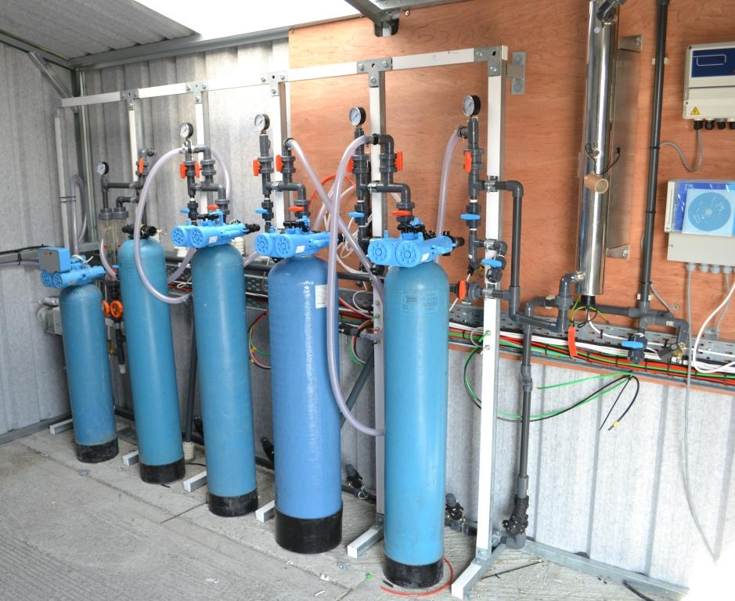
Water research facility (WRF) Facilities Overview (tertiary treatment systems)
Plug and play design
Fully automated
Manual and automatic sampling
Media filtration (e.g. sand , AC …); adsorption columns; disinfection
Trial of novel technologies

