Slide 1
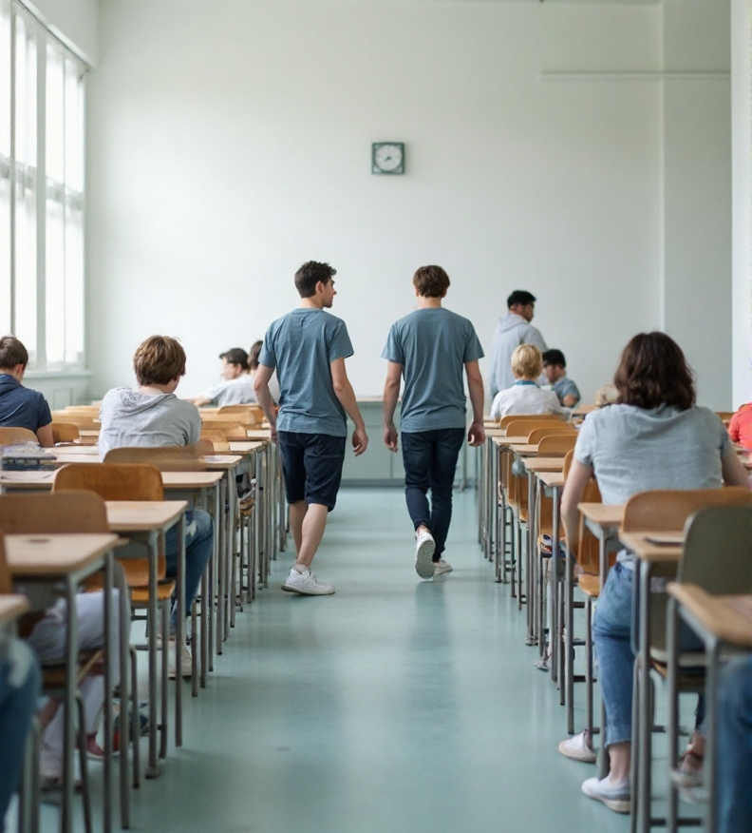



Exam information
www.universityofgalway.ie/exams
Personal Exam Timetable
Exam Advice video
FAQs
If circumstances arise which are outside your own control and you wish to defer exams, you must apply for a deferral before the examination takes place.
Details online at: www.universityofgalway.ie/exams/timetable-advice/deferrals/
examsoffice@universityofgalway.ie
091 493024

Slide 2







Exam information
Be Ready
at least 20 minutes
before exam
Familiarise yourself
with the most up to date
Exam Regulations policies
Have
your
student ID card
Read
the strict
disciplinary policy
Designed by macrovector / Freepik

Slide 3
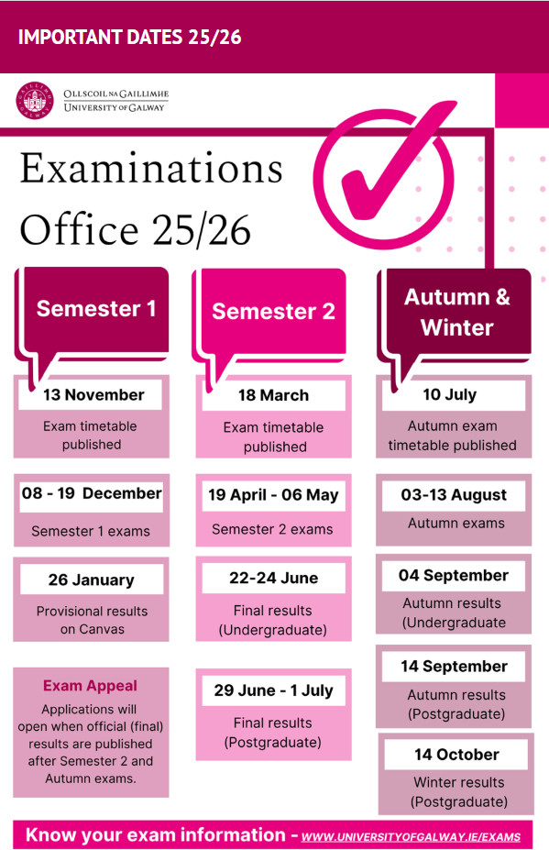

examsoffice@universityofgalway.ie
091 493024

