Slide 1
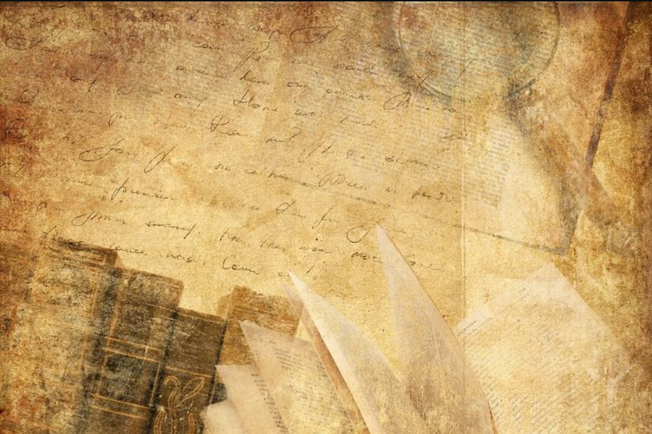
RE-MEDIATING THE EARLY BOOK: PASTS AND FUTURES
COMMONALITIES AND SHARED INTEREST PhD projects 4 – 5 – 9
Luca
Melania Rosenn

Slide 2

PhD position 4 (Luca)
Walahfrid Strabo’s Hortulus in Manuscript and Print
Starting point: 1510 edition of Strabos Hortulus printed in Vienna by the humanist Joachim Vadianus
– originally a work (poem) of the 9th century abbot Walahfrid Strabo about creating a monastery garden
– manuscript on which the print is based still exists
– rare chance to compare original manuscript with printed edition
Two main questions:
How do manuscript and printed editions compare?
Which other early medieval poets (i.e. Hrosvitha) were printed and how do they compare?
University of Zürich

Slide 3
PhD position 5 (Melania)
Manuscripts and Printed Editions of Flos Sanctorum
Legenda Aurea: wide circulation from its first appearance until the 17th century.
Two main focuses:
Study of the Occitan translation of the 15th century (ms. 9759 BnF) and its relations with five Catalan manuscript versions.
Comparison between Catalan manuscripts and seven Catalan printed versions; points of continuity and changes in the transition from manuscript to printed version, differences between the early incunabula and the later sixteenth-century editions.
University of Alicante

Slide 4

PhD position 9 (Rosenn)
Value and Intervention in 16-century Translating and Editing
Study of the publishing sphere in 16-century Lyon:
material, intellectual aspects of their value
marks of prestige, techniques used, patrons, authors and/or translators etc.
Focus on translated books from Latin into French:
Ordinance of Villers-Cotterêts
The Reformation
University of Galway

Slide 5
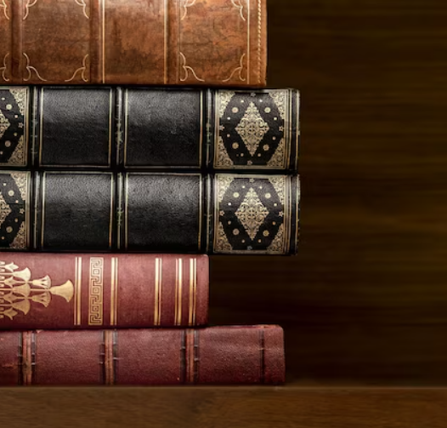
COMMONALITIES
Projects 5 - 9: vernacular translations from Latin texts
Projects 4 - 5: have at the base of their research work a famous Latin text
Projects 4 - 5 - 9: transition from manuscript to print and the evolution of the latter during the 15th and 16th centuries, how the organization of the text, lay-out, type and mise en page in the printed book changed over time compared to their manuscript models.

Slide 6
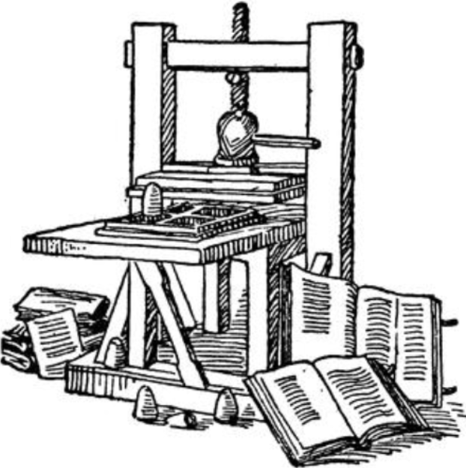
From manuscript to print
1453, Germany: Gutenberg, starting from the application of a technique already invented in 1041 by the Chinese Bi Sheng, introduced the printing technique in Europe, improving it.
Production of multiple copies of the same text from a single matrix thanks to the use of movable type.
Possibility to print hundreds of pages a day whereas a scribe could only copy three pages in the same amount of time.

Slide 7
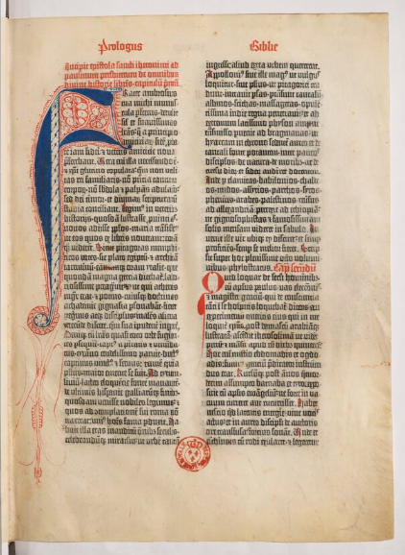
INCUNABULA
Incunabula: first printed books (1450-1500). Imitation of the aesthetics of manuscripts.
Continuity with the manuscript:
  Does not have a title page; incipit contains the name of the author and a title.
  Page numbering is often absent; the order of the pages is ensured by references at the end of each page, placed at the bottom right-hand corner.
  Text densely laid out, in two columns; use of abbreviations; same types as the ones used by contemporary scribes; wide margins.
  Hand-finished: first words of each section are rubricated, the first letter of each paragraph is painted with alternations of red and blue; empty spaces were left for musical notations, words in other languages, illustrations or decorations; margins leave plenty of space for annotations and commentary.
Bible de Gutenberg [Biblia latina], Ex. sur vélin - Volume 1
Mainz, Johannes Gutenberg et Johannes Fust, ca 1455
BnF, département Réserve des livres rares, VELINS-67

Slide 8
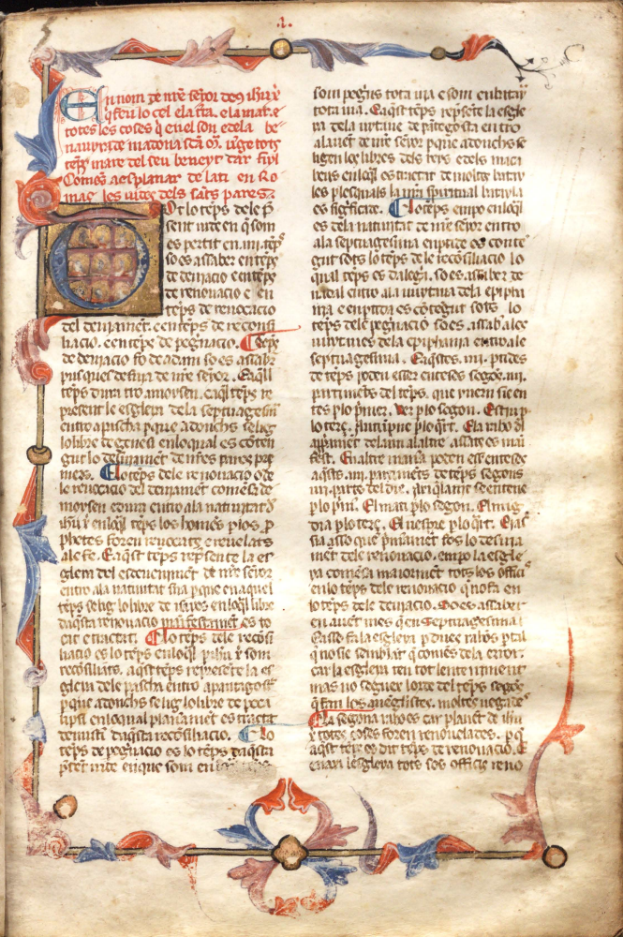
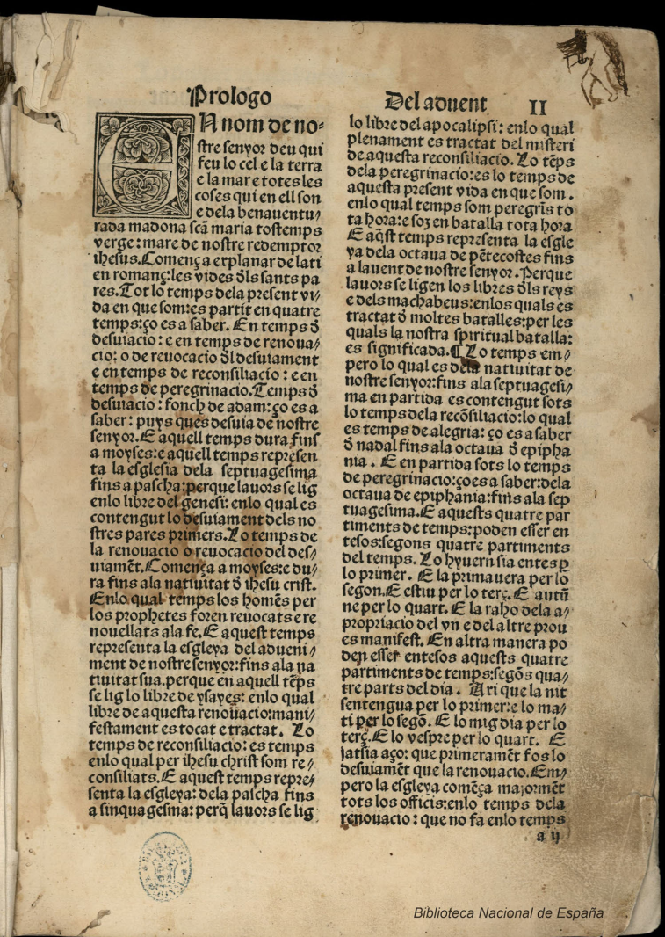
MANUSCRIPT
INCUNABLE
A page from Flos sanctorum en cathala,
ms. N-III-5, Monasterio de l'Escorial, Madrid
A page from Flos sanctorum romançat,
printed in Barcelona by Johan rosenbach, 1494.

Slide 9

SIXTEENTH-CENTURY EDITIONS
Late 15th and early 16th centuries, printing techniques evolved: drove to the apparition of the modern book format
In the composition of the book :
foliation
chapters
index and/or table of content
above all the title page
In the page:
no more 2 column layout
divers font types: roman, italic, gothic
The illustrations:
illuminations replaced by wood cut stamp.

Slide 10
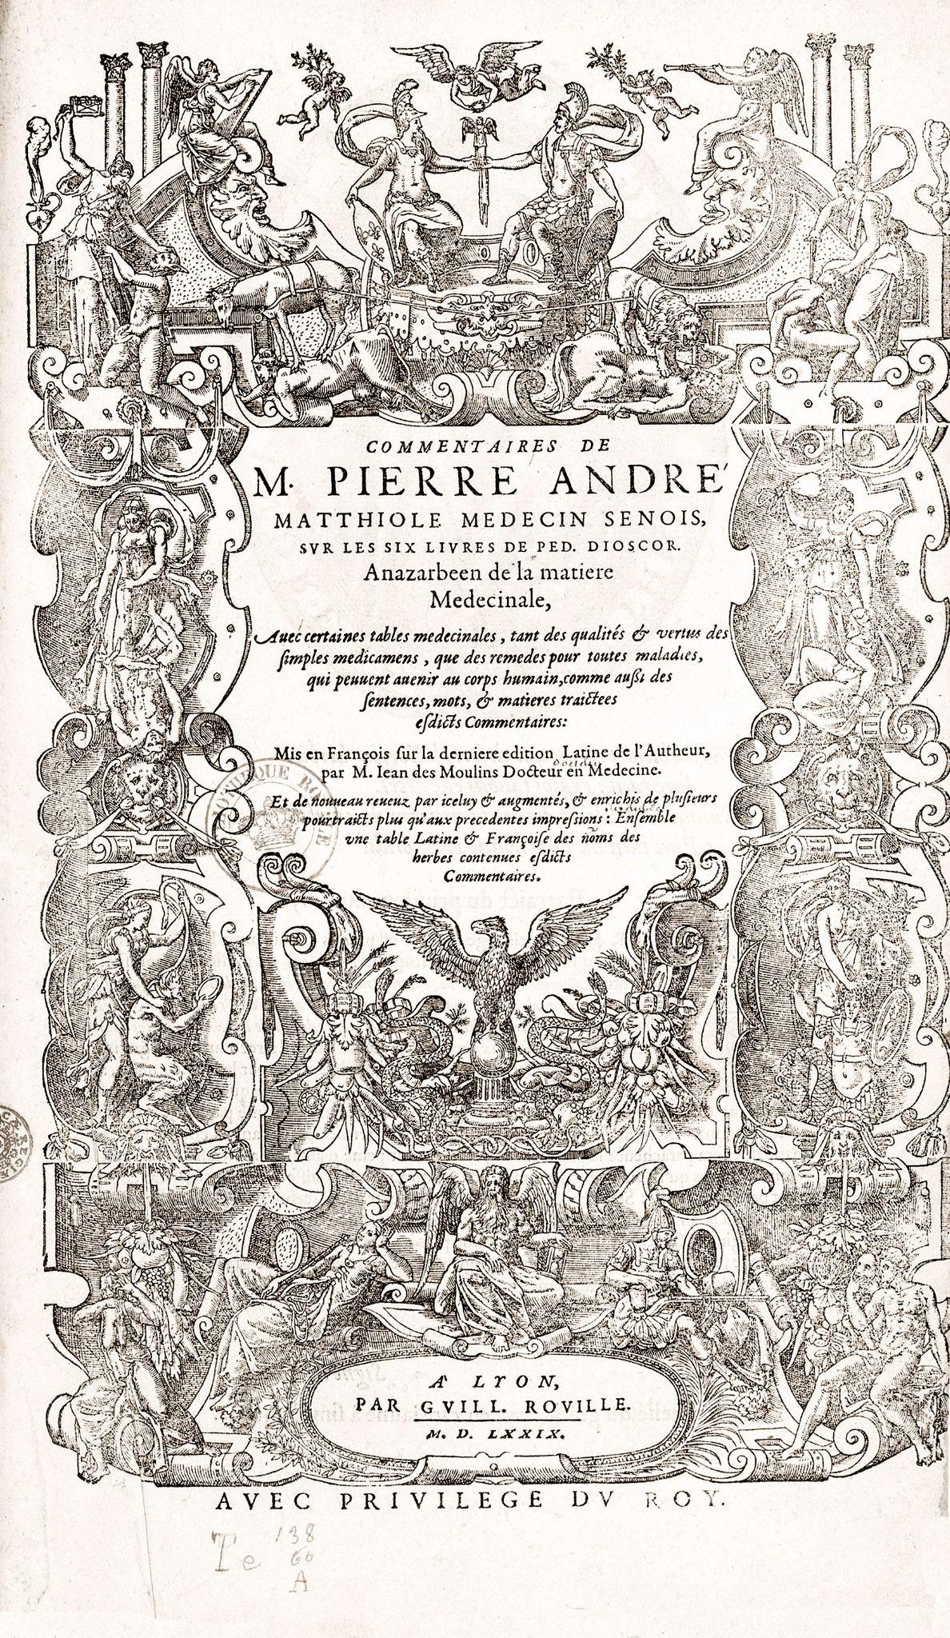
16TH CENTURY EDITIONS
Example of title page
Commentaires de M. Pierre-André Matthiole, Lyon, Rouillé, 1579

Slide 11
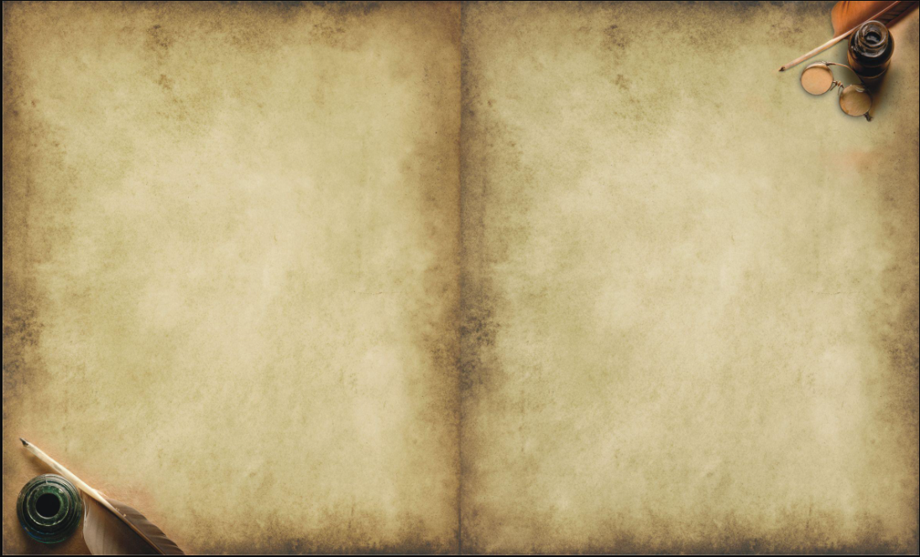
THANK YOU
for your attention
Luca Hollenborg
Melania Marra
Rosenn Nicolas

