Slide 1
Unchaining the Book
Digital Resources in Book History

Slide 2
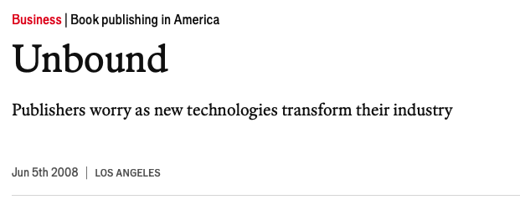

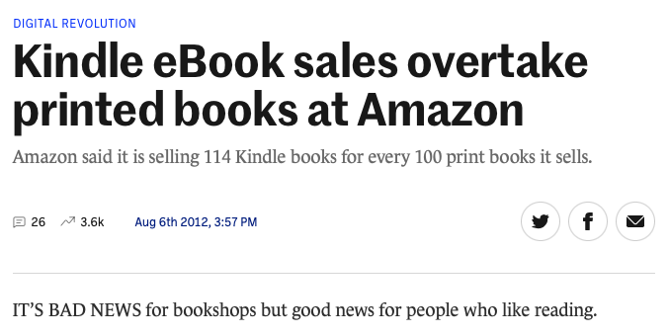
'Reports of my death have been greatly exaggerated …'
Vox, 27th June 2014
The Economist, 5th June 2008
'But the trendlines are negative for print. . . . Total book sales in 2013 was almost $15 billion . . . E-books accounted for $3 billion. If we took e-books out, print book sales would, in fact, be down almost 8% since 2008.'
The Journal, 6th August 2012
Notes:
Have a look at these headlines from the late 2000s and early 2010s
Note the quote (prediction from trendlines)

Slide 3
A win-win situation (for now)
'In the first half of 2020, unit sales of print books surprised many in the industry . . . following the onset of the Covid-19 pandemic.' ('Print book sales soar in year’s first half', Publishers Weekly, 9th July 2021)
Some indicative headlines …
'Books just had their best year in a decade, led by Obama memoir', New York Post, 8th February 2021
'How TikTok Helped Fuel The Best-Selling Year For Print Books', Forbes, 1st February 2022
'The Audiobook Market, and Its Revenue, Keep Growing', Publishers Weekly, 1st June 2023
Notes:
The truth has turned out quite different
Books in particular have not only survived Covid, but thrived as a result of it
More time at home to read!
Publishers had a bit of a scare when Amazon prioritised delivery of essential items over books
But service resumed shortly and books in both physical and digital became more successful than ever
In the years following Covid, the picture for books as a whole has only gotten better
New format on the horizon: audiobooks
Social media (which we will cover later) has also provided a boost

Slide 4
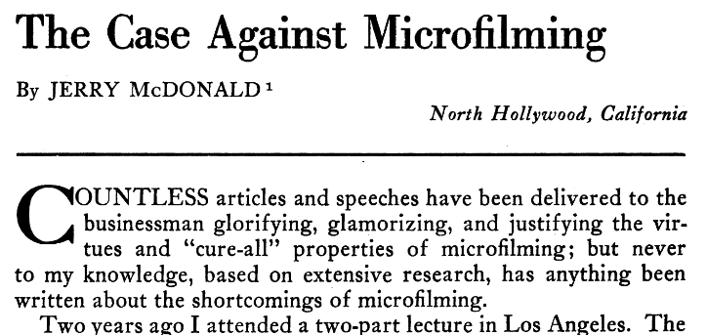
New media, old story
'For [writing] will produce forgetfulness in the minds of those who learn to use it, because they will not practice their memory. Their trust in writing, produced by external characters which are no part of themselves, will discourage the use of their own memory within them.'
Plato, Phaedrus, 275a
McDonald, J. (1957), 'The Case against Microfilming’, The American Archivist, Vol. 20, No. 4, pp. 345-356
Notes:
Fear and uncertainty over new forms of media is not a new story

Slide 5
Digital vs. Physical Resources:
Pros and Cons

Slide 6
Access & Accessibility
Physical
Location-bound
Takes up physical space
Prone to damage and decay
BUT
Invaluable sole witness to its own history
Object cannot be fully replicated
Experience cannot be fully replaced
Digital
Can be accessed anywhere and always (with a connection)
Files can be easily duplicated and distributed
Takes up virtual space
BUT
Dependent on technology
More perishable in its own way
Imperfect replication of original experience
Legality of use and reuse

Slide 7
Data Collection & Analysis
If a person does it…
Better understanding of intent
Able to apply expert knowledge
BUT
Takes a lot longer
Requires smaller sample sizes
More subjective results
If a computer does it…
Can analyze patterns across massive amounts of data
Code can be shared easily for replicability
BUT
Lacks human ability to interpret
Distances the researcher from the subject matter
Easy to create a “black box”

Slide 8
(Some) Types of Digital Resources

Slide 9
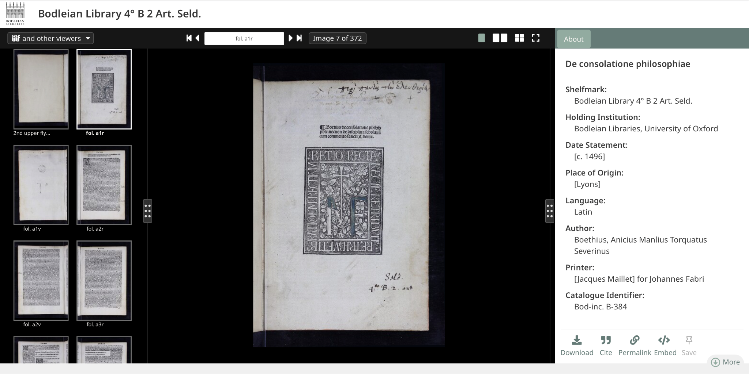
Bread and butter: digitised materials
Digital Bodleian: beautiful and fancy, but it’s Oxford I guess!

Slide 10
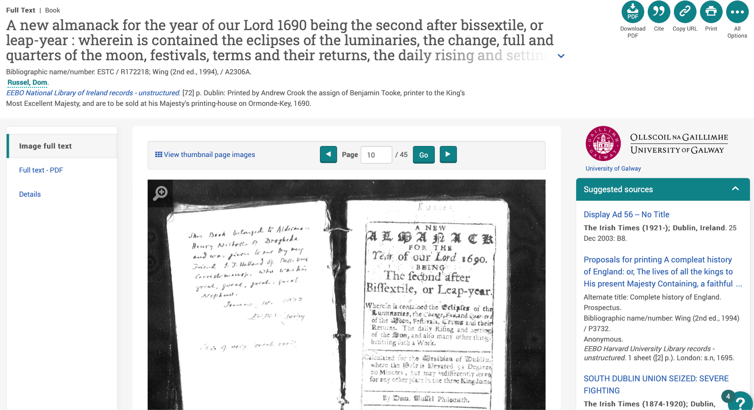
Early English Books Online: functional (but maybe not friendly?)

Slide 11
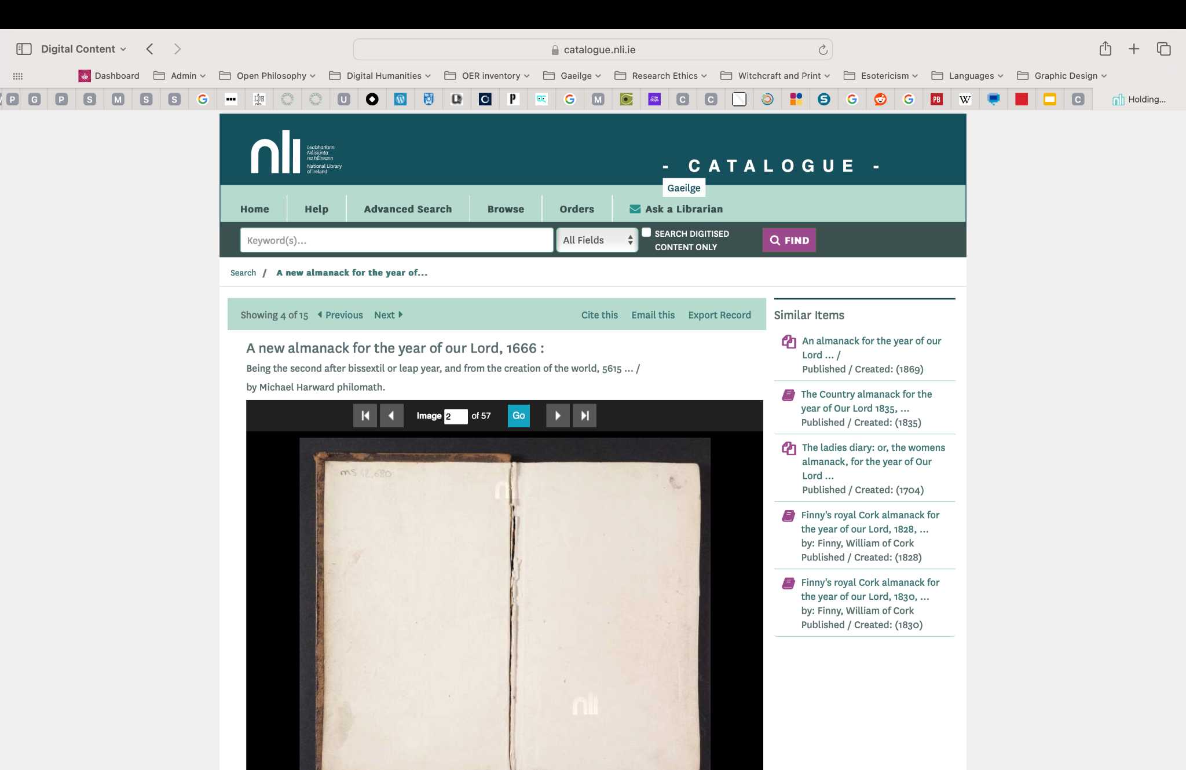
National Library of Ireland: it works … just about!
Notes:
Need for responsive design!

Slide 12
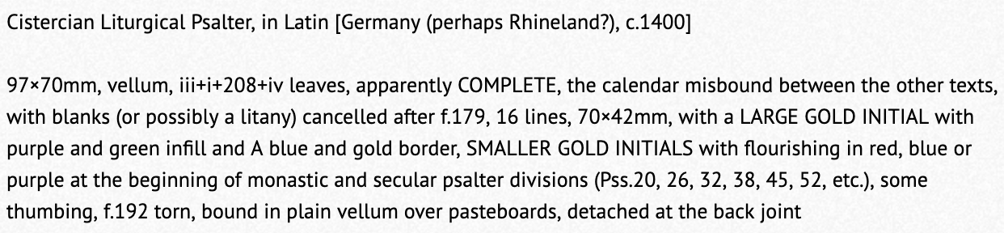
The Hot Topic: ChatGPT
Rare Book Hub: useful, but not super organised
https://www.rarebookhub.com

Slide 13
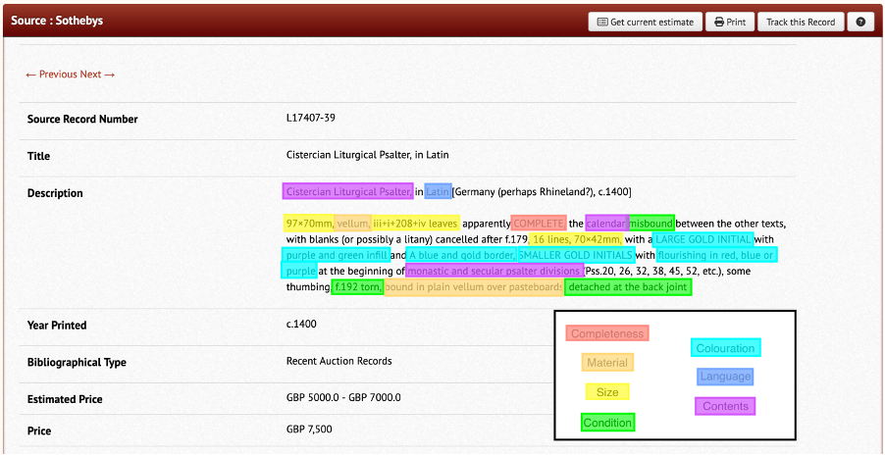

The Hot Topic: ChatGPT
Or… 10 seconds doing this
I could spend 15 minutes doing this…
https://chat.openai.com/

Slide 14
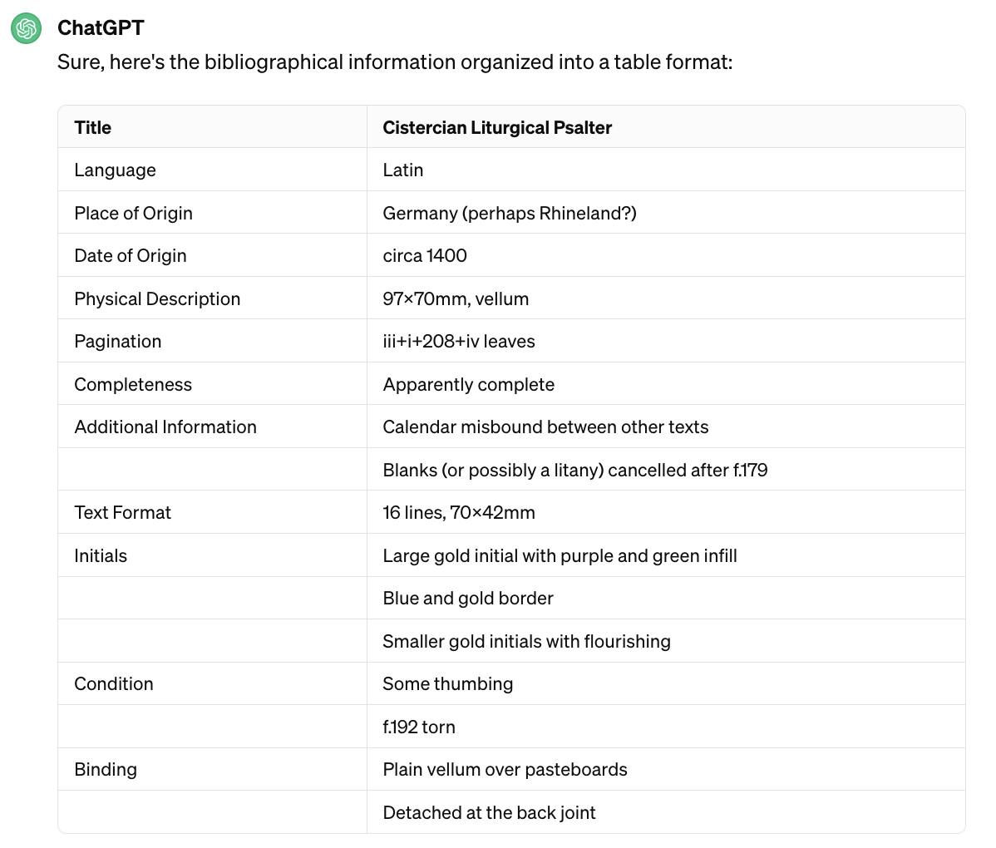
The Hot Topic: ChatGPT
It’s actually pretty good at this!

Slide 15
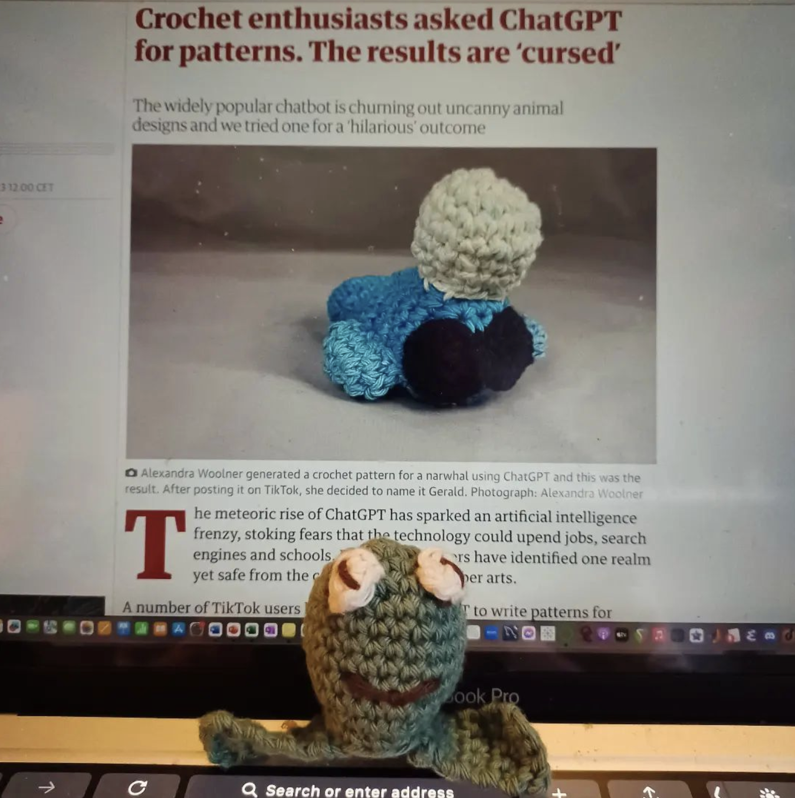
The Hot Topic: ChatGPT
Of course, there are limitations… but these can be mitigated with careful attention

Slide 16
Other kinds of resources
See also Sarah Werner’s website
Databases
Documents (typically PDF)
Websites
  Text and image
  Interactive
Multimedia
Video
Audio(?)

Slide 17
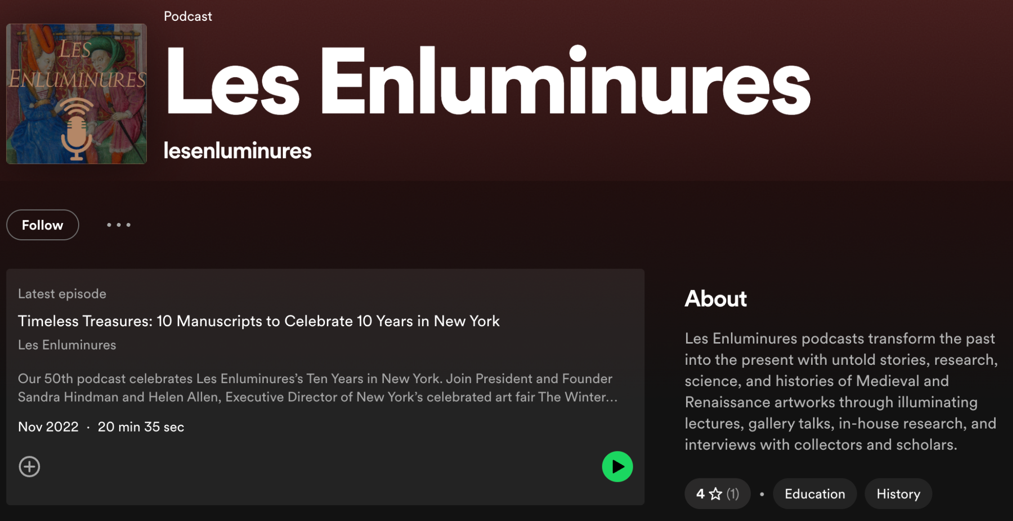
Les Enluminures podcast: listening to book history?

Slide 18
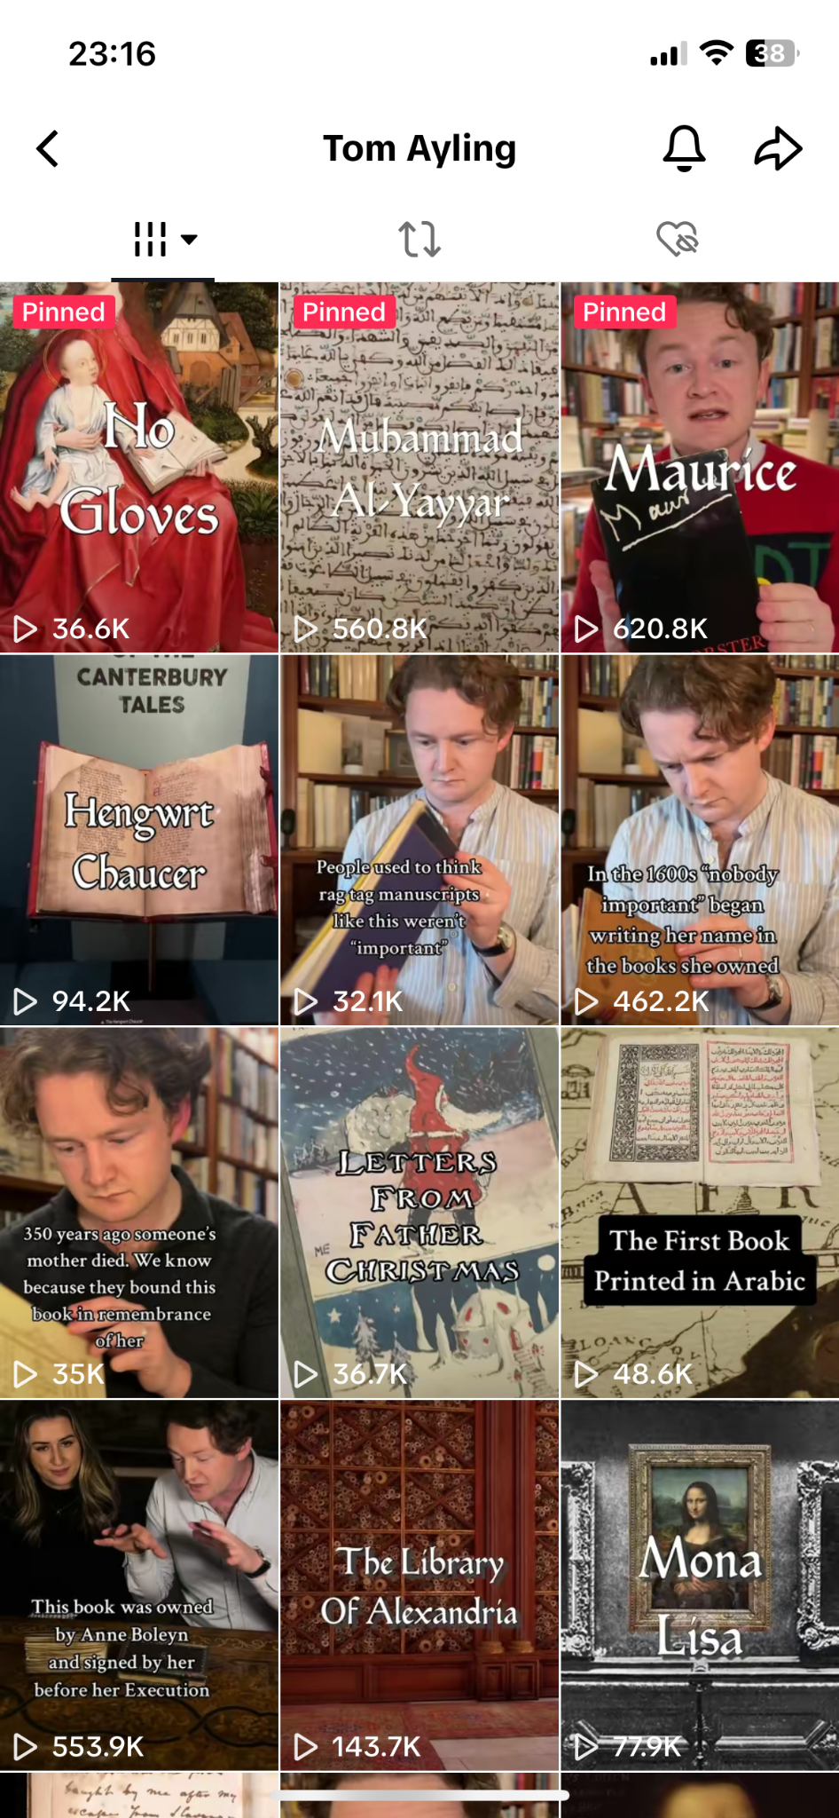
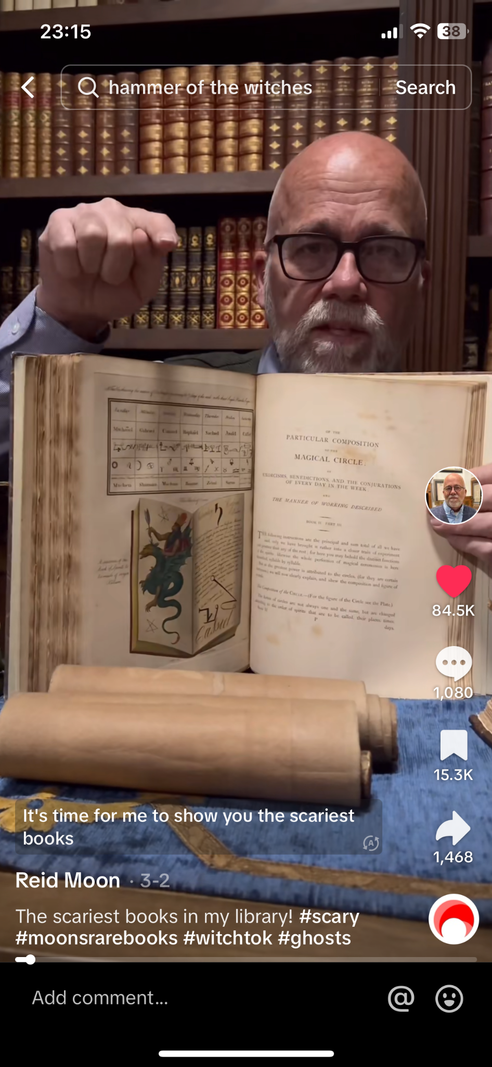
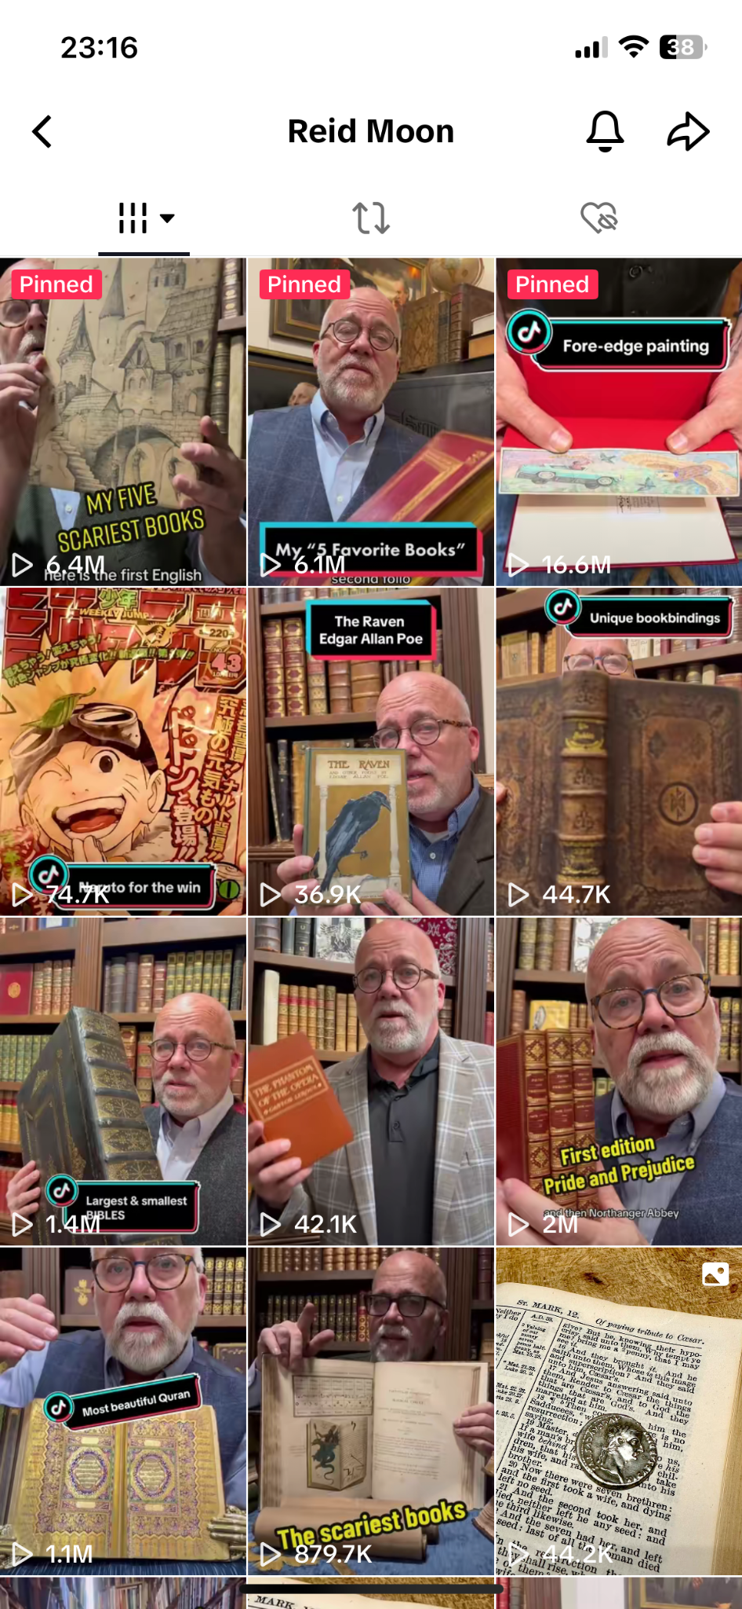
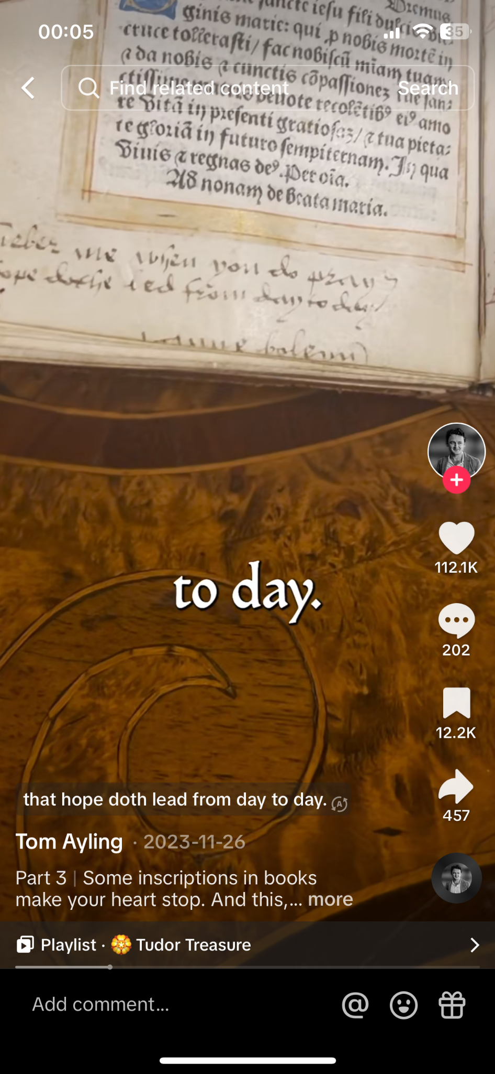
Moons Rare Books
2.2m followers
34.1m likes
Tom Ayling
326.8k followers
8.5m likes

Slide 19
The Future of Digital Resources

Slide 20

Coexistence of the Physical with the Digital
Digital resources do not substitute, but complement physical ones
Book historians must recognise and make the most of the new reality of book culture
‘This is what I describe as “bookishness”: creative acts that engage the physicality of the book within a digital culture, in modes that may be sentimental, fetishistic, radical.’
Pressman, J. (2020), Bookishness: Loving Books in a Digital Age, New York: Columbia University Press, p. 1
(Source: Literary Hub)
Notes:
The picture as it looks is that physical books and resources will coexist with digital ones
And in fact we as book historians will have to learn how to coexist with both physical and digital resources
Ultimately, new media will always find its own niche
In the way, for instance, that eBooks did not replace physical books altogether, but found their own particular purpose to fulfil (cheap and easy reads on the beach during the summer)
Digital Humanities scholar Jessica Pressman – whom I mention a lot – has identified a new culture around the books, which creatively interacts with them in both physical form (sometimes in a very Baudrillardian way, as pure simulacra) and through digital celebration

Slide 21
Technology Doesn’t Solve Everything
Increasing use of technology in written disciplines leads to the loss of a lot of valuable information
  Correspondence: emails and texts replacing letters
  Writing processes: “delete” key replacing crossing things out
    Track Changes: Textual Scholarship and the Challenge of Digital Literary Writing - Keystroke logging for genetic criticism
Open question: how does research need to adapt to this changing availability of resources?

Slide 22
Bibliography: Not Just For Physical Books
“All documents, manuscript and printed, are the bibliographer’s province; and it may be added that the aims and procedures of bibliography apply not only to written and printed books but also to any document, disc, tape, or film where reproduction is involved and variant versions may result”
Gaskell, P. (1972), 'A New Introduction to Bibliography, p. 1
Careful descriptions of documents and their transmission become more important than ever as the number of possible formats increases
Digital reproductions become even more of a boon to accessibility when stored alongside detailed bibliographic information

