Slide 1


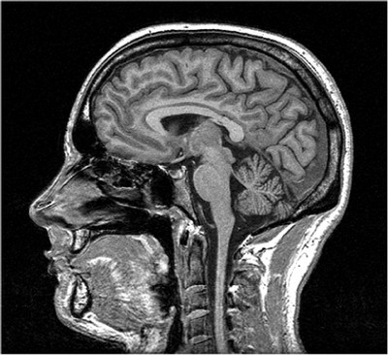
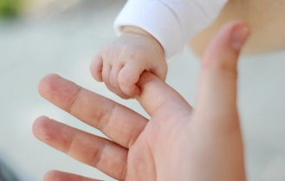
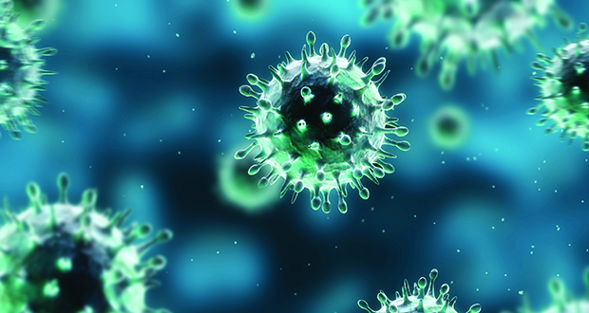
Want a picture of your brain?
NUI Galway and Trinity College Dublin are running a study on how our early life experiences, genes, and the immune system affect brain function. The study includes a neuropsychological assessment which will be done locally, and an MRI scan at St. James’s Hospital in Dublin.
You will receive a picture of your brain, and travel expenses will be reimbursed.
Interested? Please contact iRELATE@nuigalway.ie
iRELATE@nuigalway.ie iRELATE@nuigalway.ie. iRELATE@nuigalway.ie iRELATE@nuigalway.ie iRELATE@nuigalway.ie iRELATE@nuigalway.ie iRELATE@nuigalway.ie iRELATE@nuigalway.ie iRELATE@nuigalway.ie iRELATE@nuigalway.ie

